Slide 1
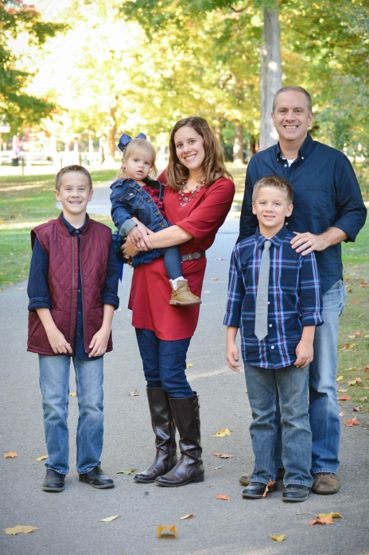
Welcome to our Class!
Meet Mrs. Wiley
My Family
I live in Fishers with my husband of 15 years, Doug, and our three children. We have two older boys, Graham (12) and Cameron (9). We also have a toddler girl, Stella (2).
How I became a teacher…
I knew since I was a child that I was meant to be a teacher. After countless hours of playing school when I was younger, I pursued a degree in elementary education when I began attending college at Butler University. Four years later, I graduated and began my career as a third grade teacher. Since then I have taught third grade for five years , second grade for three years and have been in first grade since 2014.
A glance at our classroom…
I am all about a hands-on classroom and meeting children where they are. I believe in challenging children when appropriate but also providing supports needed for them to feel success. I want everyone in this classroom to feel like they are important and that they are great readers and writers!

