Slide 1
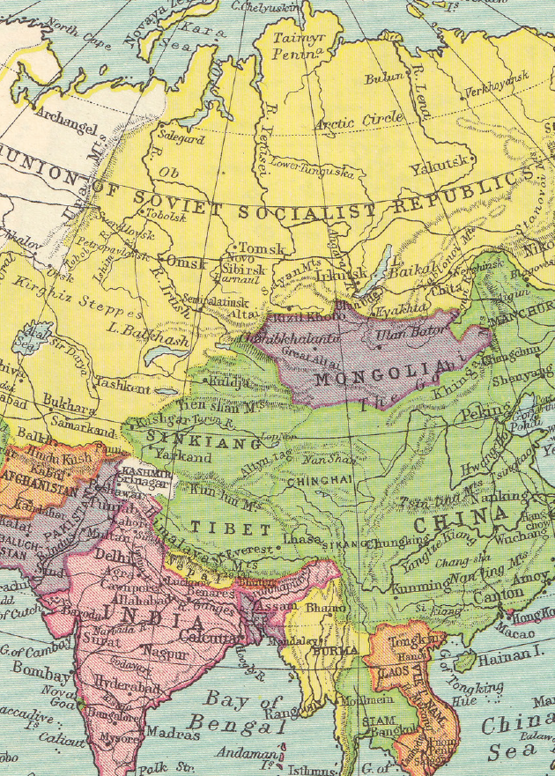
e
W

Slide 2
l
c

Slide 3
o
m

Slide 4
!
e

Slide 5
o
t

Slide 6
u
o

Slide 7
c
r

Slide 8
l
a

Slide 9
s
s

Slide 11
editable text
©www.thecurriculumcorner.com
editable text

Slide 12
editable text
©www.thecurriculumcorner.com
editable text

Slide 13
editable text
editable text
editable text

Slide 14
editable text
editable text
editable text

Slide 15
©www.thecurriculumcorner.com
©www.thecurriculumcorner.com
©www.thecurriculumcorner.com
©www.thecurriculumcorner.com
editable text
editable text
editable text
editable text

Slide 16
editable text
editable text
editable text

Slide 17
editable text
editable text
editable text

Slide 18
©www.thecurriculumcorner.com
©www.thecurriculumcorner.com
©www.thecurriculumcorner.com
©www.thecurriculumcorner.com
editable text
editable text
editable text
editable text

Slide 19
editable text
editable text
editable text

Slide 20
editable
editable
©www.thecurriculumcorner.com
©www.thecurriculumcorner.com
editable
editable
©www.thecurriculumcorner.com

Slide 21
editable
editable
editable
editable
editable
editable

Slide 22
editable
editable
editable
editable
editable
editable
editable
editable
editable

Slide 23
editable

Slide 24
editable

Slide 25
editable
editable
editable
editable

Slide 26
editable

Slide 27
editable
editable
editable
editable

Slide 28
editable
editable
editable
editable

Slide 29
Editable text – enter your own response prompt.

Slide 30
My Group Is…
1 | 2 | 3 | 4

Slide 31
My Group Is…
1 | 2 | 3 | 4 | 5

Slide 32
My Group Is…
1 | 2 | 3 | 4 | 5 | 6

Slide 33
Reading Standards
Writing Standards
©www.thecurriculumcorner.com

Slide 34
Math Standards
Today’s focus is…

Slide 35
Our Class Rules
editable text

Slide 36
editable text

Slide 37
Our Class Birthdays
January
February
March
April
May
June
July
August
September
October
November
December

