Slide 1
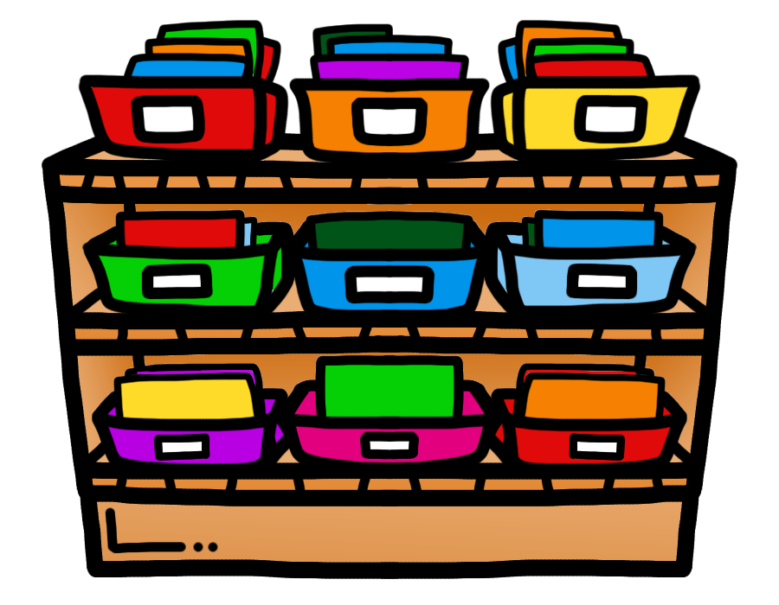

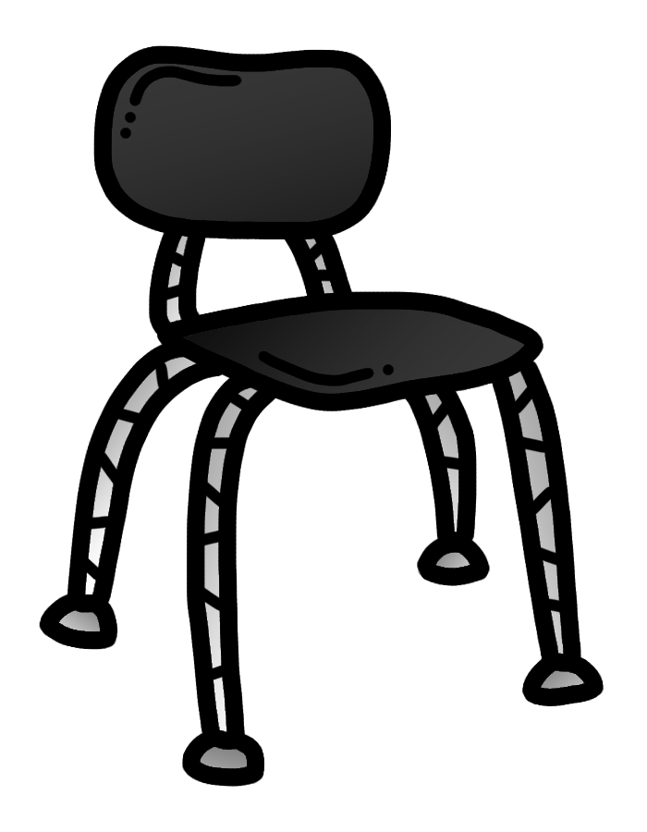
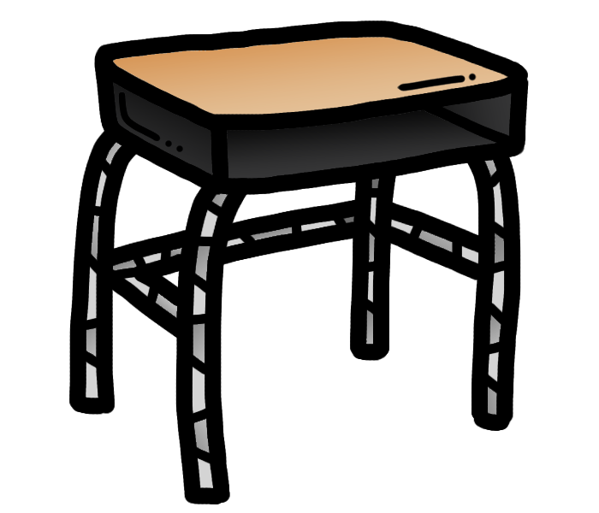

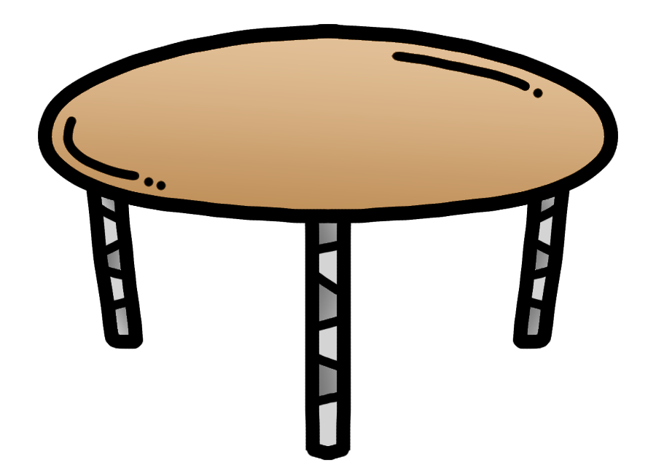

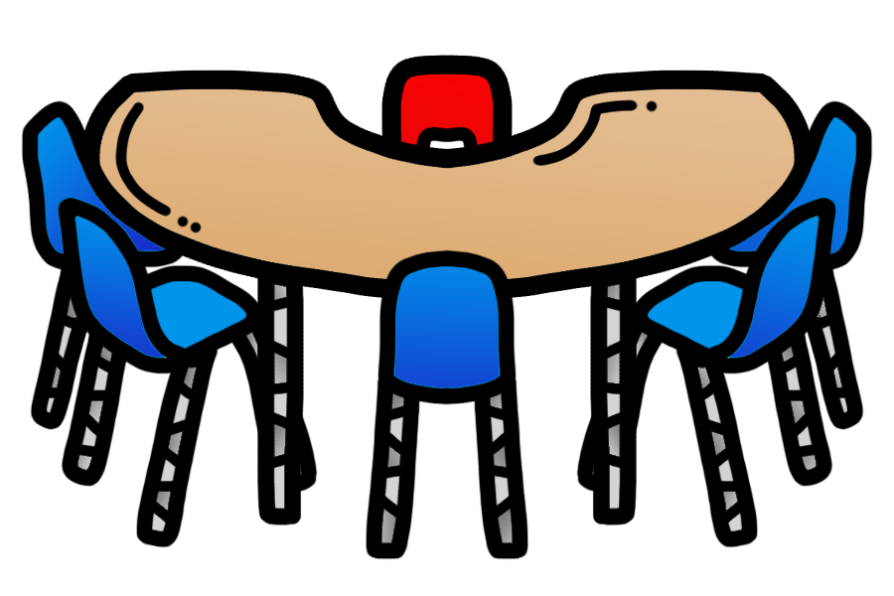
shelf
bookshelf
©www.thecurriculumcorner.com
©www.thecurriculumcorner.com
chair
desk
©www.thecurriculumcorner.com
©www.thecurriculumcorner.com
lamp
table
©www.thecurriculumcorner.com
©www.thecurriculumcorner.com
desk
kidney table
©www.thecurriculumcorner.com
©www.thecurriculumcorner.com

Slide 2



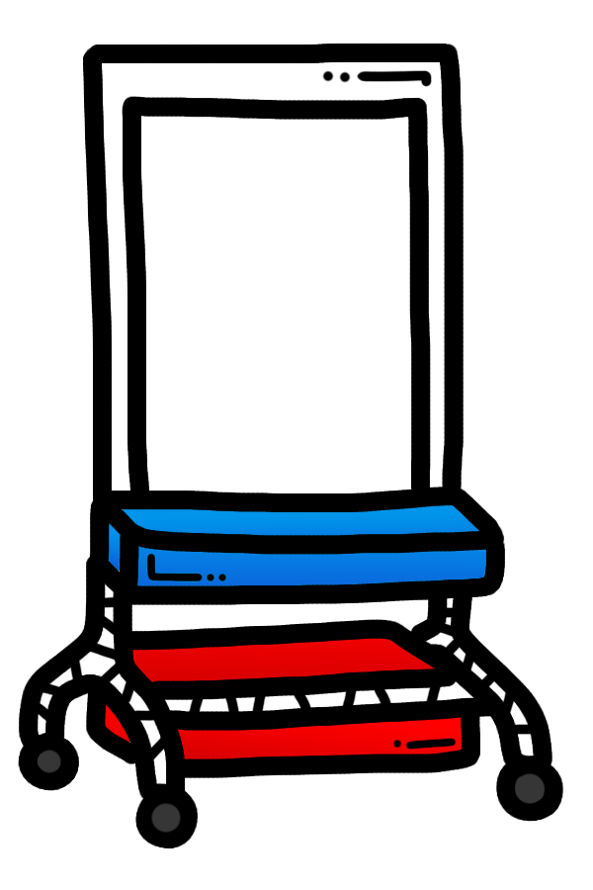




mailboxes
bean
bag
©www.thecurriculumcorner.com
©www.thecurriculumcorner.com
hand
sanitizer
easel
©www.thecurriculumcorner.com
©www.thecurriculumcorner.com
key
fire
alarm
©www.thecurriculumcorner.com
©www.thecurriculumcorner.com
lock
marble
jar
©www.thecurriculumcorner.com
©www.thecurriculumcorner.com

Slide 3

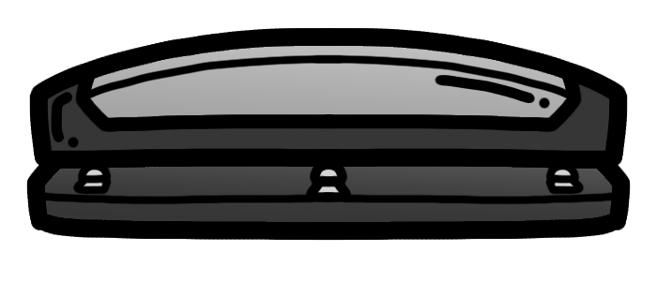



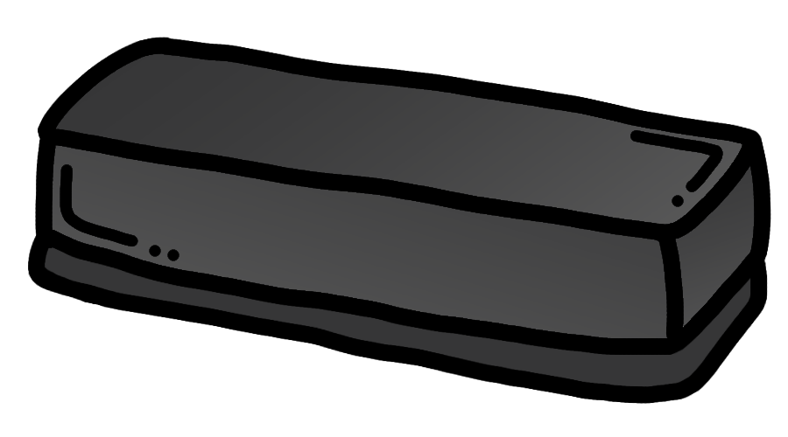


art box
hole punch
©www.thecurriculumcorner.com
©www.thecurriculumcorner.com
clock
globe
©www.thecurriculumcorner.com
©www.thecurriculumcorner.com
eraser
water
fountain
©www.thecurriculumcorner.com
©www.thecurriculumcorner.com
door
paper
towels
©www.thecurriculumcorner.com
©www.thecurriculumcorner.com

Slide 4







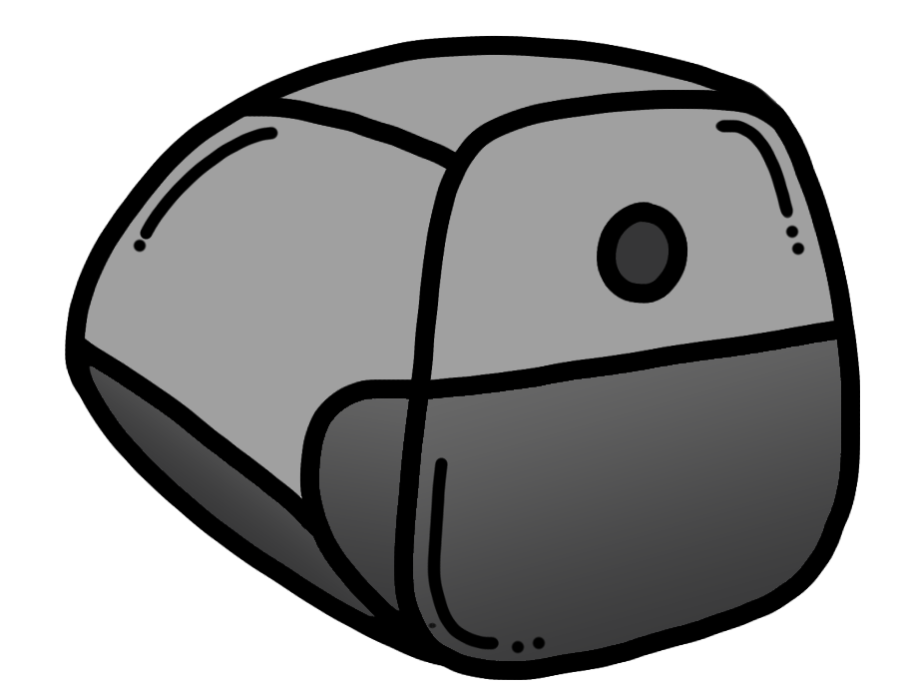
glue sticks
highlighters
©www.thecurriculumcorner.com
©www.thecurriculumcorner.com
crayons
hole punch
©www.thecurriculumcorner.com
©www.thecurriculumcorner.com
calculators
colored
pencils
©www.thecurriculumcorner.com
©www.thecurriculumcorner.com
glue
pencil
sharpener
©www.thecurriculumcorner.com
©www.thecurriculumcorner.com

Slide 5



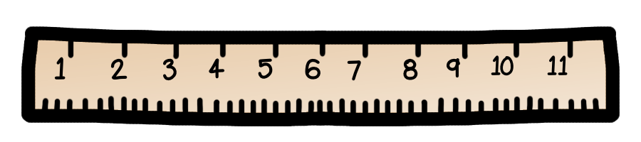




stapler
tape
©www.thecurriculumcorner.com
©www.thecurriculumcorner.com
ruler
scissors
©www.thecurriculumcorner.com
©www.thecurriculumcorner.com
markers
pencil
sharpener
©www.thecurriculumcorner.com
©www.thecurriculumcorner.com
bathroom
basket
©www.thecurriculumcorner.com
©www.thecurriculumcorner.com

Slide 6











paperclips
binder
clips
©www.thecurriculumcorner.com
©www.thecurriculumcorner.com
pens
dry erase markers
©www.thecurriculumcorner.com
©www.thecurriculumcorner.com
rubber bands
erasers
©www.thecurriculumcorner.com
©www.thecurriculumcorner.com
pencils
erasers
©www.thecurriculumcorner.com
©www.thecurriculumcorner.com

Slide 7



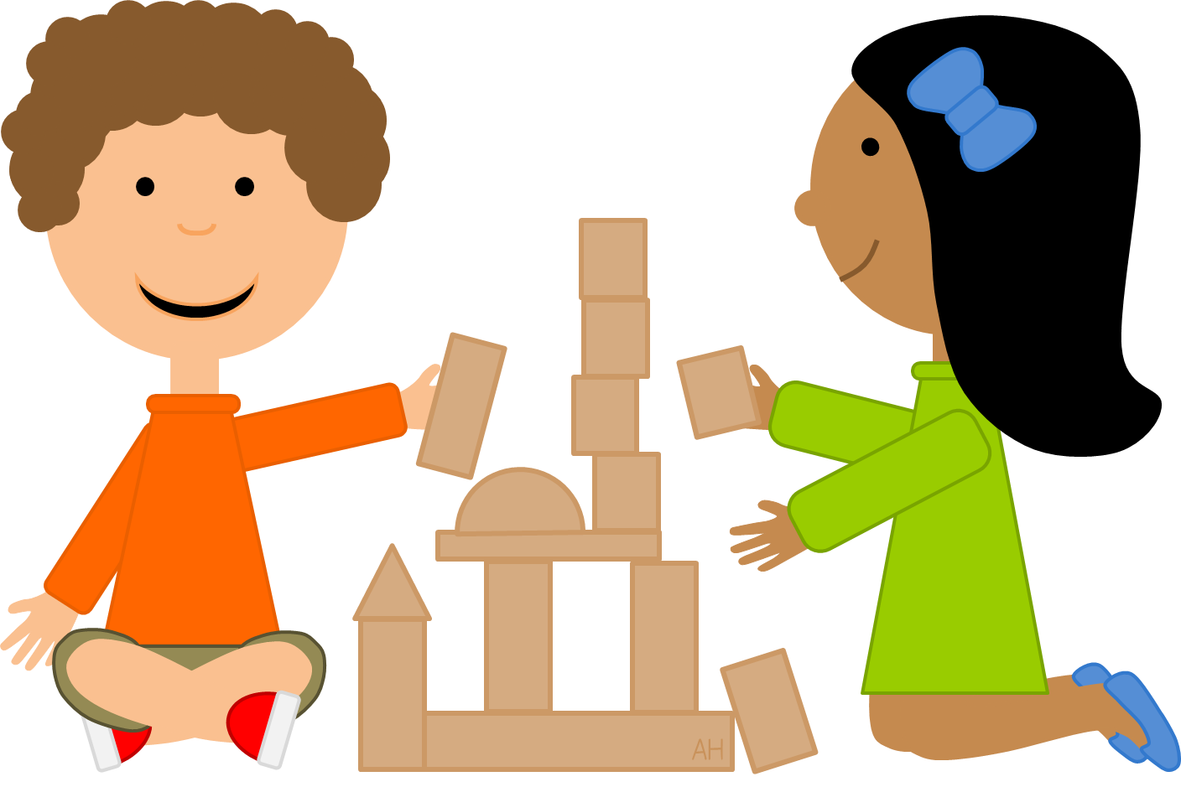



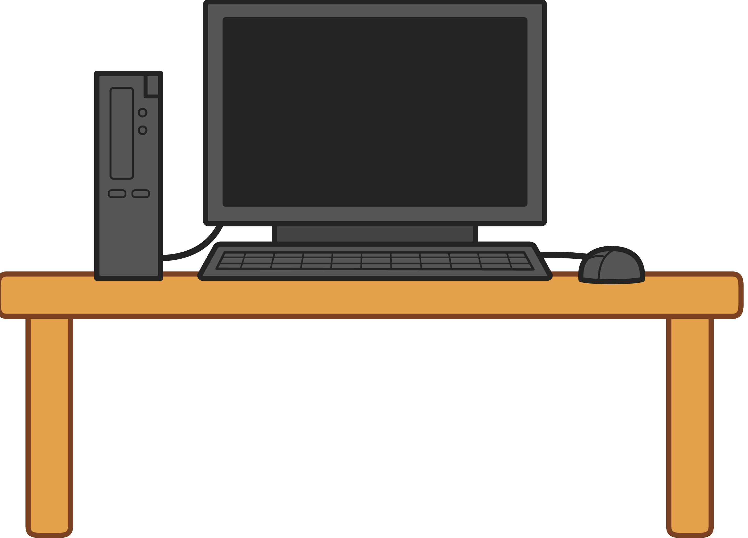
white board
chalkboard
©www.thecurriculumcorner.com
©www.thecurriculumcorner.com
blocks
flag
©www.thecurriculumcorner.com
©www.thecurriculumcorner.com
sink
light
©www.thecurriculumcorner.com
©www.thecurriculumcorner.com
interactive
whiteboard
computer
©www.thecurriculumcorner.com
©www.thecurriculumcorner.com

Slide 8
©www.thecurriculumcorner.com
©www.thecurriculumcorner.com
©www.thecurriculumcorner.com
©www.thecurriculumcorner.com
©www.thecurriculumcorner.com
©www.thecurriculumcorner.com
©www.thecurriculumcorner.com
©www.thecurriculumcorner.com

Slide 9
©www.thecurriculumcorner.com
©www.thecurriculumcorner.com
©www.thecurriculumcorner.com
©www.thecurriculumcorner.com
©www.thecurriculumcorner.com
©www.thecurriculumcorner.com
©www.thecurriculumcorner.com
©www.thecurriculumcorner.com

Slide 10
©www.thecurriculumcorner.com
©www.thecurriculumcorner.com
©www.thecurriculumcorner.com
©www.thecurriculumcorner.com
©www.thecurriculumcorner.com
©www.thecurriculumcorner.com
©www.thecurriculumcorner.com
©www.thecurriculumcorner.com

Slide 11
©www.thecurriculumcorner.com
©www.thecurriculumcorner.com
©www.thecurriculumcorner.com
©www.thecurriculumcorner.com
©www.thecurriculumcorner.com
©www.thecurriculumcorner.com
©www.thecurriculumcorner.com
©www.thecurriculumcorner.com

Slide 12
©www.thecurriculumcorner.com
©www.thecurriculumcorner.com
©www.thecurriculumcorner.com
©www.thecurriculumcorner.com
©www.thecurriculumcorner.com
©www.thecurriculumcorner.com
©www.thecurriculumcorner.com
©www.thecurriculumcorner.com

Slide 13
©www.thecurriculumcorner.com
©www.thecurriculumcorner.com
©www.thecurriculumcorner.com
©www.thecurriculumcorner.com
©www.thecurriculumcorner.com
©www.thecurriculumcorner.com
©www.thecurriculumcorner.com
©www.thecurriculumcorner.com

Slide 14
©www.thecurriculumcorner.com
©www.thecurriculumcorner.com
©www.thecurriculumcorner.com
©www.thecurriculumcorner.com
©www.thecurriculumcorner.com
©www.thecurriculumcorner.com
©www.thecurriculumcorner.com
©www.thecurriculumcorner.com

Slide 15
estantería
la
biblioteca
©www.thecurriculumcorner.com
©www.thecurriculumcorner.com
el escritorio
la
silla
©www.thecurriculumcorner.com
©www.thecurriculumcorner.com
la làmpara
la
mesa
©www.thecurriculumcorner.com
©www.thecurriculumcorner.com
el escritorio
la mesa
©www.thecurriculumcorner.com
©www.thecurriculumcorner.com

Slide 16
el buzònes
el
puf
©www.thecurriculumcorner.com
©www.thecurriculumcorner.com
disinfectante
el
caballete
©www.thecurriculumcorner.com
©www.thecurriculumcorner.com
la
llave
la alarma
de incendio
©www.thecurriculumcorner.com
©www.thecurriculumcorner.com
tarro
de
màrmol
la
cerradura
©www.thecurriculumcorner.com
©www.thecurriculumcorner.com

Slide 17
la cartuchera
la perforadora
©www.thecurriculumcorner.com
©www.thecurriculumcorner.com
el reloj
el
mundo
©www.thecurriculumcorner.com
©www.thecurriculumcorner.com
los borradores
fuente
de agua
©www.thecurriculumcorner.com
©www.thecurriculumcorner.com
las toallas
de papel
la puerta
©www.thecurriculumcorner.com
©www.thecurriculumcorner.com

Slide 18
la barra de
pegamento
el
resaltadors
©www.thecurriculumcorner.com
©www.thecurriculumcorner.com
las
perforadoras
los
crayones
©www.thecurriculumcorner.com
©www.thecurriculumcorner.com
lápices
de colores
las
calculadoras
©www.thecurriculumcorner.com
©www.thecurriculumcorner.com
el
pegamento
el
sacapuntas
©www.thecurriculumcorner.com
©www.thecurriculumcorner.com

Slide 19
la
grapadora
cinta
adhesiva
©www.thecurriculumcorner.com
©www.thecurriculumcorner.com
la reglas
la
tijeras
©www.thecurriculumcorner.com
©www.thecurriculumcorner.com
los rotuladores
el
sacapuntas
©www.thecurriculumcorner.com
©www.thecurriculumcorner.com
el baño
la
canasta
©www.thecurriculumcorner.com
©www.thecurriculumcorner.com

Slide 20
los clips
clip de
la carpetas
©www.thecurriculumcorner.com
©www.thecurriculumcorner.com
la pluma
el marcador de borrado en seco
©www.thecurriculumcorner.com
©www.thecurriculumcorner.com
las gomas
los borradores
©www.thecurriculumcorner.com
©www.thecurriculumcorner.com
los lápices
los borradores
©www.thecurriculumcorner.com
©www.thecurriculumcorner.com

Slide 21
el pizzarón blanco
la pizarra
©www.thecurriculumcorner.com
©www.thecurriculumcorner.com
la bandera
los bloques
©www.thecurriculumcorner.com
©www.thecurriculumcorner.com
el
lavabo
la luz
©www.thecurriculumcorner.com
©www.thecurriculumcorner.com
pizzarón
interactivo
la computadora
©www.thecurriculumcorner.com
©www.thecurriculumcorner.com

