Slide 1
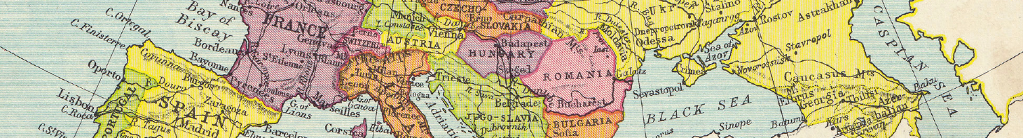
Today’s Schedule
Today’s Schedule
editable text
editable text
©www.thecurriculumcorner.com

Slide 2
Today’s Schedule
Today’s Schedule
editable text
©www.thecurriculumcorner.com

Slide 3
morning work
reading workshop
writing workshop
©www.thecurriculumcorner.com

Slide 4
math workshop
math centers
community circle
©www.thecurriculumcorner.com

Slide 5
lunch
recess
word work
©www.thecurriculumcorner.com

Slide 6
p.e.
art
music
©www.thecurriculumcorner.com

Slide 7
library
science
social studies
©www.thecurriculumcorner.com

Slide 8
editable text
editable text
editable text
©www.thecurriculumcorner.com

Slide 9
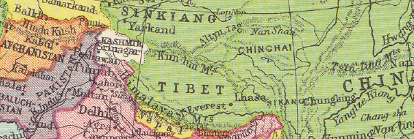
Time:
7:30
7:30
7:30
7:30
7:30
©www.thecurriculumcorner.com

Slide 10
7:30
7:30
7:30
7:30
7:30
7:30
©www.thecurriculumcorner.com

Slide 11
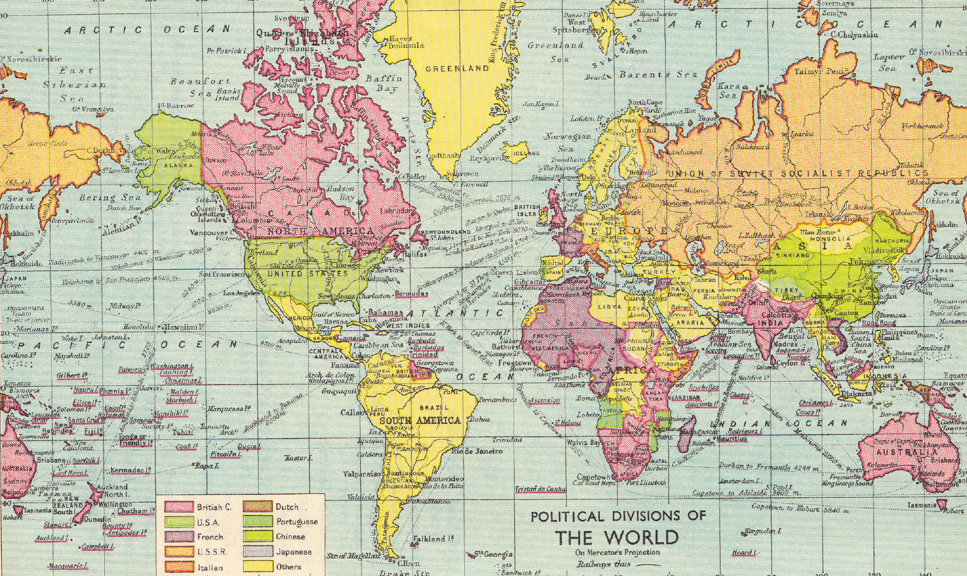
Today’s Schedule
Today’s Schedule
editable text
editable text
©www.thecurriculumcorner.com

Slide 12
Today’s Schedule
Today’s Schedule
editable text
©www.thecurriculumcorner.com

Slide 13
morning work
reading workshop
writing workshop
©www.thecurriculumcorner.com

Slide 14
math workshop
math centers
community circle
©www.thecurriculumcorner.com

Slide 15
lunch
recess
word work
©www.thecurriculumcorner.com

Slide 16
p.e.
art
music
©www.thecurriculumcorner.com

Slide 17
library
science
social studies
©www.thecurriculumcorner.com

Slide 18
editable text
editable text
editable text
©www.thecurriculumcorner.com

Slide 19
Time:
7:30
7:30
7:30
7:30
7:30
©www.thecurriculumcorner.com

Slide 20
7:30
7:30
7:30
7:30
7:30
7:30
©www.thecurriculumcorner.com

