Slide 1
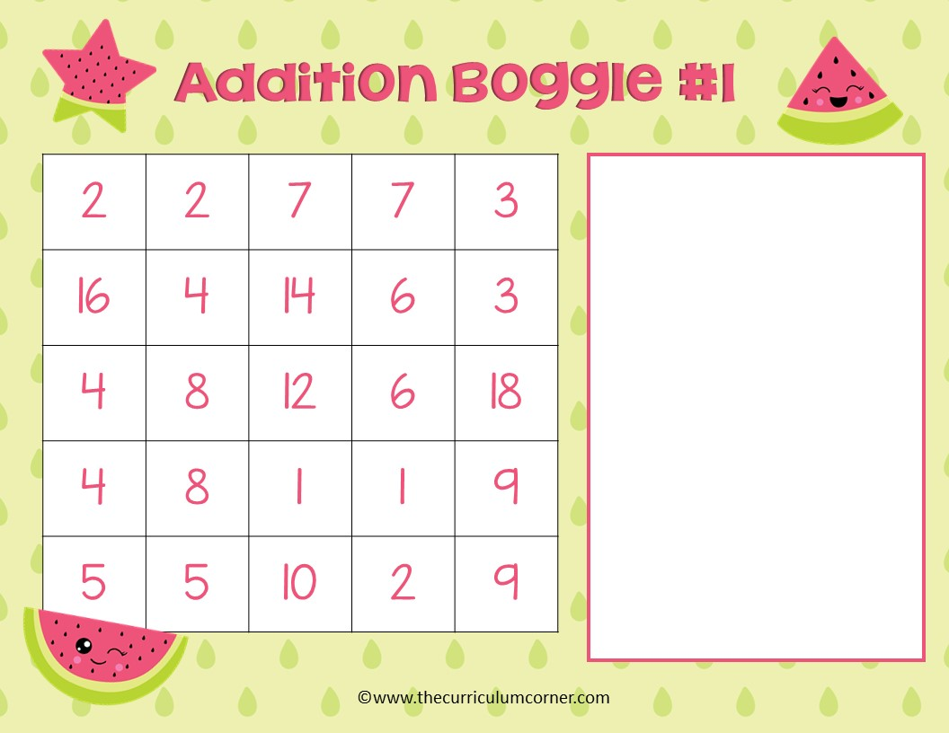
What addition facts can you find? Type your answers here.

Slide 2
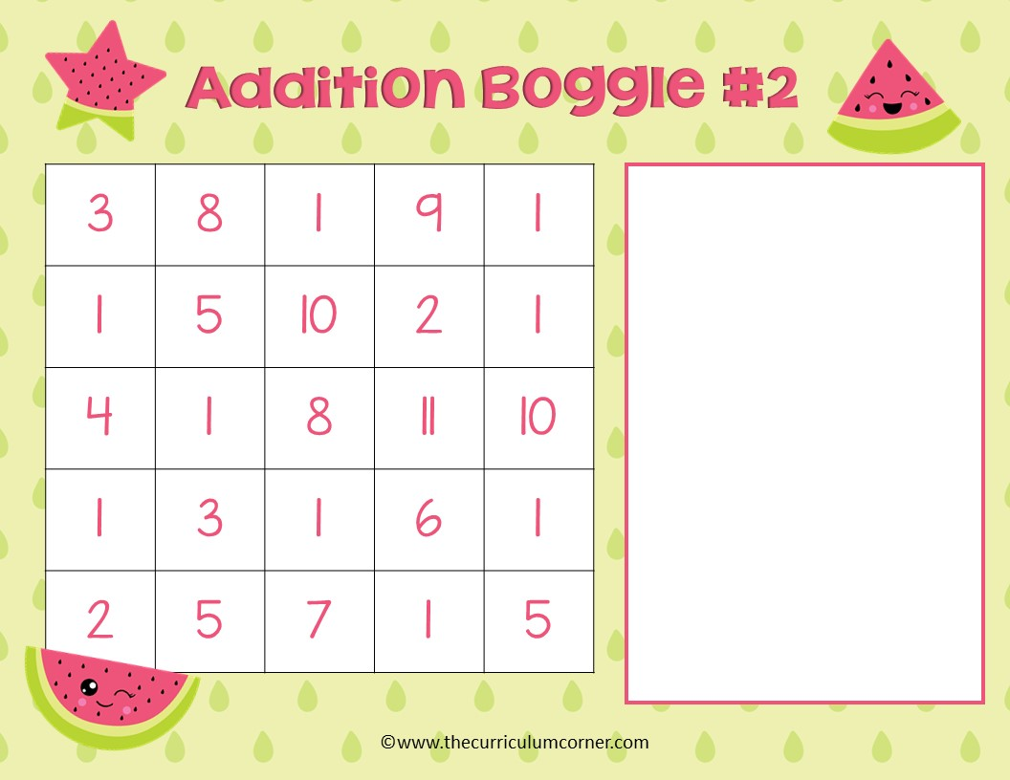
What addition facts can you find? Type your answers here.

Slide 3

What addition facts can you find? Type your answers here.

Slide 4
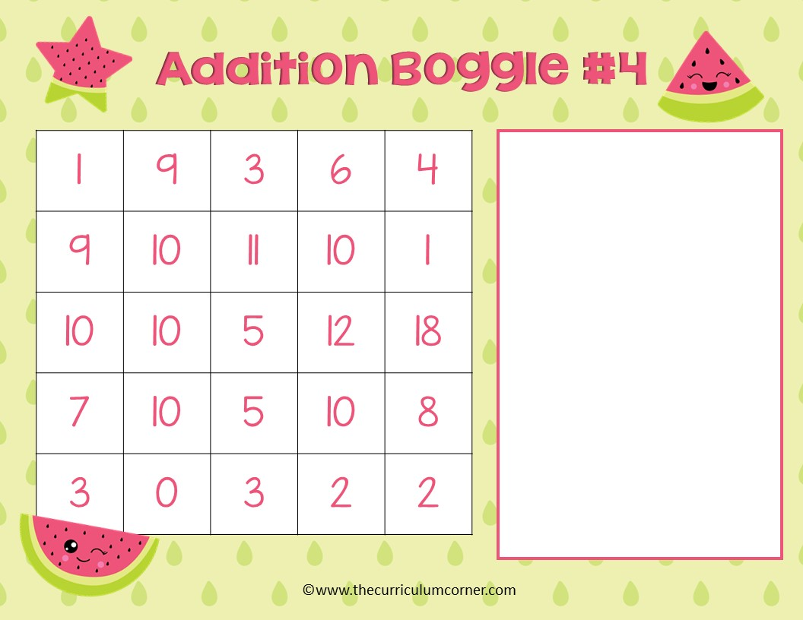
What addition facts can you find? Type your answers here.

Slide 5

What addition facts can you find? Type your answers here.

Slide 6

4 | 3 | 6 | 2 | 5
8 | 7 | 12 | 8 | 7
2 | 10 | 3 | 9 | 3
6 | 6 | 12 | 10 | 12
5 | 1 | 5 | 5 | 4
What addition facts can you find? Type your answers here.
editable boxes

