Slide 1
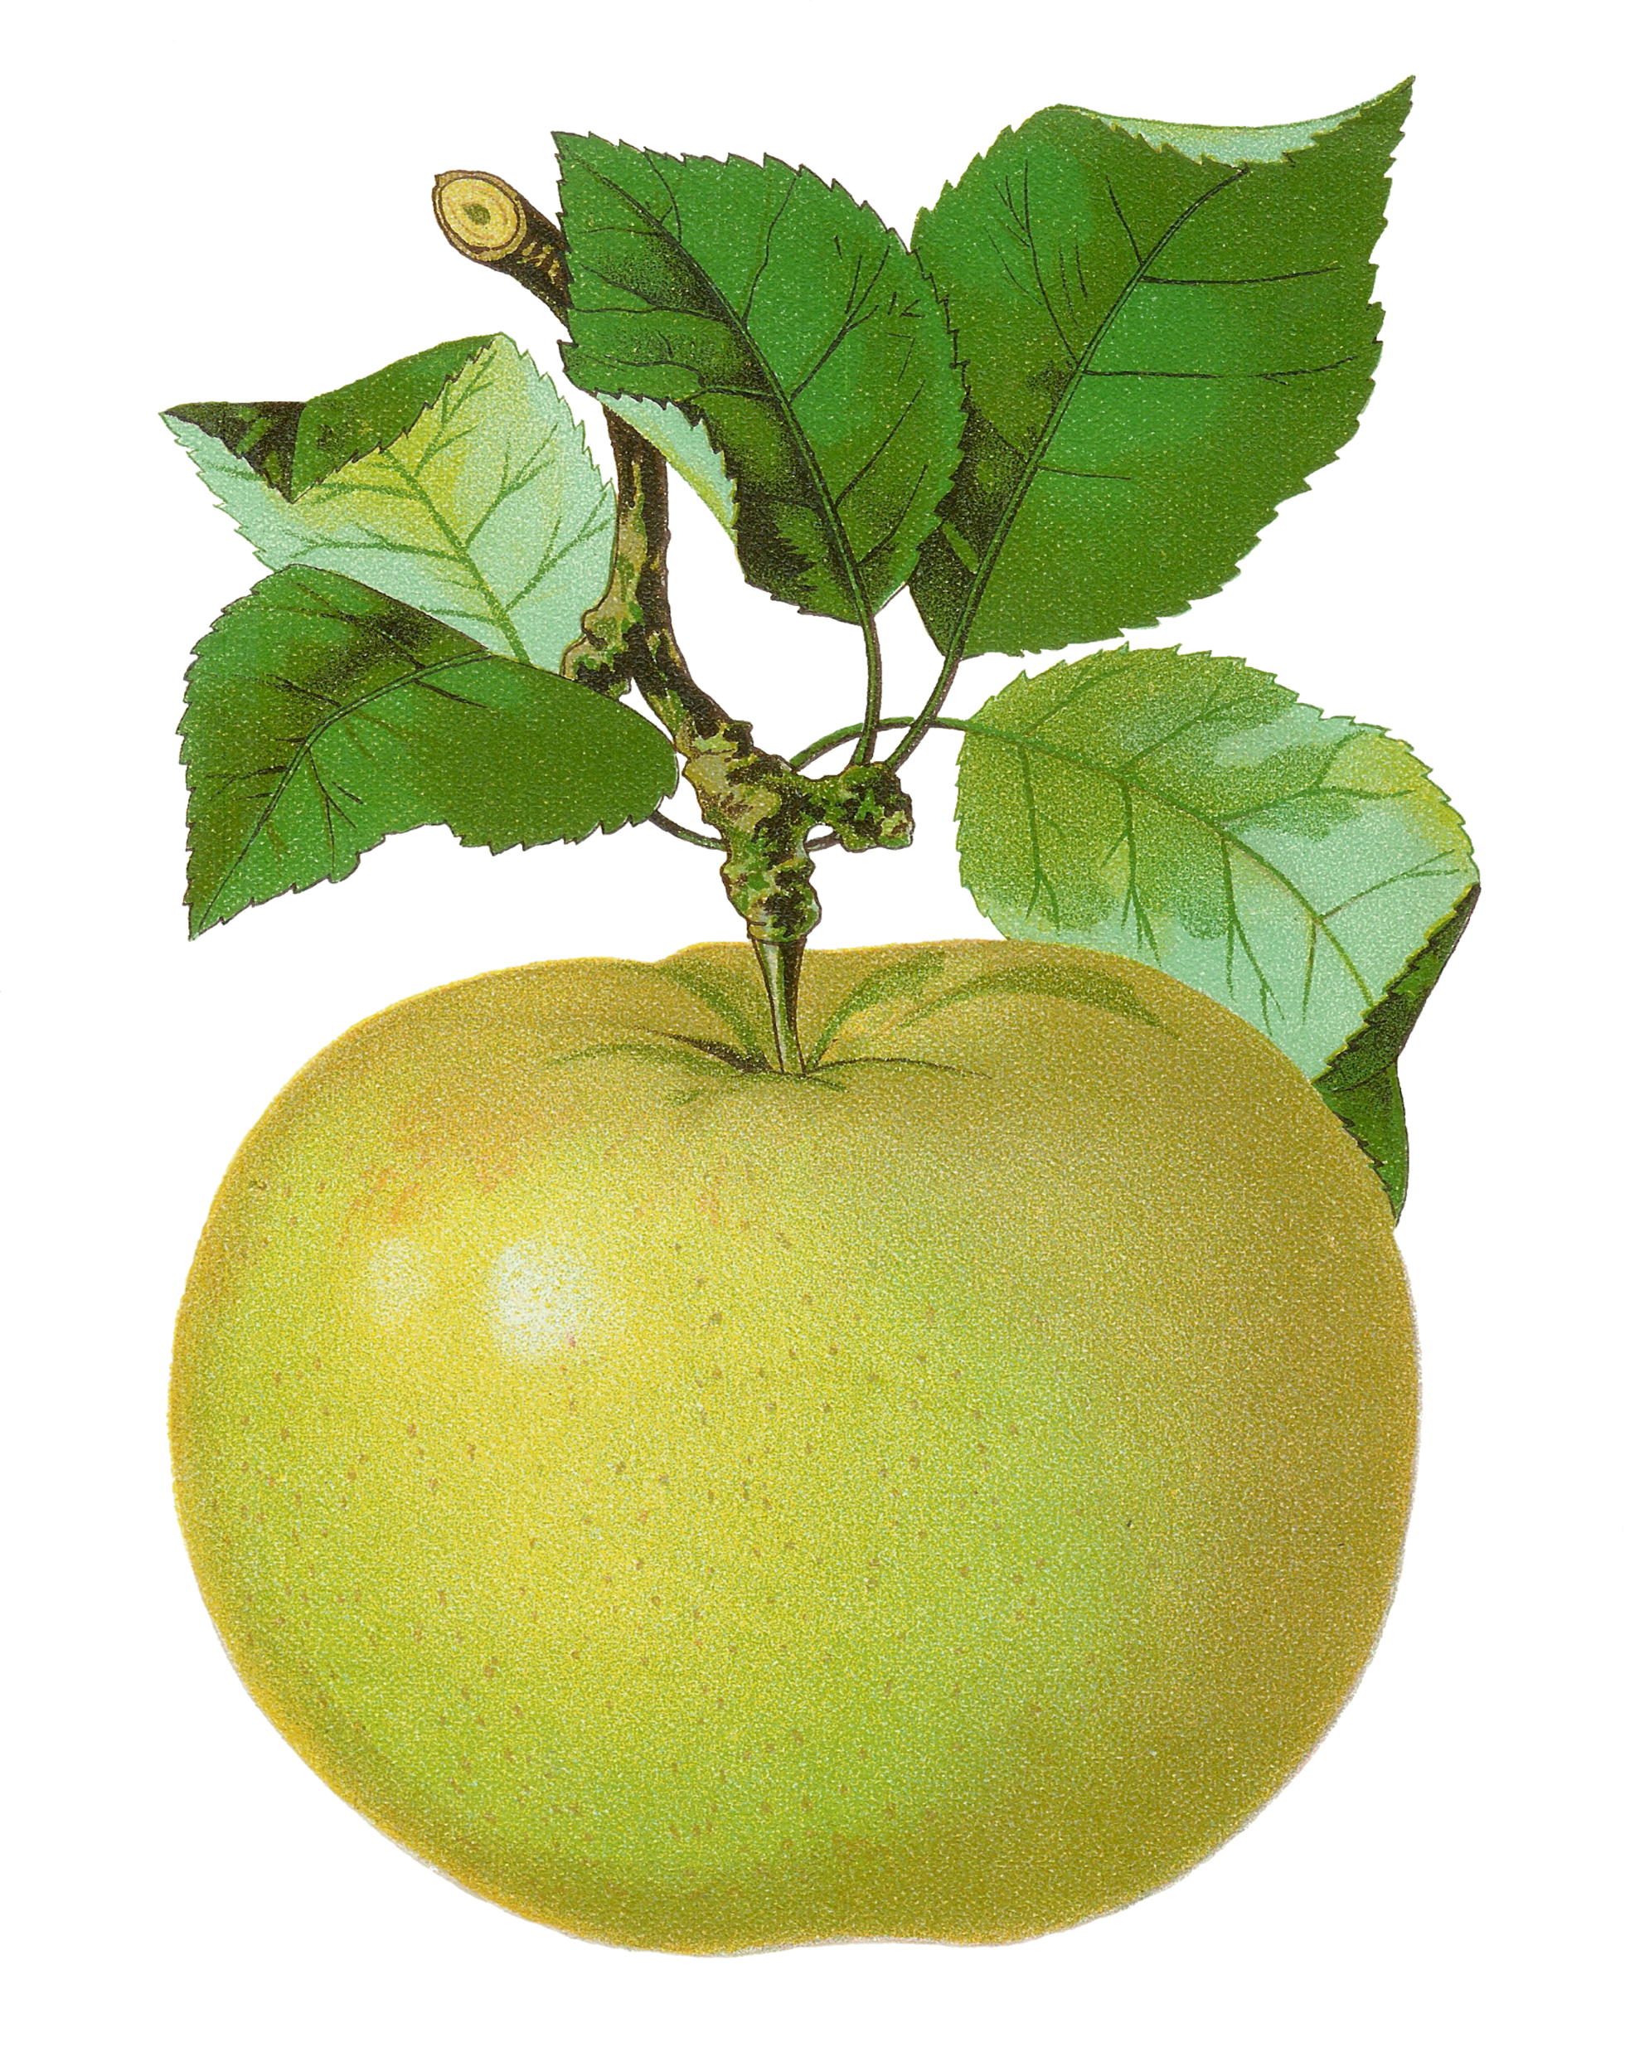
Build the Number!
Move the tens and ones to build each number.
Slide the animal over to check your answer.
A math game from
The Curriculum Corner
©www.thecurriculumcorner.com

Slide 2
52

Slide 3
19

Slide 4
36

Slide 5
81

Slide 6
63

Slide 7
90

Slide 8
48

Slide 9
71

Slide 10
59

Slide 11
26

Slide 12
37

Slide 13
12

Slide 14
85

Slide 15
25

Slide 16
7

Slide 17
40

Slide 18
64

Slide 19
72

Slide 20
83

Slide 21
99

Slide 22
Way to go!
A math game from
The Curriculum Corner
©www.thecurriculumcorner.com

