Slide 1
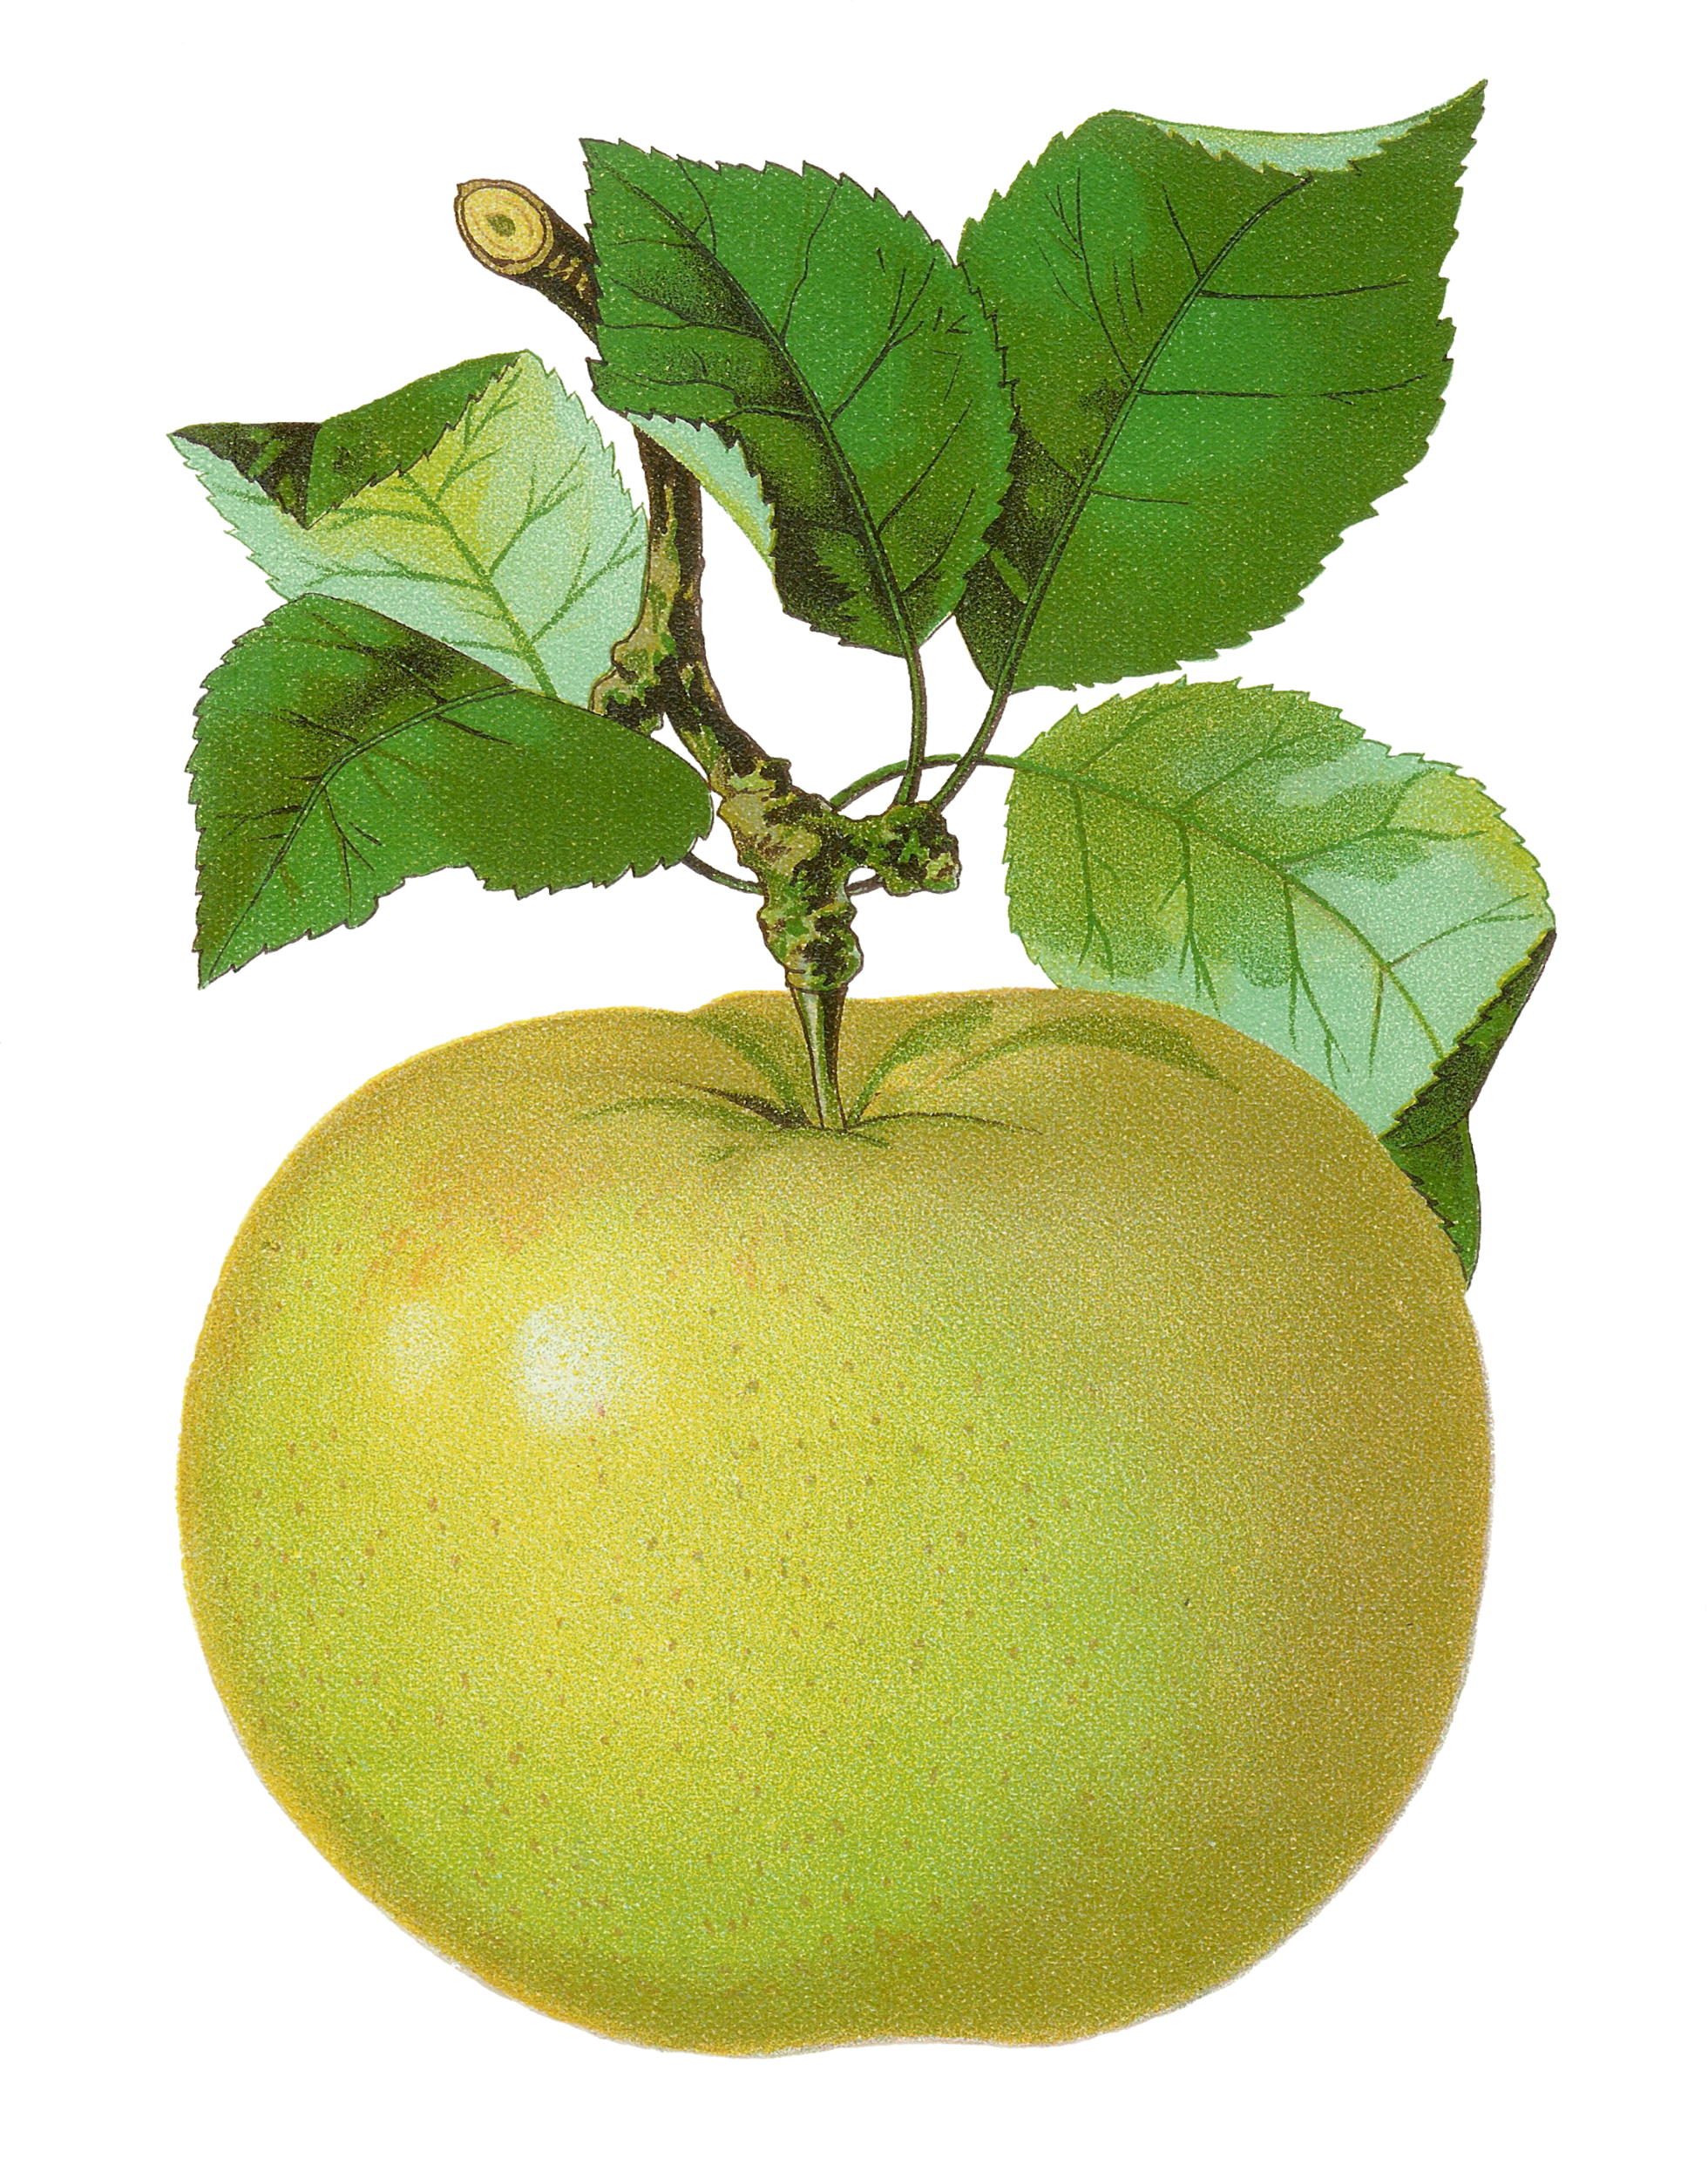
Build the Number!
Move the hundreds, tens and ones to build each number.
Slide the animal over to check your answer.
A math game from
The Curriculum Corner
©www.thecurriculumcorner.com

Slide 2
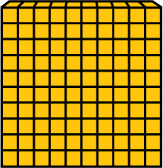
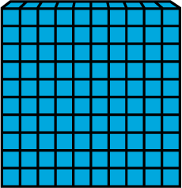
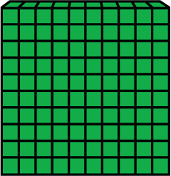
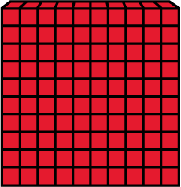
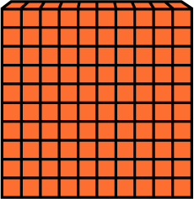
163

Slide 3
946

Slide 4
84

Slide 5
281

Slide 6
784

Slide 7
680

Slide 8
348

Slide 9
402

Slide 10
524

Slide 11
834

Slide 12
195

Slide 13
499

Slide 14
970

Slide 15
663

Slide 16
790

Slide 17
800

Slide 18
315

Slide 19
906

Slide 20
200

Slide 21
381

Slide 22
Way to go!
A math game from
The Curriculum Corner
©www.thecurriculumcorner.com

