Slide 1
Digital
Gardening
Scrambled Sentences
©www.thecurriculumcorner.com

Slide 2
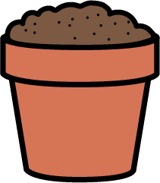
are
seeds
we
growing
The
planted
.

Slide 3
?
ladybug
see
Do
the
you
the
in
garden

Slide 4
important
Why
are
?
honeybees

Slide 5
purple
are
!
so
There
in
flowers
many
garden
our

Slide 6
colorful
The
our
flowers
likes
butterfly
.

Slide 7
at
of
vegetables
Look
all
the
!

Slide 8
help
?
these
Will
plant
me
you

Slide 9
made
.
rain
muddy
The
our
garden

Slide 10
Great practice!
©www.thecurriculumcorner.com

