Slide 1
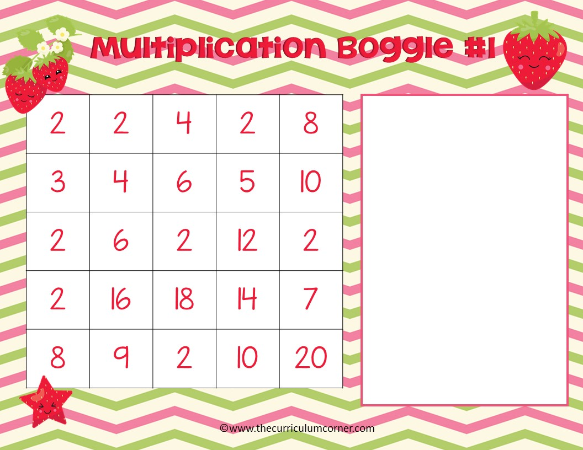
What multiplication facts can you find? Type your answers here.

Slide 2
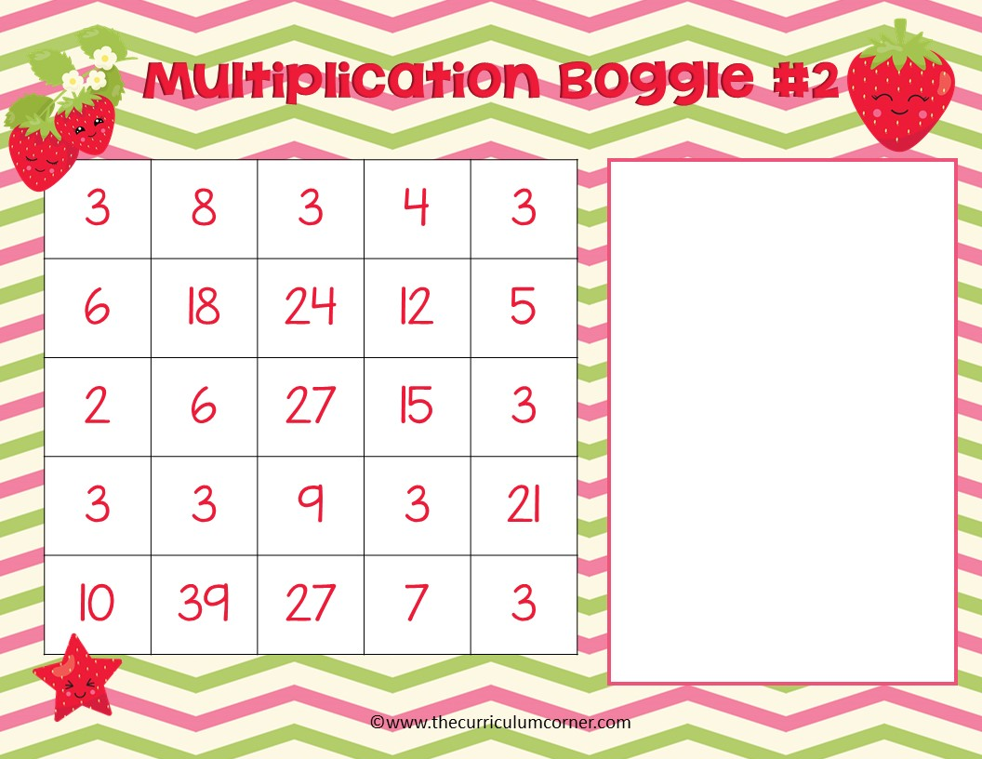
What multiplication facts can you find? Type your answers here.

Slide 3
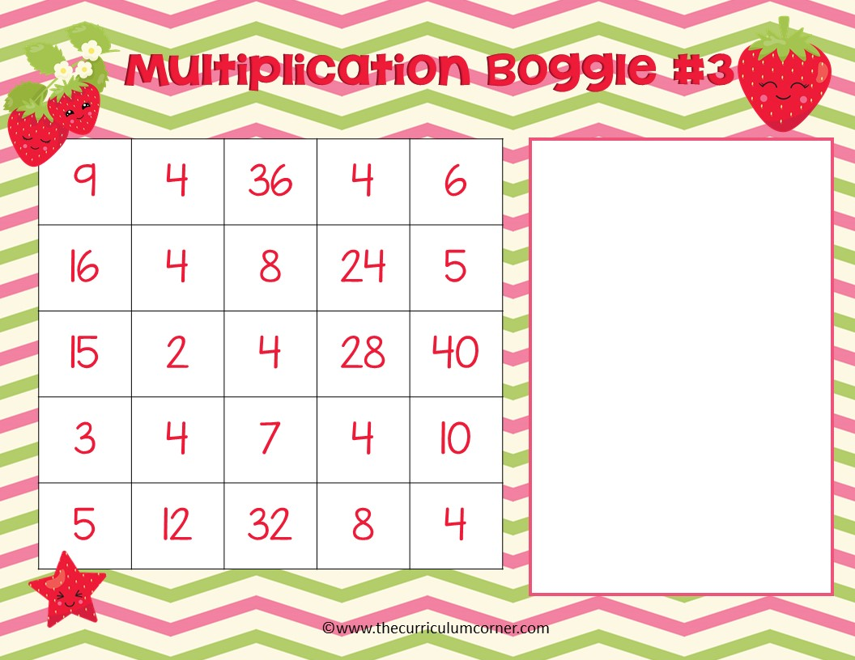
What multiplication facts can you find? Type your answers here.

Slide 4
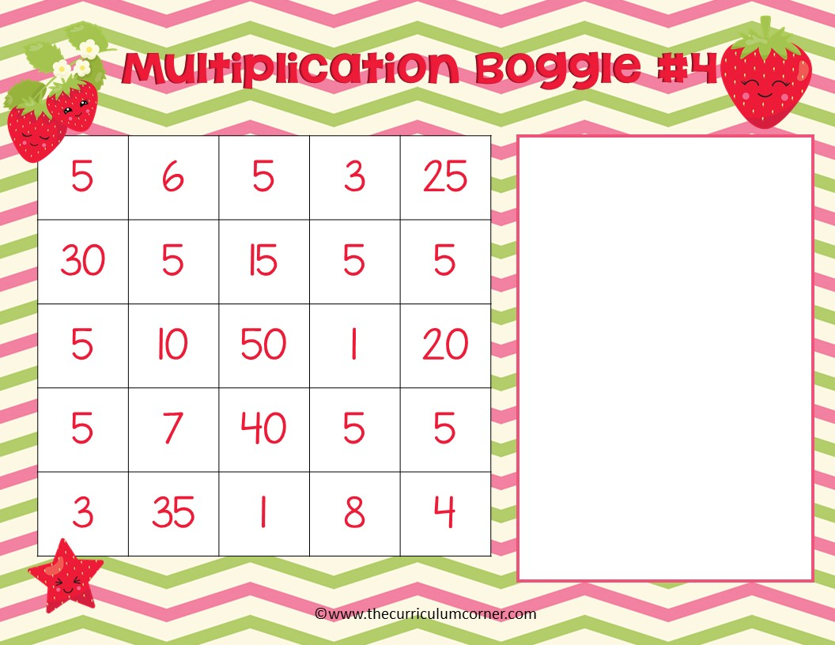
What multiplication facts can you find? Type your answers here.

Slide 5
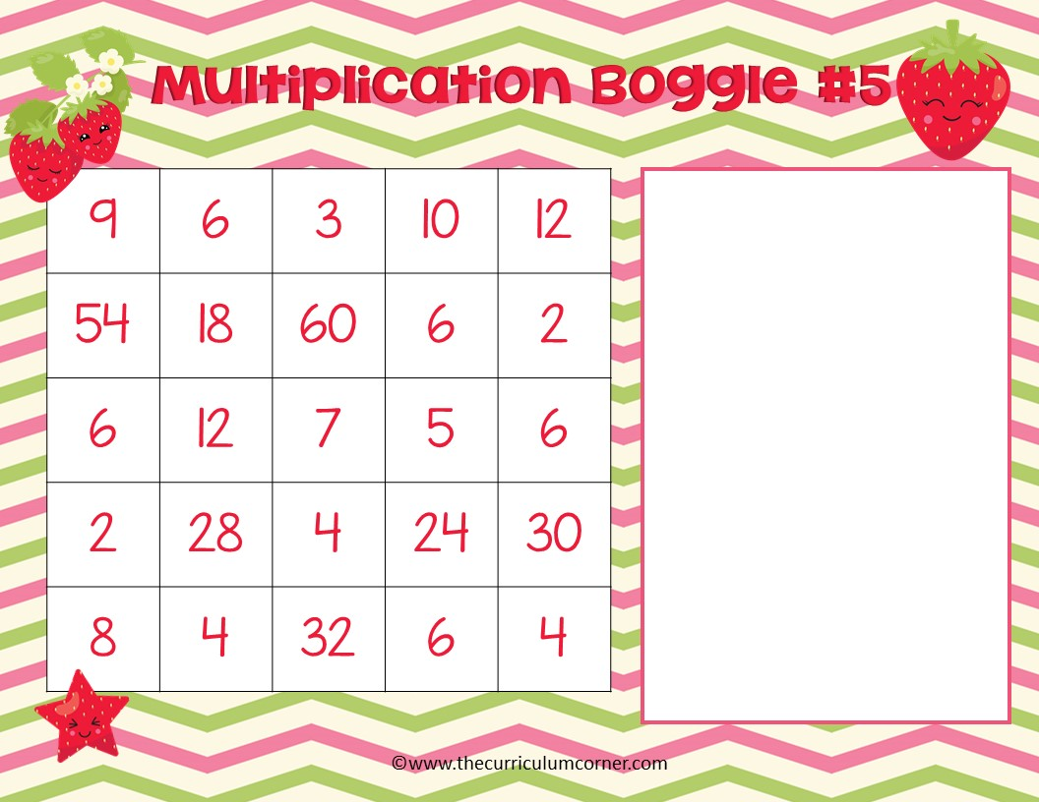
What multiplication facts can you find? Type your answers here.

Slide 6
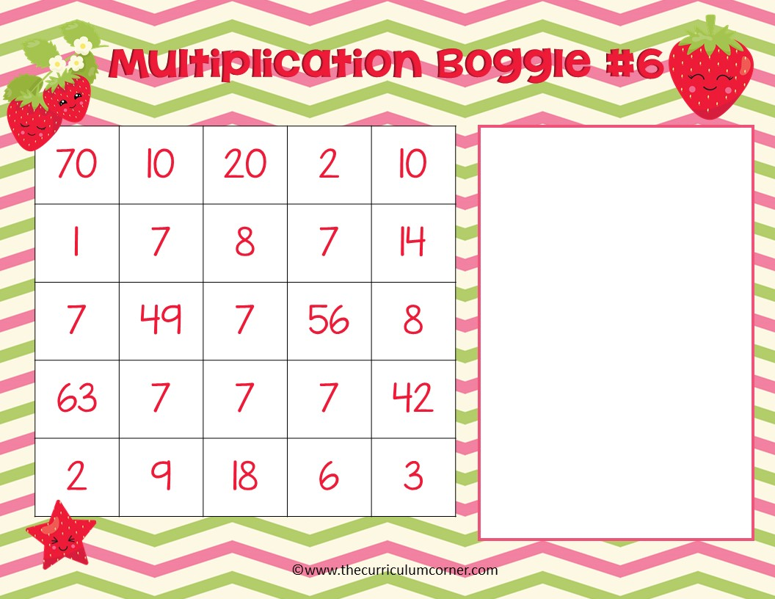
What multiplication facts can you find? Type your answers here.

Slide 7
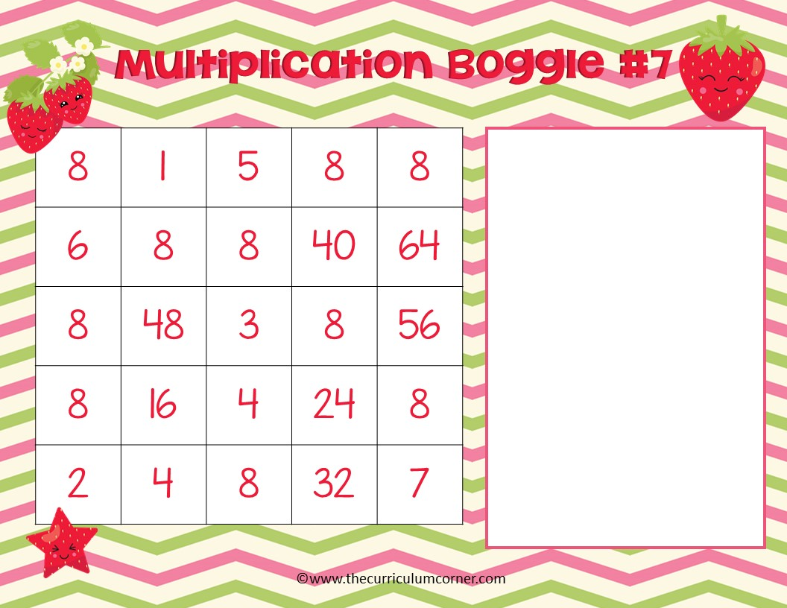
What multiplication facts can you find? Type your answers here.

Slide 8

What multiplication facts can you find? Type your answers here.

Slide 9
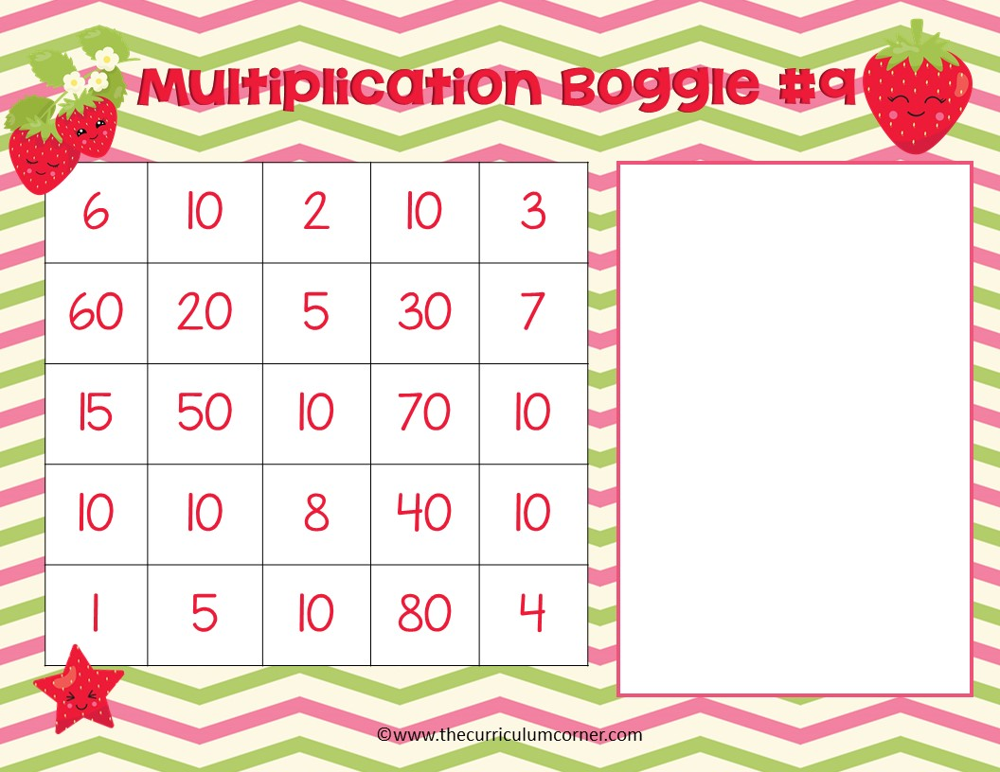
What multiplication facts can you find? Type your answers here.

Slide 10
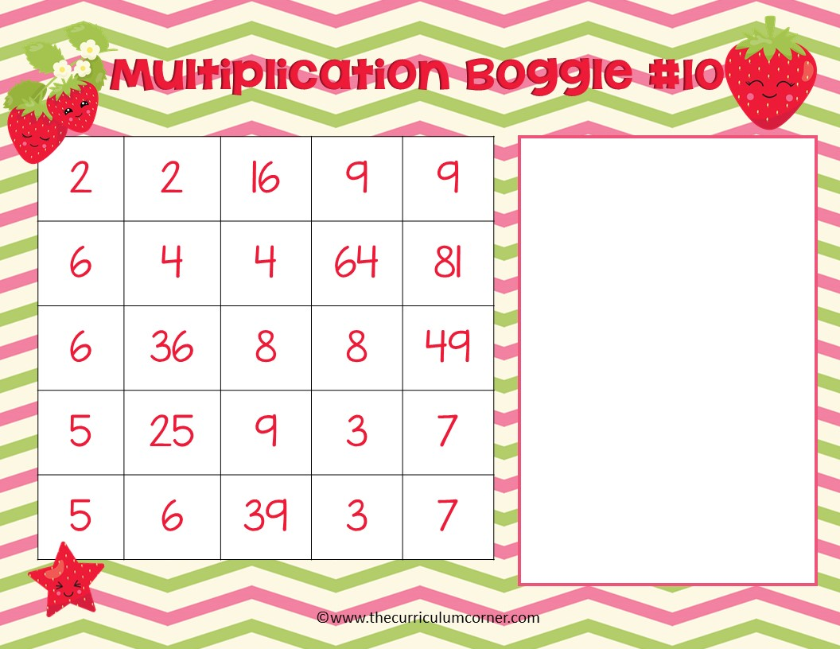
What multiplication facts can you find? Type your answers here.

Slide 11
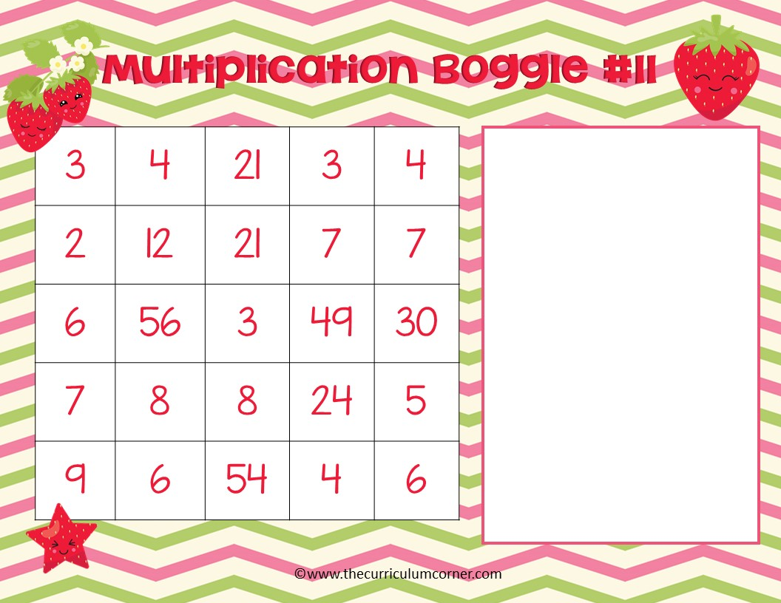
What multiplication facts can you find? Type your answers here.

Slide 12

5 | 7 | 40 | 8 | 5
6 | 35 | 4 | 8 | 64
7 | 42 | 36 | 9 | 6
5 | 9 | 32 | 4 | 56
35 | 9 | 81 | 8 | 7
What multiplication facts can you find? Type your answers here.

