Slide 1
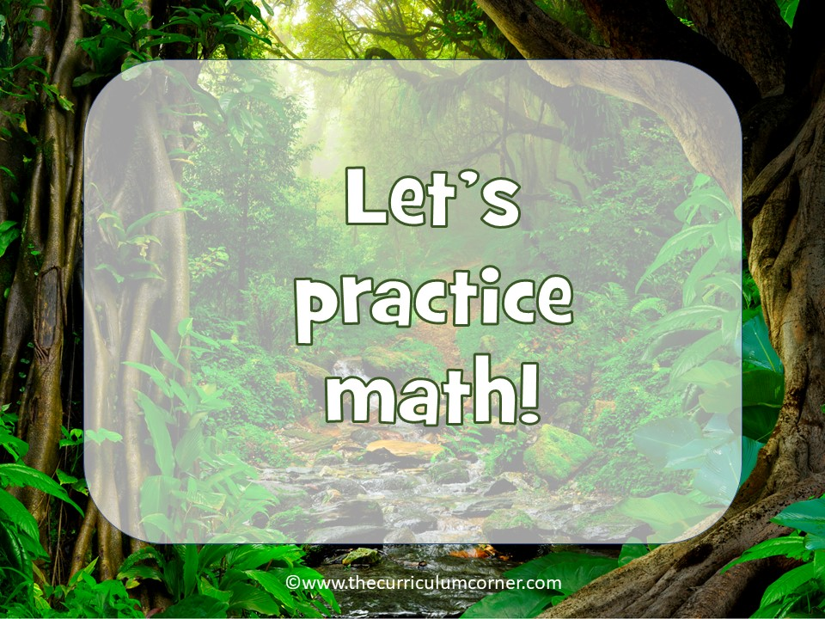

Slide 2
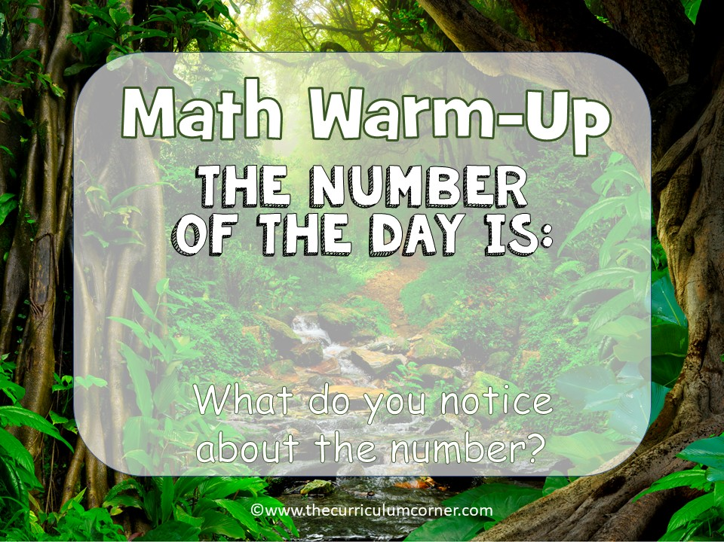
628

Slide 3

628
Write answers here

Slide 4

729

Slide 5
729
Write answers here

Slide 6
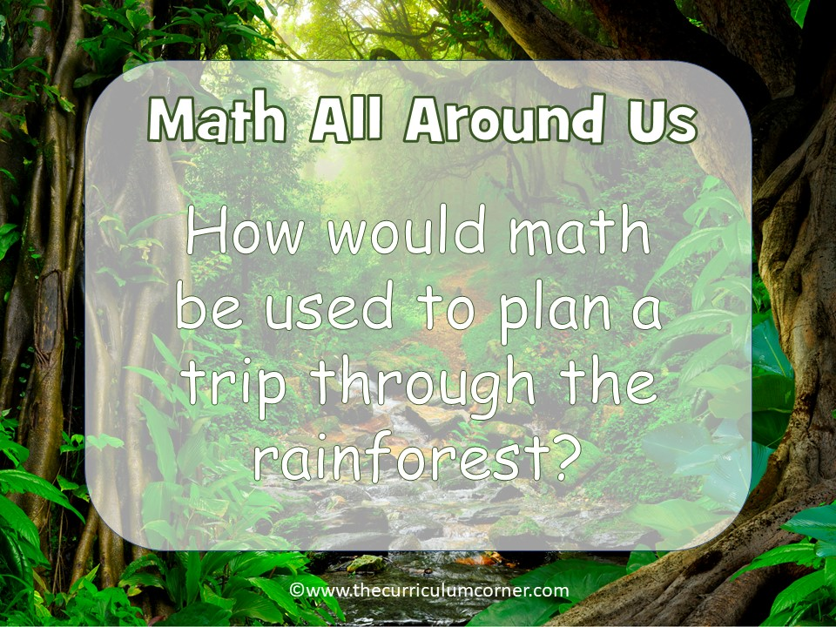

Slide 7

Write answers here

Slide 8
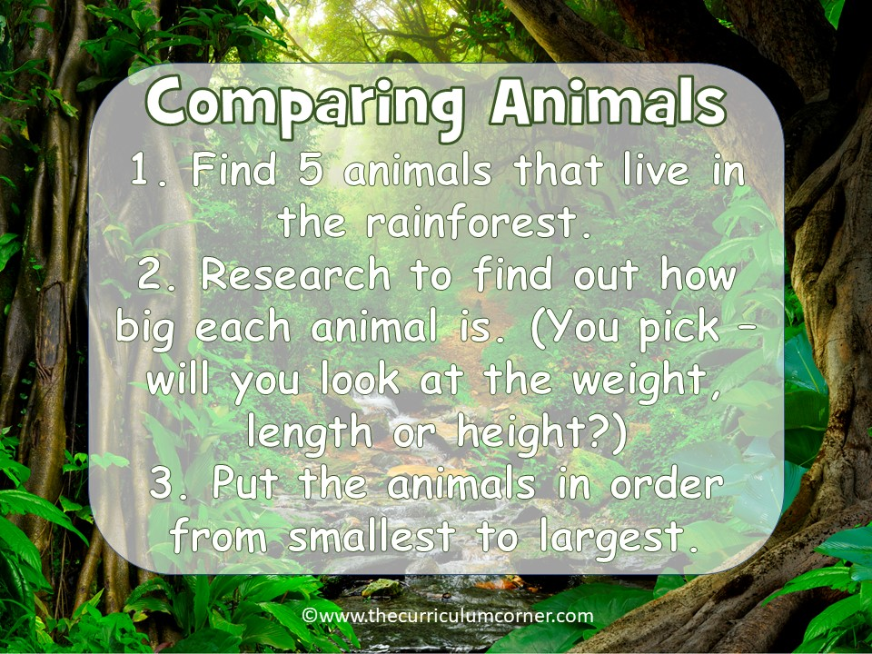

Slide 9
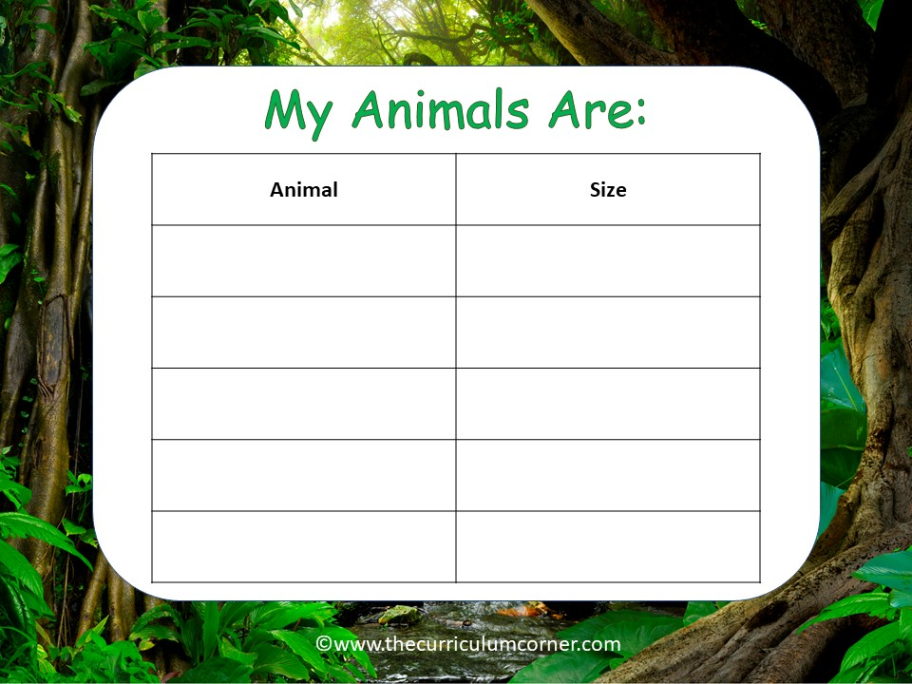
animal here | size here
animal here | size here
animal here | size here
animal here | size here
animal here | size here

Slide 10
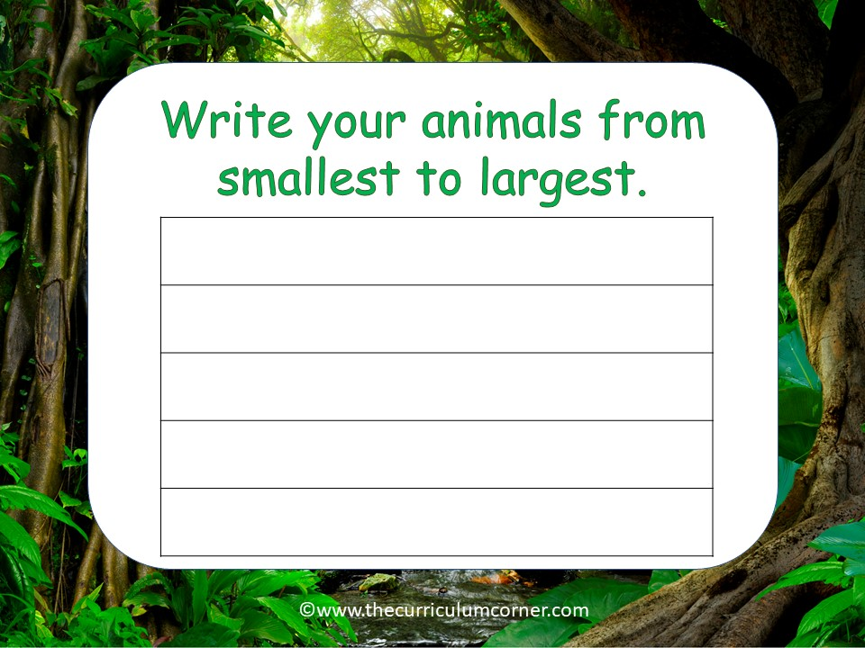
animal here
animal here
animal here
animal here
animal here

