Slide 1


Slide 2


Slide 3
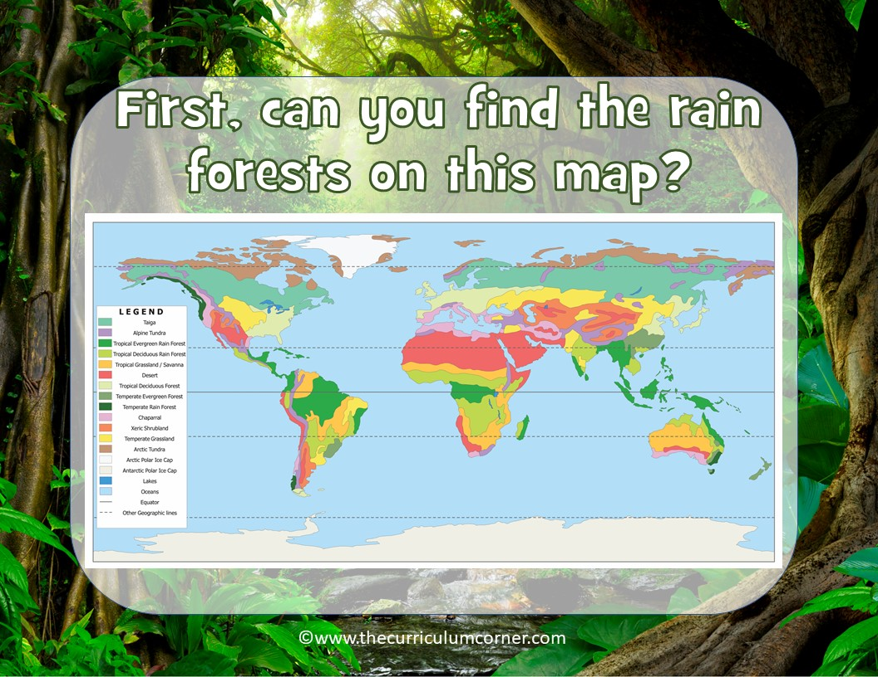

Slide 4


Slide 5
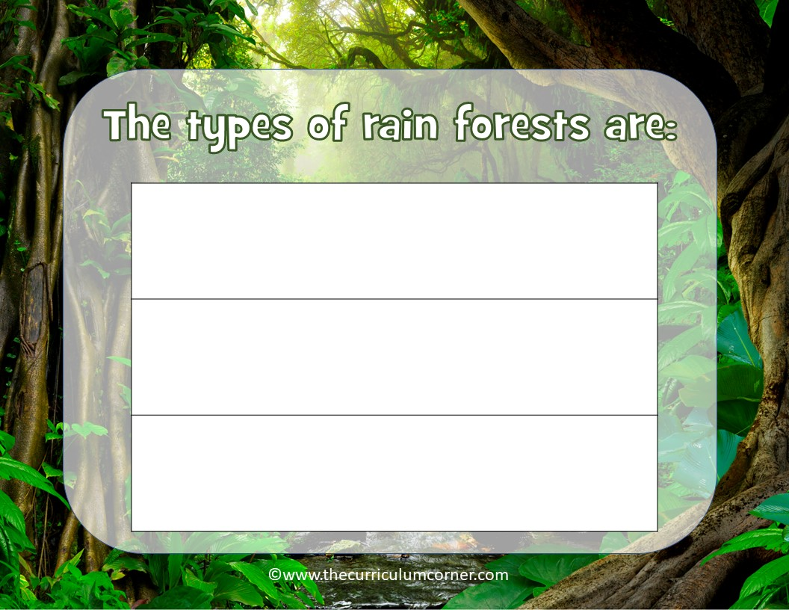
Type here
Type here
Type here

Slide 6
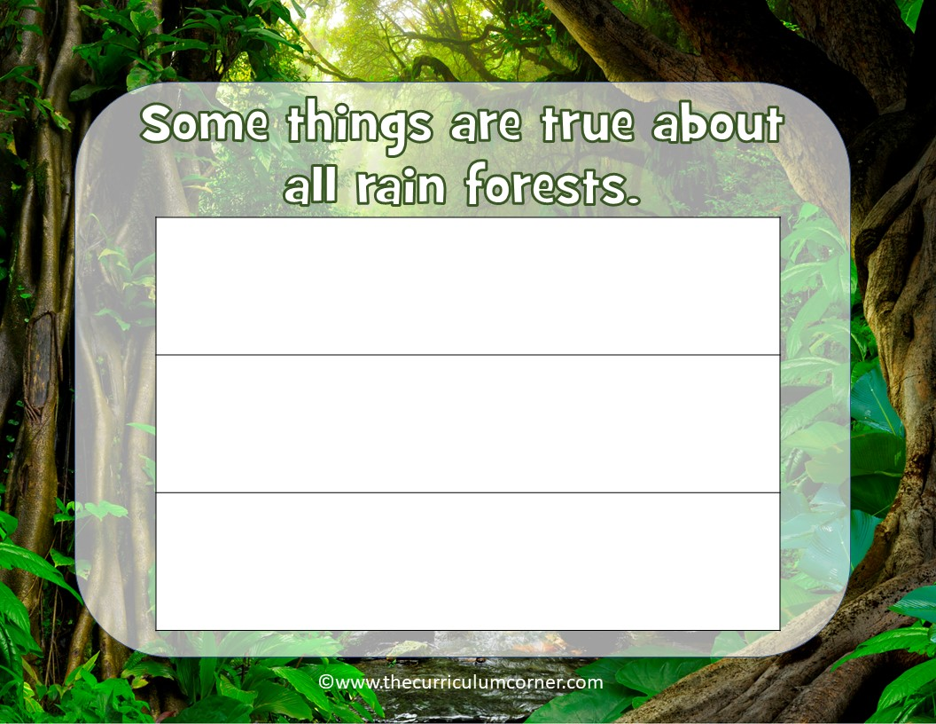
Type here
Type here
Type here

