Slide 1
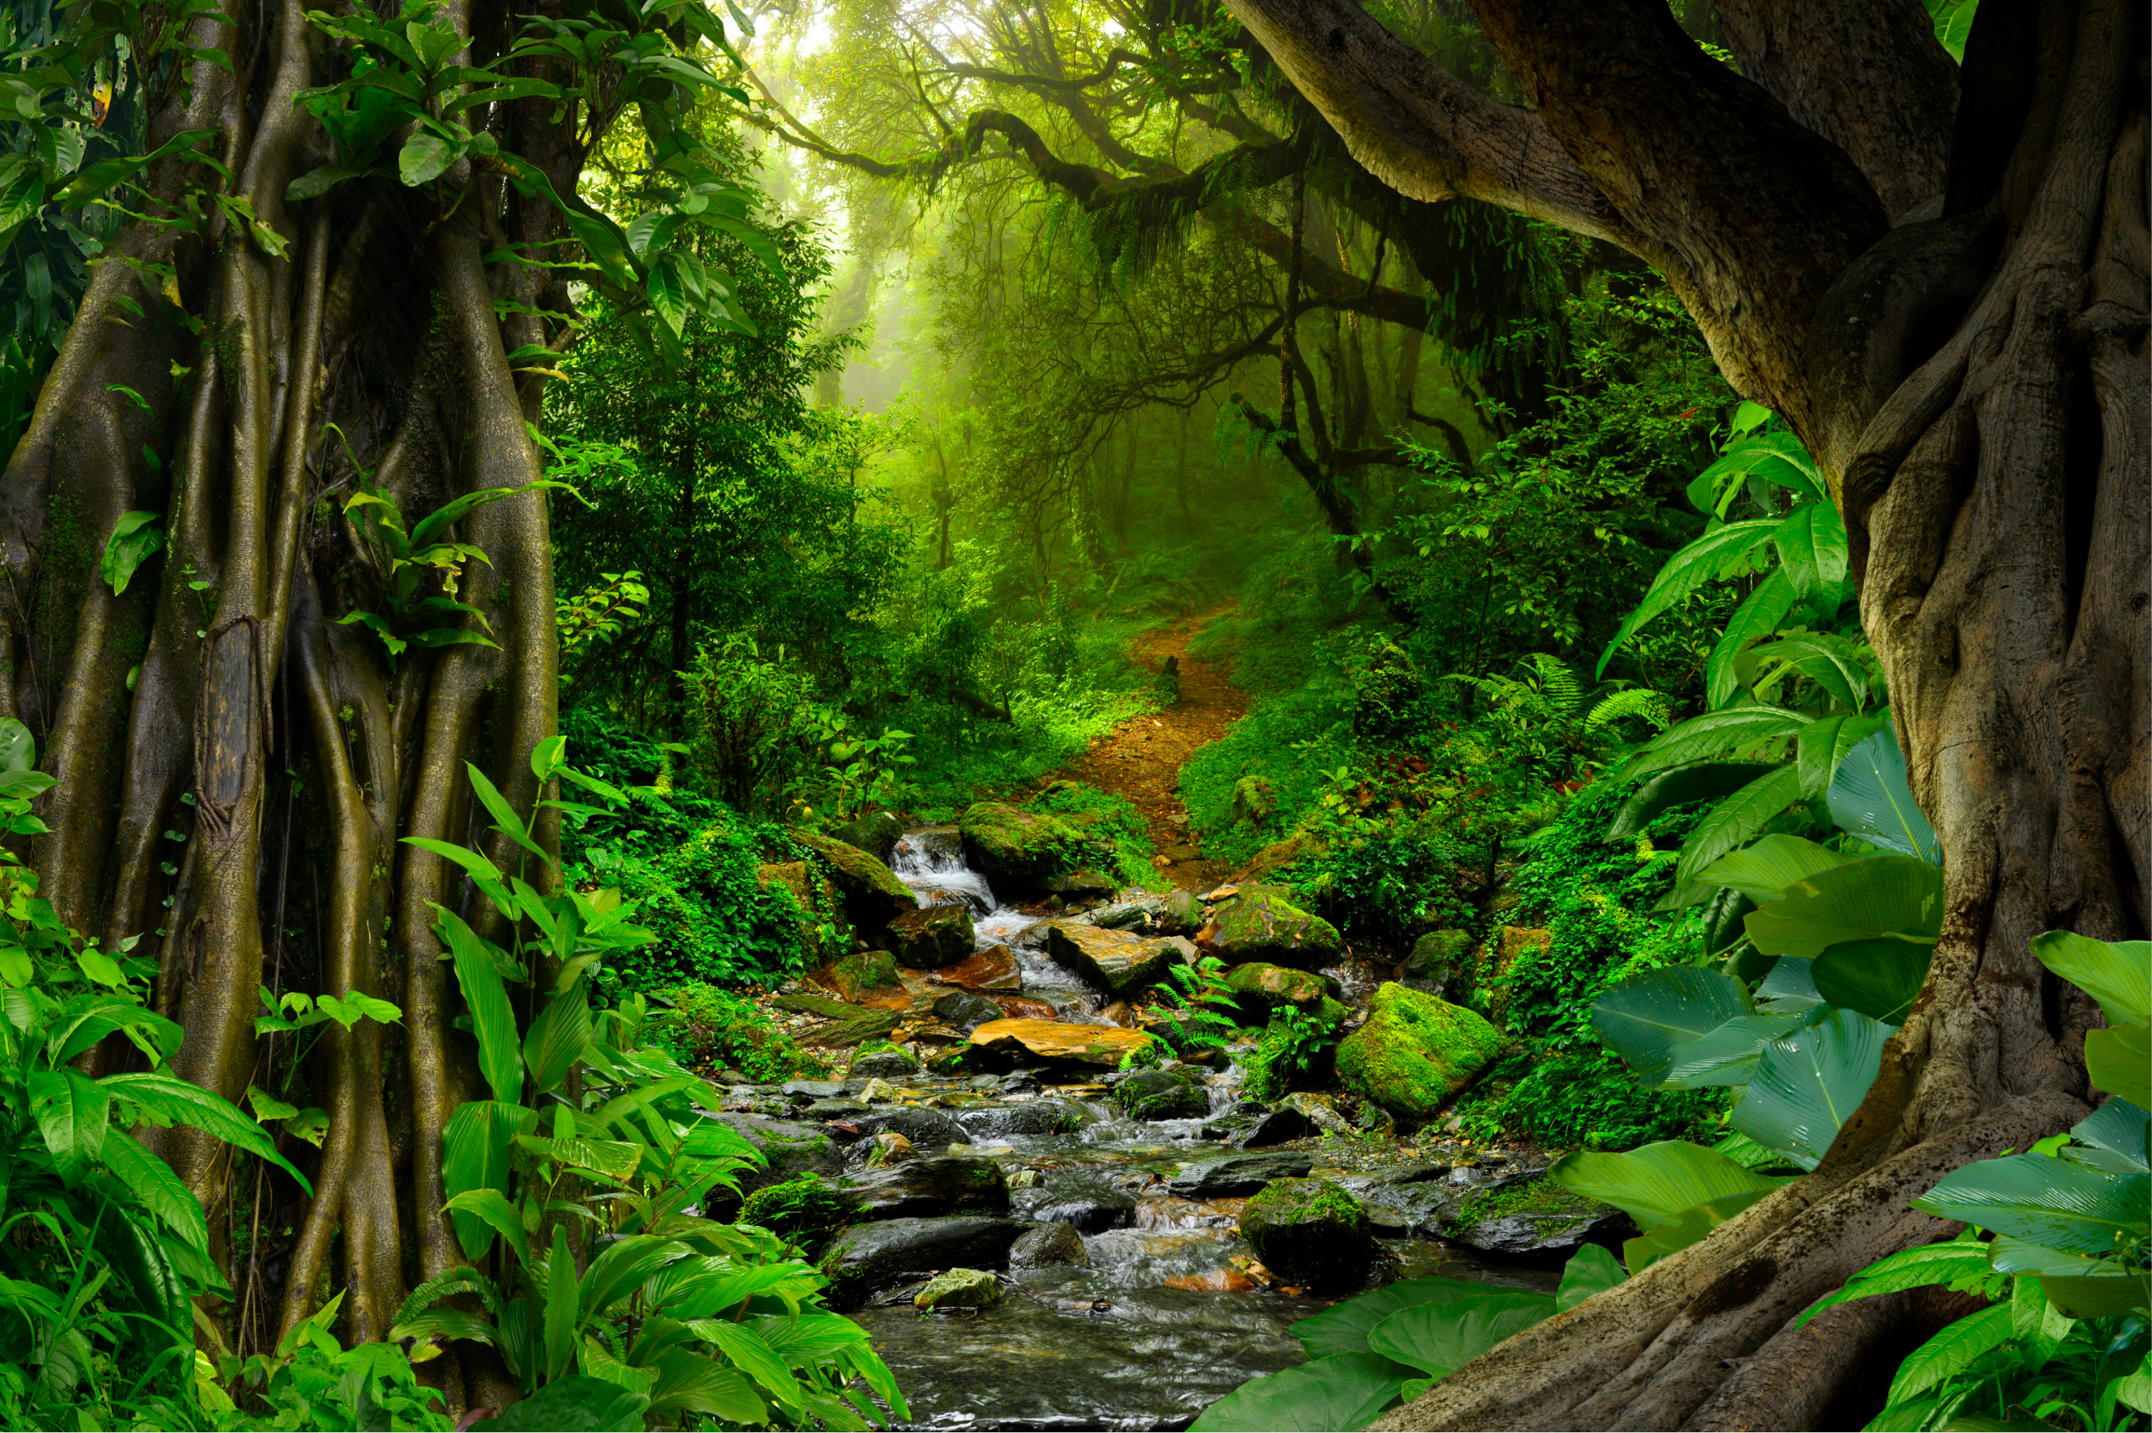
Let’s write
about the rainforest!
©www.thecurriculumcorner.com

Slide 2
Writing Warm-Up
What are nouns, verbs and adjectives?
©www.thecurriculumcorner.com

Slide 3
Make a list of nouns, verbs and adjectives that remind you of the rainforest.
©www.thecurriculumcorner.com

Slide 4
noun | verbs | adjectives
©www.thecurriculumcorner.com

Slide 5
Descriptive writing will help a reader feel like they are in a rainforest.
©www.thecurriculumcorner.com

Slide 6
What sentence could you write to help a reader feel like they are in a rainforest?
Write answer here
©www.thecurriculumcorner.com

Slide 7
Can you edit your sentence to make it even better? What words could you add to help the reader visualize what you are writing about better? You might add another sentence to your writing.
Write answer here
©www.thecurriculumcorner.com

Slide 8
Let’s turn your warm-up sentence into a paragraph about the rain forest! Start with what you have written and add to it. Tell the reader what it would feel like to walk through the rainforest. What would they see and hear?
©www.thecurriculumcorner.com

Slide 9
Write answer here
©www.thecurriculumcorner.com

