Slide 1
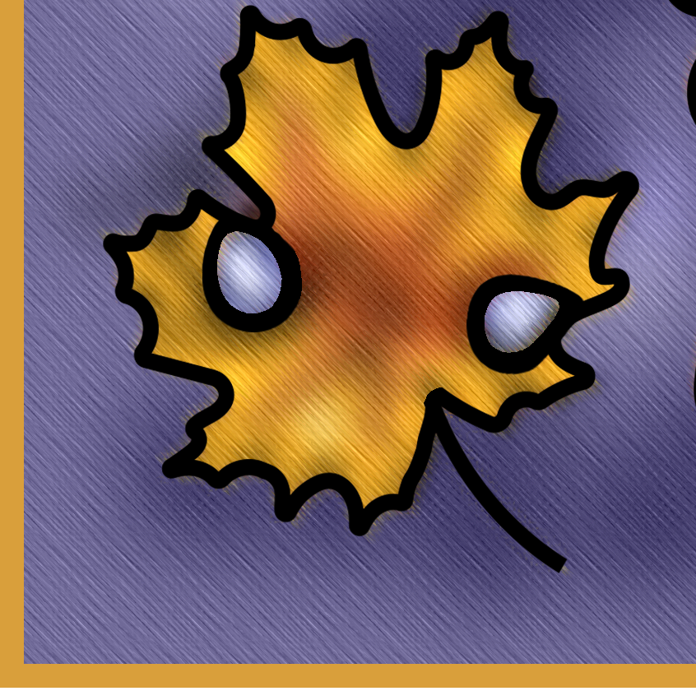
logy
ly
ward
less
ness
able
ful
or
ed

