Slide 1
Welcome to
Miss Riley’s
2nd Grade Class

Slide 2
Contact Information
classroom number: 22
classroom extension: 5183
my email: riley@myschool.com
class website: www.thecurriculumcorner.com
my cell: 555.555.5555

Slide 3
Meet the teacher!
This is my third year teaching second grade. I graduated in 2017 from The University of Boulder in Colorado. I live in Bloomberg with my new puppy and love riding my bike to school everyday. I can’t wait to get to meet your children and help them grow this year.

Slide 4
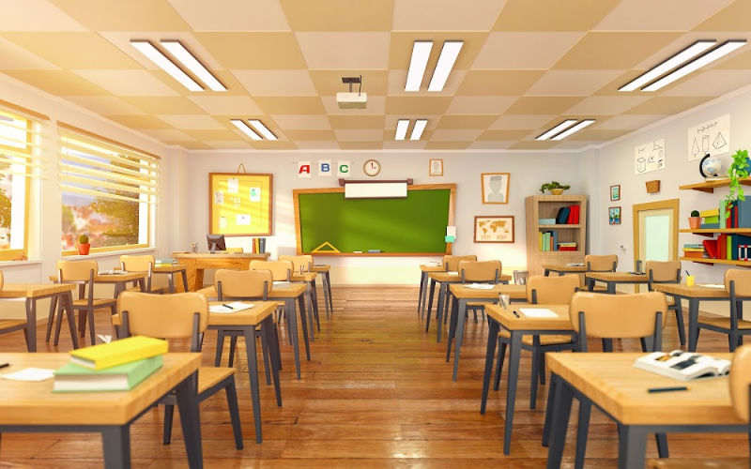
Our Classroom
I know that as parents, you want to be able to explore the place
where your children will spend the day. I am working to make our
classroom colorful and welcoming while following school guidelines. I am
looking forward to when it safe for all of our families to gather in this room!

Slide 5
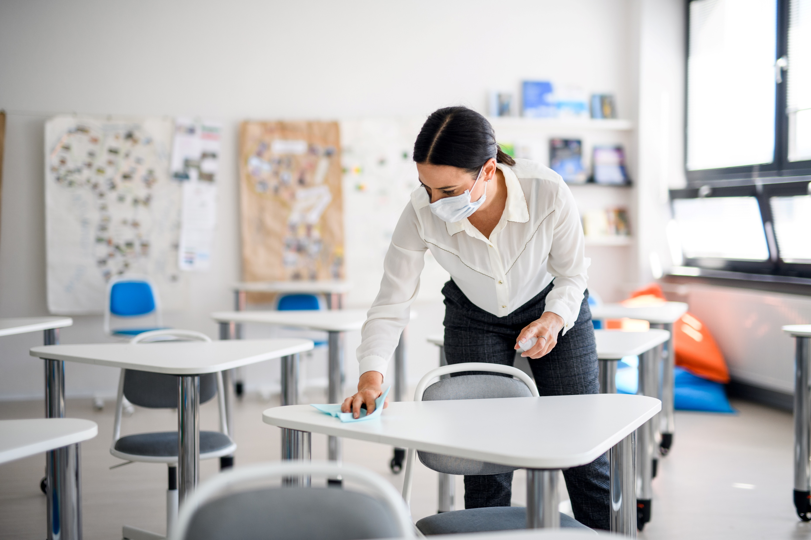
Keeping Our Room Clean
I will be taking steps each day to help us keep our classroom clean and safe. I will disinfect surfaces throughout the day. I will also collect any used materials and clean those after school.

Slide 6
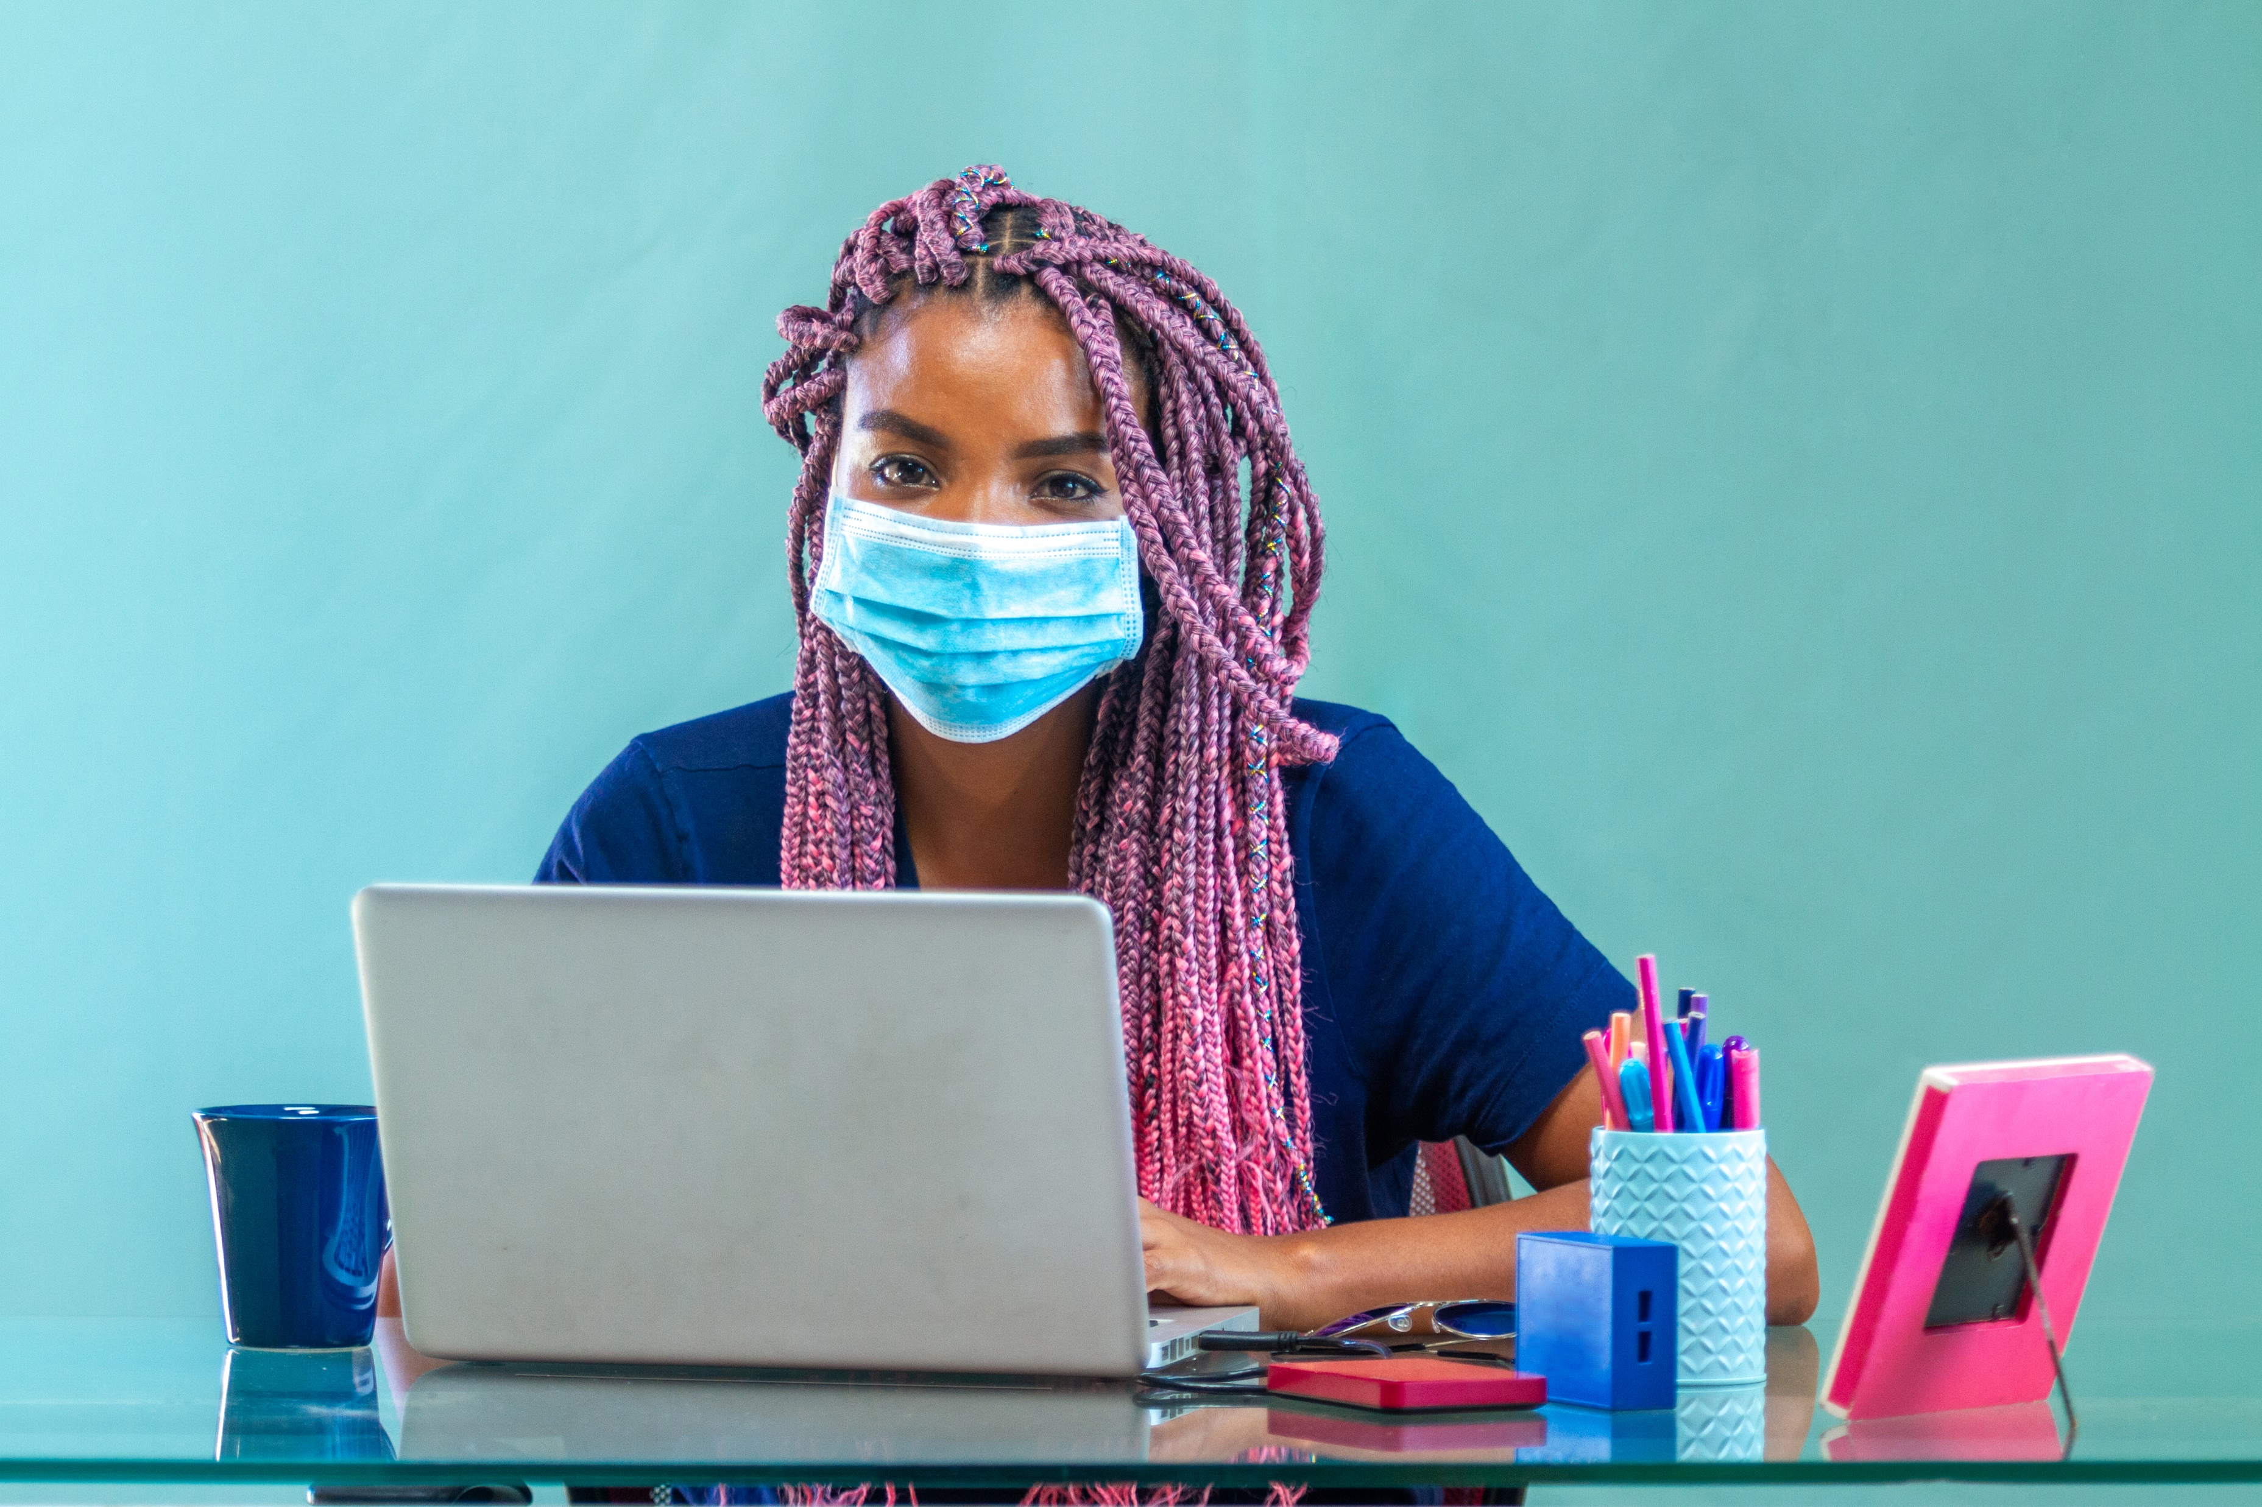
Masks
I know it can be a challenge to keep a mask on the whole day for young children. I will be modeling by wearing my mask all day, every day. We will talk about keeping our hands off our masks and only removing them when instructed to do so. Please help me by making sure to send a clean mask each day. You might also choose to store an extra in your child’s backpack just in case.

Slide 7
Staying Healthy
Teachers have worked hard to create a safe and healthy environment. These are the guidelines that will be in place:
Your child will have their temperature taken each day as they enter the school.
Children will be given hand sanitizer after their temperature is taken.
Backpacks and coats will be placed on the back of your child’s chair and remain their for the day.
Children will be allowed into restrooms one at a time. They will be sanitized in between use.

Slide 8
Outside of Our Classroom
I know that many parents are anxious to learn how gatherings outside of our classroom will occur. These are the current guidelines. This will change as we see the need.
Students must wear a mask in the café line. They must stand on the social distancing stickers.
Children will be sat at every other seat for breakfast and lunch. Chairs may not be moved by students.
One class at a time will be allowed on the playground. The playground will be sanitized in between use. Some classes will have recess not on the equipment.
Special area teachers will come to our classroom. PE may go outside, weather permitting.

Slide 9
New School Guidelines
No Visitors
Please wear a mask into the front office when signing your child out for an appointment.
Children out with a fever must stay home for a full seven days.
Please do not send your child to school with any signs of illness.
If a sibling is home with a fever, please keep home any other children.
Rules on allowed number of absences and tardies will not be enforced this school year.

Slide 10
Mental Health
My number one goal this year is to help children be happy and healthy. I know that last spring was a very difficult time for many families. Mental health will come before academics as we start the year. We will spend time reading and talking about books that will help us process how we are feeling. If at any time you have concerns about your child, please do not hesitate to contact me so we can work together.

Slide 11
Learning at School
Our classroom learning will look different from past school years. I have worked over the summer to develop lessons that will be engaging but still allow for social distancing and following of other guidelines. We will spend a great deal of time at our desks but I will be moving around the class to engage with your children. We will have less small group instruction than you are familiar with.
I would love to be able to resume flexible seating and a true workshop approach before the end of the school year.

Slide 12
Our Schedule
8:25 Morning entry
8:50 Morning meeting
9:10 Math Workshop
10:10 Restroom Break
10:25 Reading Workshop
12:00 Lunch
12:30 Recess
1:00 Special Area
1:50 Writing Workshop
2:55 Pack Up / Dismissal
This is our “goal” schedule. Modifications will need to be made as we know that restroom breaks will take longer and there will be other gaps we are not used to. Social Studies and Science instruction will be worked into our schedule once we have made adjustments.

Slide 13
Distance Learning
You will receive a distance learning schedule each Sunday when needed. Our class will utilize Zoom meetings for distance learning. I will email a code and password the morning of the meeting. Please email or text me if you are having any technology struggles.
I know that it can be difficult for children to stay engaged during Zoom meetings. I have worked hard over the summer to create engaging distance lessons to help your children learn.
If at any point you see your child struggling to stay on task during meetings, please contact me and I will work to make adjustments.

Slide 14
Google Classroom
We will use Google Classroom this year. My hope is that it will help create easy transitions between in person learning and distance learning. We will devote most of our time the first week of school becoming familiar with the platform. My goal will be to help children learn how to use each piece of this platform so they can be more independent during distance learning.
You will find tutorials in our Google Classroom page to assist when you have questions.

Slide 15
Other Important Notes
What else do you want your parents to know about the year? Place any additional information here. Duplicate this slide if you need more slides.

