Slide 1
Fractions
An Instructional Power Point by The Curriculum Corner

Slide 2
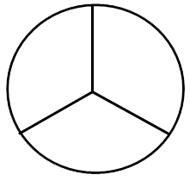
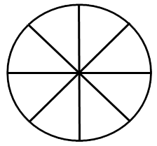
Equal Parts
To learn about fractions first you need to understand that they are Equal parts of a whole.
There are many different ways a whole can be divided into equal parts.
Take a look at the shapes as they appear . Notice all of them are divided into parts that are the same size.

Slide 3
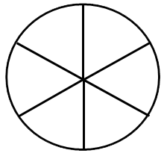
Equal Parts
Look at the following shapes as they appear.
Tell whether or not they are divided into Equal parts and discuss why.

Slide 4
Equal Parts
Shapes can be divided into any number of equal parts.
For each shape that appears discuss how many equal parts you see .

Slide 5
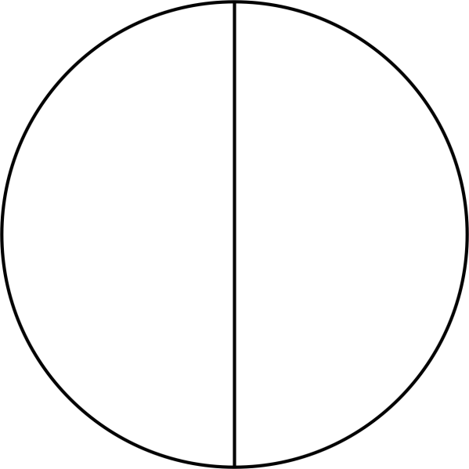
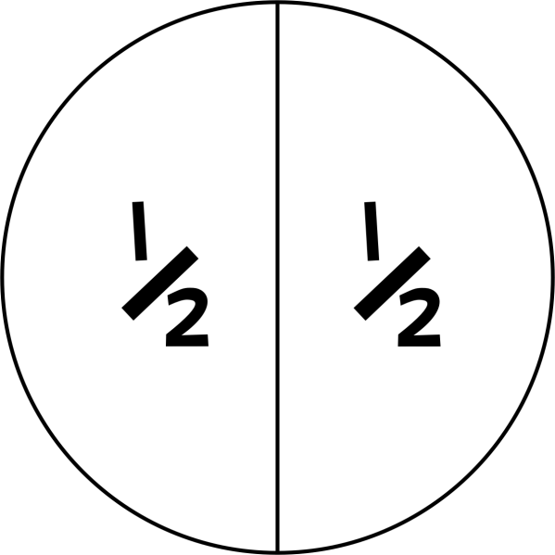
Equal Parts
We talk about a shape divided into two equal parts as being divided into halves.
half
half

Slide 6
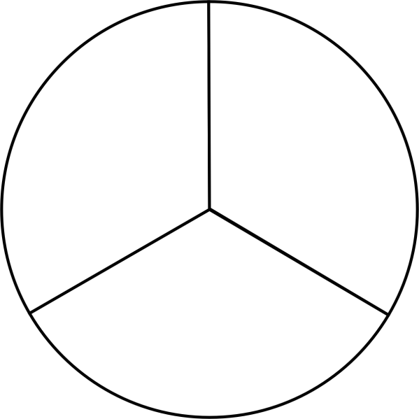
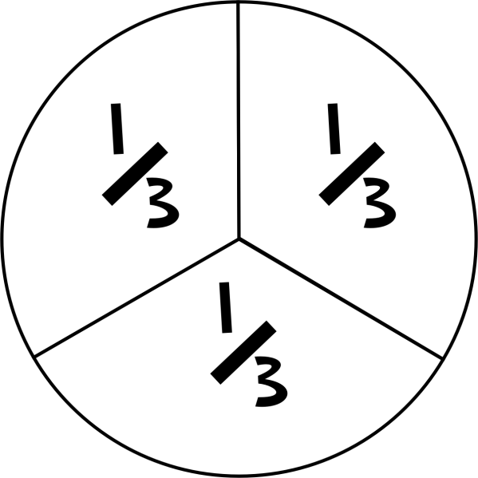
Equal Parts
We talk about a shape divided into Three equal parts as being divided into thirds.
third
third
third

Slide 7
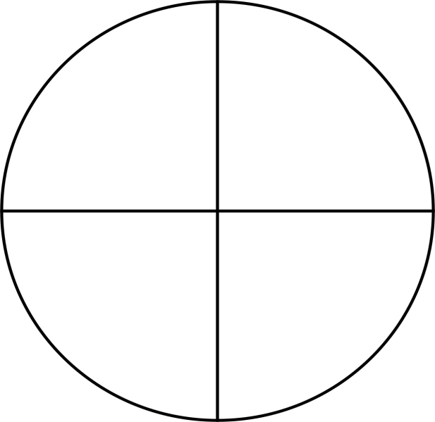
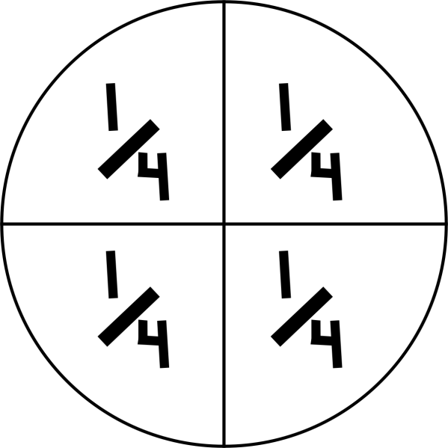
Equal Parts
We talk about a shape divided into four equal parts as being divided into fourths.
fourth
fourth
fourth
fourth

Slide 8
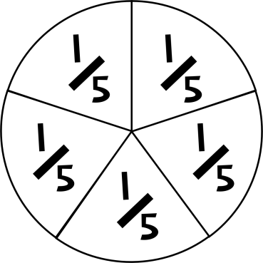
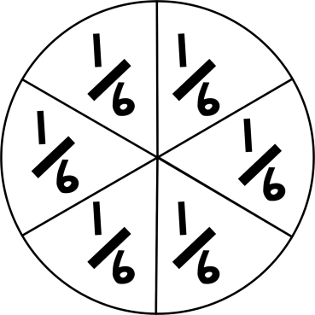
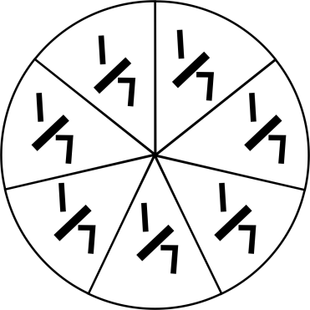
Equal Parts
The rest follow a similar pattern.
fifths
sixths
sevenths
Etc….

Slide 9
Equal Parts
If we put all the fractional parts together we get the whole.
3 parts shaded
=
=
3/3
1 whole

Slide 10
Equal Parts
When thinking about fractions, the whole doesn’t always need to be a shape.
The whole might be a Group of things.
Take a look at the groups of cubes.
Each individual cube is one equal part of the whole group.

Slide 11
Equal Parts
Fractions are the same with Groups.
10/10 of the cubes are GREEN, so the whole group is green.

Slide 12
Fractions on a Number Line
We can also think about fractions as numbers on a number line that are in between the whole numbers (1, 2, 3…).
0
1
2

Slide 13
Fractions on a Number Line
When using a number line we think of the space between two numbers as one whole part divided into smaller equal parts.
In this example the space between 1 and 2 is divided into four equal parts so the fractions look like this in between those numbers:
0
1
(4/4)
1
2
3
4
4
4

Slide 14
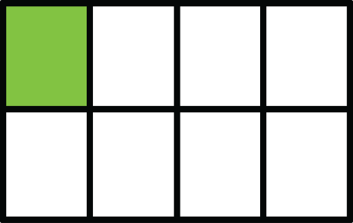
Fractions
When we talk about Fractions we are talking about any number of the equal parts of the whole.
We might only talk about One equal part.
Look at the colored parts of these examples:

Slide 15
Fractions
We also might talk about more than one of the equal parts.
Look at the colored parts of these examples.
Discuss how many equal parts are shaded in each one.

Slide 16
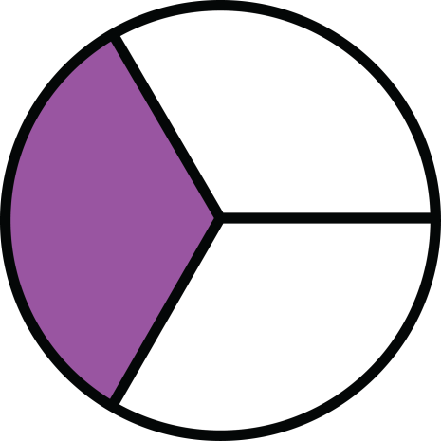
Fractions
When we write the numbers to show a fraction
we put the number of Equal Parts
in the whole on the BOTTOM.
2
=
1
3
3 equal parts

Slide 17
Fractions
The bottom number is called the denominator.
Denominator

Slide 18
Fractions
We put the Number of parts
that we are wanting to Represent on the TOP.
2
1
=
3
1 part shaded

Slide 19
Fractions
The top number is called the numerator.
Numerator

Slide 20
Fraction Practice
Let’s practice by looking at some pictures and naming the fraction they represent.
What would be the Fraction for this shape?

Slide 21
Fraction Practice
The fraction would be 1/4 because One part is shaded
out of Four equal parts.

Slide 22
Fraction Practice
Here is another one.
What would be the Fraction for this shape?

Slide 23
Fraction Practice
The fraction would be 2/6 because TWo parts are shaded
out of six equal parts.

Slide 24
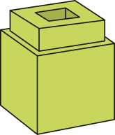
Fraction Practice
Here is another one using a group.
What would be the Fraction of GREEN cubes in this group?

Slide 25
Fraction Practice
The fraction would be 3/7 because Three out of the sEVEN cubes are GREEN.

Slide 26
Fraction Practice
Here is another one using the same group.
What would be the Fraction of PINK cubes in this group?

Slide 27
Fraction Practice
The fraction would be 4/7 because Four out of the sEVEN cubes are PINK.

Slide 28
Fraction Practice
Here is another one using a number line.
What would be the Fractions in between the two numbers?
(Hint: Count how many parts the space is
divided into.)
0
1

Slide 29
Fraction Practice
The space is divided into 8 equal parts.
1
2
3
4
5
6
7
0
1
8
8
8
8
8
8
8
(8/8)

Slide 30
Fraction Practice
Think you’ve got it?
Now practice these with your class.
What would be the Fraction for the shaded parts of this shape?

Slide 31
Fraction Practice
What would be the Fraction for the shaded parts of this shape?

Slide 32
Fraction Practice
What would be the Fraction for the shaded parts of this shape?

Slide 33
Fraction Practice
What would be the Fraction for the GREEN blocks in this group?

Slide 34
Fraction Practice
What would be the Fraction for the PINK blocks in this group?

Slide 35
Fraction Practice
What would be the Fractions in between the two numbers?
0
1

Slide 36
Fraction Practice
What would be the Fractions in between the two numbers?
0
1

