Slide 1
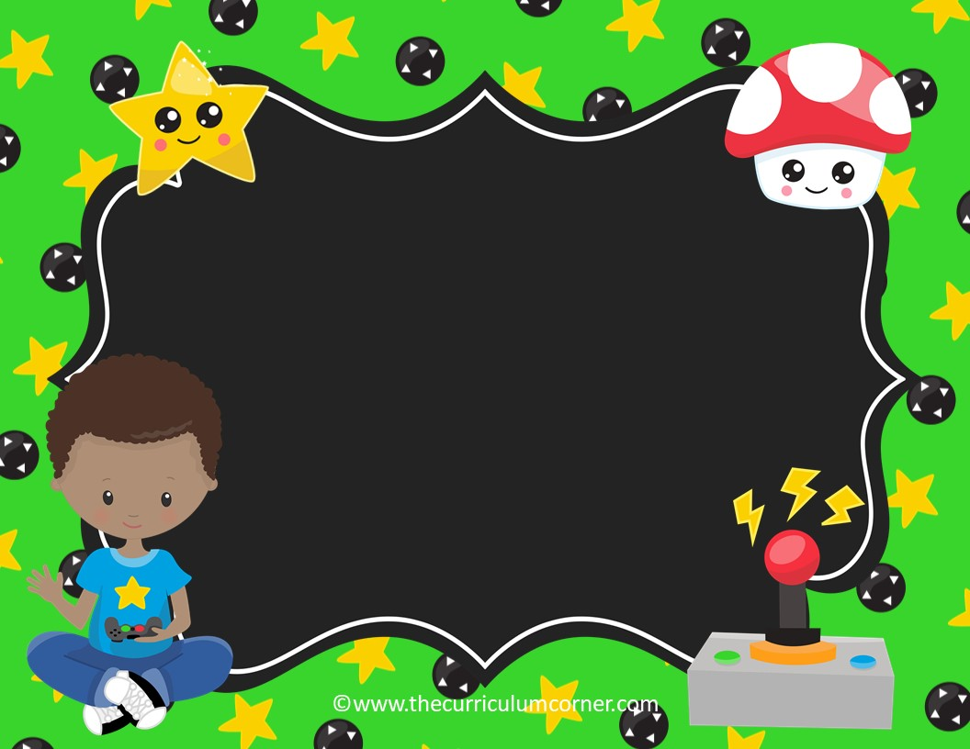
There, Their or They’re
language practice
Click here to Start
The Curriculum Corner

Slide 2
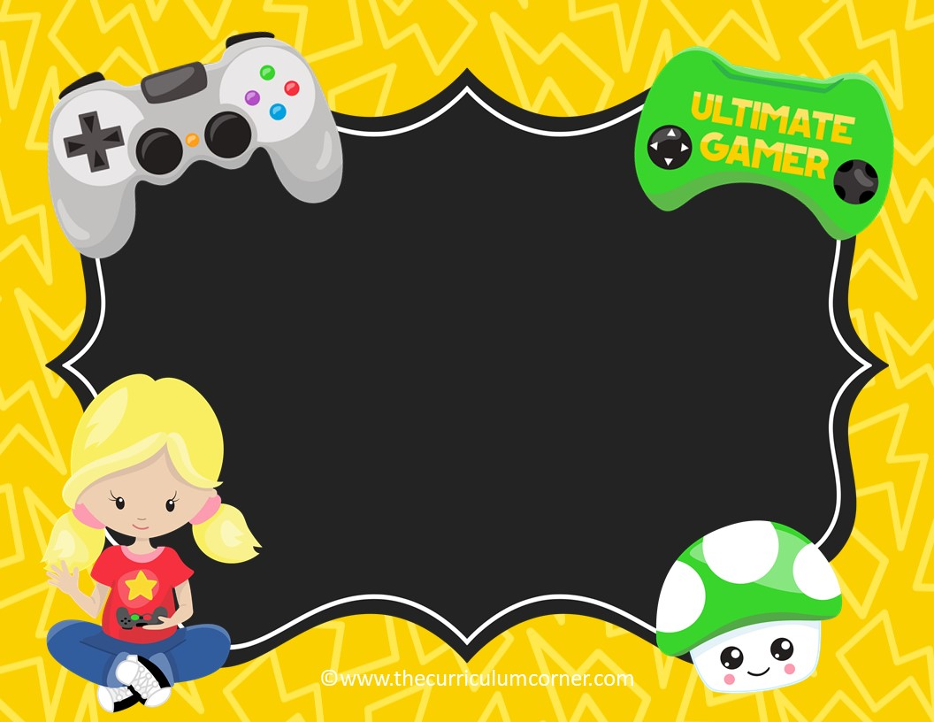
There
There refers to a place.
The game is over there.
Click here to go to the next slide

Slide 3
their
Their means belonging to them.
This is their game.
Click here to go to the next slide

Slide 4
They’re
They’re is the contraction for they are.
They’re coming over to play games.
Click here to go to the next slide

Slide 5

I will go to ________ house to
play video games after school.
there
b. their
c. they’re

Slide 6
Oops!
Click here to try again.

Slide 7
Level Up
Click here to go to the next sentence.

Slide 8
I will go over ________ to play video games after school.
there
b. their
c. they’re

Slide 9
Oops!
Click here to try again.

Slide 10
Level Up
Click here to go to the next sentence.

Slide 11
________ ready for me to come over now.
There
b. Their
c. They’re

Slide 12
Oops!
Click here to try again.

Slide 13
Level Up
Click here to go to the next sentence.

Slide 14
Do you know what game ________ going to play?
there
b. their
c. they’re

Slide 15
Oops!
Click here to try again.

Slide 16
Level Up
Click here to go to the next sentence.

Slide 17
Can you hand me the controller that is sitting over ________?
there
b. their
c. they’re

Slide 18
Oops!
Click here to try again.

Slide 19
Level Up
Click here to go to the next sentence.

Slide 20
Is this ________ game?
there
b. their
c. they’re

Slide 21
Oops!
Click here to try again.

Slide 22
Level Up
Click here to go to the next sentence.

Slide 23
The remote for the TV is over ________.
there
b. their
c. they’re

Slide 24
Oops!
Click here to try again.

Slide 25
Level Up
Click here to go to the next sentence.

Slide 26
________ playing video games this weekend.
There
b. Their
c. They’re

Slide 27
Oops!
Click here to try again.

Slide 28
Level Up
Click here to go to the next sentence.

Slide 29
I like playing games ________.
there
b. their
c. they’re

Slide 30
Oops!
Click here to try again.

Slide 31
Level Up
Click here to go to the next sentence.

Slide 32
My friends are playing ________ favorite game.
there
b. their
c. they’re

Slide 33
Oops!
Click here to try again.

Slide 34
Level Up
Click here to go to the next sentence.

Slide 35
I don’t know how to get my character ________.
there
b. their
c. they’re

Slide 36
Oops!
Click here to try again.

Slide 37
Level Up
Click here to go to the next sentence.

Slide 38
________ the best team in the gaming league.
There
b. Their
c. They’re

Slide 39
Oops!
Click here to try again.

Slide 40
Level Up
Click here to go to the next sentence.

Slide 41
I will go to ________ house to practice for the tournament.
There
b. Their
c. They’re

Slide 42
Oops!
Click here to try again.

Slide 43
Level Up
Click here to go to the next sentence.

Slide 44
________ going to raise money for a new game.
There
b. Their
c. They’re

Slide 45
Oops!
Click here to try again.

Slide 46
Level Up
Click here to go to the next sentence.

Slide 47
Do you know where ________ going to play video games after school?
There
b. Their
c. They’re

Slide 48
Oops!
Click here to try again.

Slide 49
Level Up
Click here to go to the next sentence.

Slide 50
I can’t remember where I saw the controller when I was over ________.
there
b. their
c. they’re

Slide 51
Oops!
Click here to try again.

Slide 52
Level Up
Click here to go to the next sentence.

Slide 53
How do I get ________ in the game?
there
b. their
c. they’re

Slide 54
Oops!
Click here to try again.

Slide 55
Level Up
Click here to go to the next sentence.

Slide 56
I think that is ________ favorite game to play.
there
b. their
c. they’re

Slide 57
Oops!
Click here to try again.

Slide 58
Level Up
Click here to go to the next sentence.

Slide 59
How can I get over ________ to get the stars?
there
b. their
c. they’re

Slide 60
Oops!
Click here to try again.

Slide 61
Level Up
Click here to go to the next sentence.

Slide 62
Do you know how ________ going to get to the next level?
there
b. their
c. they’re

Slide 63
Oops!
Click here to try again.

Slide 64
Level Up
Click here to go to the next sentence.

Slide 65
I think I left my game at ________ house.
there
b. their
c. they’re

Slide 66
Oops!
Click here to try again.

Slide 67
Level Up
Click here to go to the next sentence.

Slide 68
My friend left her controller over ________.
there
b. their
c. they’re

Slide 69
Oops!
Click here to try again.

Slide 70
Level Up
Click here to go back to the beginning.

