Slide 1
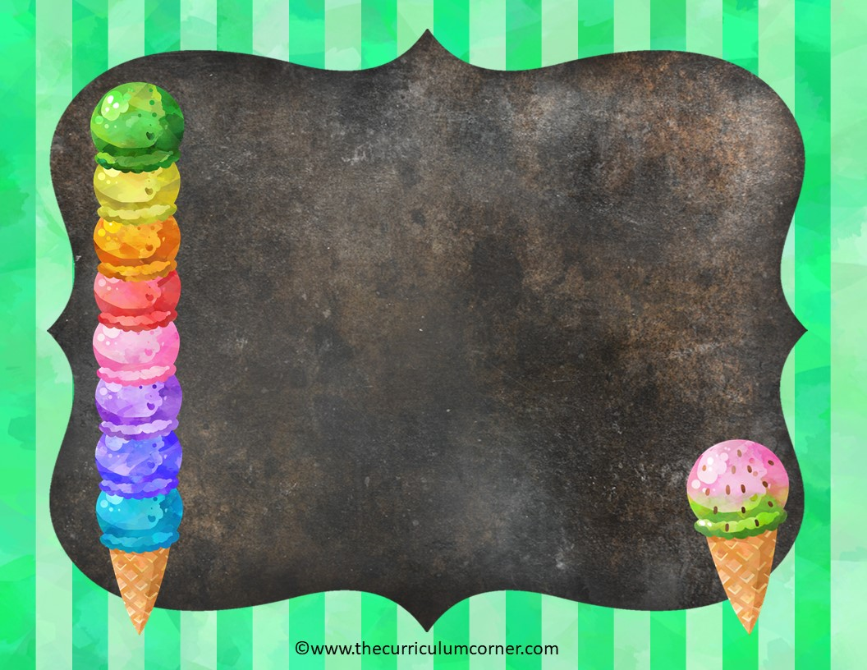
To, Too or Two
language practice
Click here to Start
The Curriculum Corner

Slide 2
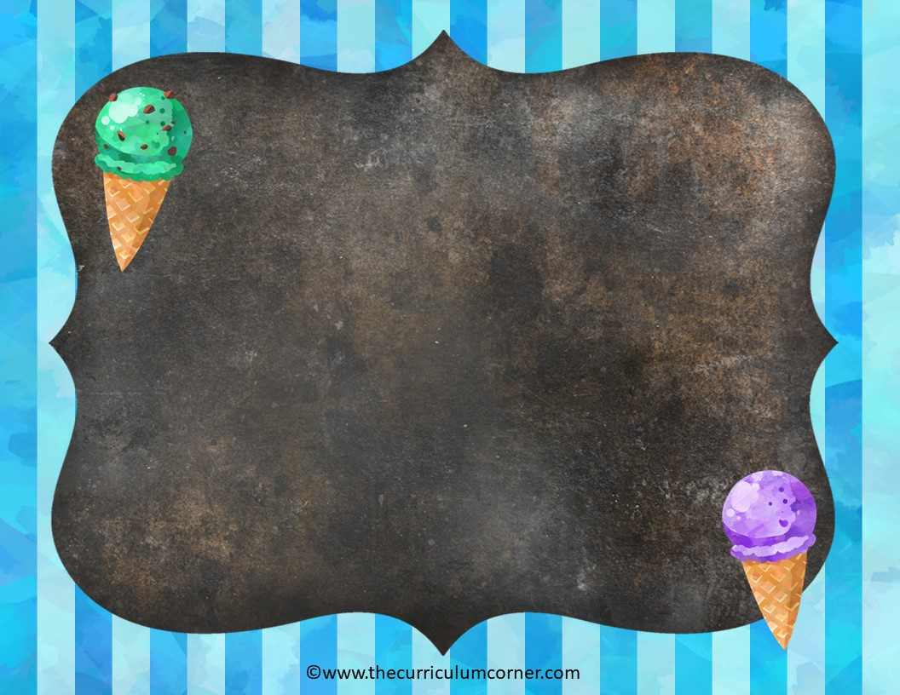
to
To shows a direction or a person receiving something.
I will walk to the library.
I will give this book to her.
Click here to go to the next slide

Slide 3
too
Too means in addition to or also.
I would like to try that book too.
I have too many books.
Click here to go to the next slide

Slide 4
two
Two is a number.
I will read two books.
Click here to go to the next slide

Slide 5
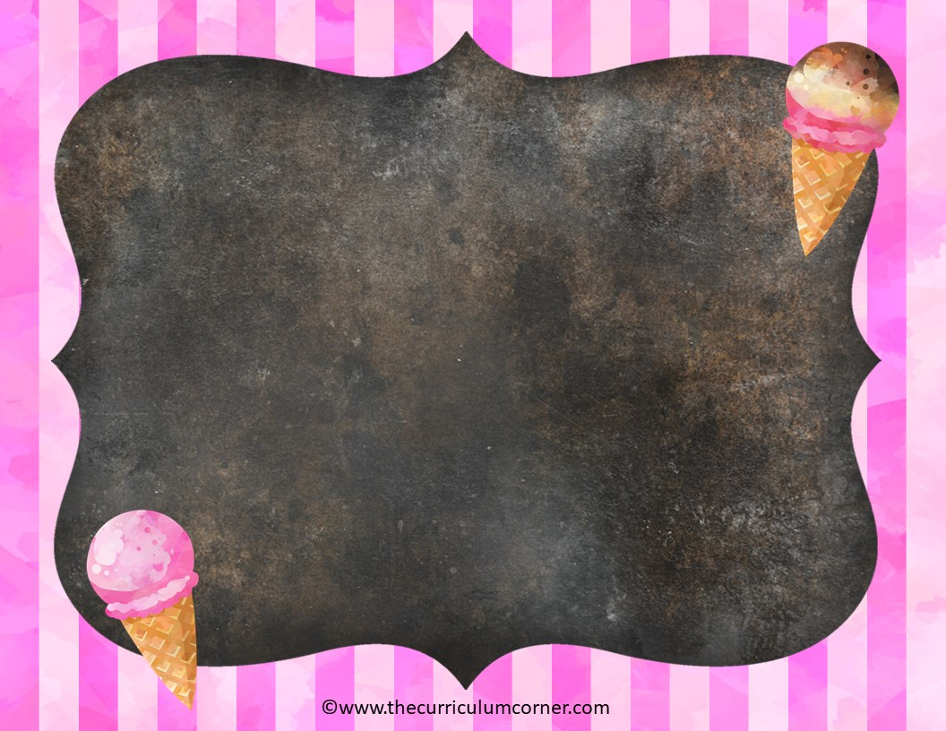
I think I had ________ much ice cream.
to
b. too
c. two

Slide 6
Oops!
Click here to try again.

Slide 7
Very cool!
Click here to go to the next sentence.

Slide 8
I will go ________ the ice cream store after school.
to
b. too
c. two

Slide 9
Oops!
Click here to try again.

Slide 10
Very cool!
Click here to go to the next sentence.

Slide 11
Can I have ________ scoops of ice cream?
to
b. too
c. two

Slide 12
Oops!
Click here to try again.

Slide 13
Very cool!
Click here to go to the next sentence.

Slide 14
I would like ________ toppings on my ice cream.
to
b. too
c. two

Slide 15
Oops!
Click here to try again.

Slide 16
Very cool!
Click here to go to the next sentence.

Slide 17
Would you like ________ come with me?
to
b. too
c. two

Slide 18
Oops!
Click here to try again.

Slide 19
Very cool!
Click here to go to the next sentence.

Slide 20
There is ________ much ice cream for me to eat it all.
to
b. too
c. two

Slide 21
Oops!
Click here to try again.

Slide 22
Very cool!
Click here to go to the next sentence.

Slide 23
I would like ________ help you scoop the ice cream.
to
b. too
c. two

Slide 24
Oops!
Click here to try again.

Slide 25
Very cool!
Click here to go to the next sentence.

Slide 26
I am going to ask ________ friends to come with me.
to
b. too
c. two

Slide 27
Oops!
Click here to try again.

Slide 28
Very cool!
Click here to go to the next sentence.

Slide 29
I like ________ order ice cream in a bowl.
to
b. too
c. two

Slide 30
Oops!
Click here to try again.

Slide 31
Very cool!
Click here to go to the next sentence.

Slide 32
Oops! I think I put ________ many sprinkles on my ice cream.
to
b. too
c. two

Slide 33
Oops!
Click here to try again.

Slide 34
Very cool!
Click here to go to the next sentence.

Slide 35
Do you know how ________ get to the ice cream shop?
to
b. too
c. two

Slide 36
Oops!
Click here to try again.

Slide 37
Very cool!
Click here to go to the next sentence.

Slide 38
Can I get ________ flavors of ice cream?
to
b. too
c. two

Slide 39
Oops!
Click here to try again.

Slide 40
Very cool!
Click here to go to the next sentence.

Slide 41
Can my friend come ________?
to
b. too
c. two

Slide 42
Oops!
Click here to try again.

Slide 43
Very cool!
Click here to go to the next sentence.

Slide 44
I found ________ chairs for the table.
to
b. too
c. two

Slide 45
Oops!
Click here to try again.

Slide 46
Very cool!
Click here to go to the next sentence.

Slide 47
There are ________ people working at the store.
to
b. too
c. two

Slide 48
Oops!
Click here to try again.

Slide 49
Very cool!
Click here to go to the next sentence.

Slide 50
I will ask the worker ________ order more chocolate ice cream.
to
b. too
c. two

Slide 51
Oops!
Click here to try again.

Slide 52
Very cool!
Click here to go to the next sentence.

Slide 53
How do I get ________ the ice cream shop?
to
b. too
c. two

Slide 54
Oops!
Click here to try again.

Slide 55
Very cool!
Click here to go to the next sentence.

Slide 56
The ice cream shop is ________ busy right now.
to
b. too
c. two

Slide 57
Oops!
Click here to try again.

Slide 58
Very cool!
Click here to go to the next sentence.

Slide 59
I would like ________ try a new flavor of ice cream.
to
b. too
c. two

Slide 60
Oops!
Click here to try again.

Slide 61
Very cool!
Click here to go to the next sentence.

Slide 62
What are your ________ favorite ice cream flavors?
to
b. too
c. two

Slide 63
Oops!
Click here to try again.

Slide 64
Very cool!
Click here to go to the next sentence.

Slide 65
It is ________ hot outside. I need some ice cream to cool off.
to
b. too
c. two

Slide 66
Oops!
Click here to try again.

Slide 67
Very cool!
Click here to go to the next sentence.

Slide 68
Will you go with me ________ the new ice cream shop Saturday?
to
b. too
c. two

Slide 69
Oops!
Click here to try again.

Slide 70
Very cool!
Click here to go back to the beginning.

