Slide 1
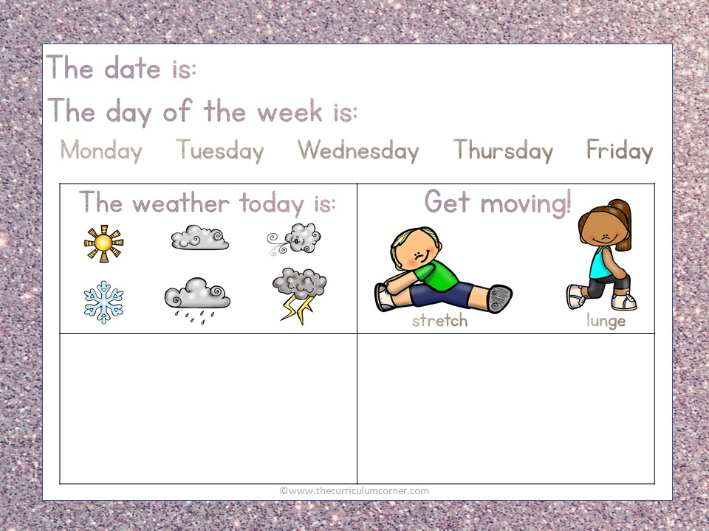
Add text here
Add text here

Slide 2
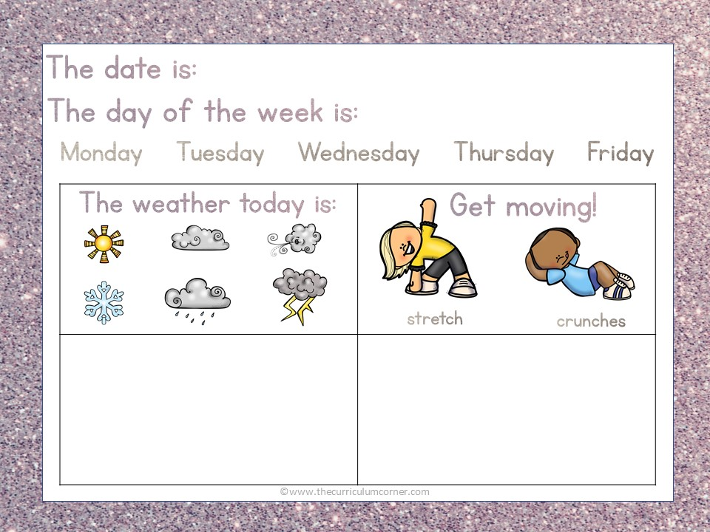
Add text here
Add text here

Slide 3
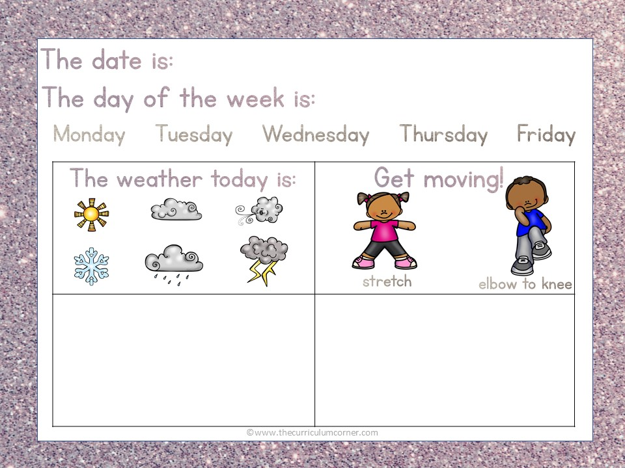
Add text here
Add text here

Slide 4
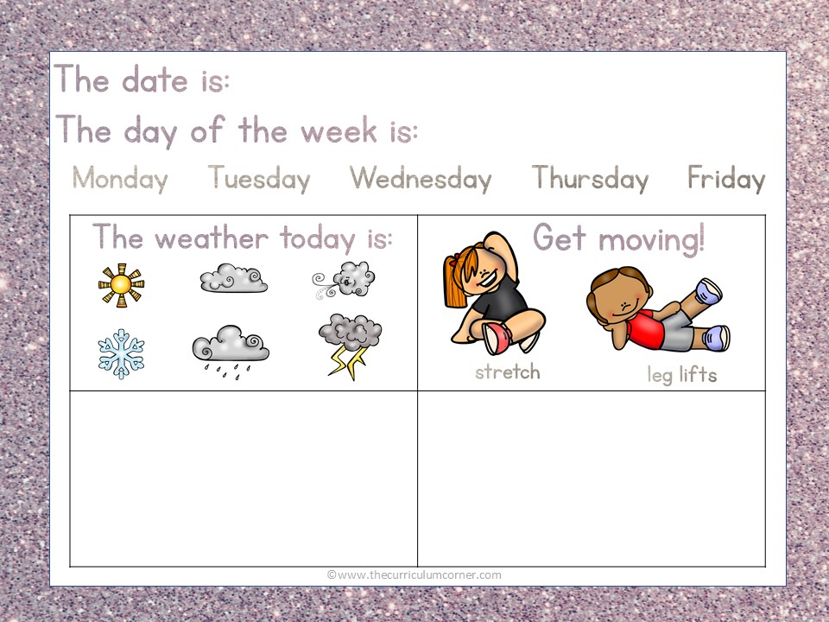
Add text here
Add text here

Slide 5
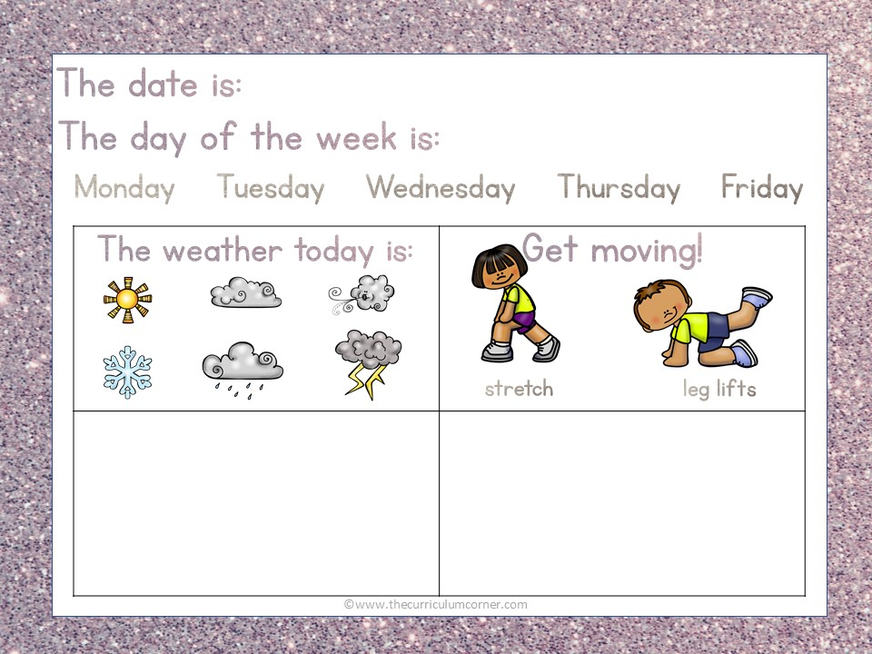
Add text here
Add text here

