Slide 1
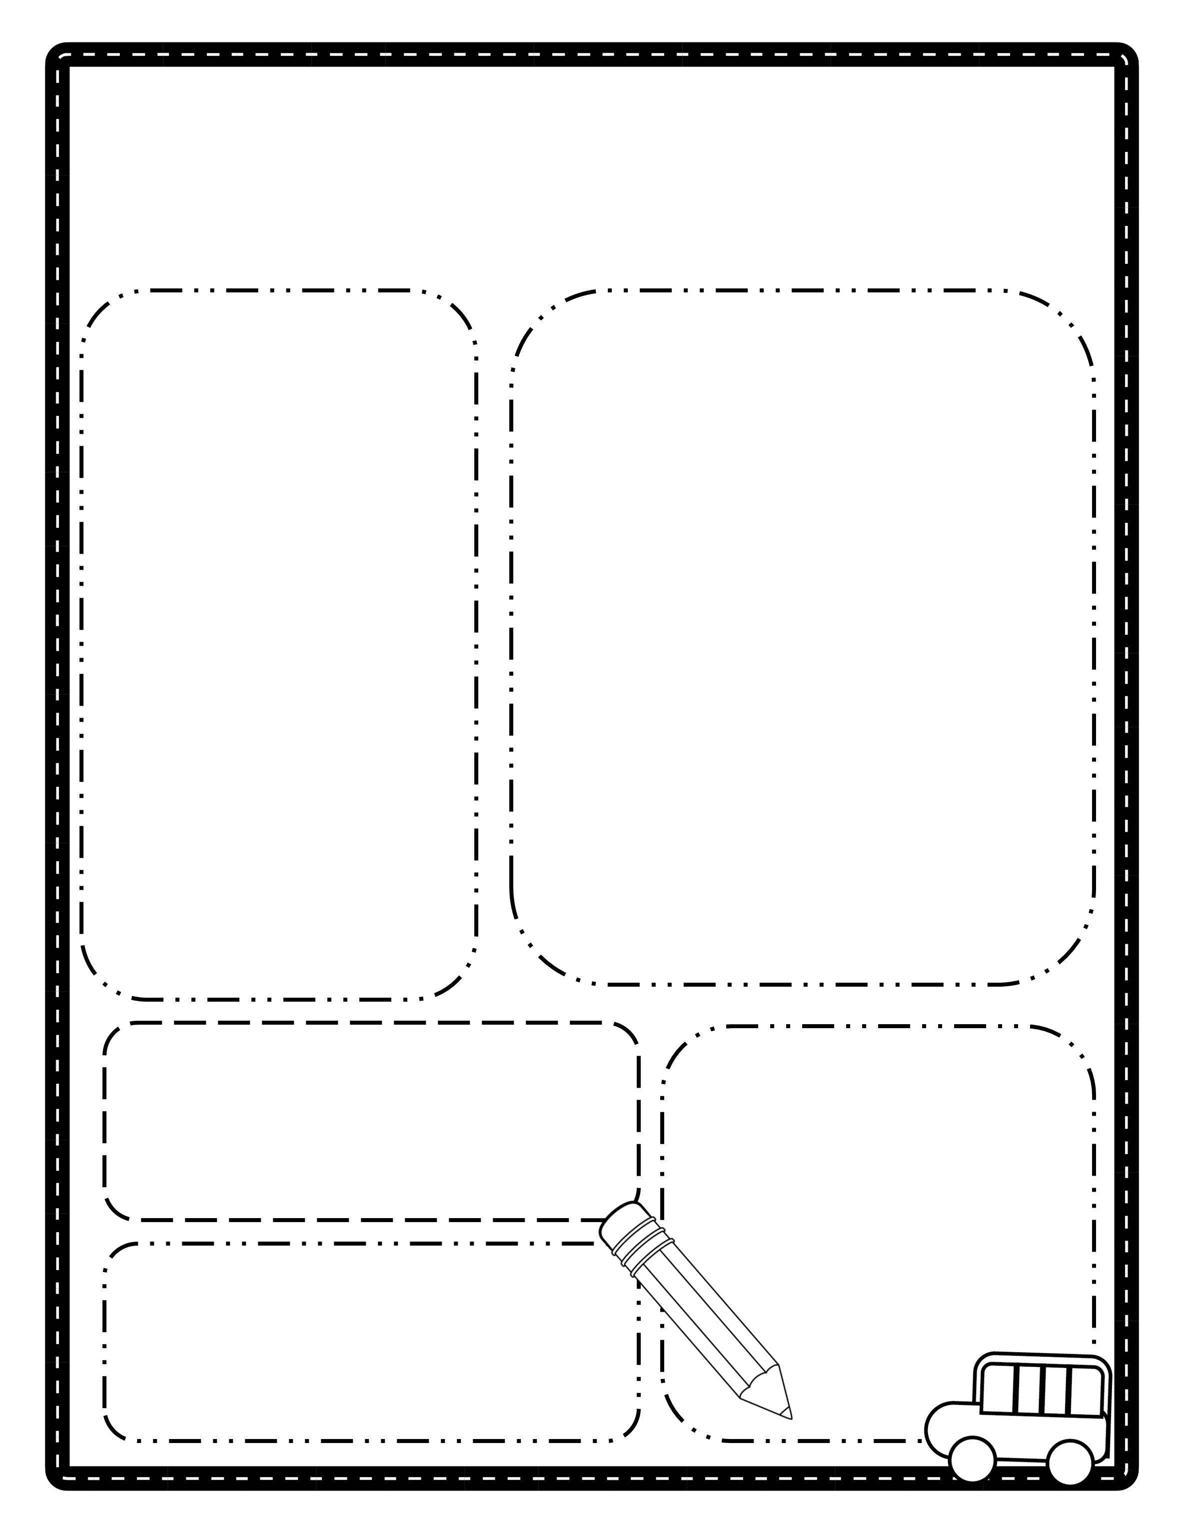
The Henry Herald
Date: August 18, 2017
Fishers Elementary
Room 2A
Coming up on our calendar:
What we are learning this week:
Reading Workshop: We are working on mastering the first 100 Fry words.
Math Workshop: This week will continue to work on number sense. Help enforce these skills by finding numbers in the real world when you are out and about.
Social Studies: We are learning about community helpers. We are looking for community helpers to come speak with our class. Please let me know if you or a family member would like to come in.
Monday: picture day
Tuesday: hat day
Wednesday: p.e. – wear your tennis shoes!
Thursday: early dismissal
Friday: reading log due
We are in need of toothpicks and marshmallows for an upcoming science activity.
Classroom
Requests:
Words of the Week
school
pencil
them
he
they
Don’t Forget!
Picture day is next Tuesday
©www.thecurriculumcorner.com

Slide 2
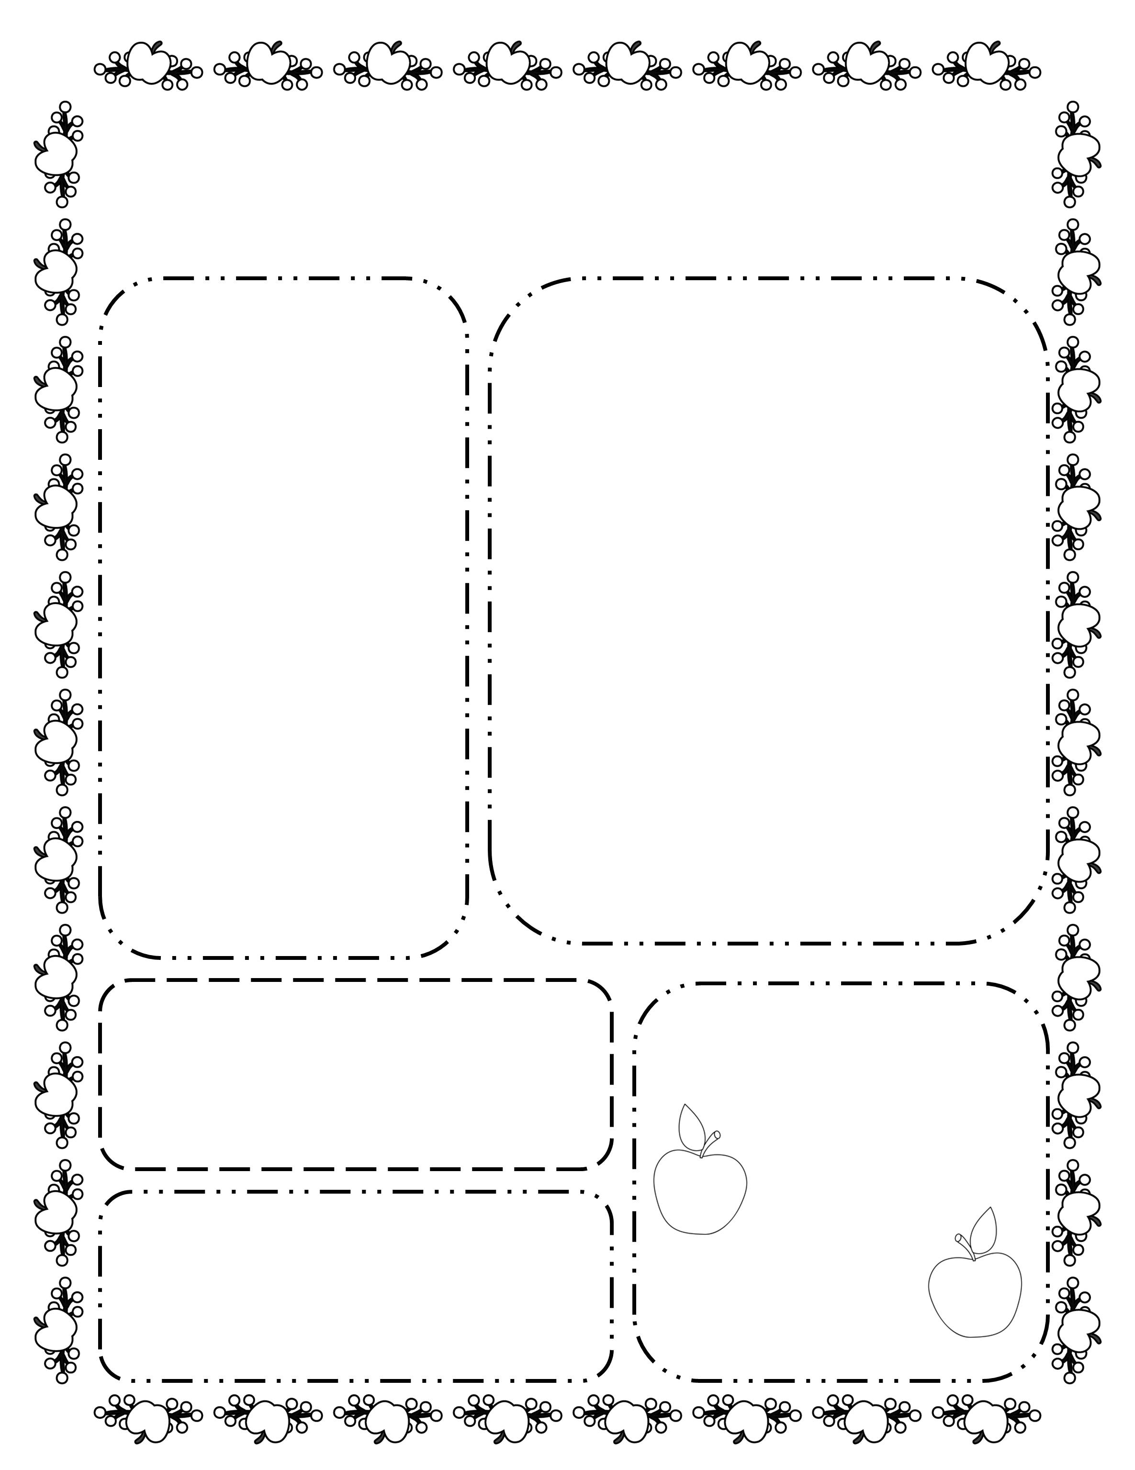
The Henry Herald
Date: September 18, 2017
Fishers Elementary
Room 2A
Coming up on our calendar:
What we are learning this week:
Reading Workshop: We are working on mastering the first 100 Fry words.
Math Workshop: This week will continue to work on number sense. Help enforce these skills by finding numbers in the real world when you are out and about.
Social Studies: We are learning about community helpers. We are looking for community helpers to come speak with our class. Please let me know if you or a family member would like to come in.
Monday: picture day
Tuesday: hat day
Wednesday: p.e. – wear your tennis shoes!
Thursday: early dismissal
Friday: reading log due
We are in need of toothpicks and marshmallows for an upcoming science activity.
Classroom
Requests:
Words of the Week
school
pencil
them
he
they
Don’t Forget!
Picture day is next Tuesday
©www.thecurriculumcorner.com

Slide 3
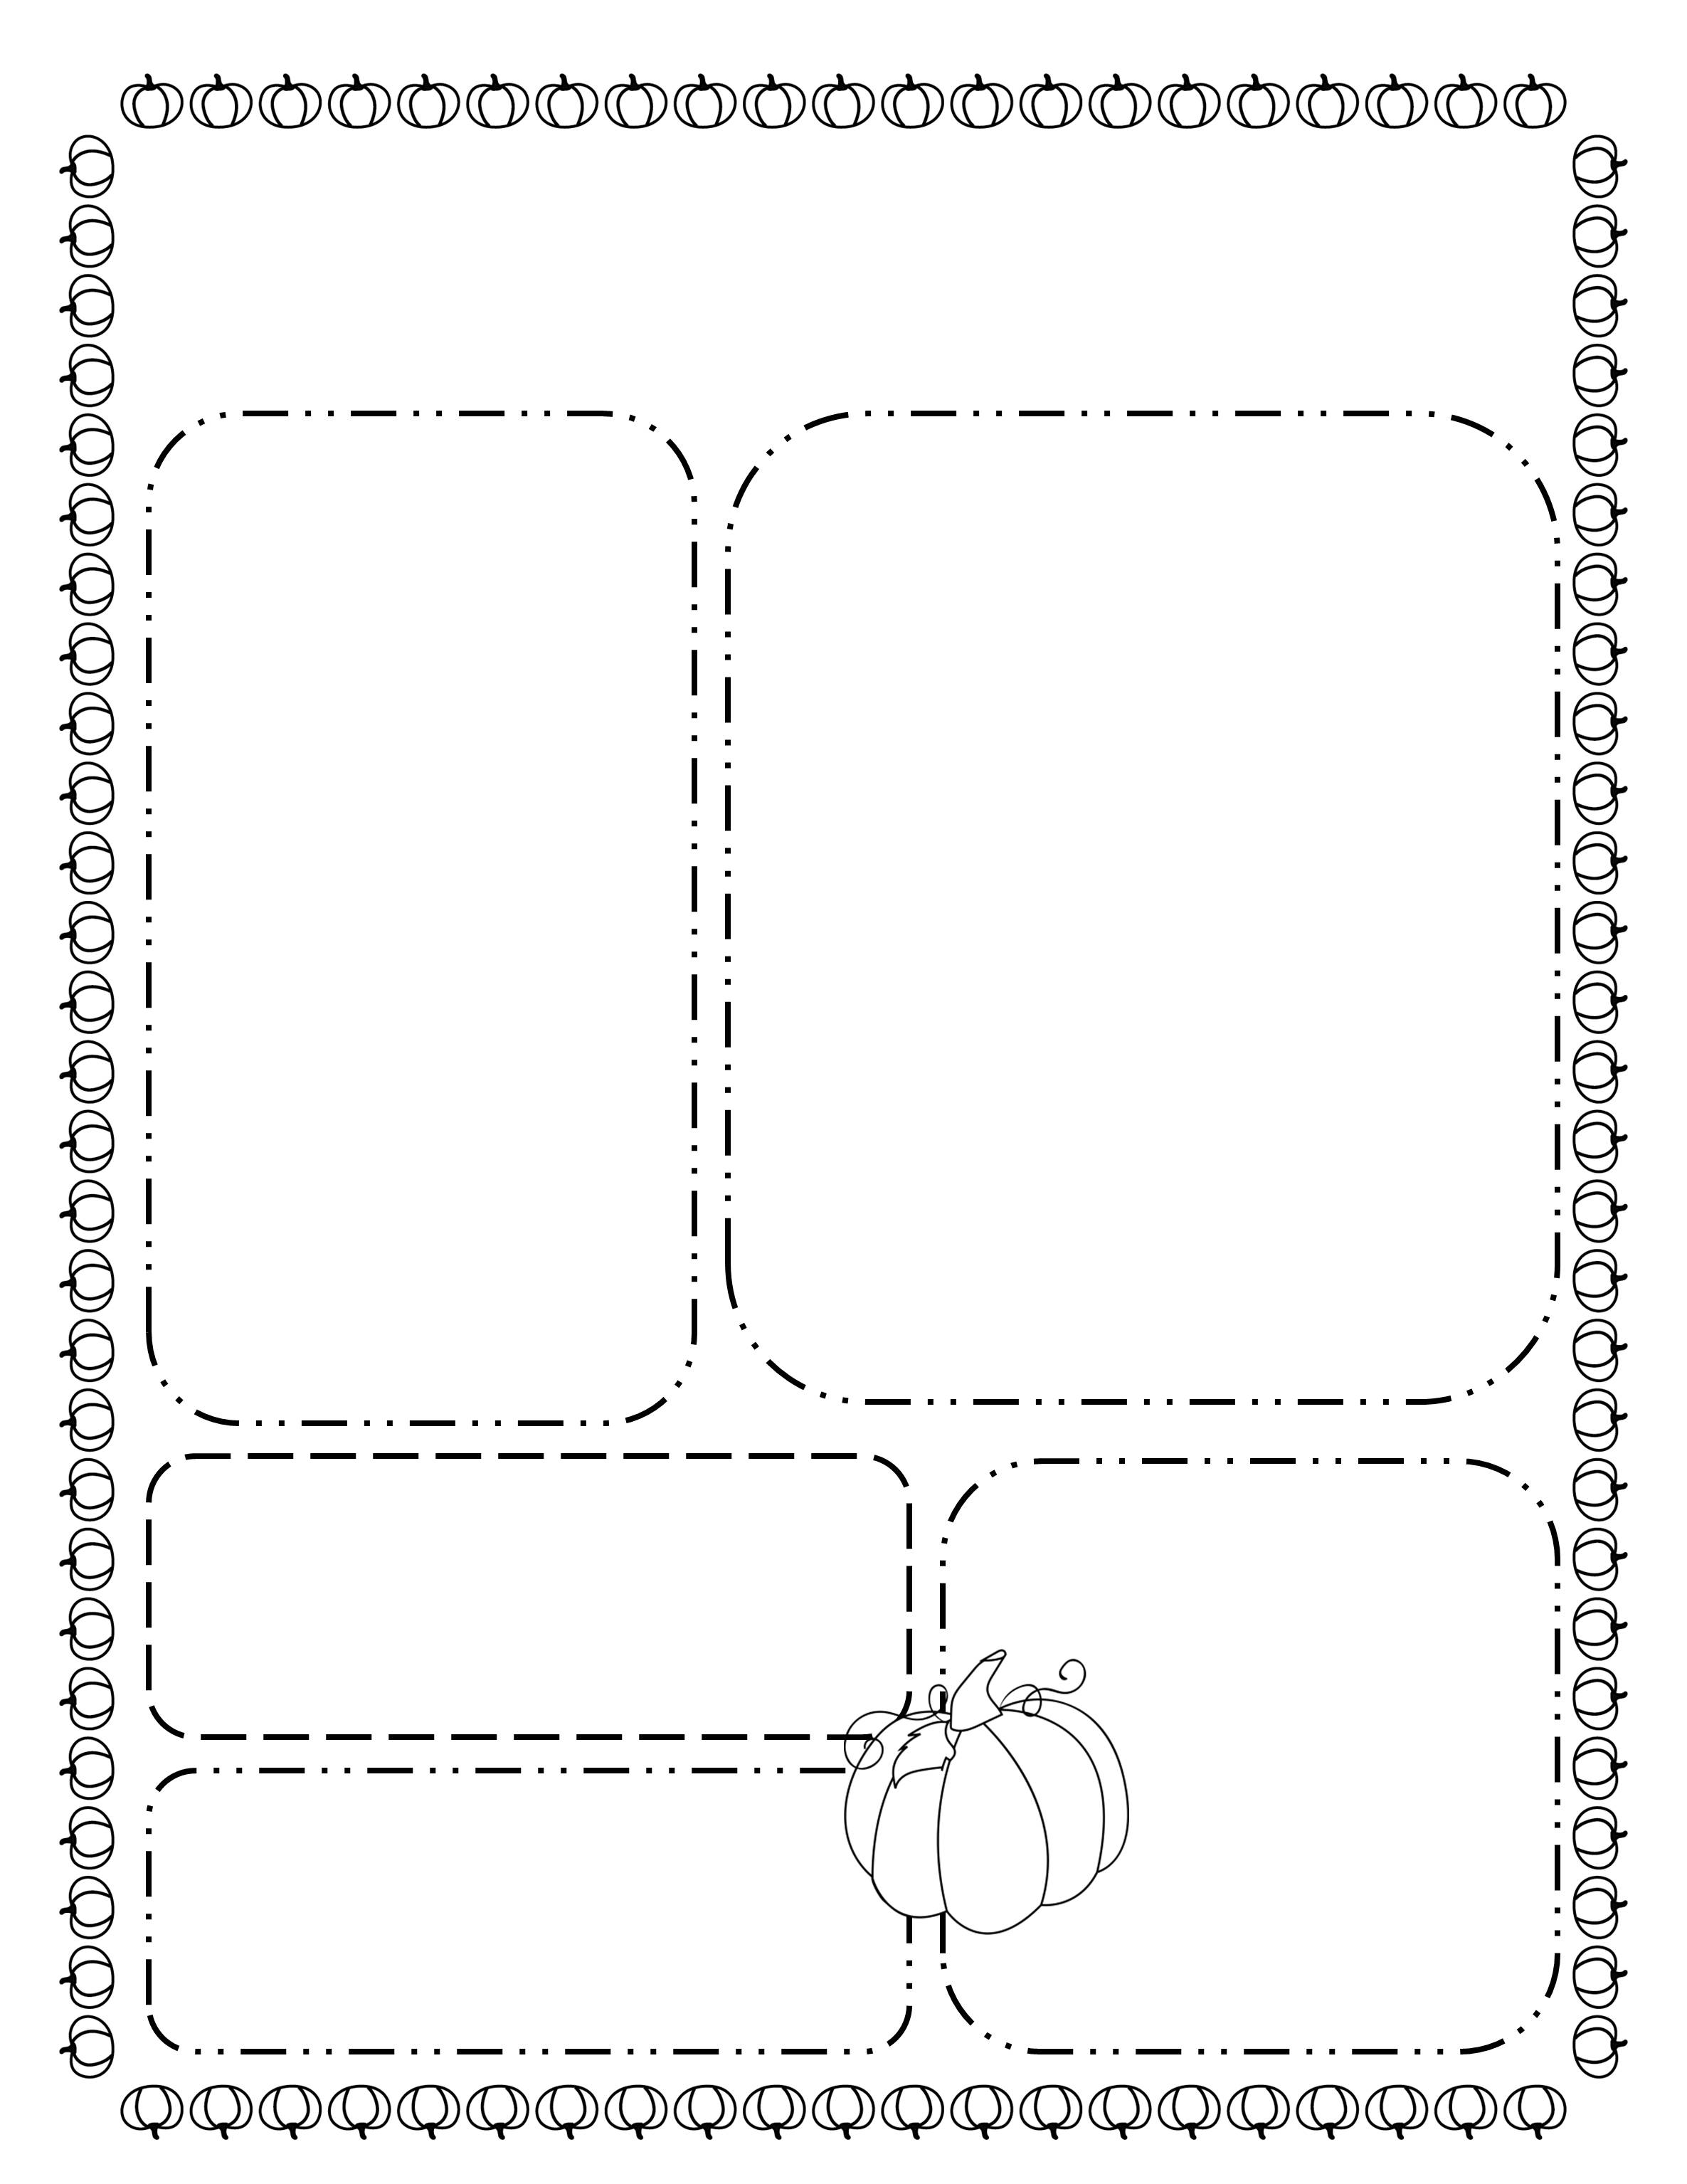
The Henry Herald
Date: October 18, 2017
Fishers Elementary
Room 2A
Coming up on our calendar:
What we are learning this week:
Reading Workshop: We are working on mastering the first 100 Fry words.
Math Workshop: This week will continue to work on number sense. Help enforce these skills by finding numbers in the real world when you are out and about.
Social Studies: We are learning about community helpers. We are looking for community helpers to come speak with our class. Please let me know if you or a family member would like to come in.
Monday: picture day
Tuesday: hat day
Wednesday: p.e. – wear your tennis shoes!
Thursday: early dismissal
Friday: reading log due
We are in need of toothpicks and marshmallows for an upcoming science activity.
Classroom
Requests:
Words of the Week
school
pencil
them
he
they
Don’t Forget!
Picture day is next Tuesday
©www.thecurriculumcorner.com

Slide 4
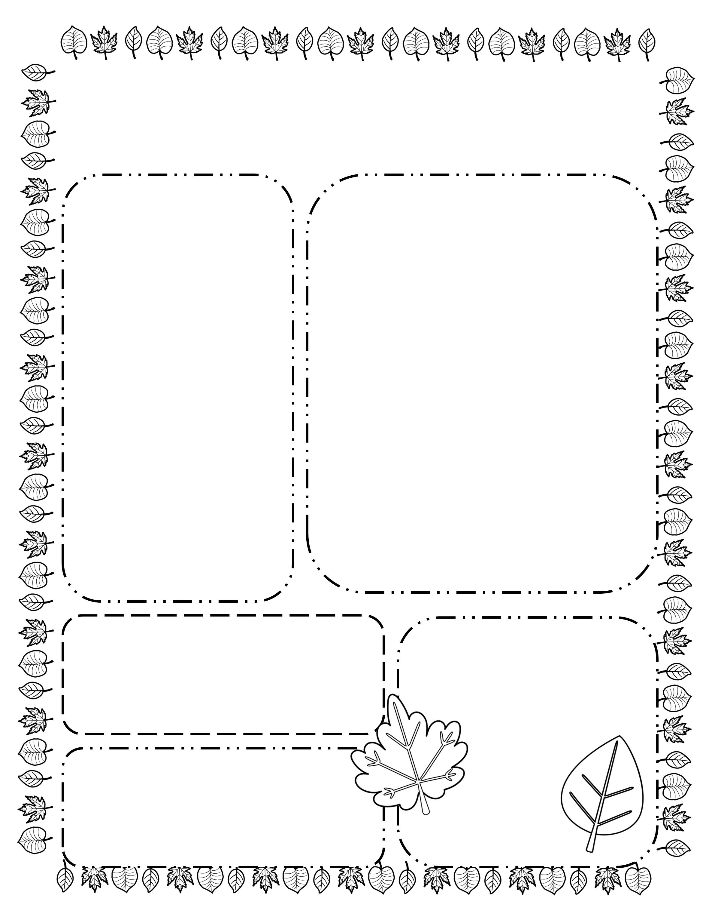
The Henry Herald
Date: November 18, 2017
Fishers Elementary
Room 2A
Coming up on our calendar:
What we are learning this week:
Reading Workshop: We are working on mastering the first 100 Fry words.
Math Workshop: This week will continue to work on number sense. Help enforce these skills by finding numbers in the real world when you are out and about.
Social Studies: We are learning about community helpers. We are looking for community helpers to come speak with our class. Please let me know if you or a family member would like to come in.
Monday: picture day
Tuesday: hat day
Wednesday: p.e. – wear your tennis shoes!
Thursday: early dismissal
Friday: reading log due
We are in need of toothpicks and marshmallows for an upcoming science activity.
Classroom
Requests:
Words of the Week
school
pencil
them
he
they
Don’t Forget!
Picture day is next Tuesday
©www.thecurriculumcorner.com

Slide 5
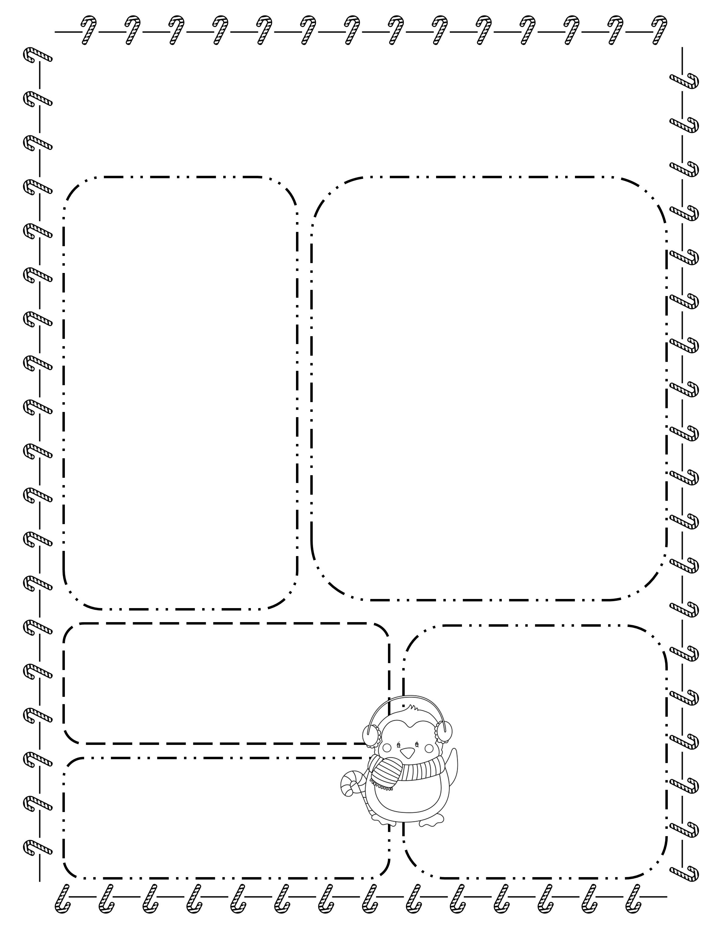
The Henry Herald
Date: December 18, 2017
Fishers Elementary
Room 2A
Coming up on our calendar:
What we are learning this week:
Reading Workshop: We are working on mastering the first 100 Fry words.
Math Workshop: This week will continue to work on number sense. Help enforce these skills by finding numbers in the real world when you are out and about.
Social Studies: We are learning about community helpers. We are looking for community helpers to come speak with our class. Please let me know if you or a family member would like to come in.
Monday: picture day
Tuesday: hat day
Wednesday: p.e. – wear your tennis shoes!
Thursday: early dismissal
Friday: reading log due
We are in need of toothpicks and marshmallows for an upcoming science activity.
Classroom
Requests:
Words of the Week
school
pencil
them
he
they
Don’t Forget!
Picture day is next Tuesday
©www.thecurriculumcorner.com

Slide 6
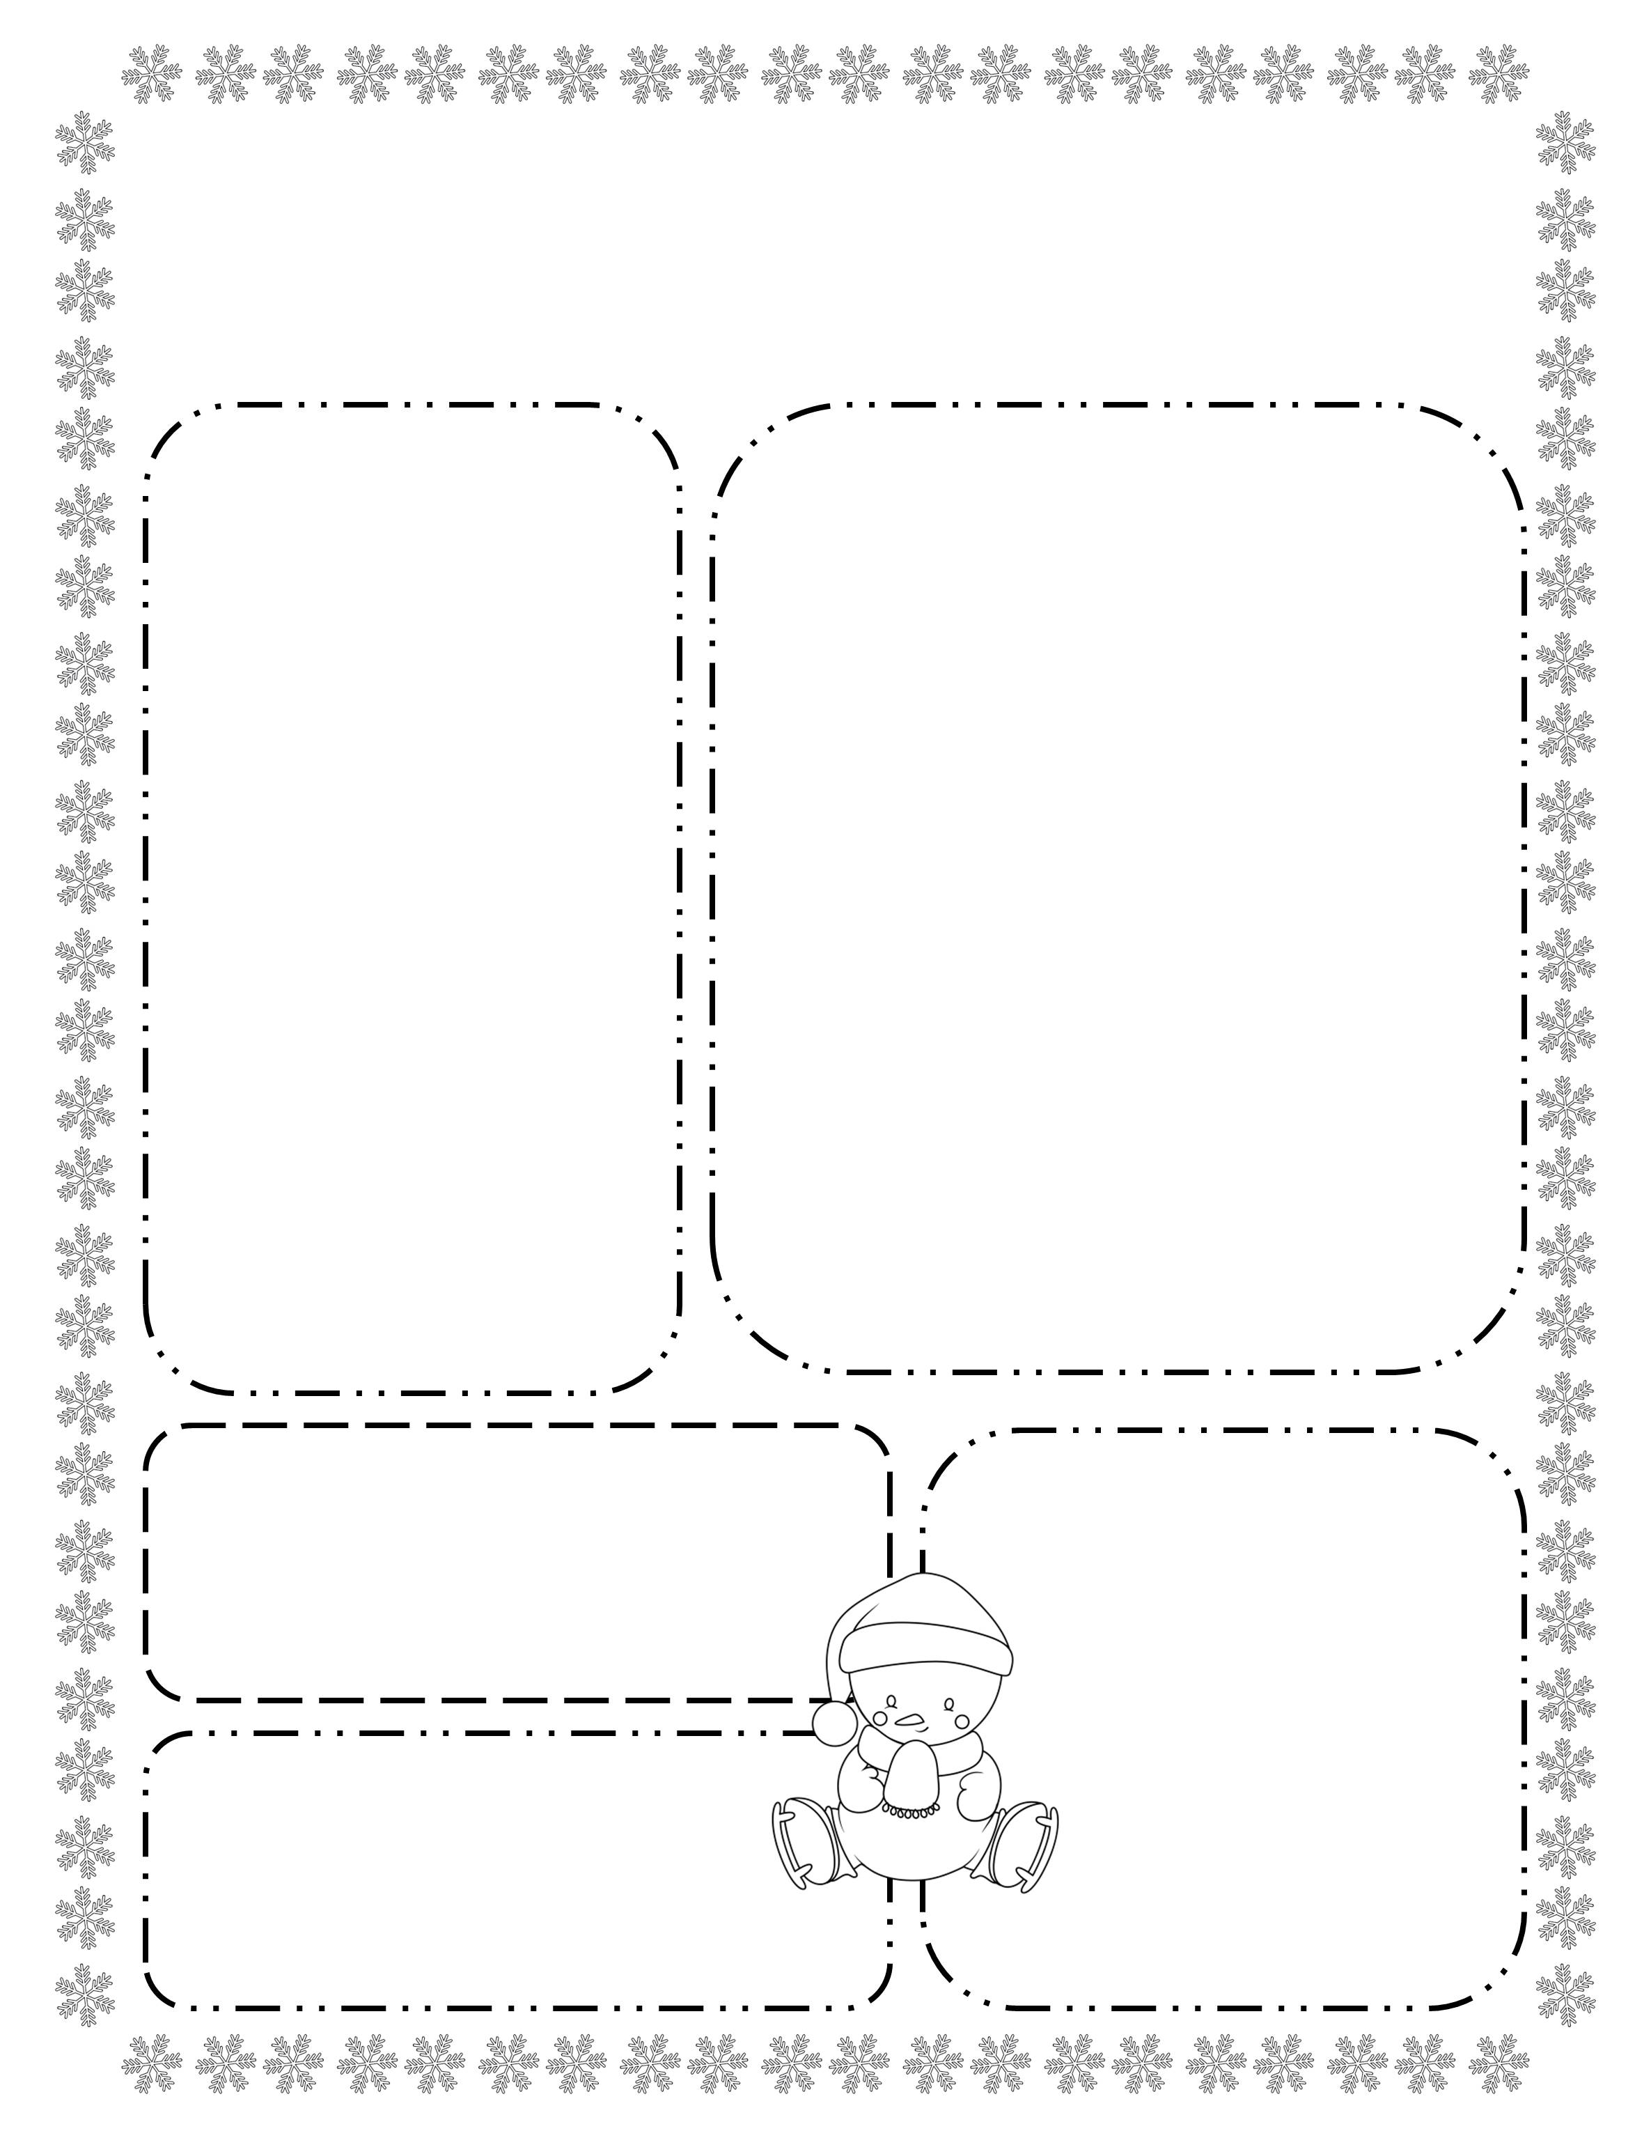
The Henry Herald
Date: January 18, 2017
Fishers Elementary
Room 2A
Coming up on our calendar:
What we are learning this week:
Reading Workshop: We are working on mastering the first 100 Fry words.
Math Workshop: This week will continue to work on number sense. Help enforce these skills by finding numbers in the real world when you are out and about.
Social Studies: We are learning about community helpers. We are looking for community helpers to come speak with our class. Please let me know if you or a family member would like to come in.
Monday: picture day
Tuesday: hat day
Wednesday: p.e. – wear your tennis shoes!
Thursday: early dismissal
Friday: reading log due
We are in need of toothpicks and marshmallows for an upcoming science activity.
Classroom
Requests:
Words of the Week
school
pencil
them
he
they
Don’t Forget!
Picture day is next Tuesday
©www.thecurriculumcorner.com

Slide 7
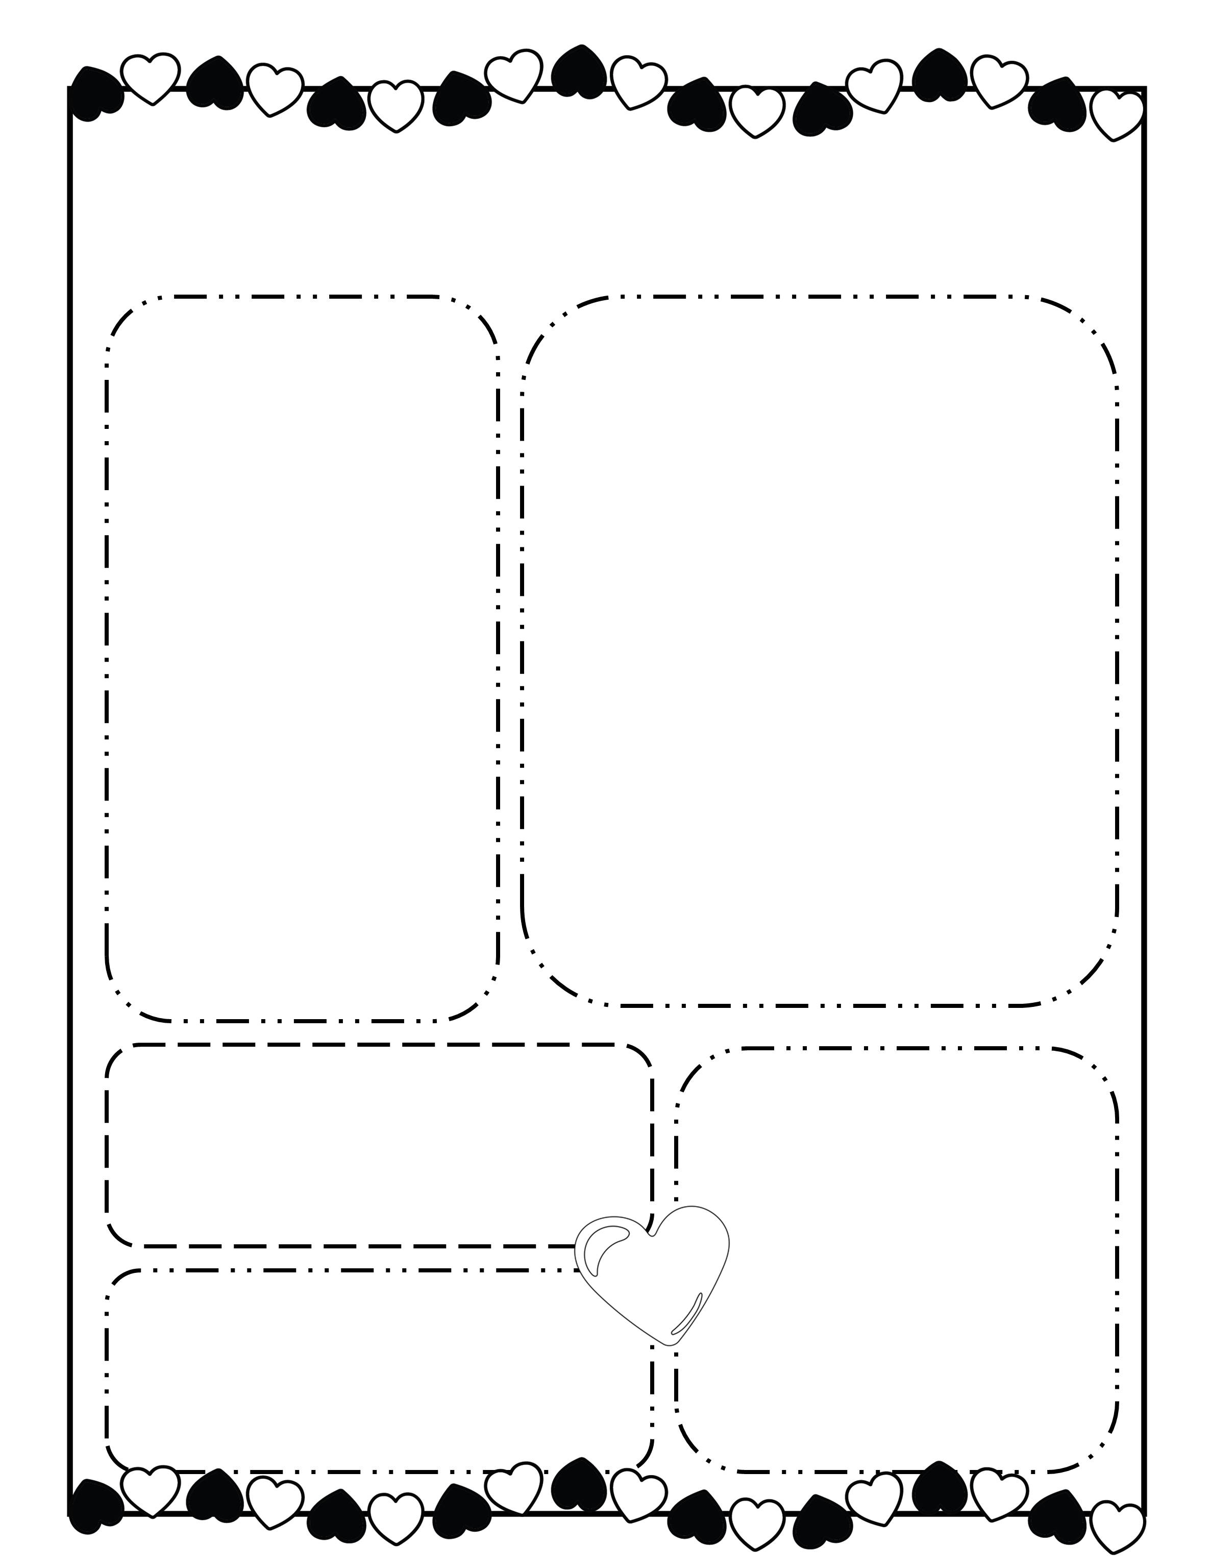
The Henry Herald
Date: February 18, 2017
Fishers Elementary
Room 2A
Coming up on our calendar:
What we are learning this week:
Reading Workshop: We are working on mastering the first 100 Fry words.
Math Workshop: This week will continue to work on number sense. Help enforce these skills by finding numbers in the real world when you are out and about.
Social Studies: We are learning about community helpers. We are looking for community helpers to come speak with our class. Please let me know if you or a family member would like to come in.
Monday: picture day
Tuesday: hat day
Wednesday: p.e. – wear your tennis shoes!
Thursday: early dismissal
Friday: reading log due
We are in need of toothpicks and marshmallows for an upcoming science activity.
Classroom
Requests:
Words of the Week
school
pencil
them
he
they
Don’t Forget!
Picture day is next Tuesday
©www.thecurriculumcorner.com

Slide 8
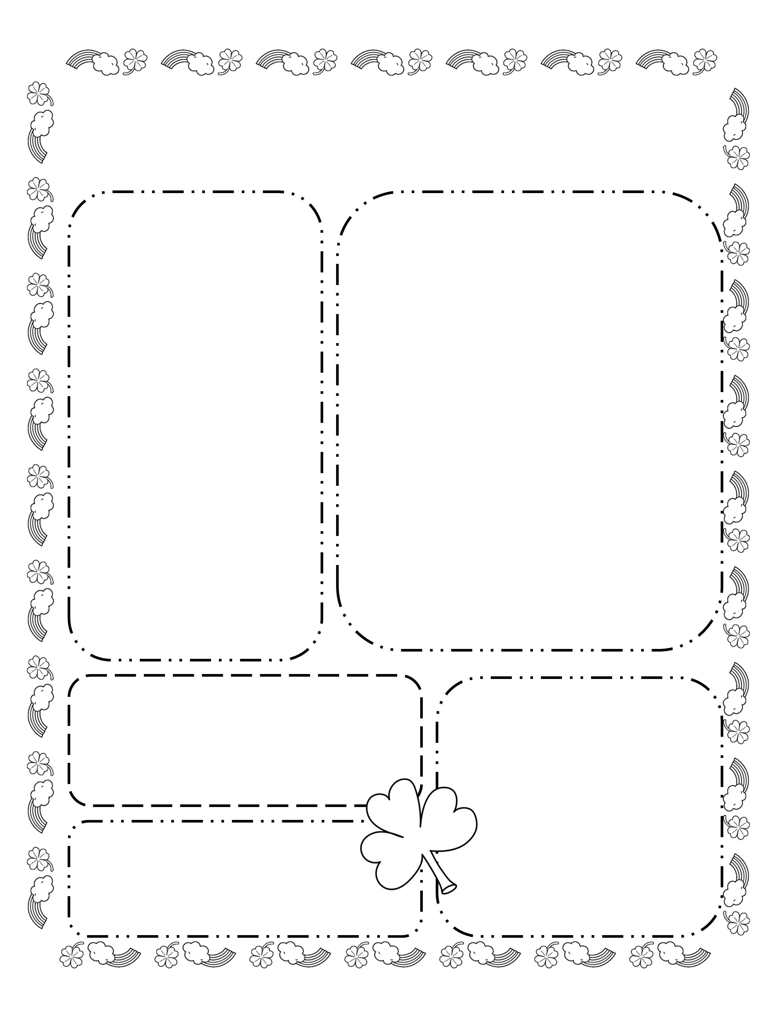
The Henry Herald
Date: March 18, 2017
Fishers Elementary
Room 2A
Coming up on our calendar:
What we are learning this week:
Reading Workshop: We are working on mastering the first 100 Fry words.
Math Workshop: This week will continue to work on number sense. Help enforce these skills by finding numbers in the real world when you are out and about.
Social Studies: We are learning about community helpers. We are looking for community helpers to come speak with our class. Please let me know if you or a family member would like to come in.
Monday: picture day
Tuesday: hat day
Wednesday: p.e. – wear your tennis shoes!
Thursday: early dismissal
Friday: reading log due
We are in need of toothpicks and marshmallows for an upcoming science activity.
Classroom
Requests:
Words of the Week
school
pencil
them
he
they
Don’t Forget!
Picture day is next Tuesday
©www.thecurriculumcorner.com

Slide 9
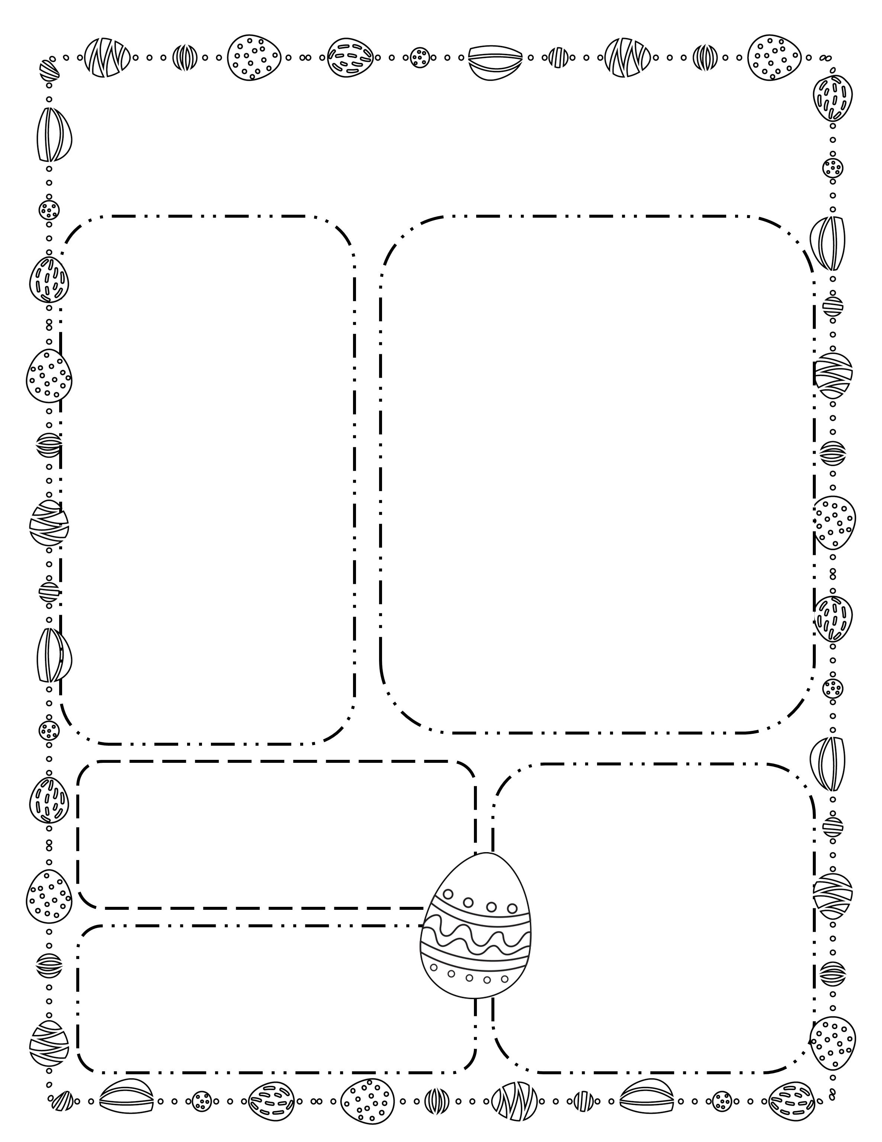
The Henry Herald
Date: April 18, 2017
Fishers Elementary
Room 2A
Coming up on our calendar:
What we are learning this week:
Reading Workshop: We are working on mastering the first 100 Fry words.
Math Workshop: This week will continue to work on number sense. Help enforce these skills by finding numbers in the real world when you are out and about.
Social Studies: We are learning about community helpers. We are looking for community helpers to come speak with our class. Please let me know if you or a family member would like to come in.
Monday: picture day
Tuesday: hat day
Wednesday: p.e. – wear your tennis shoes!
Thursday: early dismissal
Friday: reading log due
We are in need of toothpicks and marshmallows for an upcoming science activity.
Classroom
Requests:
Words of the Week
school
pencil
them
he
they
Don’t Forget!
Picture day is next Tuesday

Slide 10
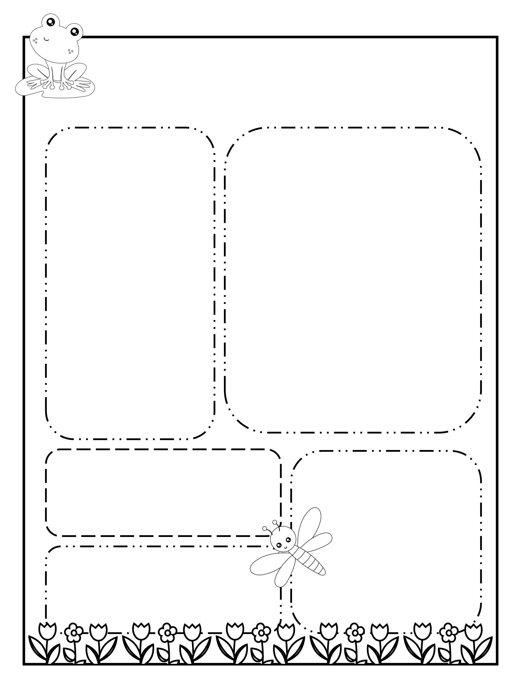
The Henry Herald
Date: May 18, 2017
Fishers Elementary
Room 2A
Coming up on our calendar:
What we are learning this week:
Reading Workshop: We are working on mastering the first 100 Fry words.
Math Workshop: This week will continue to work on number sense. Help enforce these skills by finding numbers in the real world when you are out and about.
Social Studies: We are learning about community helpers. We are looking for community helpers to come speak with our class. Please let me know if you or a family member would like to come in.
Monday: picture day
Tuesday: hat day
Wednesday: p.e. – wear your tennis shoes!
Thursday: early dismissal
Friday: reading log due
We are in need of toothpicks and marshmallows for an upcoming science activity.
Classroom
Requests:
Words of the Week
school
pencil
them
he
they
Don’t Forget!
Picture day is next Tuesday
©www.thecurriculumcorner.com

Slide 11
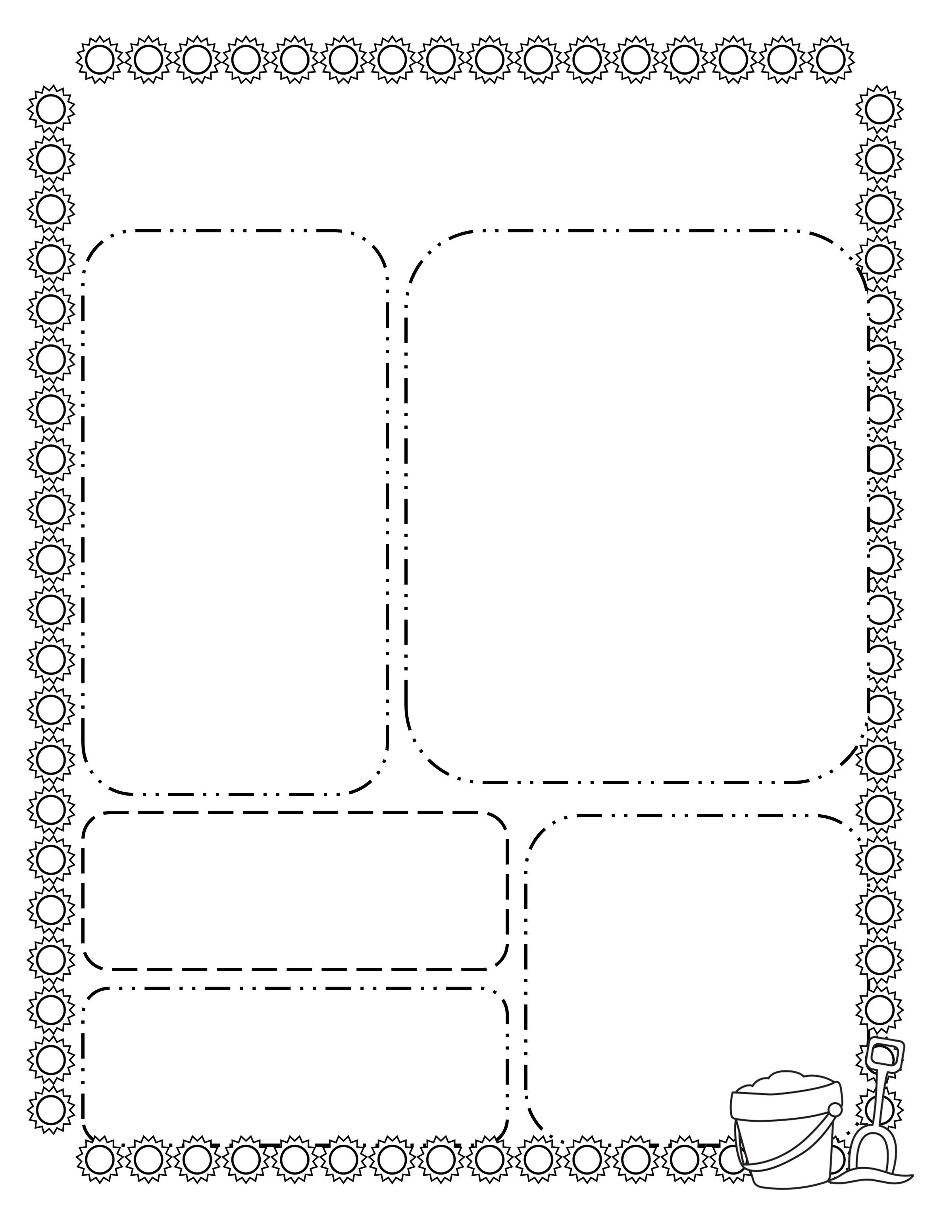
The Henry Herald
Date: June 18, 2017
Fishers Elementary
Room 2A
Coming up on our calendar:
What we are learning this week:
Reading Workshop: We are working on mastering the first 100 Fry words.
Math Workshop: This week will continue to work on number sense. Help enforce these skills by finding numbers in the real world when you are out and about.
Social Studies: We are learning about community helpers. We are looking for community helpers to come speak with our class. Please let me know if you or a family member would like to come in.
Monday: picture day
Tuesday: hat day
Wednesday: p.e. – wear your tennis shoes!
Thursday: early dismissal
Friday: reading log due
We are in need of toothpicks and marshmallows for an upcoming science activity.
Classroom
Requests:
Words of the Week
school
pencil
them
he
they
Don’t Forget!
Picture day is next Tuesday
©www.thecurriculumcorner.com

Slide 12
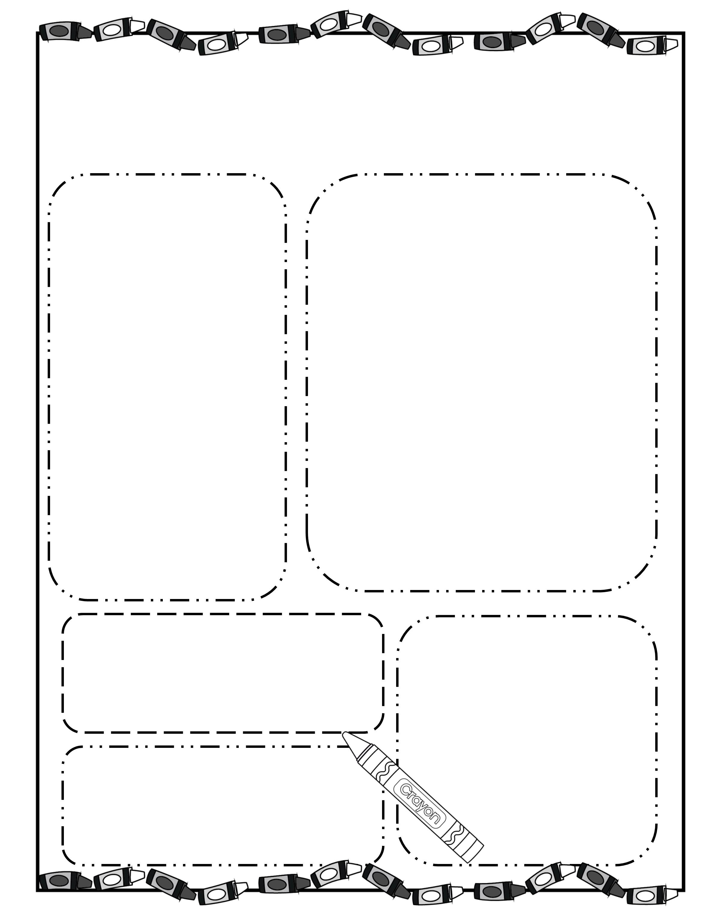
The Henry Herald
Date: July 18, 2017
Fishers Elementary
Room 2A
Coming up on our calendar:
What we are learning this week:
Reading Workshop: We are working on mastering the first 100 Fry words.
Math Workshop: This week will continue to work on number sense. Help enforce these skills by finding numbers in the real world when you are out and about.
Social Studies: We are learning about community helpers. We are looking for community helpers to come speak with our class. Please let me know if you or a family member would like to come in.
Monday: picture day
Tuesday: hat day
Wednesday: p.e. – wear your tennis shoes!
Thursday: early dismissal
Friday: reading log due
We are in need of toothpicks and marshmallows for an upcoming science activity.
Classroom
Requests:
Words of the Week
school
pencil
them
he
they
Don’t Forget!
Picture day is next Tuesday
©www.thecurriculumcorner.com

