Slide 1

Polygons
A PowerPoint Practice Game
Click here to start.
created by The Curriculum Corner

Slide 2

Is the shape a polygon?
a. yes
a. no

Slide 3

Try again!
Click here to go back to the problem.

Slide 4
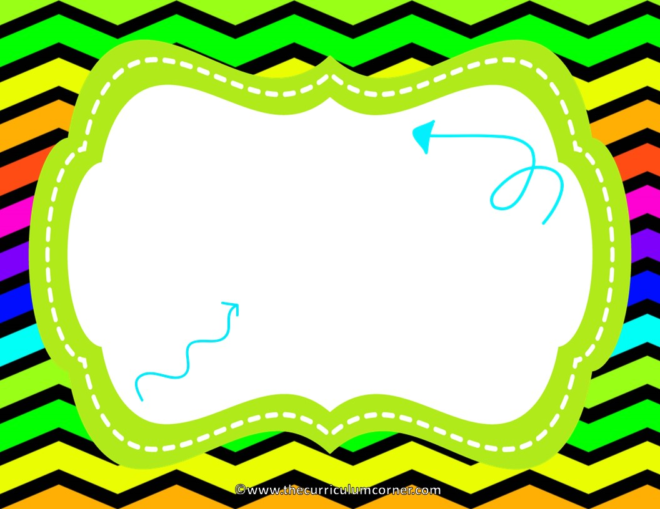
Wonderful!
Click here to go to the next problem.

Slide 5
Is the shape a polygon?
a. yes
a. no

Slide 6
Try again!
Click here to go back to the problem.

Slide 7
You’re a math star!
Click here to go to the next problem.

Slide 8
Is the shape a polygon?
a. yes
a. no

Slide 9
Try again!
Click here to go back to the problem.

Slide 10
Nice work!
Click here to go to the next problem.

Slide 11
Is the shape a polygon?
a. yes
a. no

Slide 12
Try again!
Click here to go back to the problem.

Slide 13
Awesome!
Click here to go to the next problem.

Slide 14
Is the shape a polygon?
a. yes
a. no

Slide 15
Try again!
Click here to go back to the problem.

Slide 16
Wonderful!
Click here to go to the next problem.

Slide 17
Is the shape a polygon?
a. yes
a. no

Slide 18
Try again!
Click here to go back to the problem.

Slide 19
Fabulous thinking!
Click here to go to the next problem.

Slide 20
Name the shape.
a. triangle
b. quadrilateral
c. pentagon

Slide 21
Try again!
Click here to go back to the problem.

Slide 22
Awesome!
Click here to go to the next problem.

Slide 23
Name the shape.
a. triangle
b. quadrilateral
c. pentagon

Slide 24
Try again!
Click here to go back to the problem.

Slide 25
Keep on going!
Click here to go to the next problem.

Slide 26
Name the shape.
a. triangle
b. quadrilateral
c. pentagon

Slide 27
Try again!
Click here to go back to the problem.

Slide 28
Magnificent!
Click here to go to the next problem.

Slide 29
Name the shape.
a. pentagon
b. hexagon
c. octagon

Slide 30
Try again!
Click here to go back to the problem.

Slide 31
You’ve got it!
Click here to go to the next problem.

Slide 32
Name the shape.
a. pentagon
b. hexagon
c. octagon

Slide 33
Try again!
Click here to go back to the problem.

Slide 34
Fantastic!
Click here to go to the next problem.

Slide 35
Is the polygon convex or concave?
a. convex
b. concave

Slide 36
Try again!
Click here to go back to the problem.

Slide 37
Awesome!
Click here to go to the next problem.

Slide 38
Is the polygon convex or concave?
a. convex
b. concave

Slide 39
Try again!
Click here to go back to the problem.

Slide 40
Great work!
Click here to go to the next problem.

Slide 41
Is the polygon convex or concave?
a. convex
b. concave

Slide 42
Try again!
Click here to go back to the problem.

Slide 43
Keep going!
Click here to go to the next problem.

Slide 44
Is the polygon convex or concave?
a. convex
b. concave

Slide 45
Try again!
Click here to go back to the problem.

Slide 46
Super!
Click here to go to the next problem.

Slide 47
Name the triangle.
a. equilateral triangle
b. isosceles triangle
c. scalene triangle

Slide 48
Try again!
Click here to go back to the problem.

Slide 49
Awesome!
Click here to go to the next problem.

Slide 50
Name the triangle.
a. equilateral triangle
b. isosceles triangle
c. scalene triangle

Slide 51
Try again!
Click here to go back to the problem.

Slide 52
Wonderful!
Click here to go to the next problem.

Slide 53
Name the triangle.
a. equilateral triangle
b. isosceles triangle
c. scalene triangle

Slide 54
Try again!
Click here to go back to the problem.

Slide 55
Fabulous!
Click here to go to the next problem.

Slide 56
Name the triangle.
a. right triangle
b. acute triangle
c. obtuse triangle

Slide 57
Try again!
Click here to go back to the problem.

Slide 58
Great thinking!
Click here to go to the next problem.

Slide 59
Name the triangle.
a. right triangle
b. acute triangle
c. obtuse triangle

Slide 60
Try again!
Click here to go back to the problem.

Slide 61
Fabulous!
Click here to go to the next problem.

Slide 62
A ____________ has opposite sides that are equal and parallel.
a. parallelogram
b. rectangle
c. rhombus

Slide 63
Try again!
Click here to go back to the problem.

Slide 64
Wow!
Click here to go to the next problem.

Slide 65
A ____________ is a parallelogram with four equal sides.
a. parallelogram
b. rectangle
c. rhombus

Slide 66
Try again!
Click here to go back to the problem.

Slide 67
Fantastic!
Click here to go to the next problem.

Slide 68
A ____________ is a rhombus with four right angles.
a. parallelogram
b. rectangle
c. square

Slide 69
Try again!
Click here to go back to the problem.

Slide 70
Way to go!
Click here to go to the next problem.

Slide 71
A ____________ has exactly one pair of parallel sides.
a. parallelogram
b. trapezoid
c. square

Slide 72
Try again!
Click here to go back to the problem.

Slide 73
Awesome!
Click here to go back to the beginning.

