Slide 1
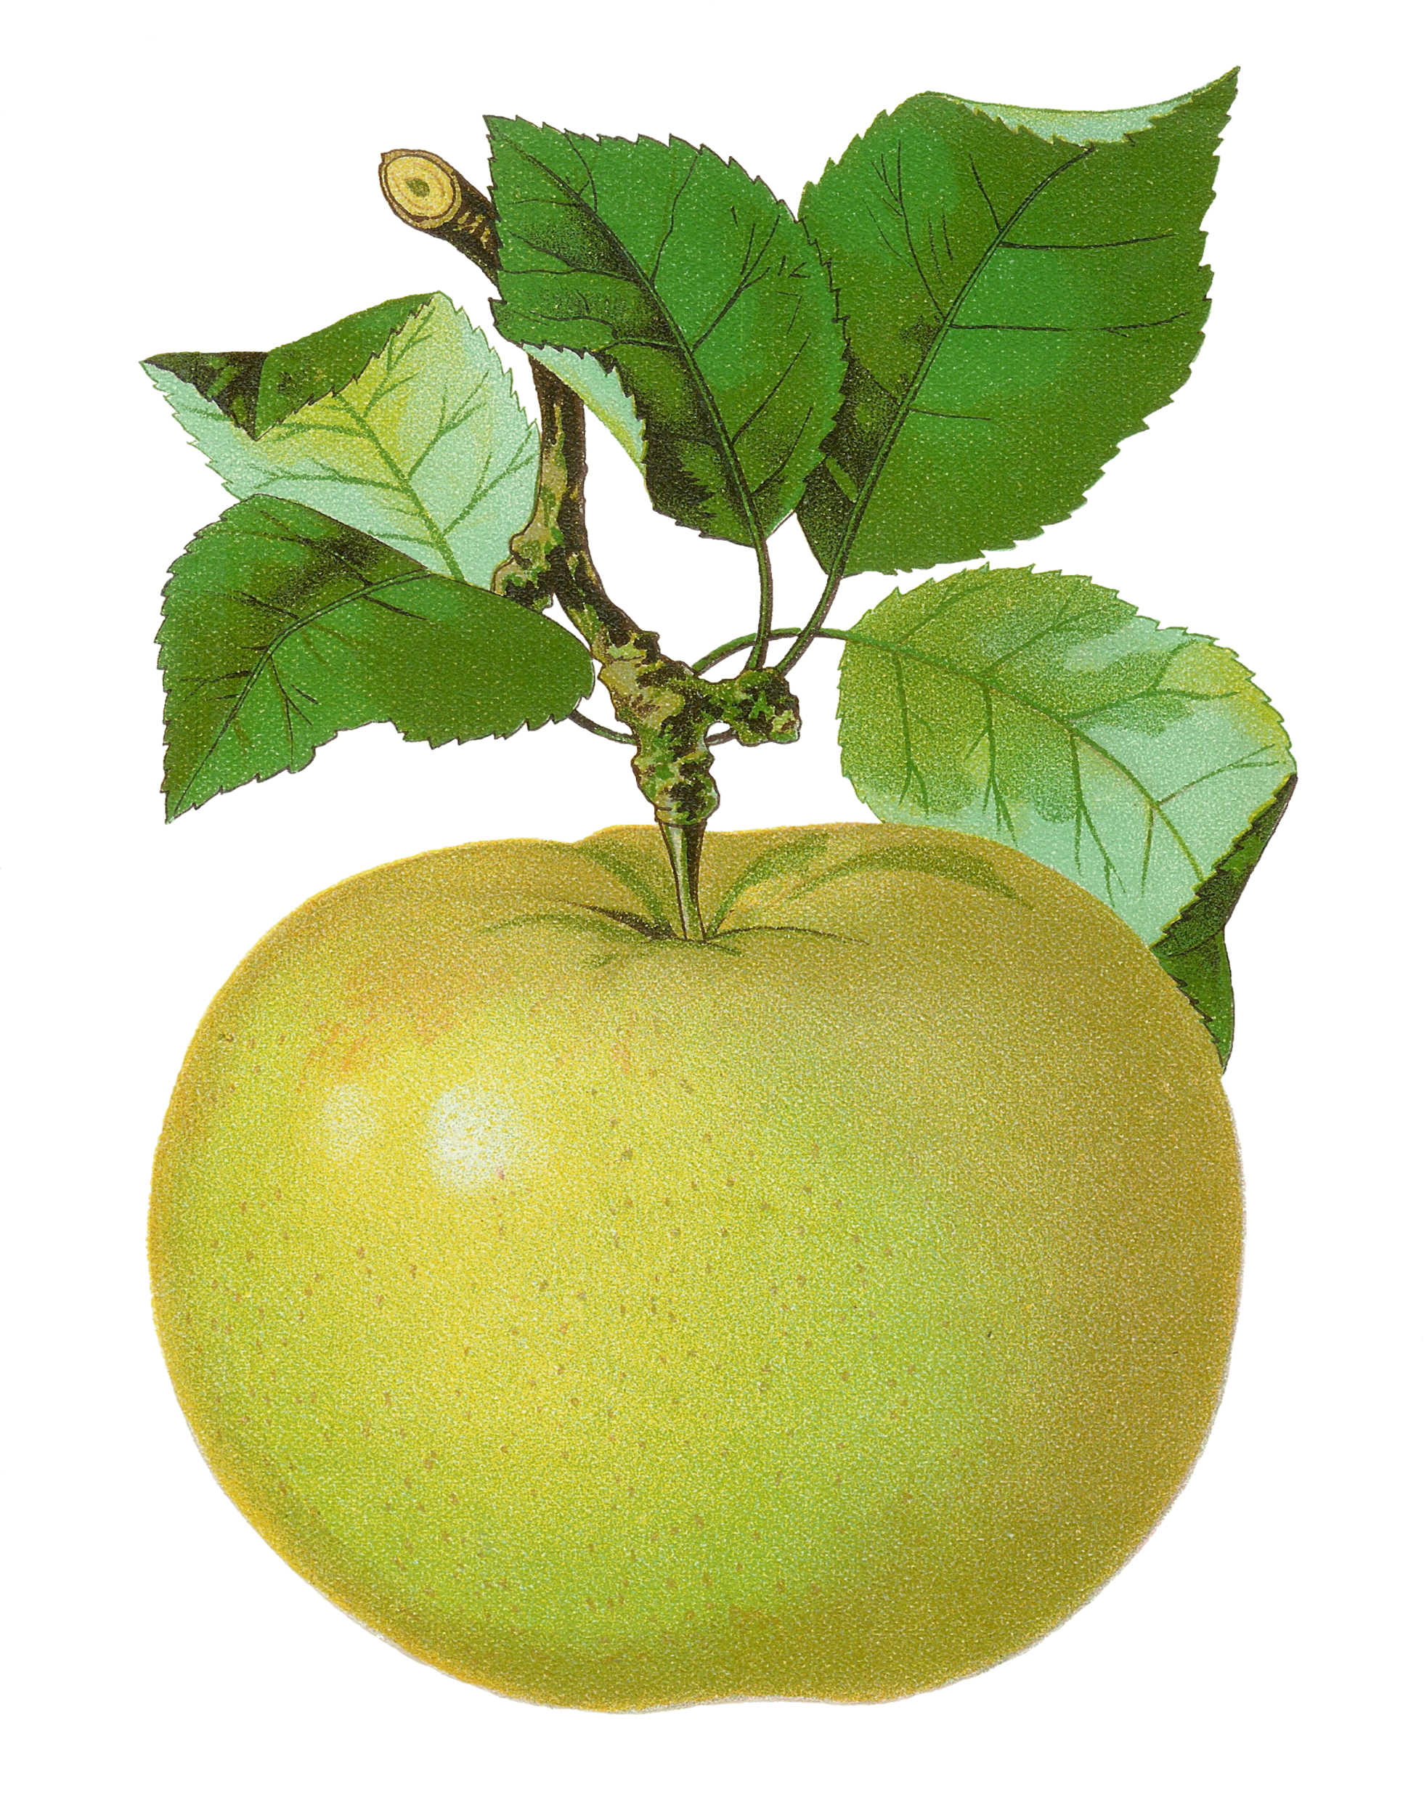
1st Grade
Computation Review
created by
The Curriculum Corner

Slide 2
+
a. 8
b. 7
c. 6

Slide 3
Try again!
Click here to go back to the problem.

Slide 4
Perfect!
Click here to go to the next problem.

Slide 5
+
a. 5
b. 6
c. 7

Slide 6
Try again!
Click here to go back to the problem.

Slide 7
Wonderful!
Click here to go to the next problem.

Slide 8
+
a. 7
b. 8
c. 9

Slide 9
Try again!
Click here to go back to the problem.

Slide 10
You’ve got it!
Click here to go to the next problem.

Slide 11
+
a. 10
b. 11
c. 12

Slide 12
Try again!
Click here to go back to the problem.

Slide 13
Keep it up!
Click here to go to the next problem.

Slide 14
+
a. 10
b. 11
c. 12

Slide 15
Try again!
Click here to go back to the problem.

Slide 16
Terrific!
Click here to go to the next problem.

Slide 17
+
a. 15
b. 16
c. 17

Slide 18
Try again!
Click here to go back to the problem.

Slide 19
Marvelous!
Click here to go to the next problem.

Slide 20
+
a. 17
b. 18
c. 19

Slide 21
Try again!
Click here to go back to the problem.

Slide 22
Wow!
Click here to go to the next problem.

Slide 23
4 + 8
a. 10
b. 11
c. 12

Slide 24
Try again!
Click here to go back to the problem.

Slide 25
Awesome!
Click here to go to the next problem.

Slide 26
3 + 5
a. 8
b. 9
c. 10

Slide 27
Try again!
Click here to go back to the problem.

Slide 28
Nice job!
Click here to go to the next problem.

Slide 29
6 + 1
a. 6
b. 7
c. 8

Slide 30
Try again!
Click here to go back to the problem.

Slide 31
Keep it up!
Click here to go to the next problem.

Slide 32
4 + 8
a. 653
b. 643
c. 633

Slide 33
Try again!
Click here to go back to the problem.

Slide 34
Wonderful!
Click here to go to the next problem.

Slide 35
7 + 4
a. 11
b. 12
c. 13

Slide 36
Try again!
Click here to go back to the problem.

Slide 37
Well done!
Click here to go to the next problem.

Slide 38
7 - 4
a. 3
b. 4
c. 5

Slide 39
Try again!
Click here to go back to the problem.

Slide 40
High five!
Click here to go to the next problem.

Slide 41
6 - 3
a. 1
b. 2
c. 3

Slide 42
Try again!
Click here to go back to the problem.

Slide 43
Perfect!
Click here to go to the next problem.

Slide 44
9 - 4
a. 4
b. 5
c. 6

Slide 45
Try again!
Click here to go back to the problem.

Slide 46
Nice work!
Click here to go to the next problem.

Slide 47
13 - 6
a. 6
b. 7
c. 9

Slide 48
Try again!
Click here to go back to the problem.

Slide 49
Good thinking!
Click here to go to the next problem.

Slide 50
7 - 2
a. 7
b. 6
c. 5

Slide 51
Try again!
Click here to go back to the problem.

Slide 52
You’ve got it!
Click here to go to the next problem.

Slide 53
14 - 7
a. 5
b. 6
c. 7

Slide 54
Try again!
Click here to go back to the problem.

Slide 55
Way to go!
Click here to go to the next problem.

Slide 56
4 + 2 + 3
a. 7
b. 8
c. 9

Slide 57
Try again!
Click here to go back to the problem.

Slide 58
Magnificent!
Click here to go to the next problem.

Slide 59
2 + 1 + 2
a. 5
b. 4
c. 3

Slide 60
Try again!
Click here to go back to the problem.

Slide 61
Wow!
Click here to go to the next problem.

Slide 62
4 + 5 + 3
a. 9
b. 13
c. 12

Slide 63
Try again!
Click here to go back to the problem.

Slide 64
Terrific!
Click here to go to the next problem.

Slide 65
1 + 3 + 5
a. 10
b. 11
c. 9

Slide 66
Try again!
Click here to go back to the problem.

Slide 67
Marvelous!
Click here to go to the next problem.

Slide 68
4 + 2 + 4
a. 10
b. 13
c. 12

Slide 69
Try again!
Click here to go back to the problem.

Slide 70
Nice!
Click here to go back to the beginning.

Slide 71
3 + ___ = 6
a. 3
b. 4
c. 5

Slide 72
Try again!
Click here to go back to the problem.

Slide 73
Hurray!
Click here to go back to the beginning.

Slide 74
2 + ___ = 6
a. 4
b. 5
c. 6

Slide 75
Try again!
Click here to go back to the problem.

Slide 76
Good!
Click here to go to the next problem.

Slide 77
5 + ____ = 9
a. 4
b. 5
c. 6

Slide 78
Try again!
Click here to go back to the problem.

Slide 79
Wow!
Click here to go to the next problem.

Slide 80
___ + 3 = 6
a. 3
b. 4
c. 5

Slide 81
Try again!
Click here to go back to the problem.

Slide 82
Great practice!
Click here to go back to the beginning.

