Slide 1
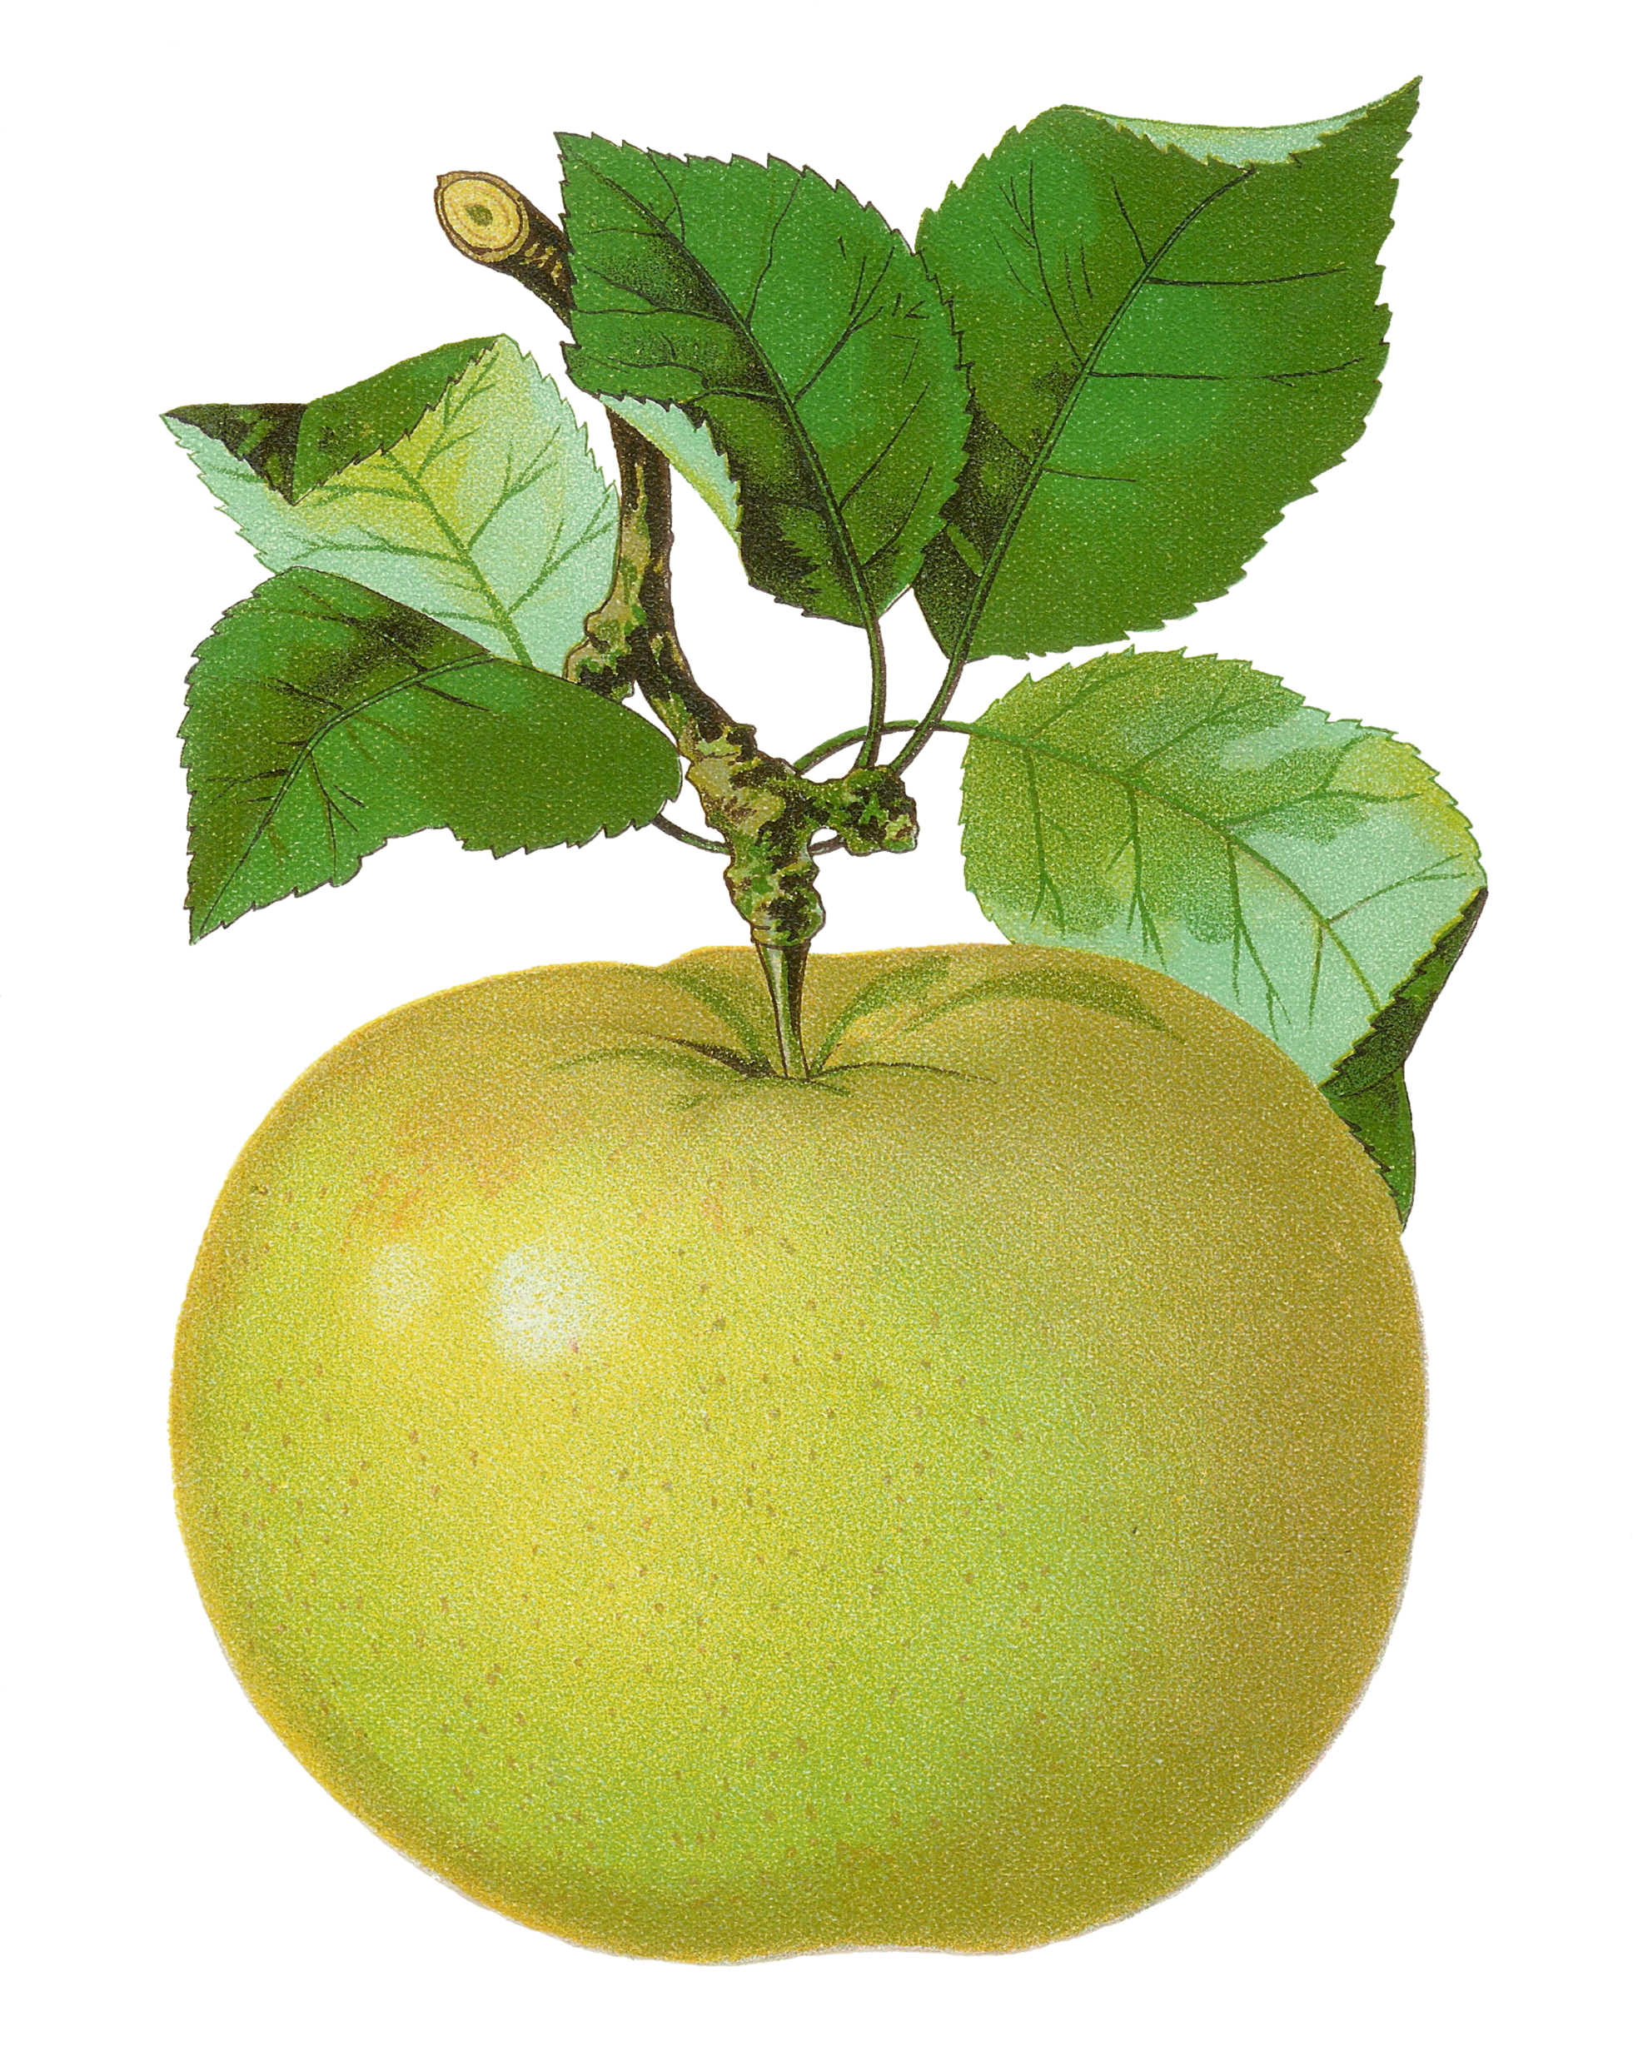
2nd Grade
Computation Review
created by
The Curriculum Corner

Slide 2
4 + 5
a. 8
b. 9
c. 10

Slide 3
Try again!
Click here to go back to the problem.

Slide 4
Perfect!
Click here to go to the next problem.

Slide 5
8 + 7
a. 15
b. 16
c. 17

Slide 6
Try again!
Click here to go back to the problem.

Slide 7
Wonderful!
Click here to go to the next problem.

Slide 8
6 + 9
a. 17
b. 16
c. 15

Slide 9
Try again!
Click here to go back to the problem.

Slide 10
You’ve got it!
Click here to go to the next problem.

Slide 11
15 - 5
a. 10
b. 11
c. 12

Slide 12
Try again!
Click here to go back to the problem.

Slide 13
Keep it up!
Click here to go to the next problem.

Slide 14
12 - 8
a. 6
b. 5
c. 4

Slide 15
Try again!
Click here to go back to the problem.

Slide 16
Terrific!
Click here to go to the next problem.

Slide 17
16 - 9
a. 7
b. 8
c. 9

Slide 18
Try again!
Click here to go back to the problem.

Slide 19
Marvelous!
Click here to go to the next problem.

Slide 20
34
+ 55
a. 88
b. 89
c. 90

Slide 21
Try again!
Click here to go back to the problem.

Slide 22
Wow!
Click here to go to the next problem.

Slide 23
46
+ 27
a. 53
b. 63
c. 73

Slide 24
Try again!
Click here to go back to the problem.

Slide 25
Awesome!
Click here to go to the next problem.

Slide 26
57
+ 15
a. 72
b. 82
c. 92

Slide 27
Try again!
Click here to go back to the problem.

Slide 28
Nice job!
Click here to go to the next problem.

Slide 29
247
+ 431
a. 677
b. 678
c. 679

Slide 30
Try again!
Click here to go back to the problem.

Slide 31
Keep it up!
Click here to go to the next problem.

Slide 32
408
+ 245
a. 653
b. 643
c. 633

Slide 33
Try again!
Click here to go back to the problem.

Slide 34
Wonderful!
Click here to go to the next problem.

Slide 35
527
+ 185
a. 712
b. 702
c. 602

Slide 36
Try again!
Click here to go back to the problem.

Slide 37
Well done!
Click here to go to the next problem.

Slide 38
62
- 31
a. 31
b. 33
c. 35

Slide 39
Try again!
Click here to go back to the problem.

Slide 40
High five!
Click here to go to the next problem.

Slide 41
74
- 35
a. 41
b. 31
c. 39

Slide 42
Try again!
Click here to go back to the problem.

Slide 43
Perfect!
Click here to go to the next problem.

Slide 44
83
- 27
a. 64
b. 56
c. 66

Slide 45
Try again!
Click here to go back to the problem.

Slide 46
Nice work!
Click here to go to the next problem.

Slide 47
673
- 34 1
a. 334
b. 332
c. 331

Slide 48
Try again!
Click here to go back to the problem.

Slide 49
Good thinking!
Click here to go to the next problem.

Slide 50
859
- 468
a. 401
b. 411
c. 391

Slide 51
Try again!
Click here to go back to the problem.

Slide 52
You’ve got it!
Click here to go to the next problem.

Slide 53
Keegan baked 11 muffins and Tyler baked 16. They brought them to share with their teachers. How many muffins did they bake altogether?
a. 20
b. 24
c. 27

Slide 54
Try again!
Click here to go back to the problem.

Slide 55
Way to go!
Click here to go to the next problem.

Slide 56
The two 2nd grade classes planted 22 flowers in front of the school. The other class planted 10 flowers and our class planted the rest. How many did we plant?
a. 32
b. 22
c. 12

Slide 57
Try again!
Click here to go back to the problem.

Slide 58
Magnificent!
Click here to go to the next problem.

Slide 59
I went to the fair. I spent $4 on tickets, $3 on a lemonade and $4 on snacks. How much money did I spend?
a. $11
b. $8
c. $7

Slide 60
Try again!
Click here to go back to the problem.

Slide 61
Wow!
Click here to go to the next problem.

Slide 62
4 + 5 + 6
a. 9
b. 13
c. 15

Slide 63
Try again!
Click here to go back to the problem.

Slide 64
Terrific!
Click here to go to the next problem.

Slide 65
7 + 3 + 8
a. 10
b. 11
c. 18

Slide 66
Try again!
Click here to go back to the problem.

Slide 67
Marvelous!
Click here to go to the next problem.

Slide 68
4 + 9 + 6
a. 19
b. 13
c. 10

Slide 69
Try again!
Click here to go back to the problem.

Slide 70
Great practice!
Click here to go back to the beginning.

