Slide 1
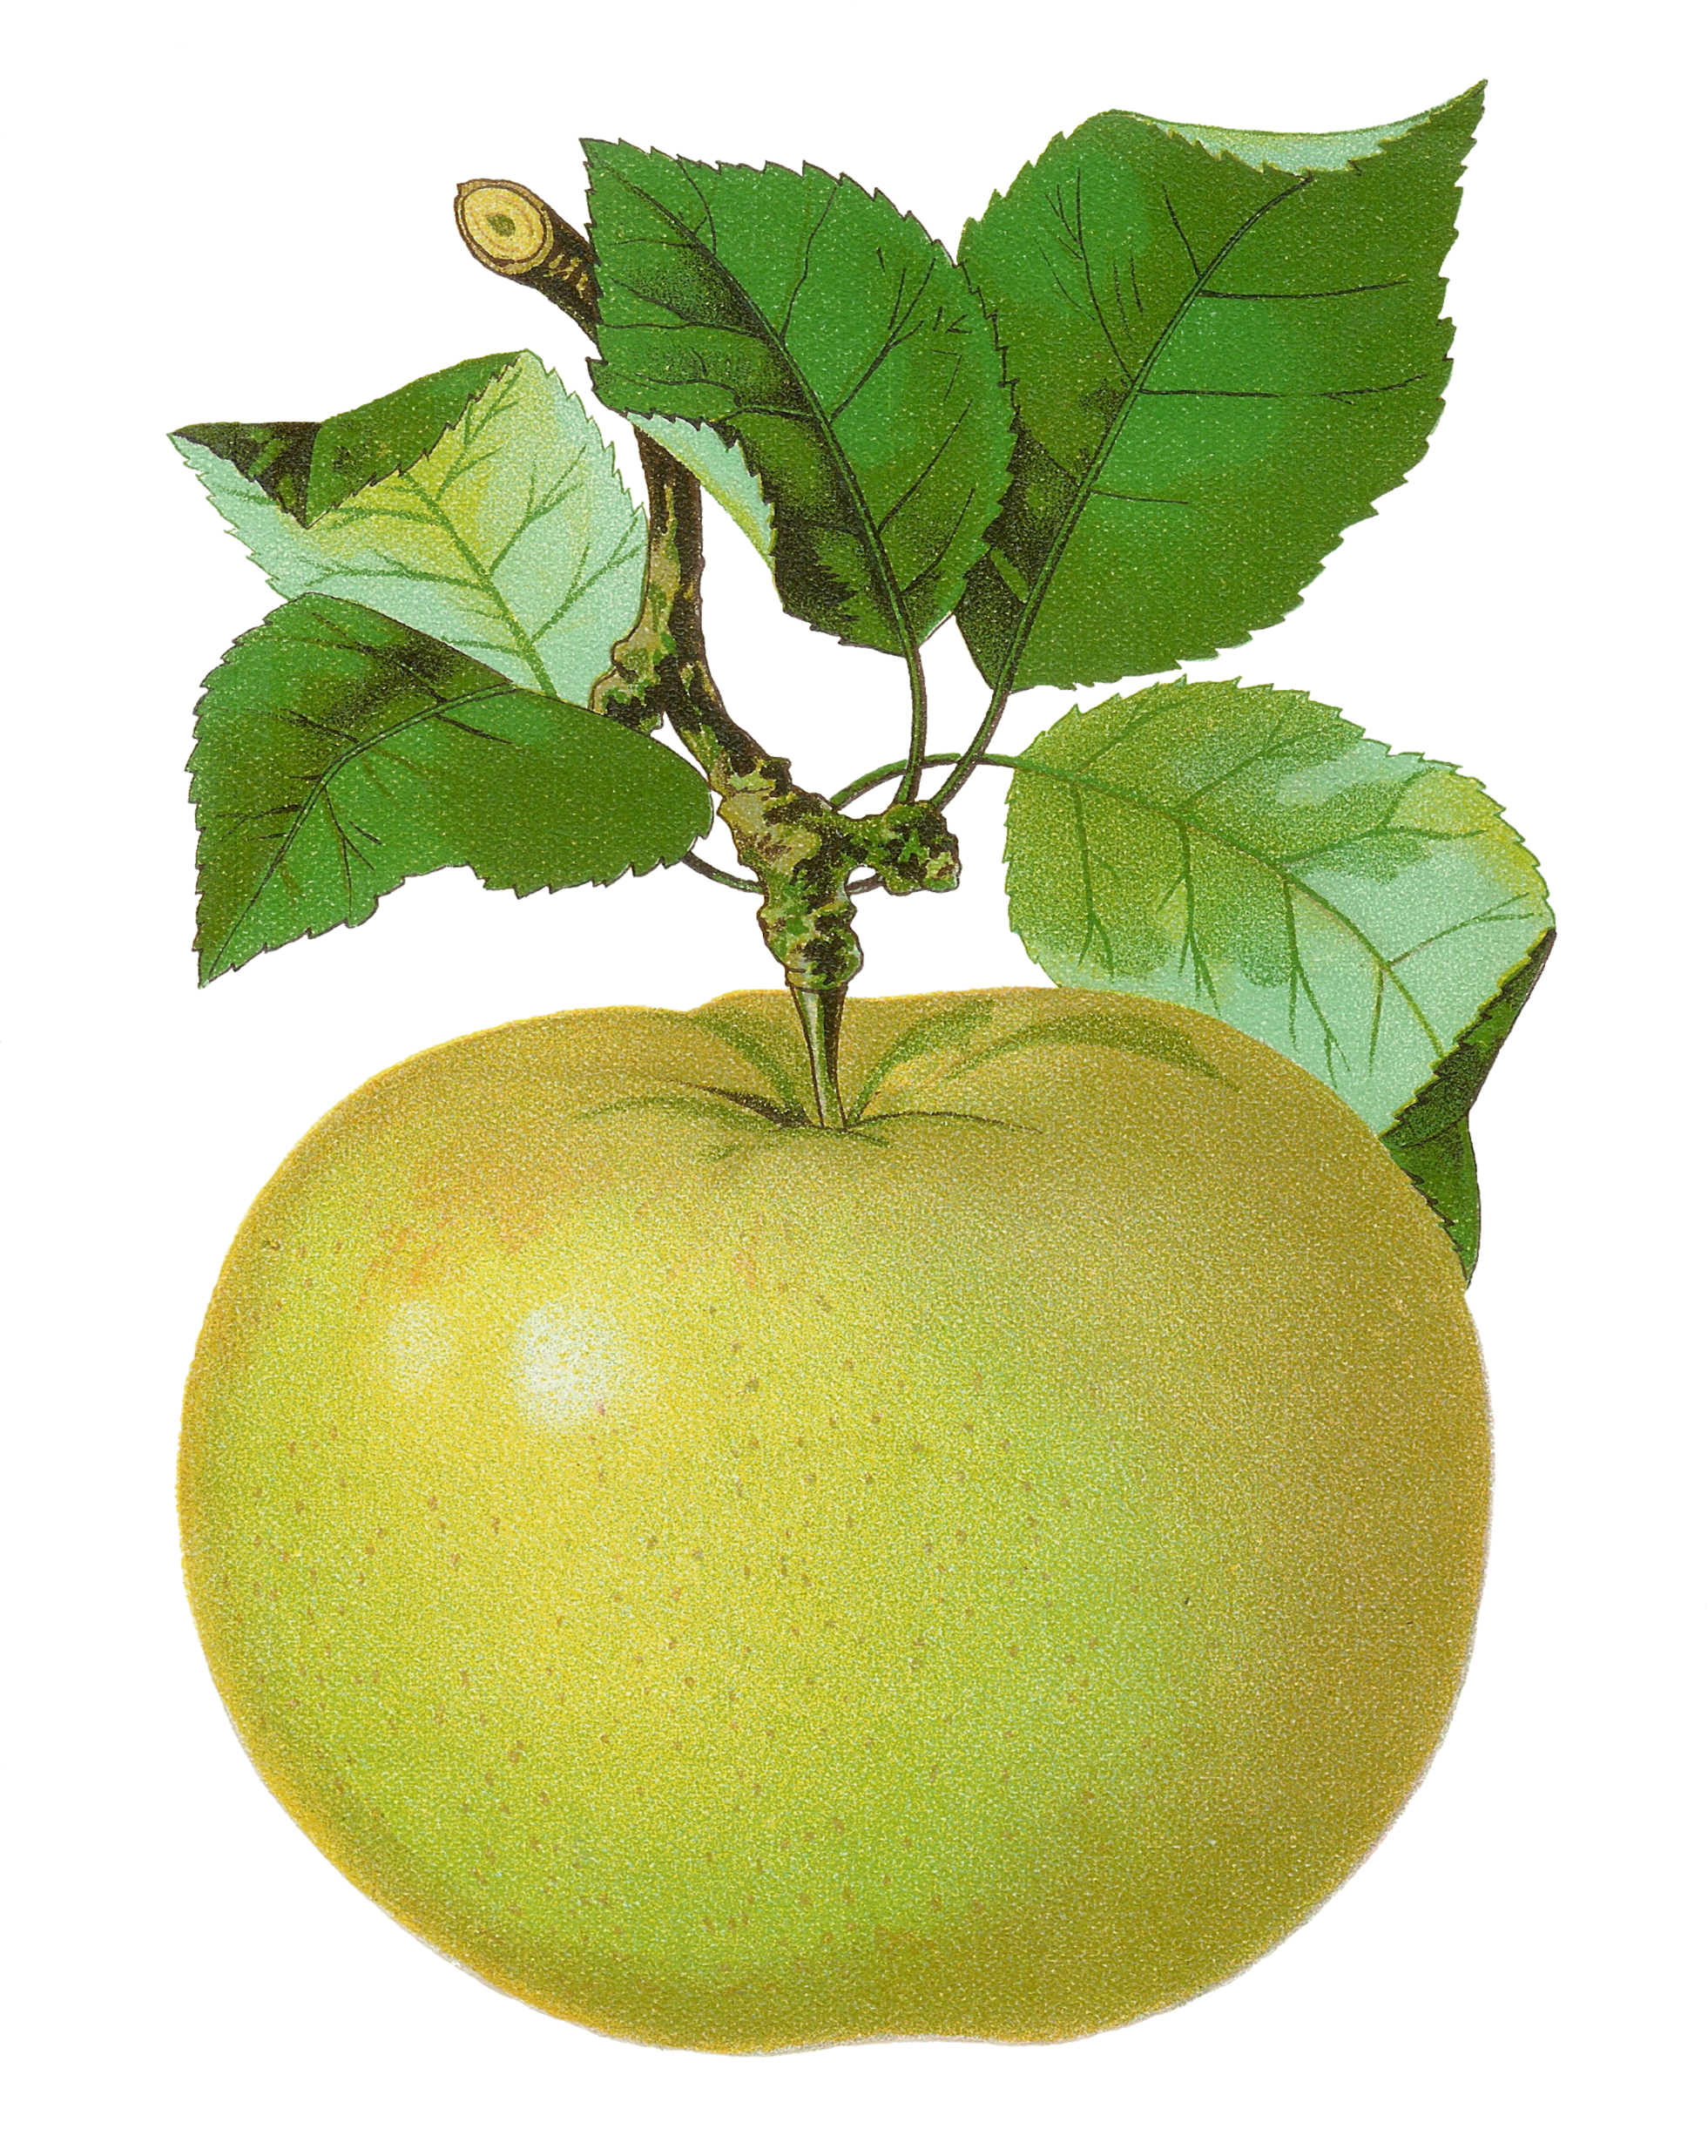
3rd Grade
Computation Review
created by
The Curriculum Corner

Slide 2
23
+ 55
a. 76
b. 77
c. 78

Slide 3
Try again!
Click here to go back to the problem.

Slide 4
Nice work!
Click here to go to the next problem.

Slide 5
48
+ 1 7
a. 55
b. 65
c. 75

Slide 6
Try again!
Click here to go back to the problem.

Slide 7
You’re on your way!
Click here to go to the next problem.

Slide 8
67
+ 24
a. 91
b. 81
c. 71

Slide 9
Try again!
Click here to go back to the problem.

Slide 10
Super star!
Click here to go to the next problem.

Slide 11
357
+ 432
a. 787
b. 788
c. 789

Slide 12
Try again!
Click here to go back to the problem.

Slide 13
Way to go!
Click here to go to the next problem.

Slide 14
526
+ 283
a. 809
b. 709
c. 609

Slide 15
Try again!
Click here to go back to the problem.

Slide 16
Outstanding!
Click here to go to the next problem.

Slide 17
238
247
+ 362
a. 737
b. 747
c. 847

Slide 18
Try again!
Click here to go back to the problem.

Slide 19
Fantastic!
Click here to go to the next problem.

Slide 20
87
- 32
a. 53
b. 55
c. 57

Slide 21
Try again!
Click here to go back to the problem.

Slide 22
Super work!
Click here to go to the next problem.

Slide 23
80
- 35
a. 45
b. 50
c. 55

Slide 24
Try again!
Click here to go back to the problem.

Slide 25
Exceptional!
Click here to go to the next problem.

Slide 26
93
- 32
a. 60
b. 61
c. 62

Slide 27
Try again!
Click here to go back to the problem.

Slide 28
You figured it out!
Click here to go to the next problem.

Slide 29
576
- 432
a. 124
b. 134
c. 144

Slide 30
Try again!
Click here to go back to the problem.

Slide 31
Magnificent!
Click here to go to the next problem.

Slide 32
900
- 239
a. 661
b. 639
c. 739

Slide 33
Try again!
Click here to go back to the problem.

Slide 34
Well done!
Click here to go to the next problem.

Slide 35
6 x 8
a. 68
b. 48
c. 28

Slide 36
Try again!
Click here to go back to the problem.

Slide 37
Incredible!
Click here to go to the next problem.

Slide 38
0 x 6
a. 0
b. 1
c. 6

Slide 39
Try again!
Click here to go back to the problem.

Slide 40
Remarkable!
Click here to go to the next problem.

Slide 41
3 x 1
a. 0
b. 1
c. 3

Slide 42
Try again!
Click here to go back to the problem.

Slide 43
Way to go!
Click here to go to the next problem.

Slide 44
8 x 7
a. 56
b. 57
c. 58

Slide 45
Try again!
Click here to go back to the problem.

Slide 46
Awesome!
Click here to go to the next problem.

Slide 47
6 x 7
a. 46
b. 44
c. 42

Slide 48
Try again!
Click here to go back to the problem.

Slide 49
Perfect!
Click here to go to the next problem.

Slide 50
9 x 5
a. 45
b. 50
c. 55

Slide 51
Try again!
Click here to go back to the problem.

Slide 52
Nice thinking!
Click here to go to the next problem.

Slide 53
10 x 7
a. 68
b. 70
c. 72

Slide 54
Try again!
Click here to go back to the problem.

Slide 55
Tremendous!
Click here to go to the next problem.

Slide 56
35 ÷ 7
a. 5
b. 6
c. 7

Slide 57
Try again!
Click here to go back to the problem.

Slide 58
Wonderful!
Click here to go to the next problem.

Slide 59
90 ÷ 9
a. 8
b. 9
c. 10

Slide 60
Try again!
Click here to go back to the problem.

Slide 61
Keep it up!
Click here to go to the next problem.

Slide 62
32 ÷ 8
a. 5
b. 7
c. 4

Slide 63
Try again!
Click here to go back to the problem.

Slide 64
Wonderful!
Click here to go to the next problem.

Slide 65
42 ÷ 7
a. 5
b. 6
c. 7

Slide 66
Try again!
Click here to go back to the problem.

Slide 67
Terrific!
Click here to go to the next problem.

Slide 68
Caroline had 72 jelly beans to divide evenly between 9 of her friends. How many jelly beans can she give to each friend?
a. 6
b. 7
c. 8

Slide 69
Try again!
Click here to go back to the problem.

Slide 70
Marvelous!
Click here to go to the next problem.

Slide 71
Hadley wanted to give each of her teachers 3 cookies. She had 4 teachers. How many cookies did she need to bake?
a. 12
b. 7
c. 16

Slide 72
Try again!
Click here to go back to the problem.

Slide 73
Wow!
Click here to go to the next problem.

Slide 74
The two 3rd grade classes planted 34 trees altogether. One class planted 18 trees and our class planted the rest. How many did we plant?
a. 16
b. 24
c. 13

Slide 75
Try again!
Click here to go back to the problem.

Slide 76
You’ve done great!
Click here to go to the next problem.

Slide 77
I had $20 to spend at the fair. I spent $6 on tickets, $3 on a lemonade and $5 on snacks. How much money did I have left?
a. $6
b. $7
c. $8

Slide 78
Try again!
Click here to go back to the problem.

Slide 79
Great job practicing!
Click here to go back to the beginning.

