Slide 1
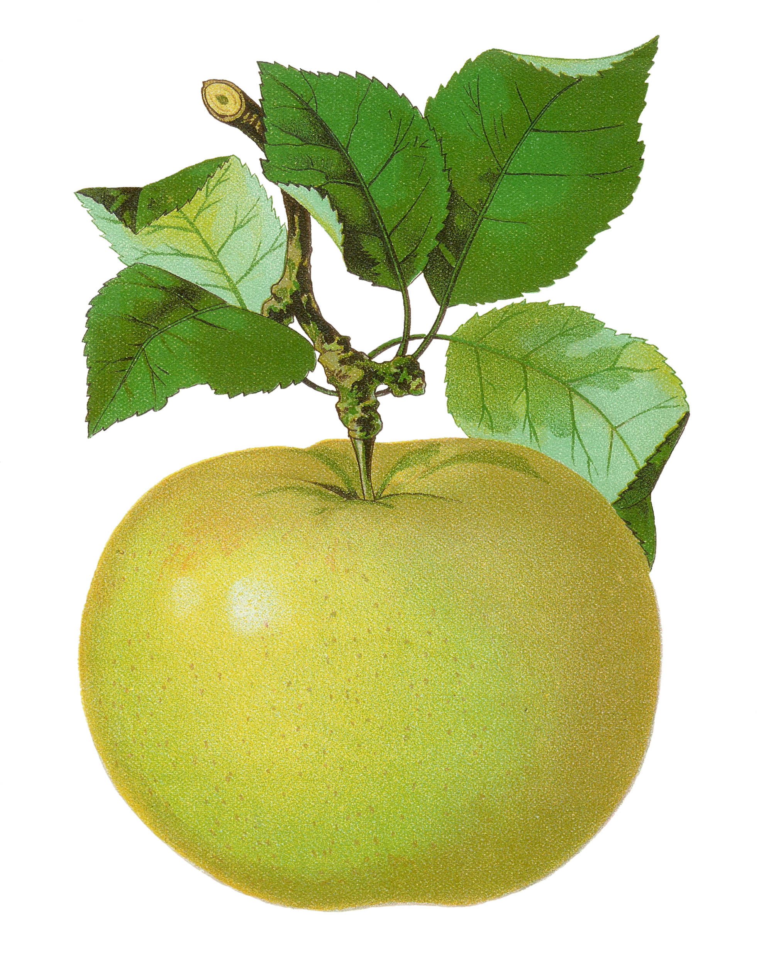
2nd Grade
Number Sense Review
created by
The Curriculum Corner

Slide 2
Find the number.
a. 83
b. 73
c. 93

Slide 3
Try again!
Click here to go back to the problem.

Slide 4
Good thinking!
Click here to go to the next problem.

Slide 5
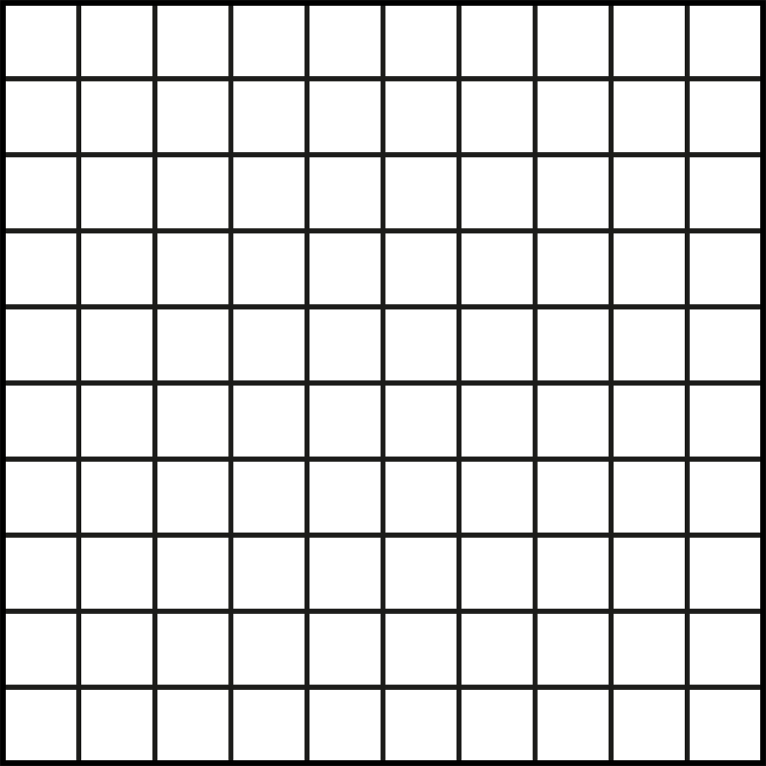
Find the number.
a. 352
b. 262
c. 362

Slide 6
Try again!
Click here to go back to the problem.

Slide 7
Great work!
Click here to go to the next problem.

Slide 8
Find the number.
a. 861
b. 592
c. 591

Slide 9
Try again!
Click here to go back to the problem.

Slide 10
Terrific!
Click here to go to the next problem.

Slide 11
Find the next three numbers.
43, 45, 46, ___, ___, ___
a. 46, 47, 48
b. 45, 46, 47
c. 47, 48, 49

Slide 12
Try again!
Click here to go back to the problem.

Slide 13
Super duper!
Click here to go to the next problem.

Slide 14
Find the next three numbers.
335, 340, 345, ___, ___, ___
a. 350, 360, 370
b. 355, 360, 365
c. 350, 355, 360

Slide 15
Try again!
Click here to go back to the problem.

Slide 16
Wow!
Click here to go to the next problem.

Slide 17
Find the next three numbers.
12, 14, 16, ___, ___, ___
a. 17, 18, 19
b. 18, 20, 22
c. 18, 19, 20

Slide 18
Try again!
Click here to go back to the problem.

Slide 19
Wonderful!
Click here to go to the next problem.

Slide 20
The is on the _________ apple.
a. sixth
b. seventh
c. eighth

Slide 21
Try again!
Click here to go back to the problem.

Slide 22
Great work!
Click here to go to the next problem.

Slide 23
The is on the _________ apple.
a. third
b. fourth
c. fifth

Slide 24
Try again!
Click here to go back to the problem.

Slide 25
Keep it up!
Click here to go to the next problem.

Slide 26
The is on the _________ apple.
a. tenth
b. eleventh
c. twelfth

Slide 27
Try again!
Click here to go back to the problem.

Slide 28
Marvelous!
Click here to go to the next problem.

Slide 29
Find the number in word form.
83
a. eight three
b. eighteen three
c. eighty-three

Slide 30
Try again!
Click here to go back to the problem.

Slide 31
Magnificent!
Click here to go to the next problem.

Slide 32
Find the number in word form.
192
a. one hundred ninety-two
b. one hundred nine two
c. one hundred ninety

Slide 33
Try again!
Click here to go back to the problem.

Slide 34
You’ve got it!
Click here to go to the next problem.

Slide 35
Find the number in word form.
674
a. six hundred seventeen four
b. six hundred seventy-four
c. sixty hundred four

Slide 36
Try again!
Click here to go back to the problem.

Slide 37
Wonderful!
Click here to go to the next problem.

Slide 38
Find the number in expanded form.
58
a. 5 + 8
b. 50 + 8
c. 50 + 80

Slide 39
Try again!
Click here to go back to the problem.

Slide 40
Nice work!
Click here to go to the next problem.

Slide 41
Find the number in expanded form.
802
a. 800 + 2
b. 80 + 2
c. 8 + 2

Slide 42
Try again!
Click here to go back to the problem.

Slide 43
Tremendous!
Click here to go to the next problem.

Slide 44
Find the number in expanded form.
946
a. 900 + 4 + 6
b. 90 + 40 + 6
c. 900 + 40 + 6

Slide 45
Try again!
Click here to go back to the problem.

Slide 46
Wow!
Click here to go to the next problem.

Slide 47
Find the number in standard form.
ninety-nine
a. 19
b. 99
c. 909

Slide 48
Try again!
Click here to go back to the problem.

Slide 49
Pretty great!
Click here to go to the next problem.

Slide 50
Find the number in standard form.
three hundred twenty-eight
a. 30028
b. 3128
c. 328

Slide 51
Try again!
Click here to go back to the problem.

Slide 52
Nice thinking!
Click here to go to the next problem.

Slide 53
Find the number in standard form.
seven hundred thirteen
a. 713
b. 70013
c. 730

Slide 54
Try again!
Click here to go back to the problem.

Slide 55
You’ve got it!
Click here to go to the next problem.

Slide 56
Find the value of the underlined number.
61
a. 6
b. 60
c. 1

Slide 57
Try again!
Click here to go back to the problem.

Slide 58
Great work!
Click here to go to the next problem.

Slide 59
Find the value of the underlined number.
415
a. 400
b. 40
c. 4

Slide 60
Try again!
Click here to go back to the problem.

Slide 61
Wonderful!
Click here to go to the next problem.

Slide 62
Find the value of the underlined number.
502
a. 2
b. 50
c. 500

Slide 63
Try again!
Click here to go back to the problem.

Slide 64
Great!
Click here to go to the next problem.

Slide 65
Compare the numbers.
84 ____ 86
a. <
b. >
c. =

Slide 66
Try again!
Click here to go back to the problem.

Slide 67
Perfect!
Click here to go to the next problem.

Slide 68
Compare the numbers.
170 ____ 107
a. <
b. >
c. =

Slide 69
Try again!
Click here to go back to the problem.

Slide 70
Great work!
Click here to go to the next problem.

Slide 71
Compare the numbers.
999 ____ 999
a. <
b. >
c. =

Slide 72
Try again!
Click here to go back to the problem.

Slide 73
Wow!
Click here to go to the next problem.

Slide 74
Which number is odd?
3, 6, 8
a. 3
b. 6
c. 8

Slide 75
Try again!
Click here to go back to the problem.

Slide 76
Wonderful!
Click here to go to the next problem.

Slide 77
Which number is odd?
16, 21, 14
a. 16
b. 21
c. 4

Slide 78
Try again!
Click here to go back to the problem.

Slide 79
Good!
Click here to go to the next problem.

Slide 80
Which number is even?
35, 40, 61
a. 35
b. 40
c. 61

Slide 81
Try again!
Click here to go back to the problem.

Slide 82
Great practice!
Click here to go back to the beginning.

