Slide 1
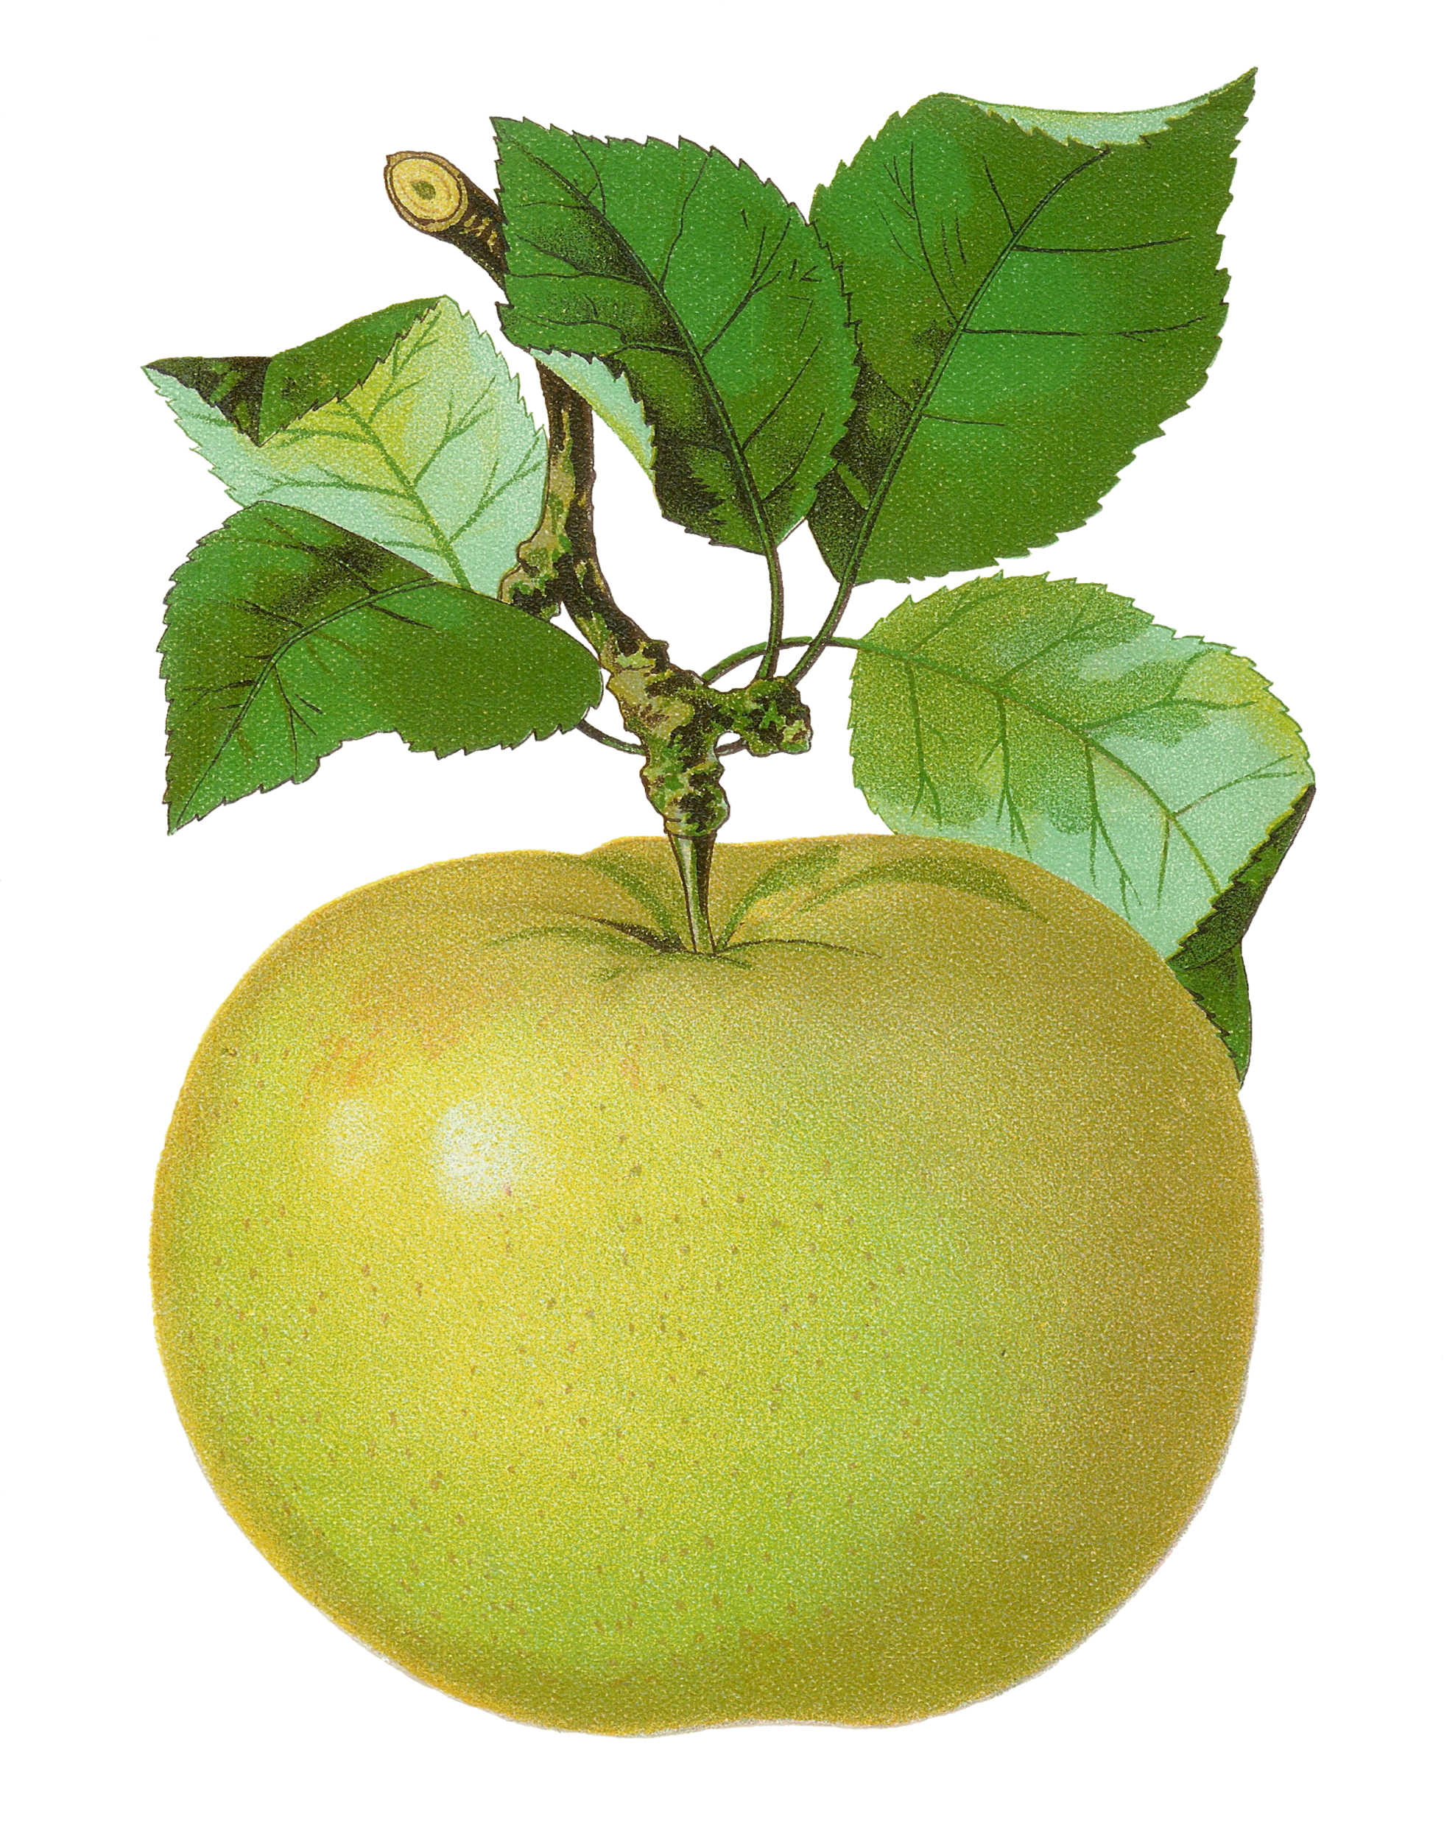
3rd Grade
Number Sense Review
created by
The Curriculum Corner

Slide 2
Find the number in word form.
268
a. two hundred sixty-eight
b. two hundred and sixty-eight
c. two hundred eighty-six

Slide 3
Try again!
Click here to go back to the problem.

Slide 4
Good thinking!
Click here to go to the next problem.

Slide 5
Find the number in word form.
6,234
a. six thousand, two hundred thirty-three
b. six thousand, two hundred thirty-four
c. six thousand, three hundred, thirty-four

Slide 6
Try again!
Click here to go back to the problem.

Slide 7
Awesome!
Click here to go to the next problem.

Slide 8
Find the number in word form.
9,082
a. nine thousand, eighty-twelve
b. nine thousand, eight hundred two
c. nine thousand, eighty-two

Slide 9
Try again!
Click here to go back to the problem.

Slide 10
Way to go!
Click here to go to the next problem.

Slide 11
Find the number in standard form.
five hundred thirty-nine
a. 593
b. 539
c. 509

Slide 12
Try again!
Click here to go back to the problem.

Slide 13
Very good!
Click here to go to the next problem.

Slide 14
Find the number in standard form.
seven thousand, two hundred fifty
a. 7,255
b. 7,252
c. 7,250

Slide 15
Try again!
Click here to go back to the problem.

Slide 16
Perfect!
Click here to go to the next problem.

Slide 17
Find the number in standard form.
two thousand, ninety-eight
a. 2,098
b. 2,908
c. 2,980

Slide 18
Try again!
Click here to go back to the problem.

Slide 19
Way to go!
Click here to go to the next problem.

Slide 20
Find the value of the underlined number.
831
a. 300
b. 30
c. 3

Slide 21
Try again!
Click here to go back to the problem.

Slide 22
Way to go!
Click here to go to the next problem.

Slide 23
Find the value of the underlined number.
2,804
a. 2,000
b. 200
c. 20

Slide 24
Try again!
Click here to go back to the problem.

Slide 25
Way to go!
Click here to go to the next problem.

Slide 26
Find the value of the underlined number.
6,713
a. 1,000
b. 100
c. 10

Slide 27
Try again!
Click here to go back to the problem.

Slide 28
Way to go!
Click here to go to the next problem.

Slide 29
Find the missing numbers.
40
45
47
a. 43, 44, 48
b. 41, 43, 48
c. 41, 44, 48

Slide 30
Try again!
Click here to go back to the problem.

Slide 31
Way to go!
Click here to go to the next problem.

Slide 32
Find the missing numbers.
70
80
84
a. 72, 76, 88
b. 71, 79, 85
c. 72, 78, 86

Slide 33
Try again!
Click here to go back to the problem.

Slide 34
Way to go!
Click here to go to the next problem.

Slide 35
Find the missing numbers.
15
30
40
50
a. 15, 30, 65
b. 20, 35, 60
c. 20, 35, 55

Slide 36
Try again!
Click here to go back to the problem.

Slide 37
Way to go!
Click here to go to the next problem.

Slide 38
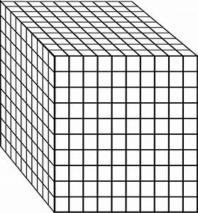
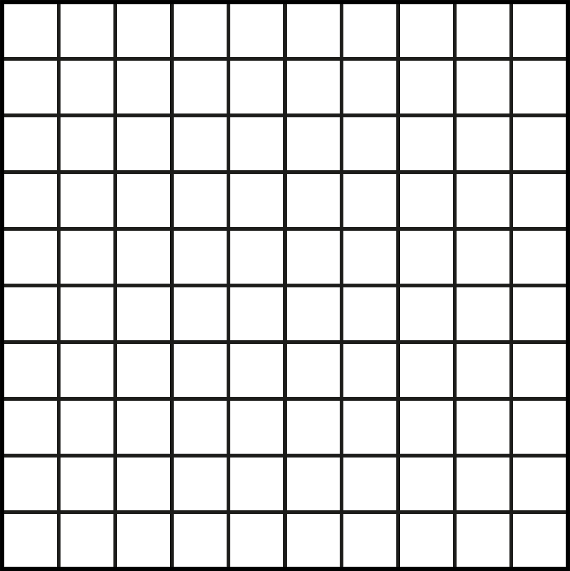
Find the number.
a. 2,332
b. 2,233
c. 2,323

Slide 39
Try again!
Click here to go back to the problem.

Slide 40
Wonderful!
Click here to go to the next problem.

Slide 41
Find the number.
a. 1,365
b. 1,546
c. 1,365

Slide 42
Try again!
Click here to go back to the problem.

Slide 43
Way to go!
Click here to go to the next problem.

Slide 44
Find the number.
a. 2,444
b. 2,483
c. 2,484

Slide 45
Try again!
Click here to go back to the problem.

Slide 46
You’re a math star!
Click here to go to the next problem.

Slide 47
I have 3 tens, 15 ones and 4 hundreds.
What number am I?
a. 435
b. 4,315
c. 445

Slide 48
Try again!
Click here to go back to the problem.

Slide 49
Marvelous!
Click here to go to the next problem.

Slide 50
I have 4 hundreds, 8 tens and 13 ones.
What number am I?
a. 493
b. 4,813
c. 483

Slide 51
Try again!
Click here to go back to the problem.

Slide 52
Keep it up!
Click here to go to the next problem.

Slide 53
I have 6 hundreds, 7 tens and 15 ones.
What number am I?
a. 6,715
b. 675
c. 685

Slide 54
Try again!
Click here to go back to the problem.

Slide 55
Great work!
Click here to go to the next problem.

Slide 56
Compare the numbers.
6,260 ____ 6,206
a. <
b. >
c. =

Slide 57
Try again!
Click here to go back to the problem.

Slide 58
Super!
Click here to go to the next problem.

Slide 59
Compare the numbers.
3,817 ____ 3,817
a. <
b. >
c. =

Slide 60
Try again!
Click here to go back to the problem.

Slide 61
Way to go!
Click here to go to the next problem.

Slide 62
Compare the numbers.
9,163 ____ 9,613
a. <
b. >
c. =

Slide 63
Try again!
Click here to go back to the problem.

Slide 64
Perfect!
Click here to go to the next problem.

Slide 65
Round the number to the nearest ten.
7,038
a. 7,030
b. 7,100
c. 7,040

Slide 66
Try again!
Click here to go back to the problem.

Slide 67
Magnificent!
Click here to go to the next problem.

Slide 68
Round the number to the nearest hundred.
5,208
a. 5,200
b. 5,000
c. 521

Slide 69
Try again!
Click here to go back to the problem.

Slide 70
You’ve got it!
Click here to go to the next problem.

Slide 71
Round the number to the nearest hundred.
6,919
a. 7,000
b. 6,920
c. 6,900

Slide 72
Try again!
Click here to go back to the problem.

Slide 73
Wow!
Click here to go to the next problem.

Slide 74
Round the number to the nearest hundred.
7,491
a. 7,500
b. 7,000
c. 7.490

Slide 75
Try again!
Click here to go back to the problem.

Slide 76
Great practice!
Click here to go back to the beginning.

