Slide 1
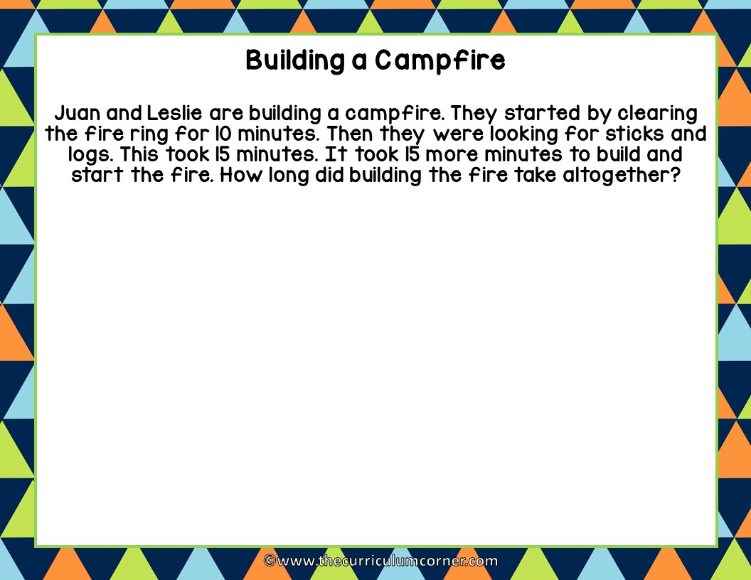
Type here: Use words and numbers to show your thinking and solve the problem.

Slide 2
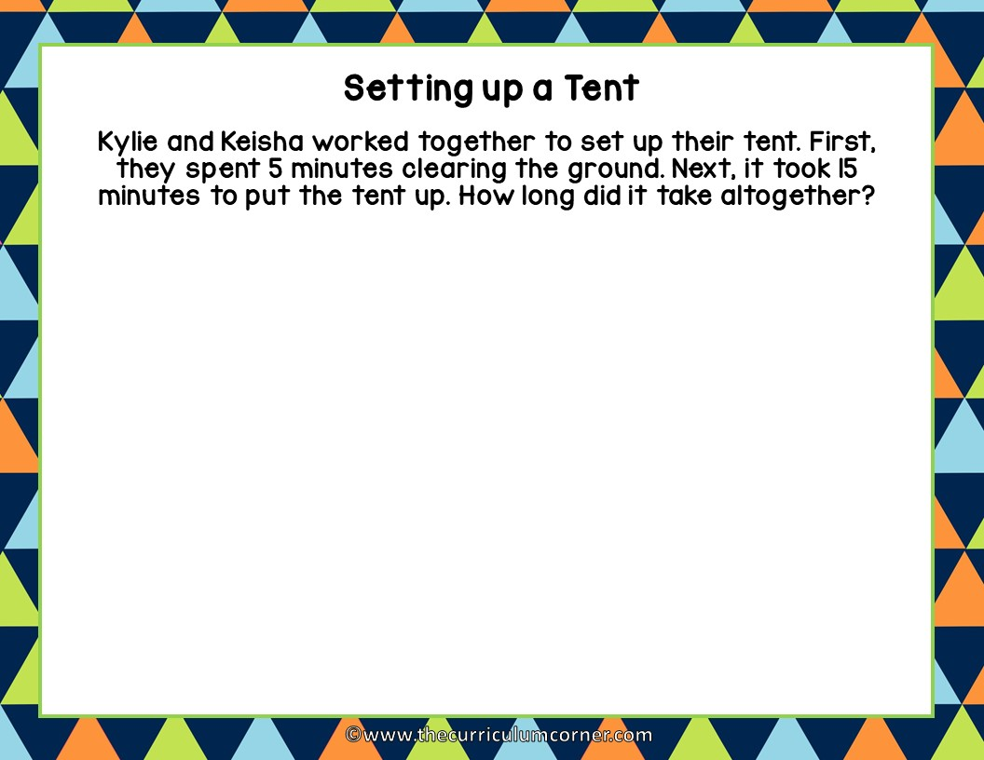
Type here: Use words and numbers to show your thinking and solve the problem.

Slide 3
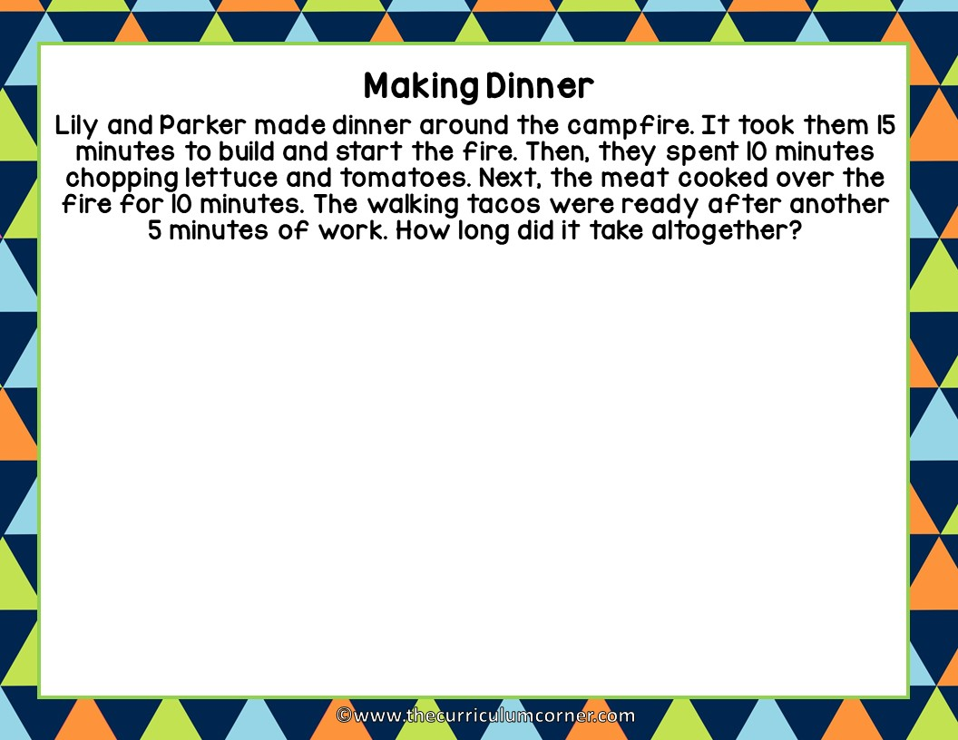
Type here: Use words and numbers to show your thinking and solve the problem.

Slide 4
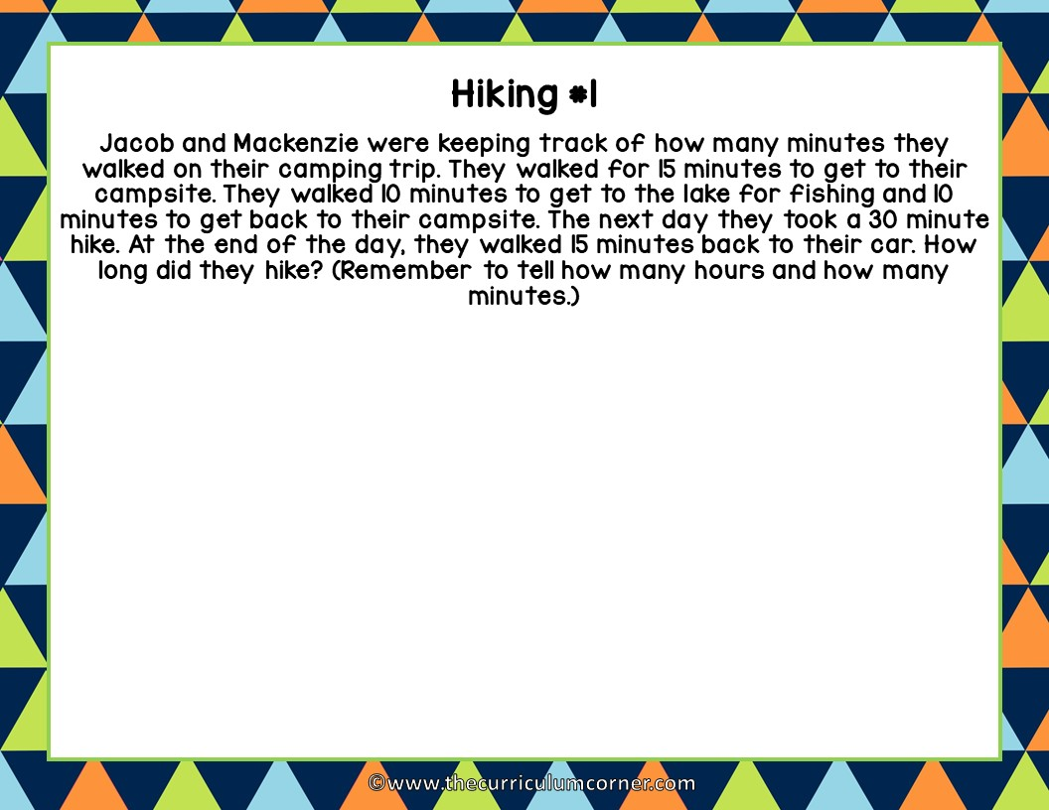
Type here: Use words and numbers to show your thinking and solve the problem.

Slide 5
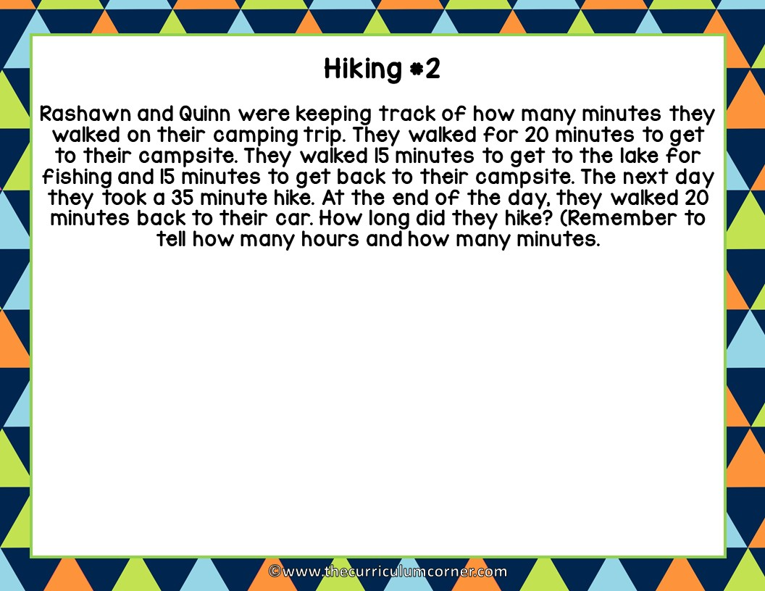
Type here: Use words and numbers to show your thinking and solve the problem.

