Slide 1
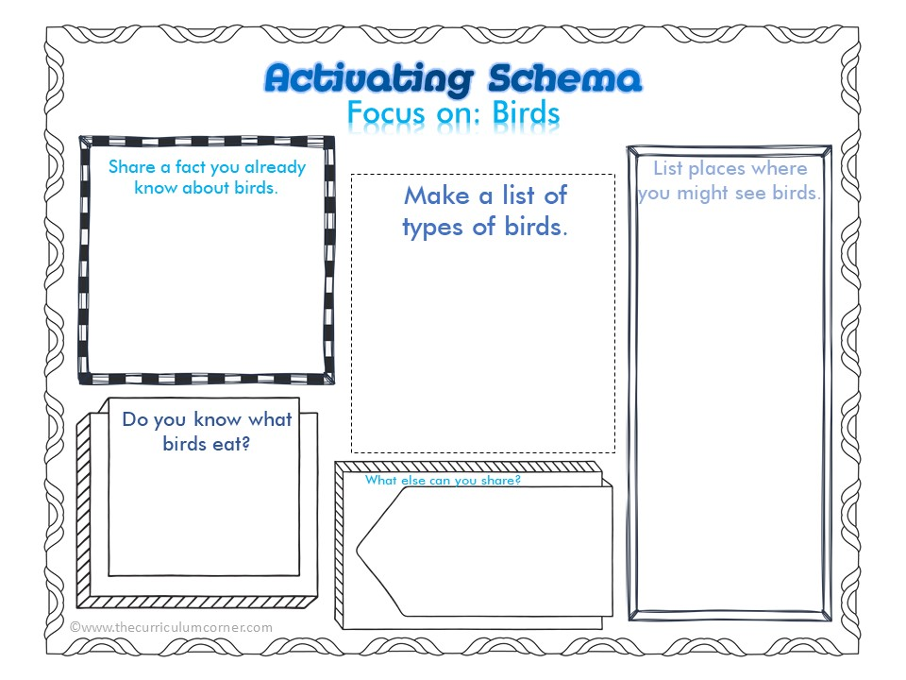
Type answer here
Type answer here
Type answer here
Type answer here
Type answer here

Slide 2
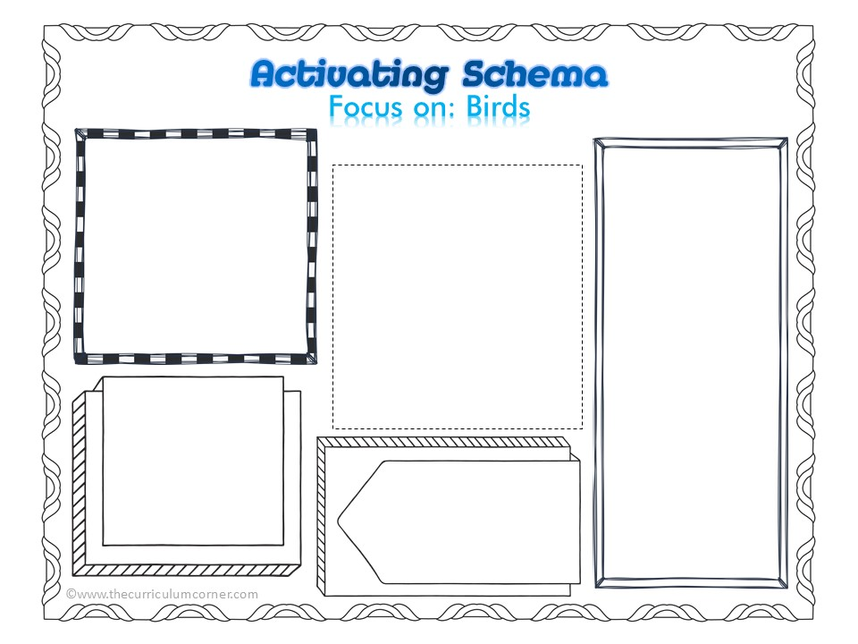
Type answer here
Type answer here
Type answer here
Type answer here
Type answer here

Slide 3
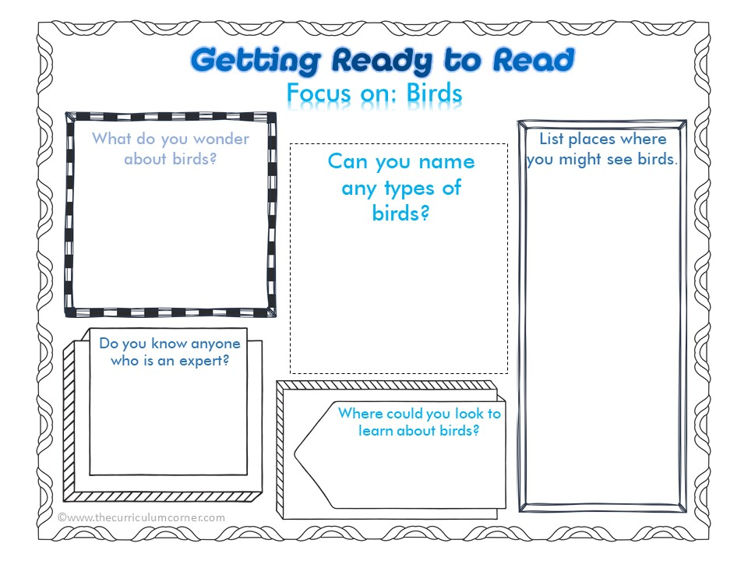
Type answer here
Type answer here
Type answer here
Type answer here
Type answer here

Slide 4
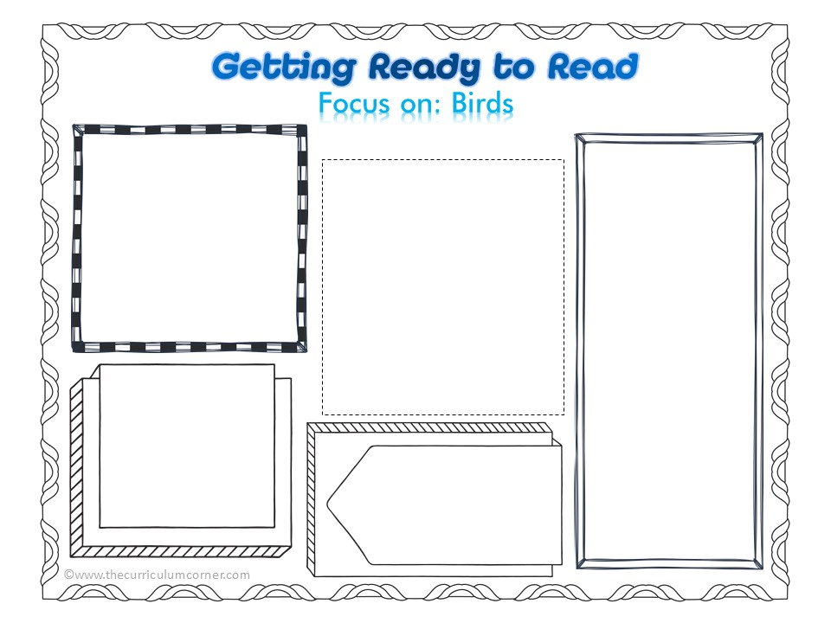
Type answer here
Type answer here
Type answer here
Type answer here
Type answer here

Slide 5
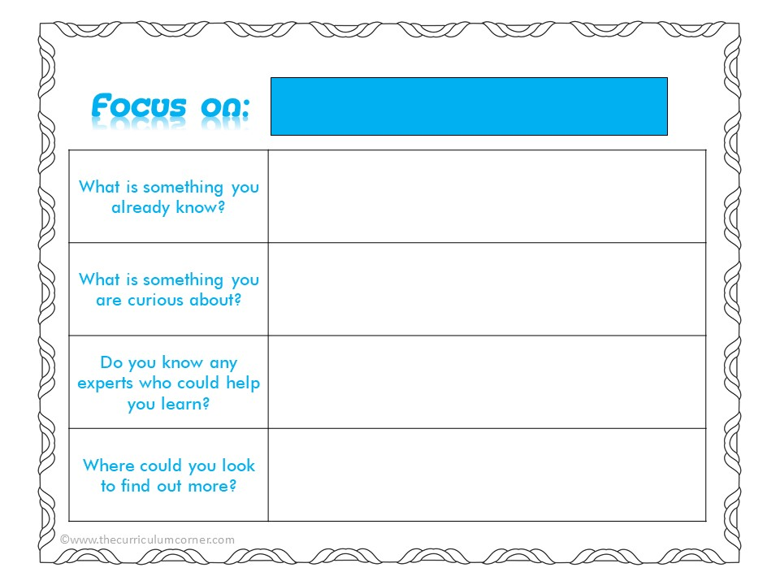
Type answer here
Type answer here
Type answer here
Type answer here

Slide 6
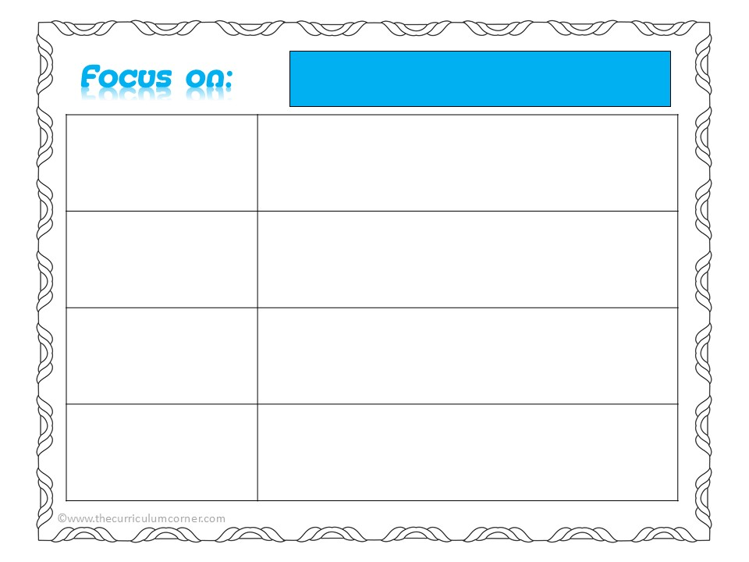
Type answer here
Type answer here
Type answer here
Type answer here

Slide 7
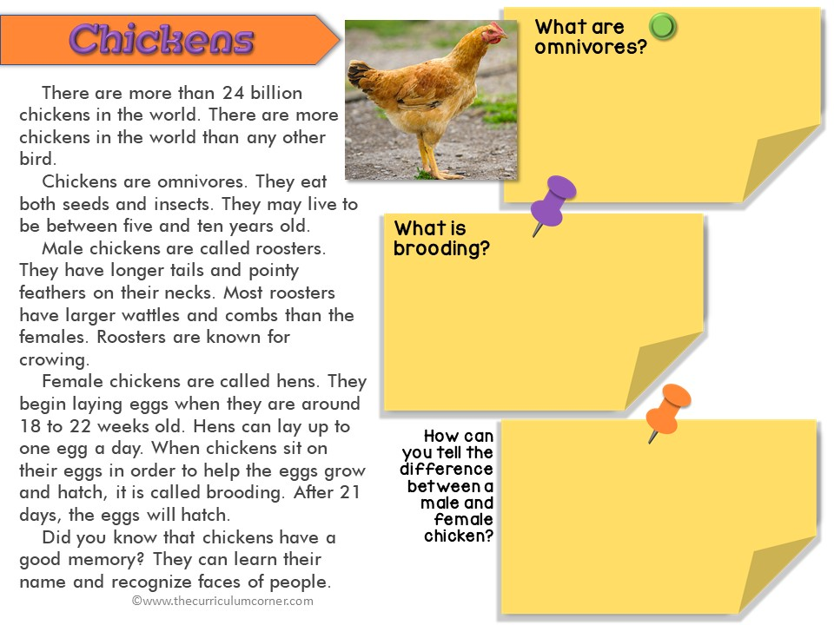
Type answer here
Type answer here
Type answer here

Slide 8
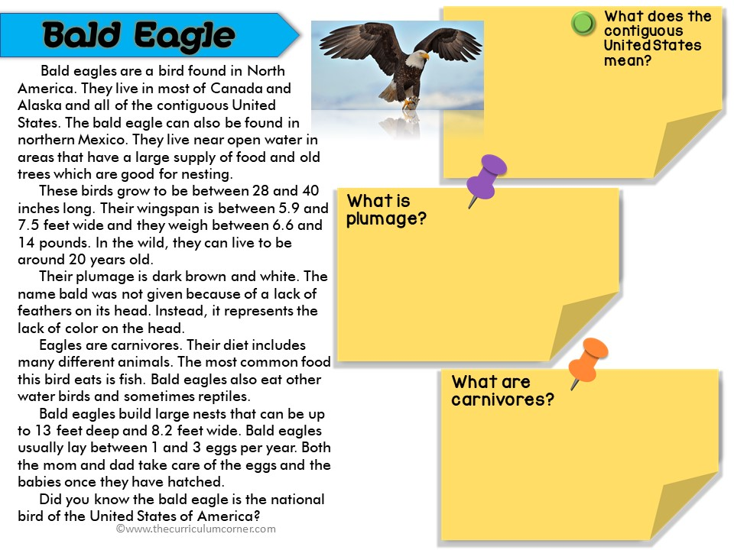
Type answer here
Type answer here
Type answer here

Slide 9
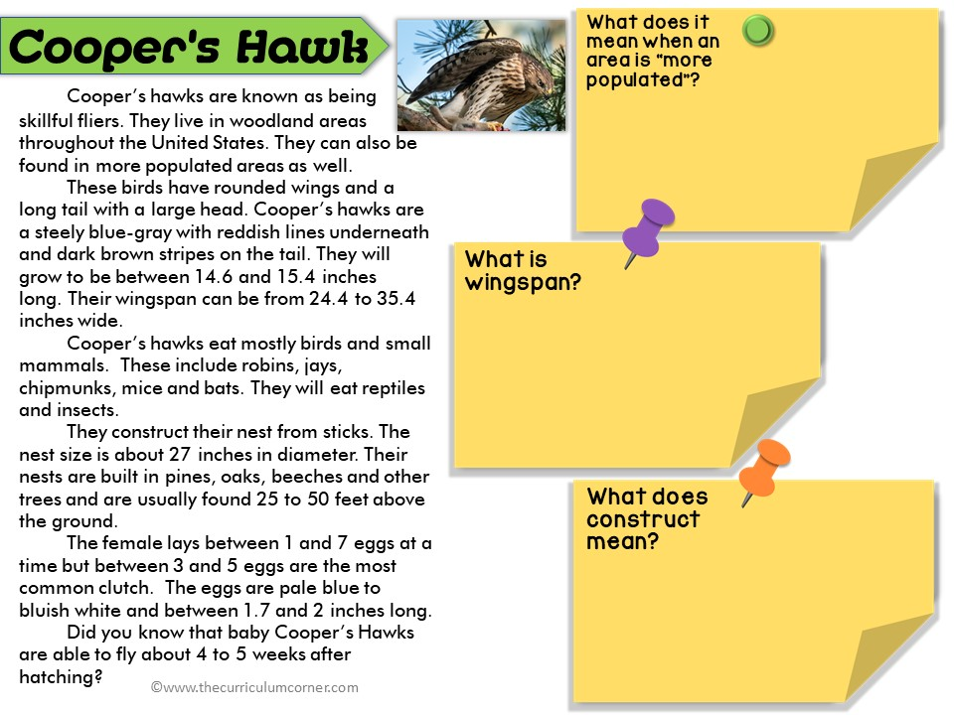
Type answer here
Type answer here
Type answer here

Slide 10
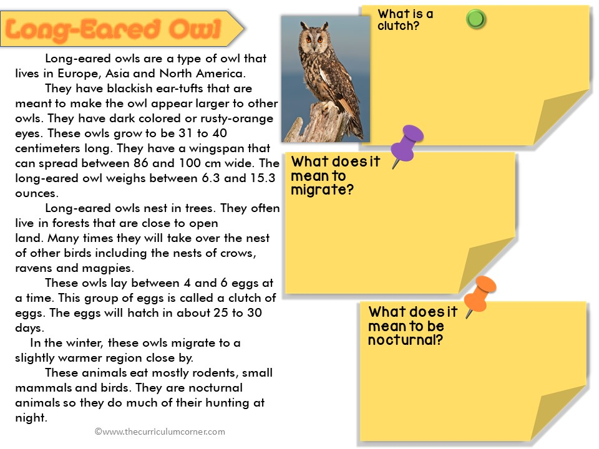
Type answer here
Type answer here
Type answer here

Slide 11
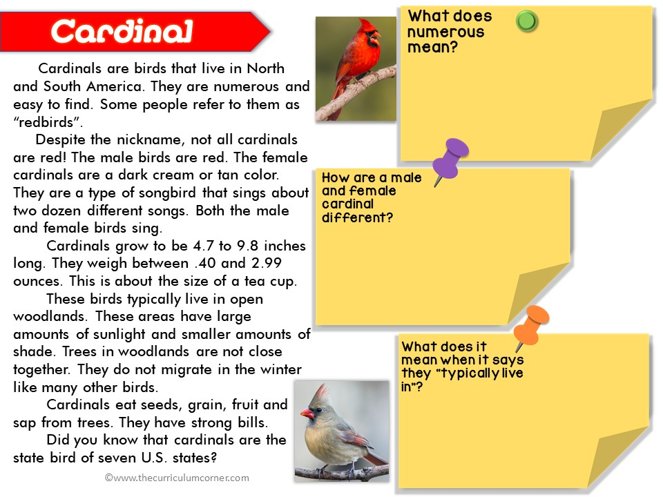
Type answer here
Type answer here
Type answer here

Slide 12
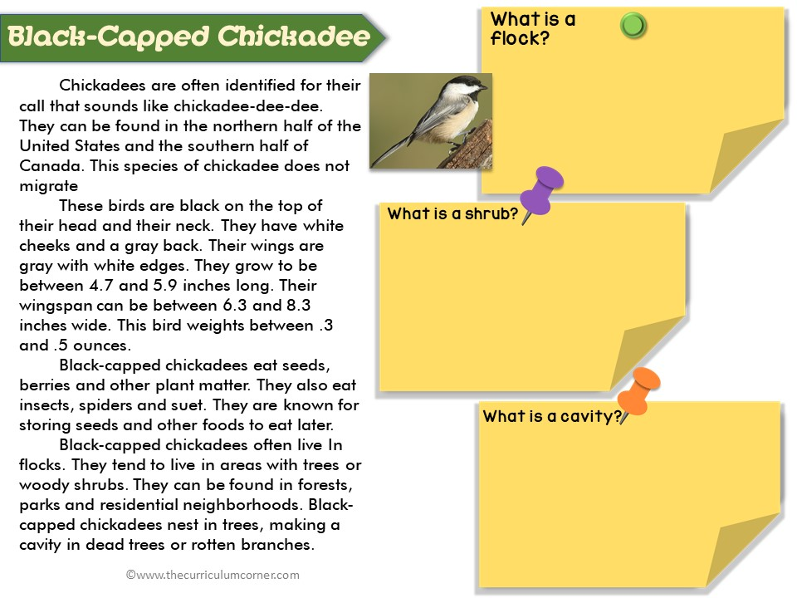
Type answer here
Type answer here
Type answer here

Slide 13
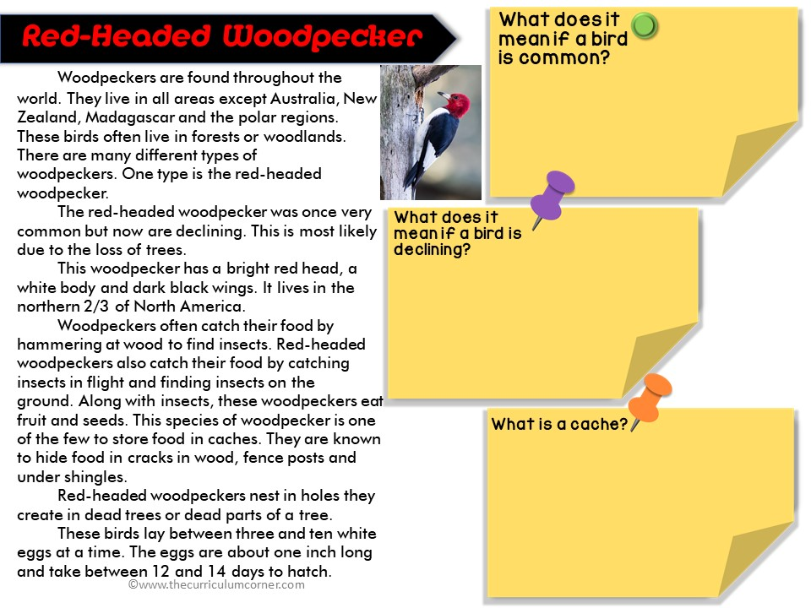
Type answer here
Type answer here
Type answer here

Slide 14
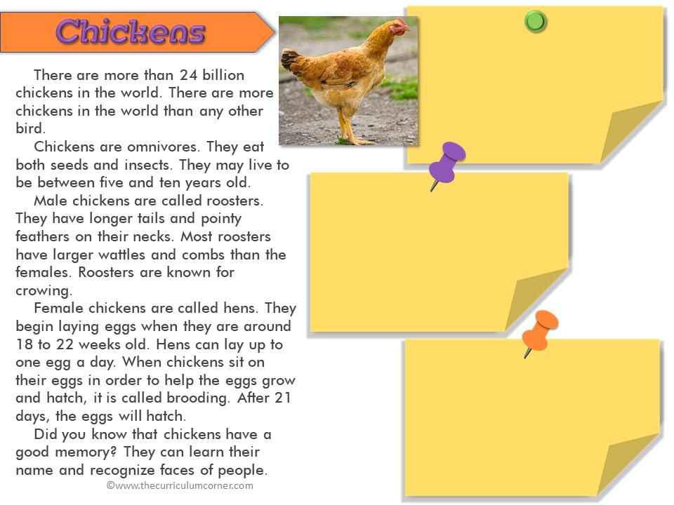
Type here
Type here
Type here

Slide 15
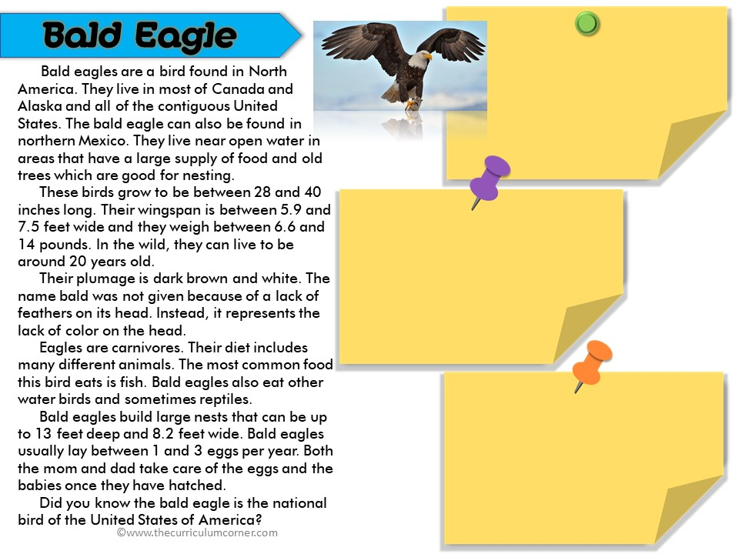
Type here
Type here
Type here

Slide 16
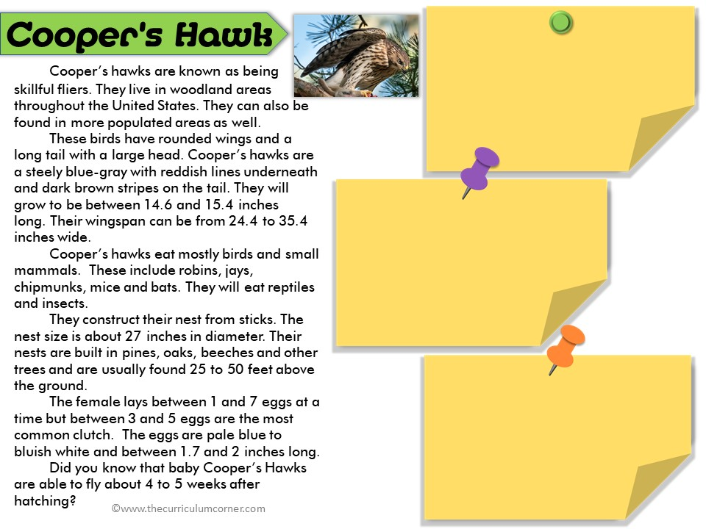
Type here
Type here
Type here

Slide 17
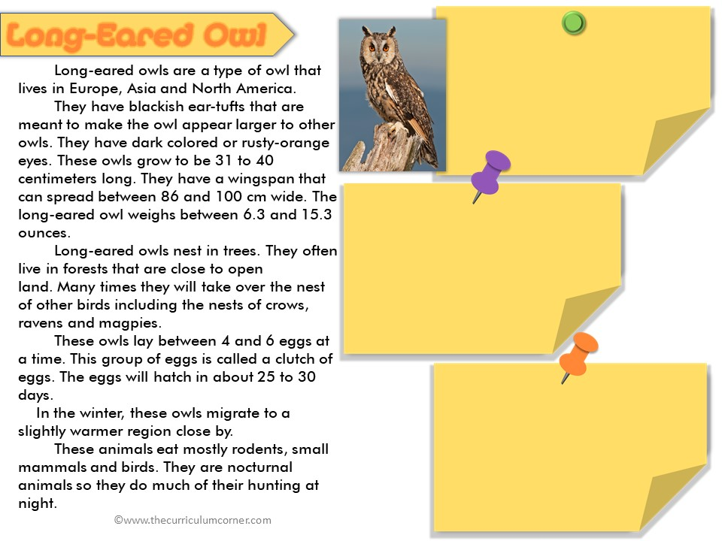
Type here
Type here
Type here

Slide 18
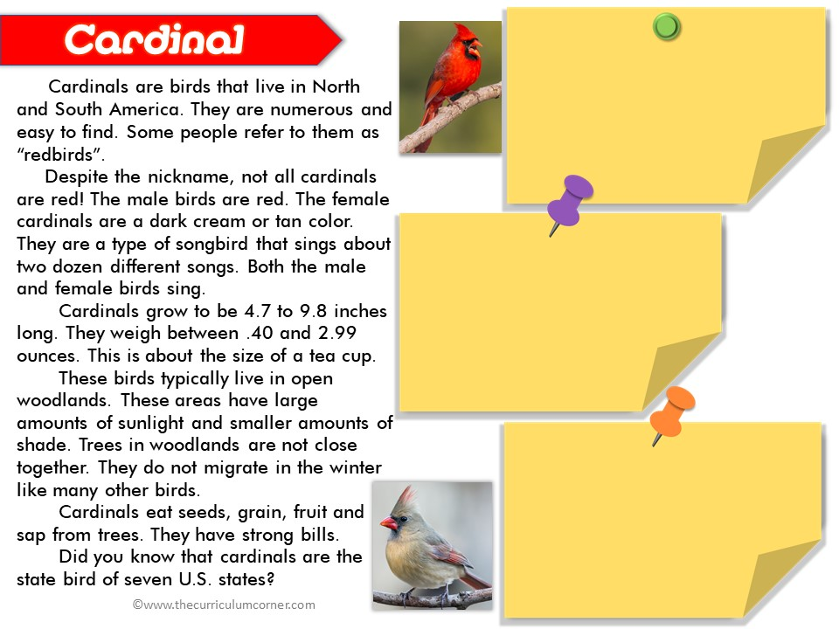
Type here
Type here
Type here

Slide 19
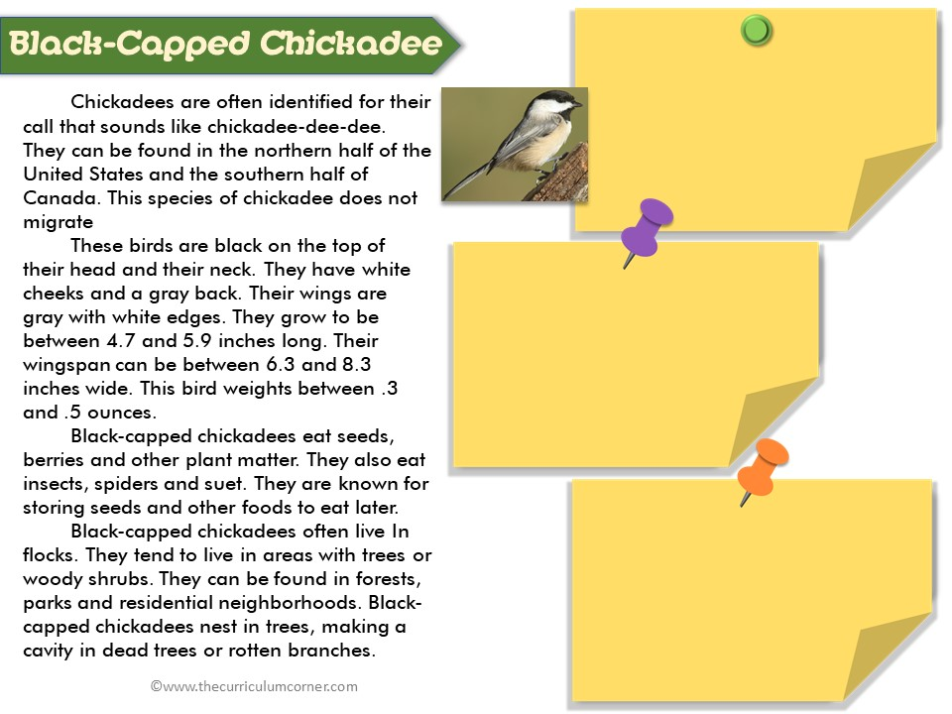
Type here
Type here
Type here

Slide 20
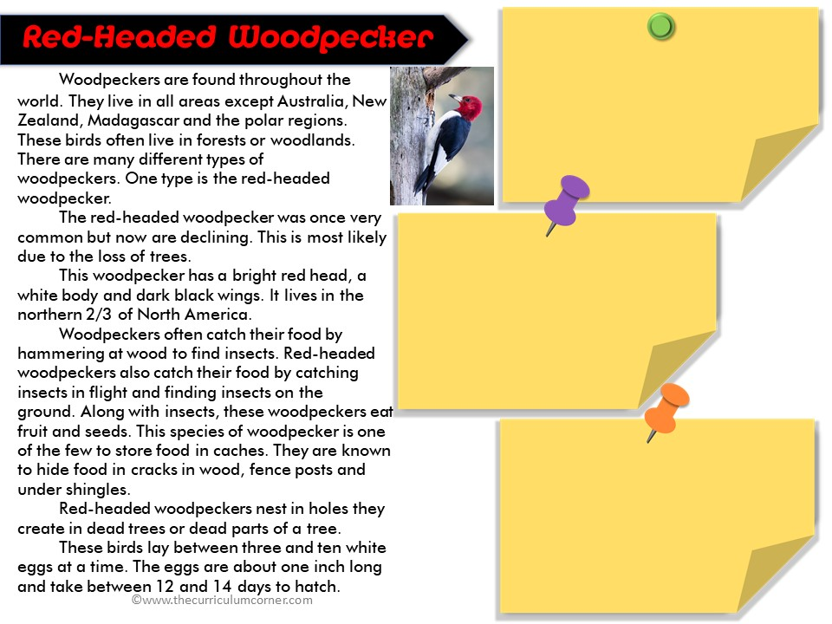
Type here
Type here
Type here

