Slide 1

Find the Sound
a phonics practice game
beginning ch, sh & th
Click to start.
Created by The Curriculum Corner

Slide 2
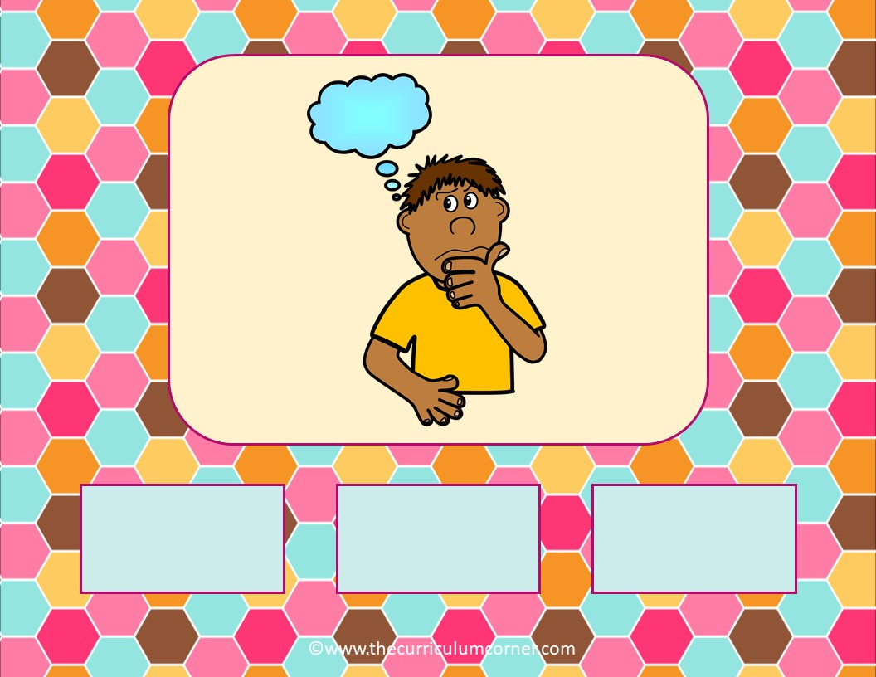
ch
sh
th

Slide 3
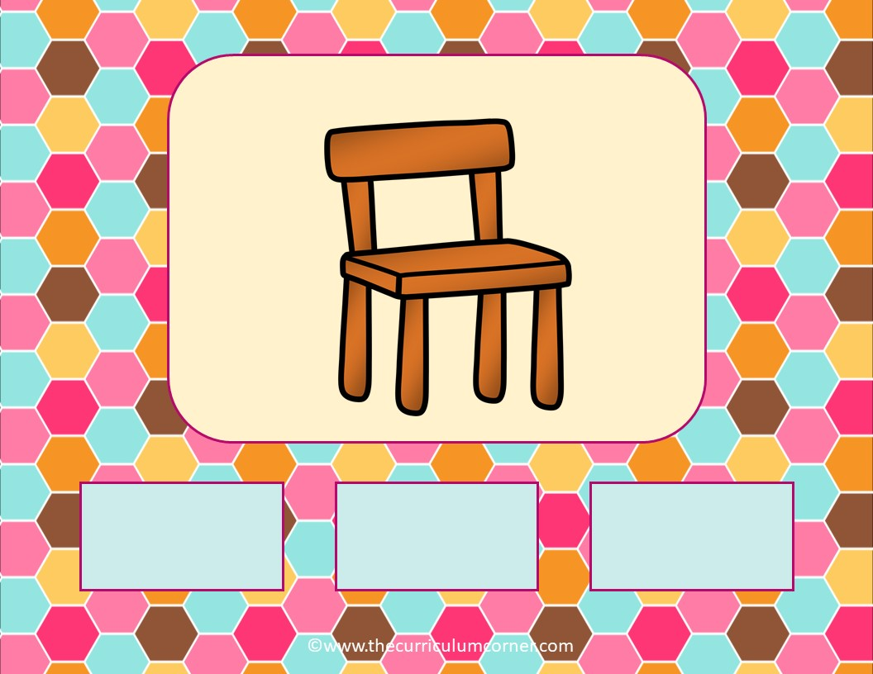
ch
sh
th

Slide 4

ch
sh
th

Slide 5

ch
sh
th

Slide 6
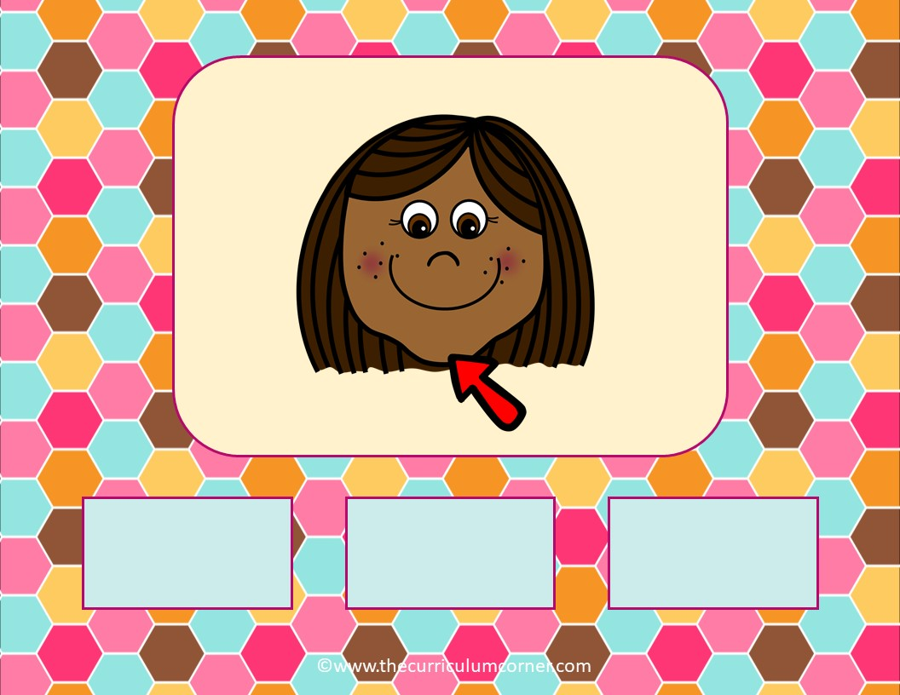
ch
sh
th

Slide 7
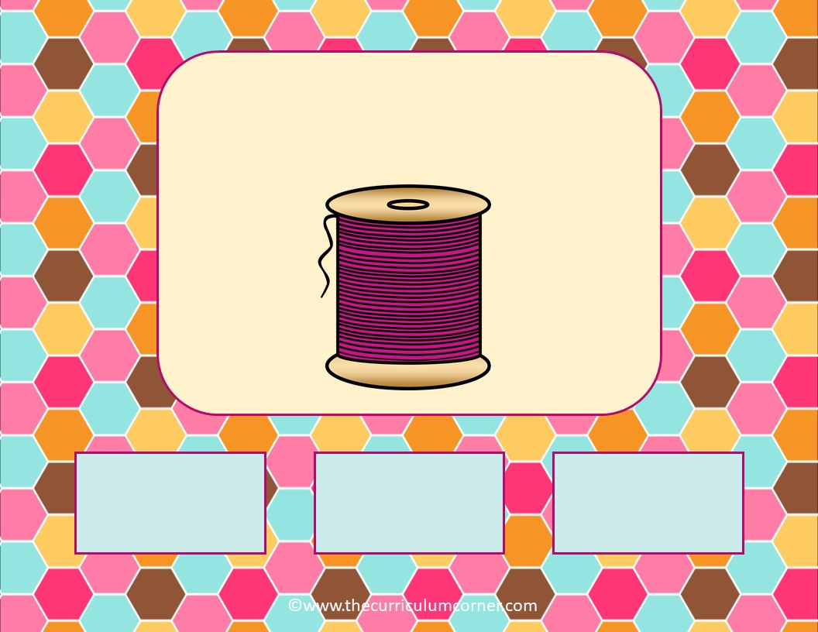
ch
sh
th

Slide 8
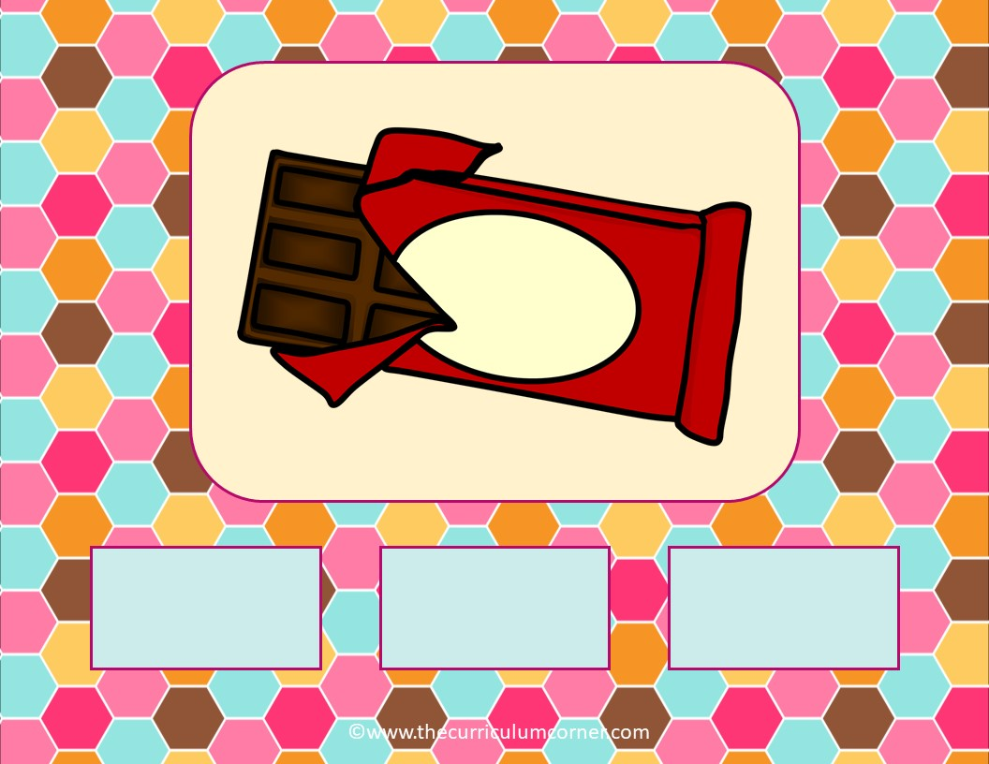
ch
sh
th

Slide 9

ch
sh
th

Slide 10
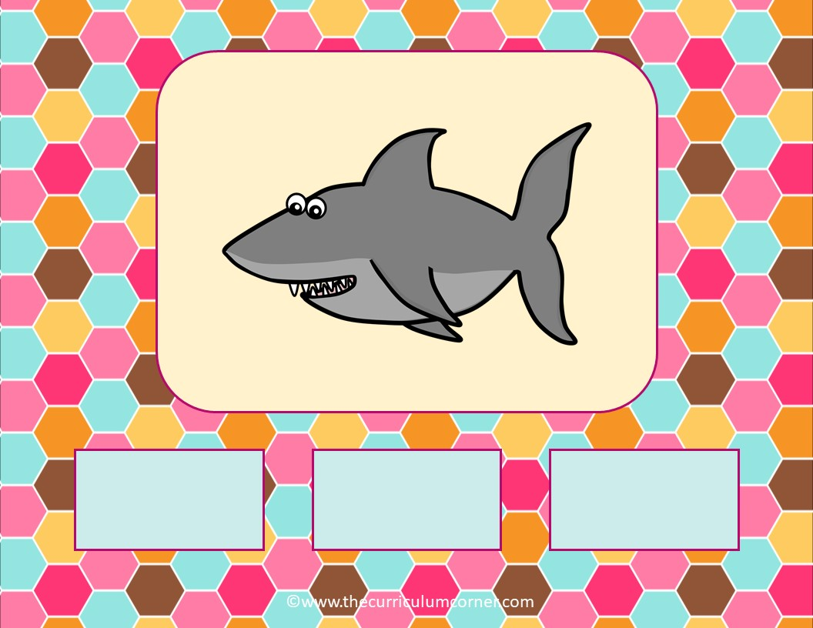
ch
sh
th

Slide 11

ch
sh
th

Slide 12
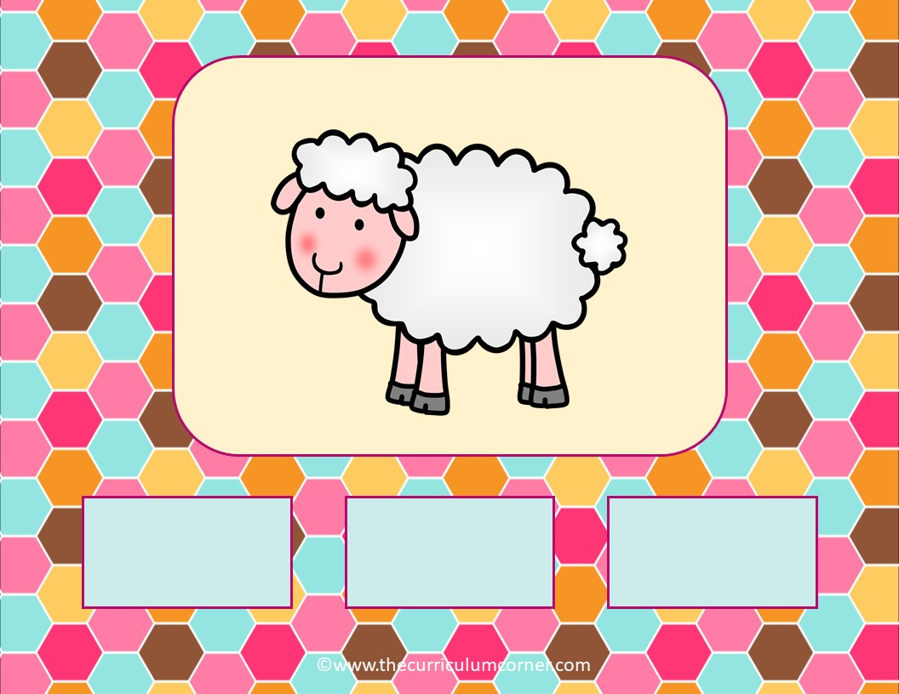
ch
sh
th

Slide 13
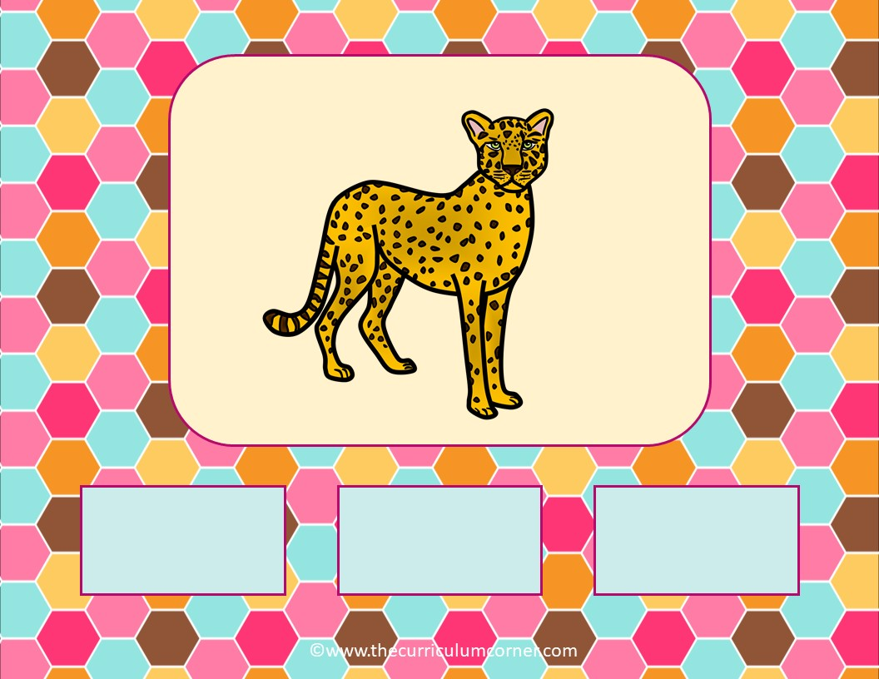
ch
sh
th

Slide 14
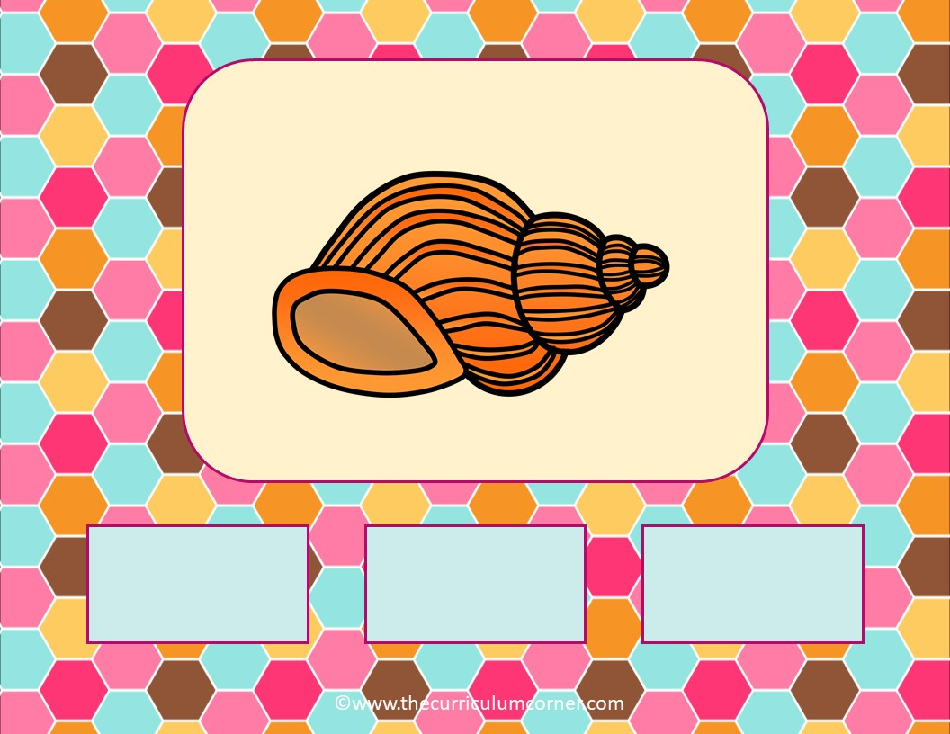
ch
sh
th

Slide 15

ch
sh
th

Slide 16
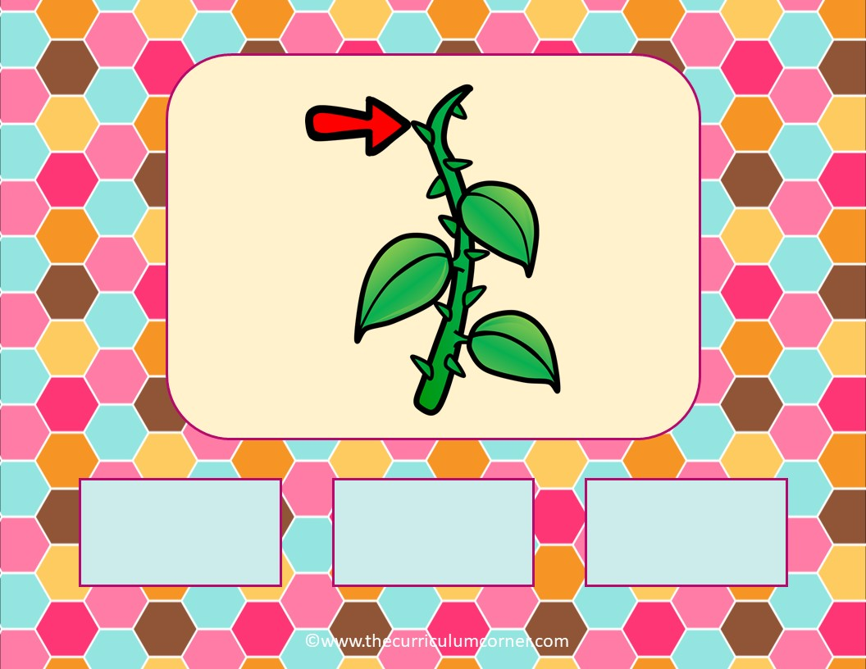
ch
sh
th

Slide 17
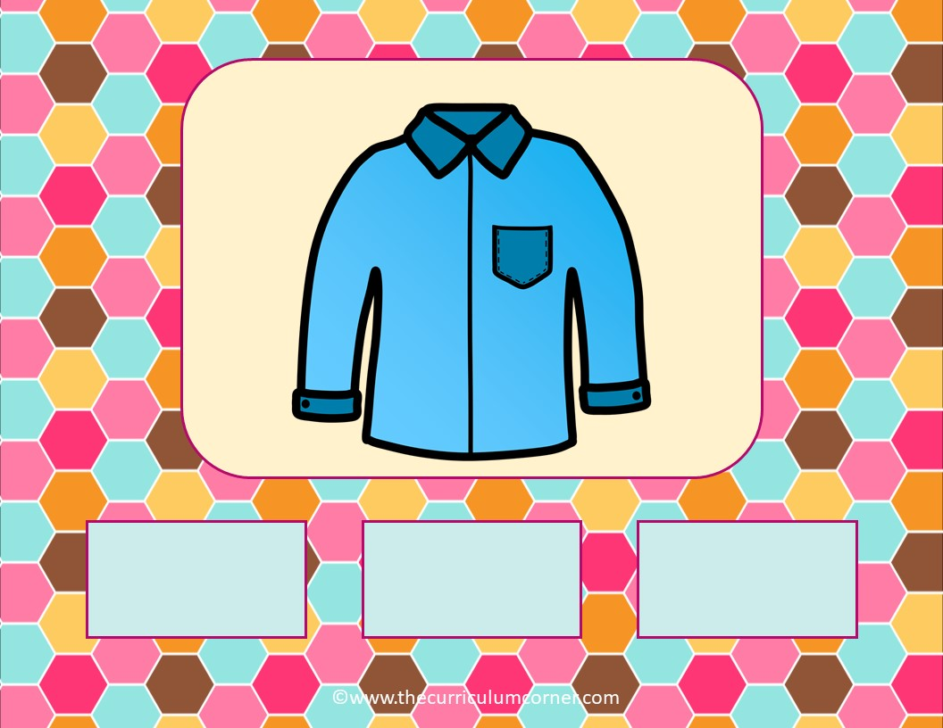
ch
sh
th

Slide 18
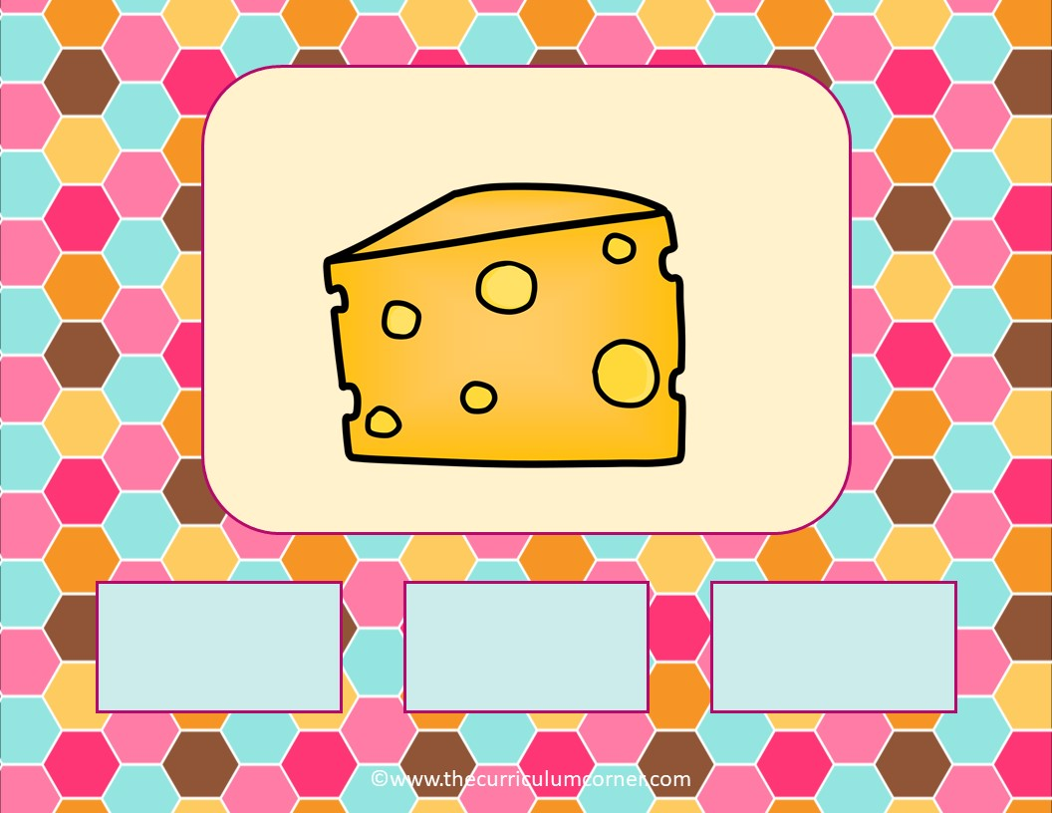
ch
sh
th

Slide 19

ch
sh
th

Slide 20
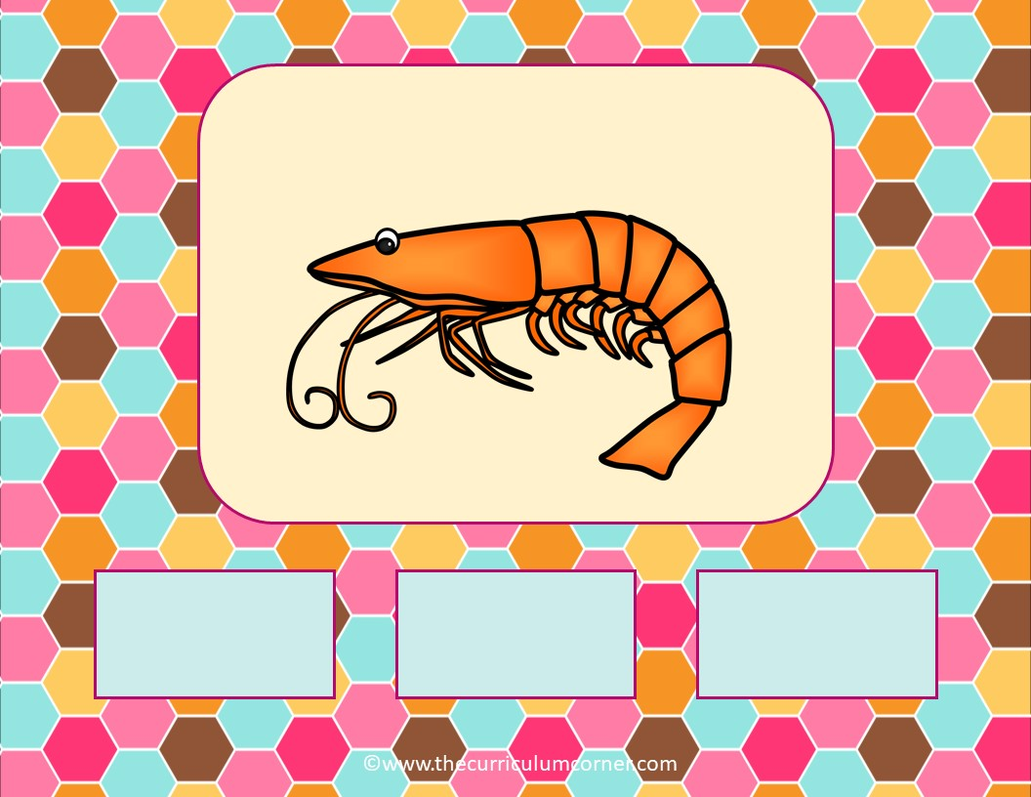
ch
sh
th

Slide 21
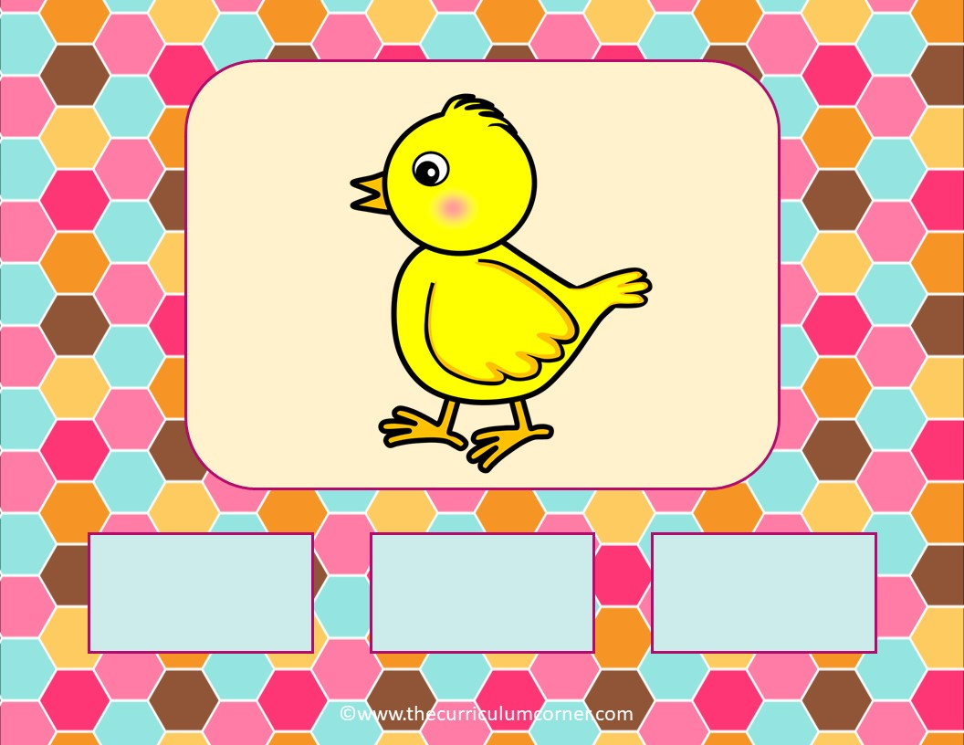
ch
sh
th

Slide 22
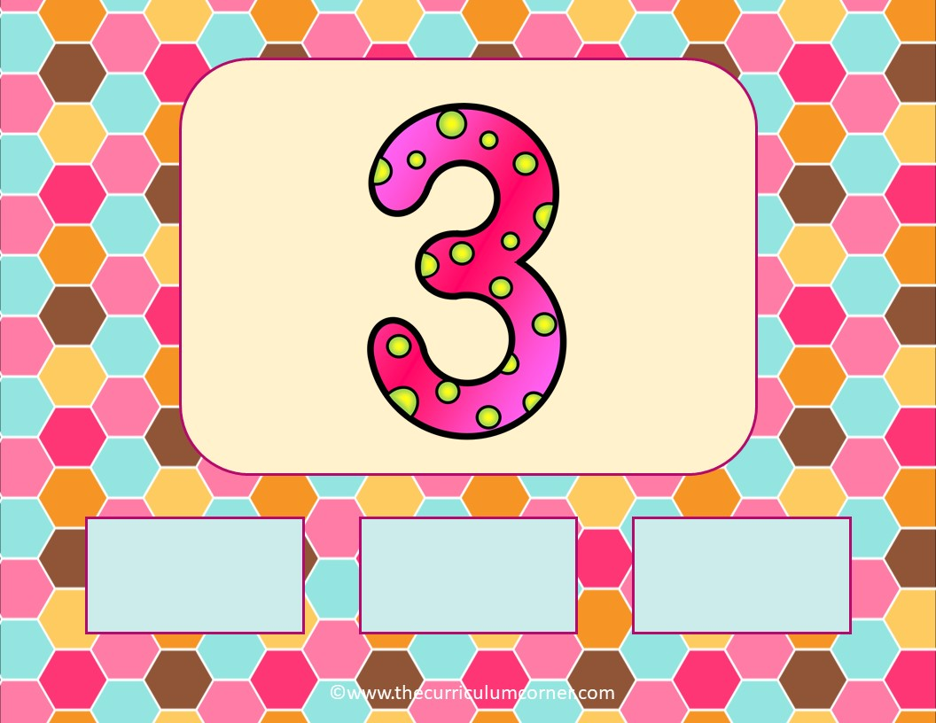
ch
sh
th

Slide 23
Way to Go!
Click here to go back to the start.
Created by The Curriculum Corner

