Slide 1

Hard or Soft C?
a phonics practice game
Click to start.
Created by The Curriculum Corner

Slide 2
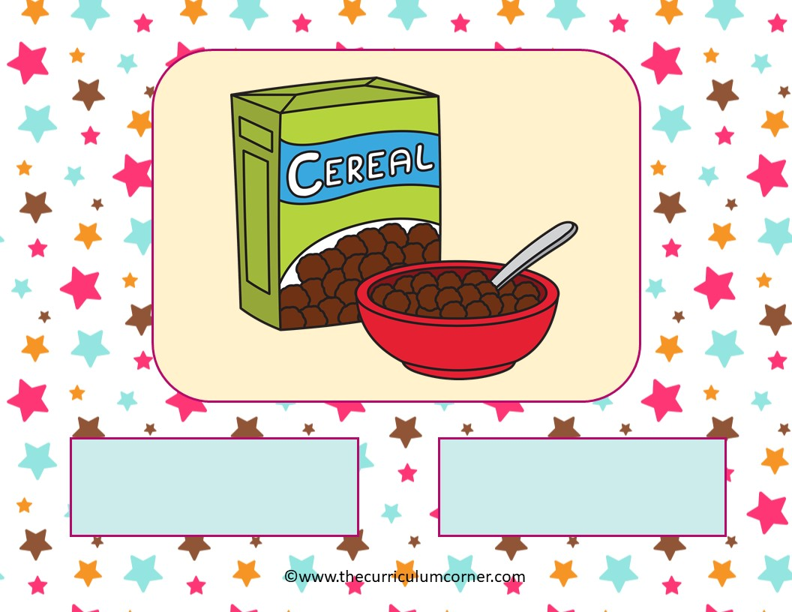
Hard C
Soft C

Slide 3
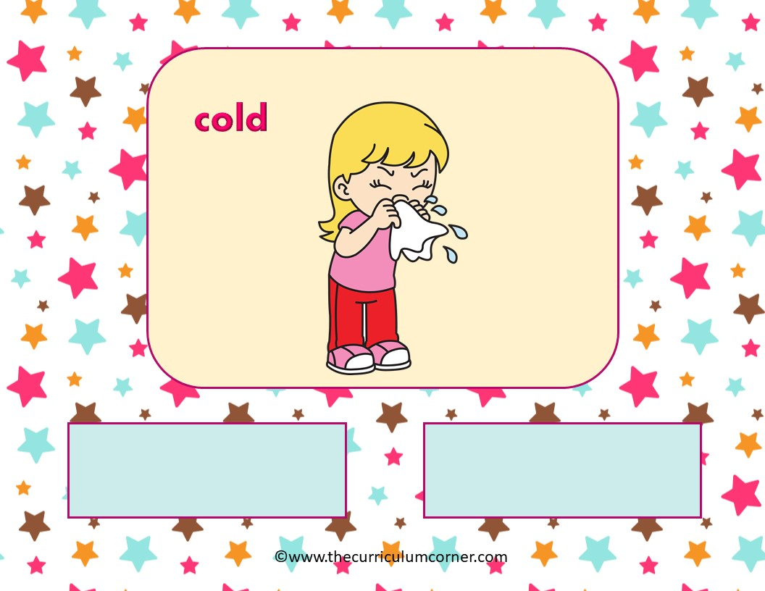
Hard C
Soft C

Slide 4
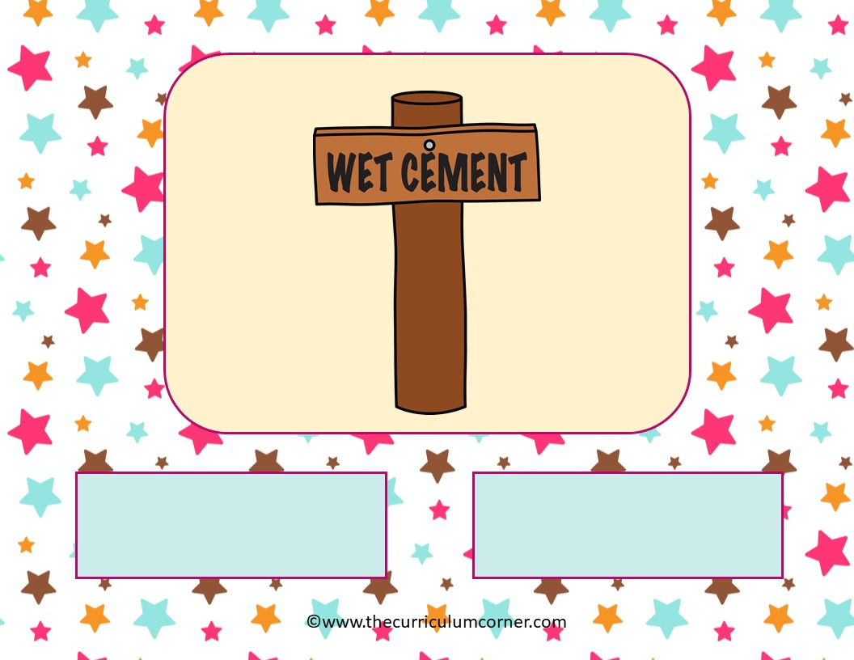
Hard C
Soft C

Slide 5
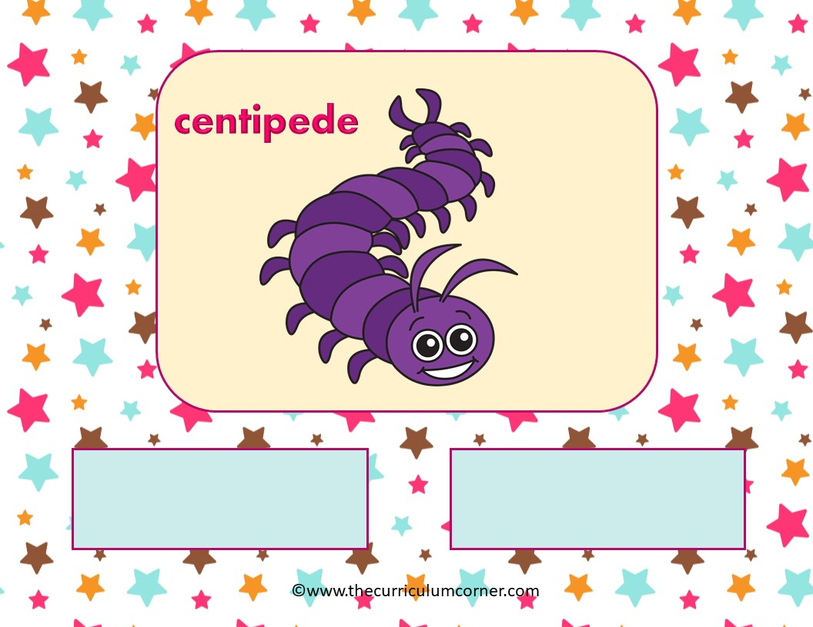
Hard C
Soft C

Slide 6
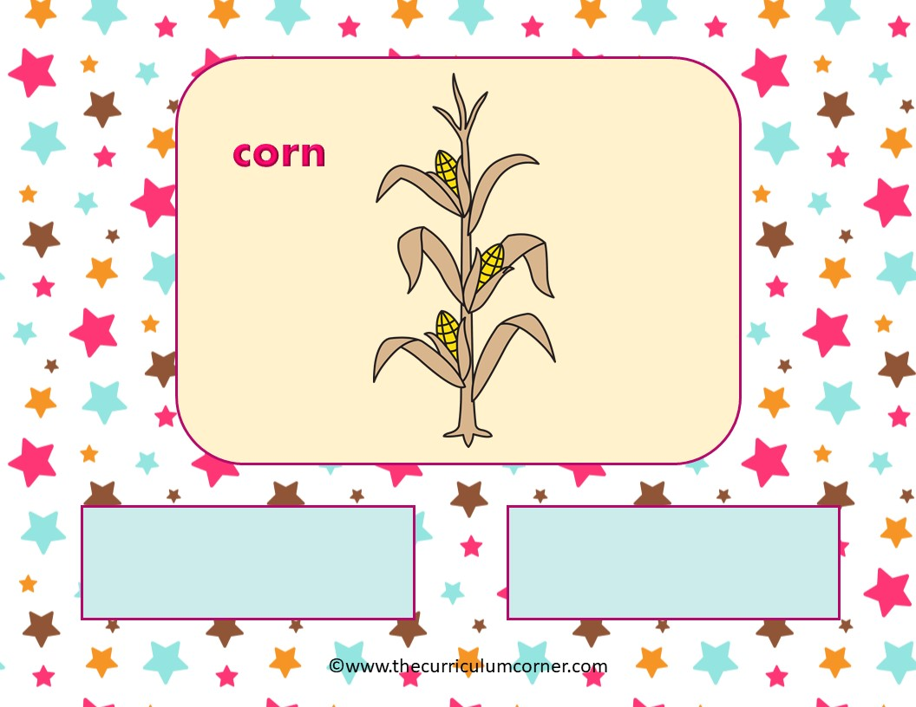
Hard C
Soft C

Slide 7
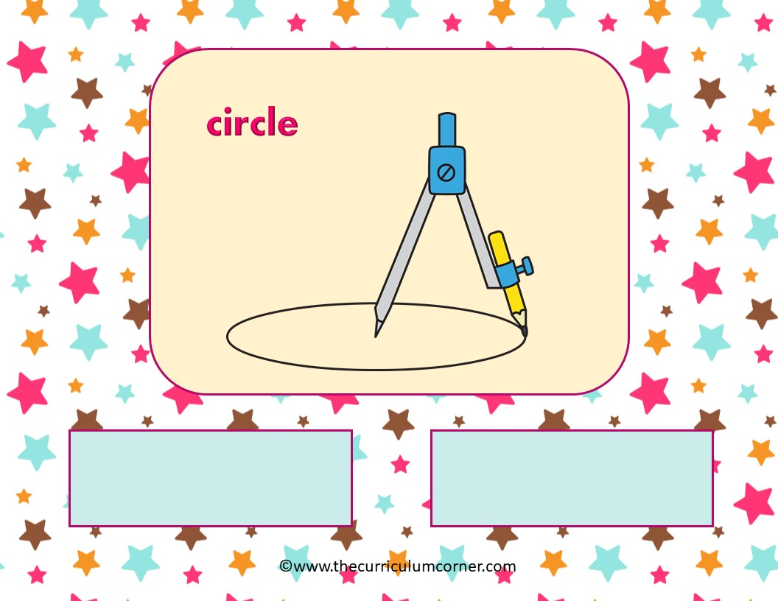
Hard C
Soft C

Slide 8
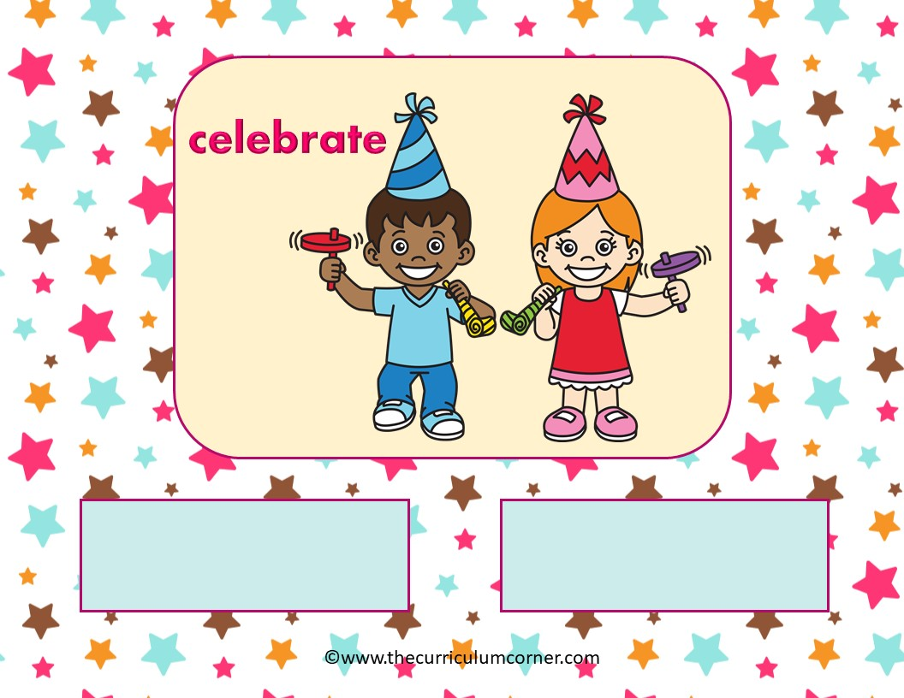
Hard C
Soft C

Slide 9
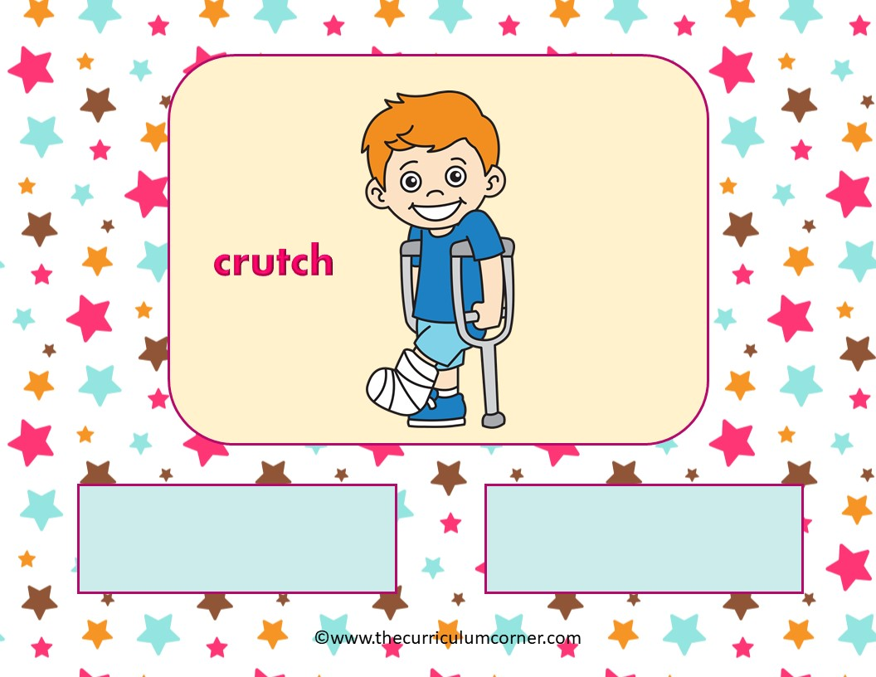
Hard C
Soft C

Slide 10
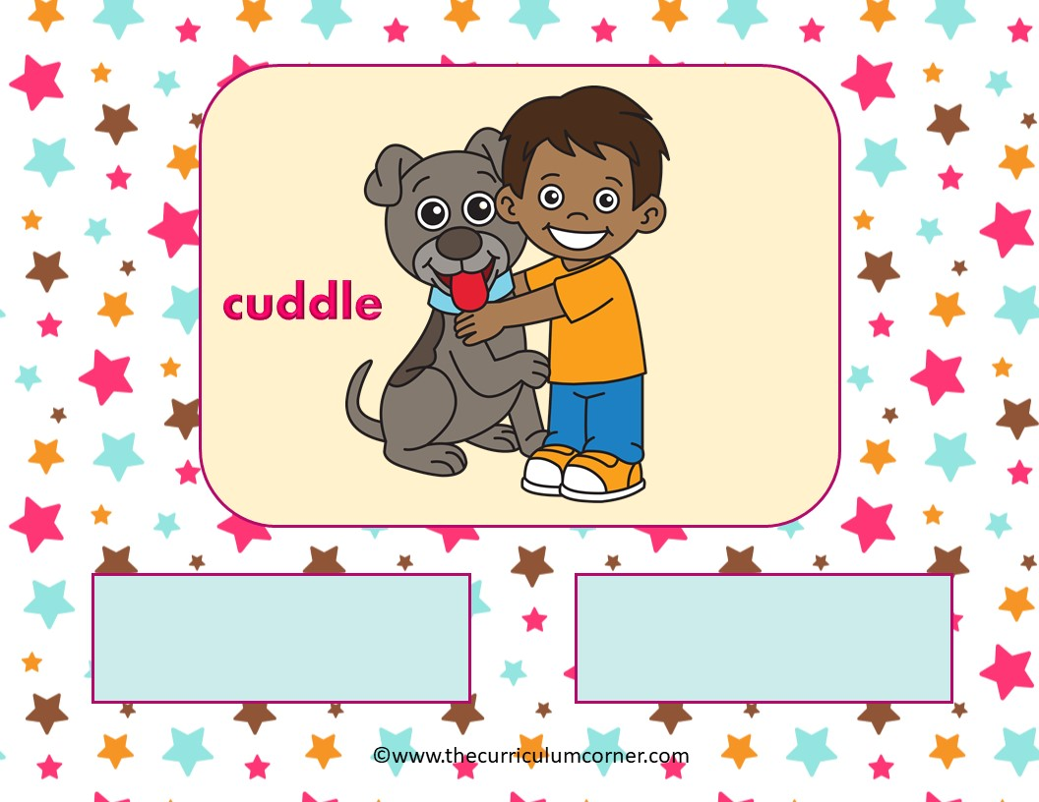
Hard C
Soft C

Slide 11
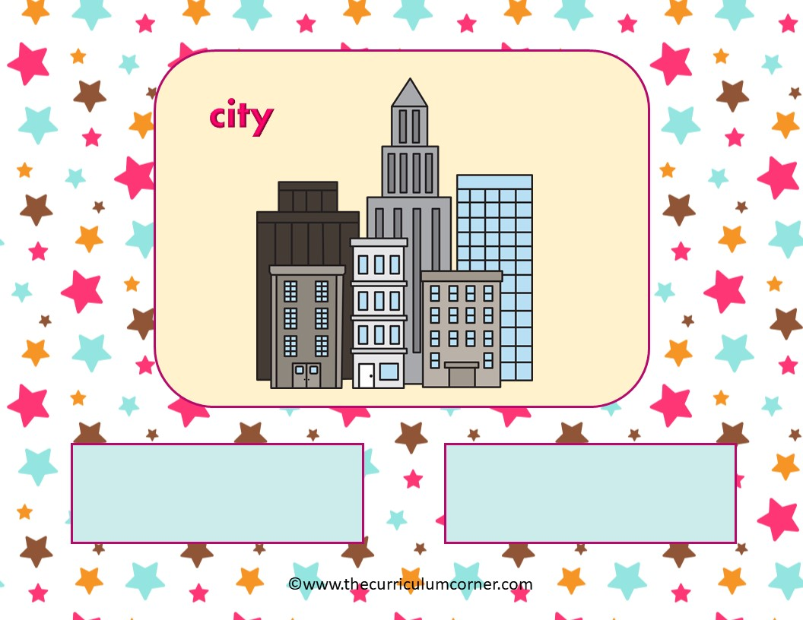
Hard C
Soft C

Slide 12
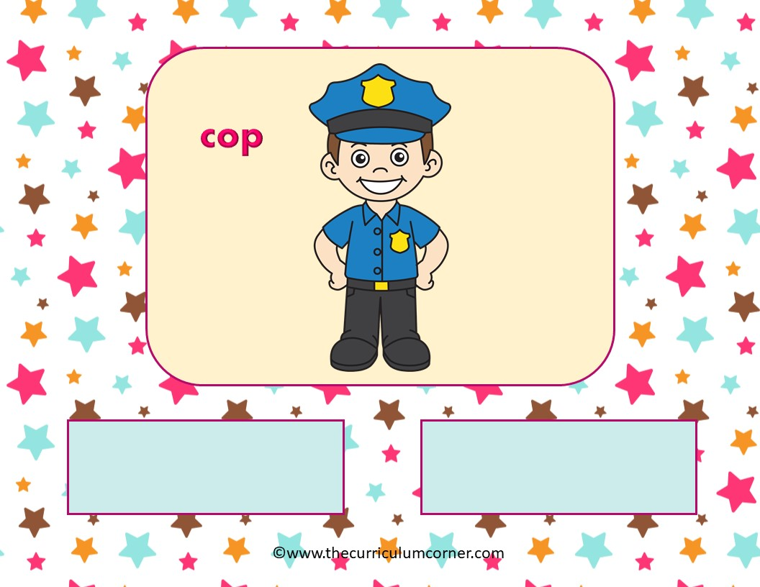
Hard C
Soft C

Slide 13
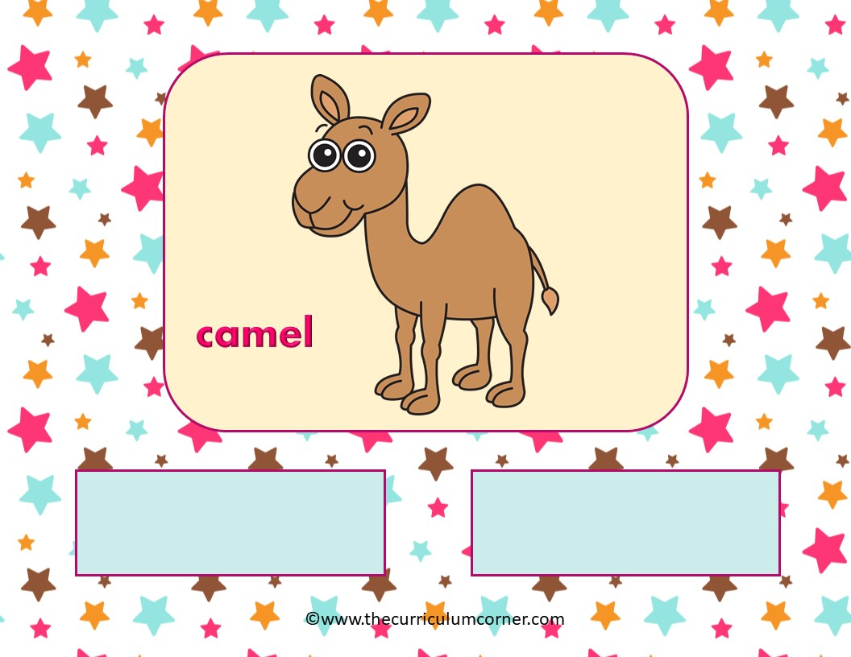
Hard C
Soft C

Slide 14
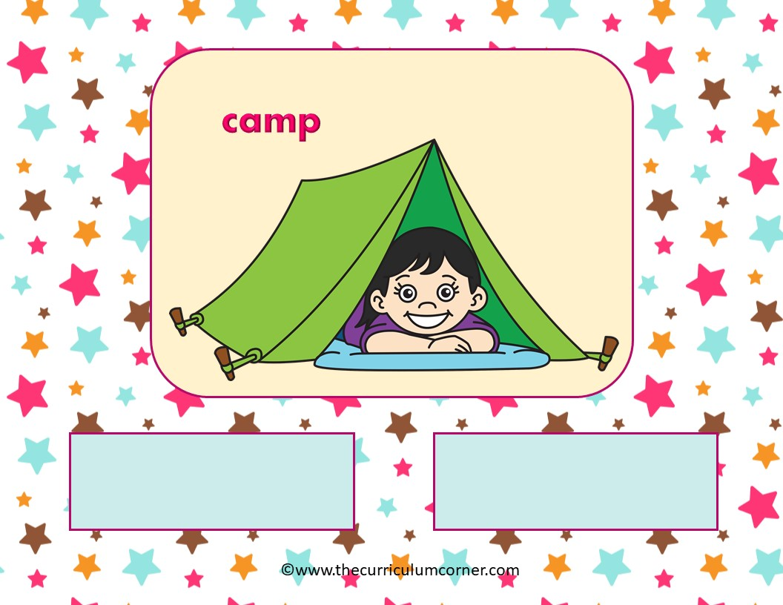
Hard C
Soft C

Slide 15
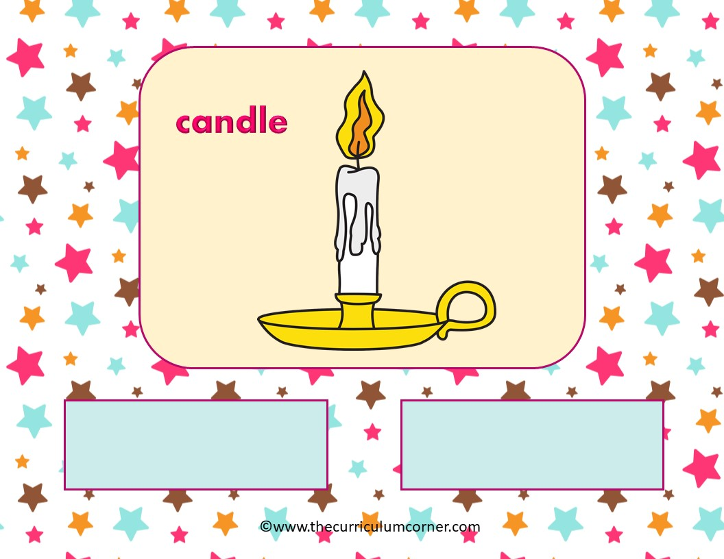
Hard C
Soft C

Slide 16
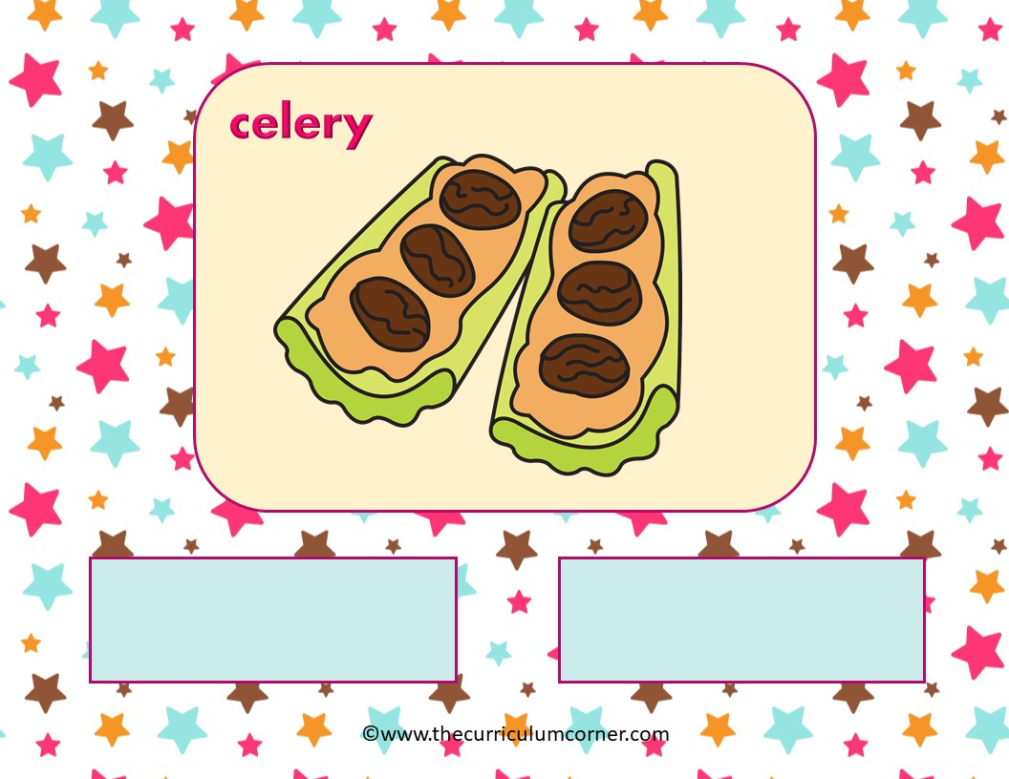
Hard C
Soft C

Slide 17
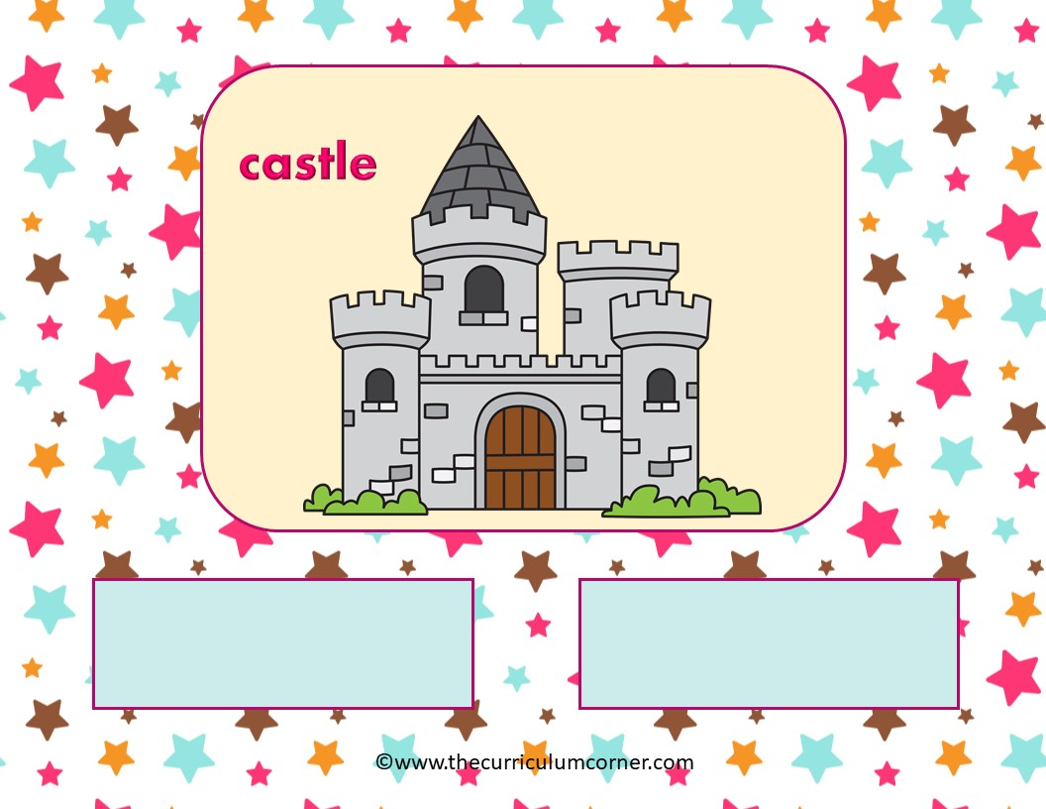
Hard C
Soft C

Slide 18
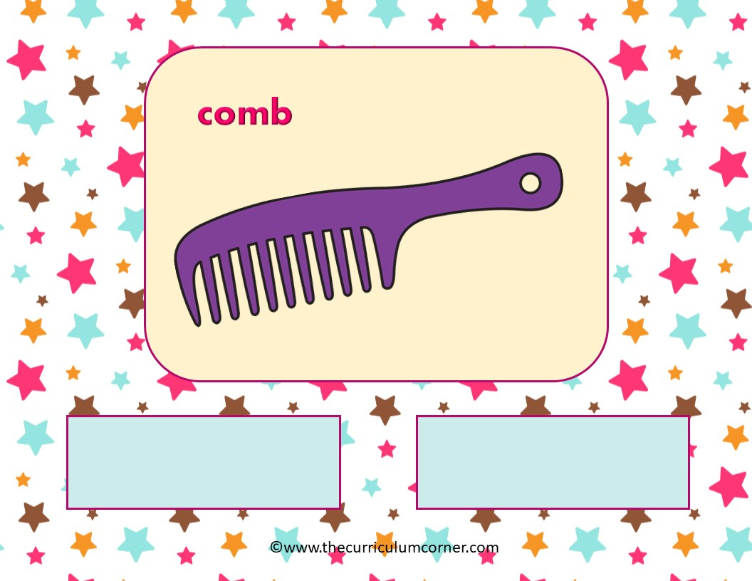
Hard C
Soft C

Slide 19
Way to Go!
Click here to go back to the beginning.
Created by The Curriculum Corner

