Slide 1

Find the Missing Letter
a phonics practice game
long vowel sounds
Click to start.
Created by The Curriculum Corner

Slide 2
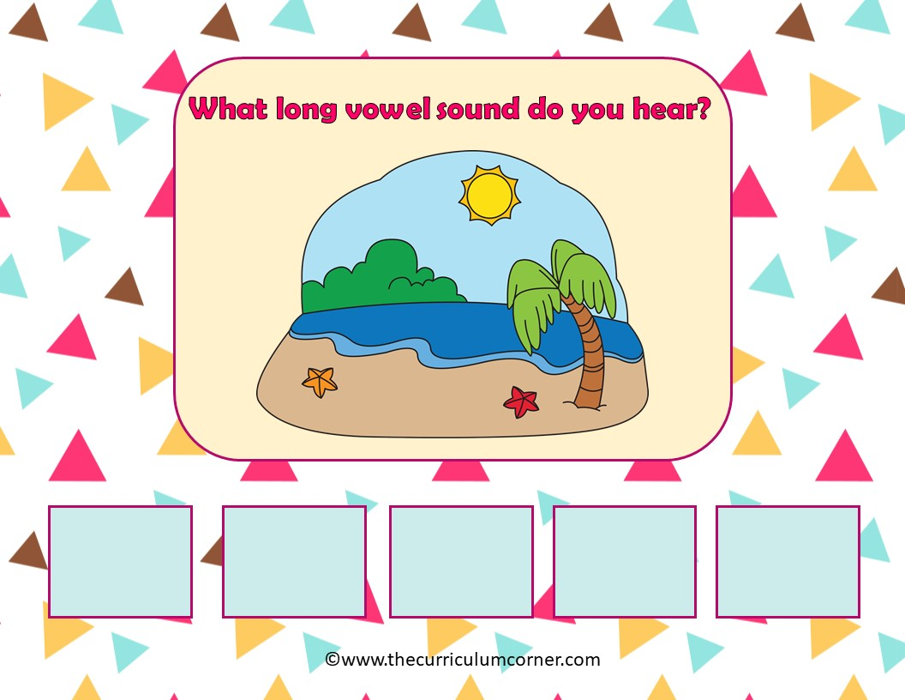
island
a
e
i
o
u

Slide 3
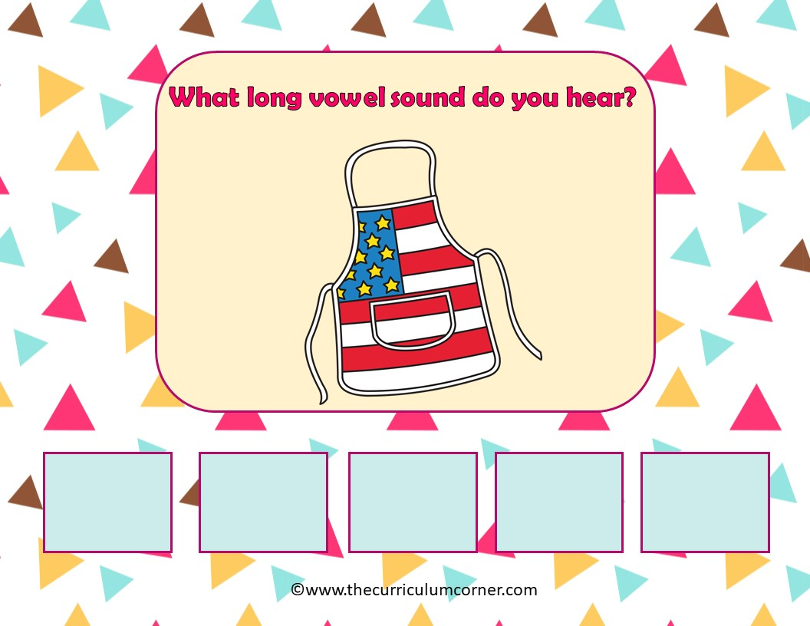
apron
a
e
i
o
u

Slide 4
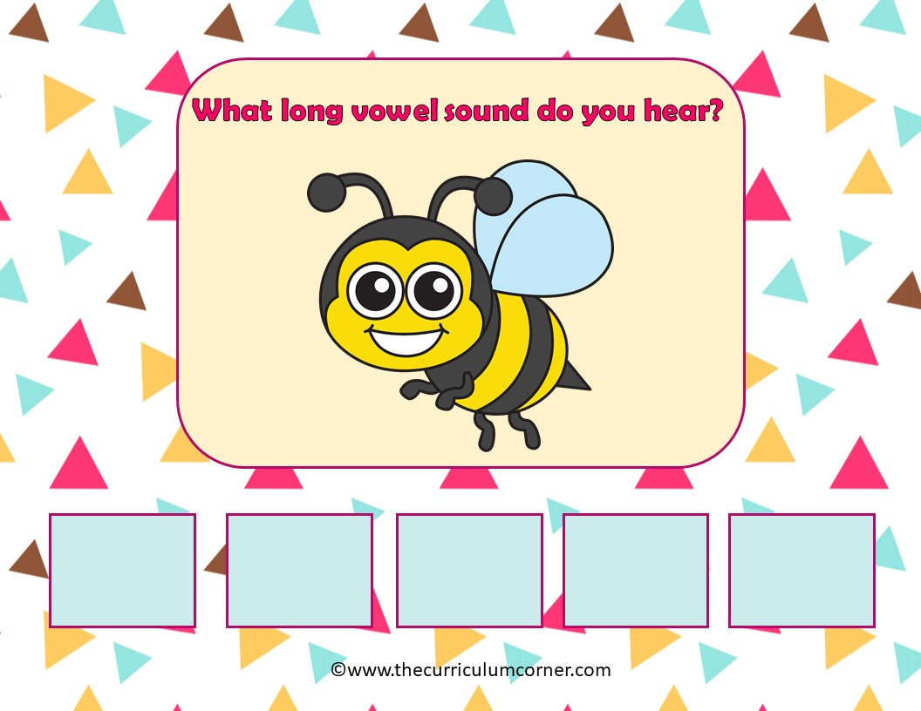
bee
a
e
i
o
u

Slide 5
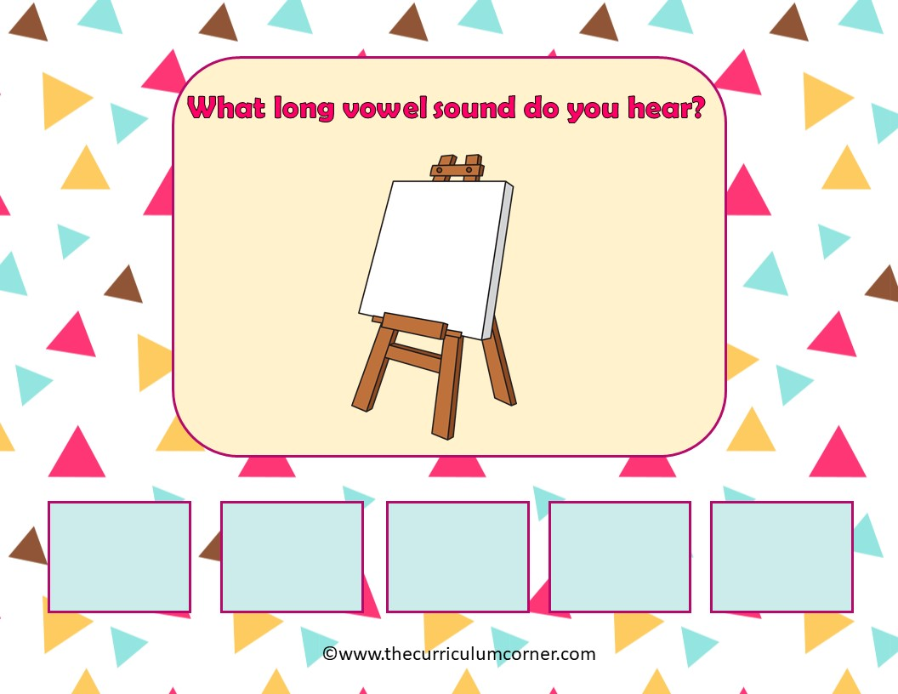
easel
a
e
i
o
u

Slide 6
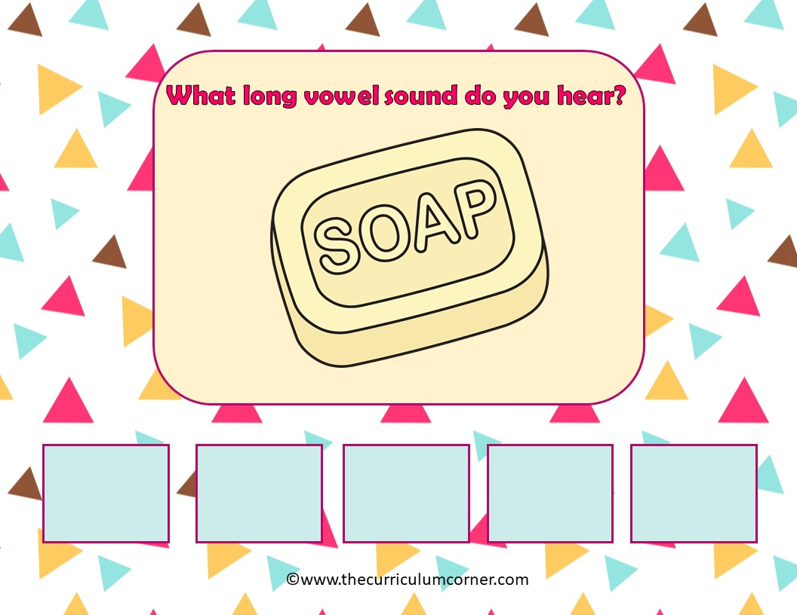
a
e
i
o
u

Slide 7
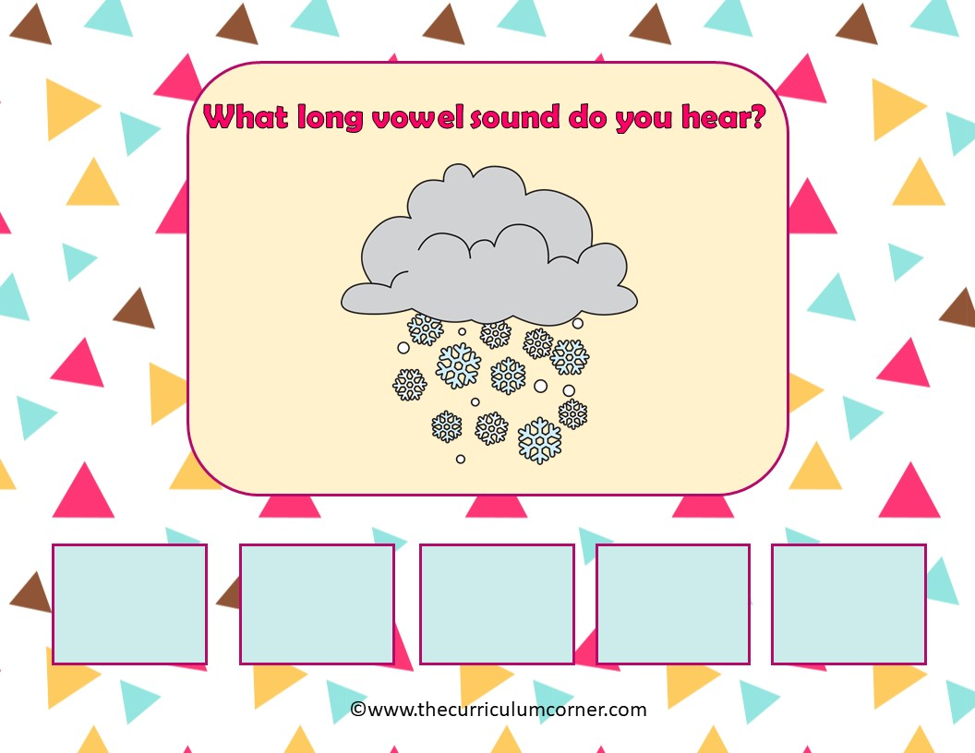
snow
a
e
i
o
u

Slide 8
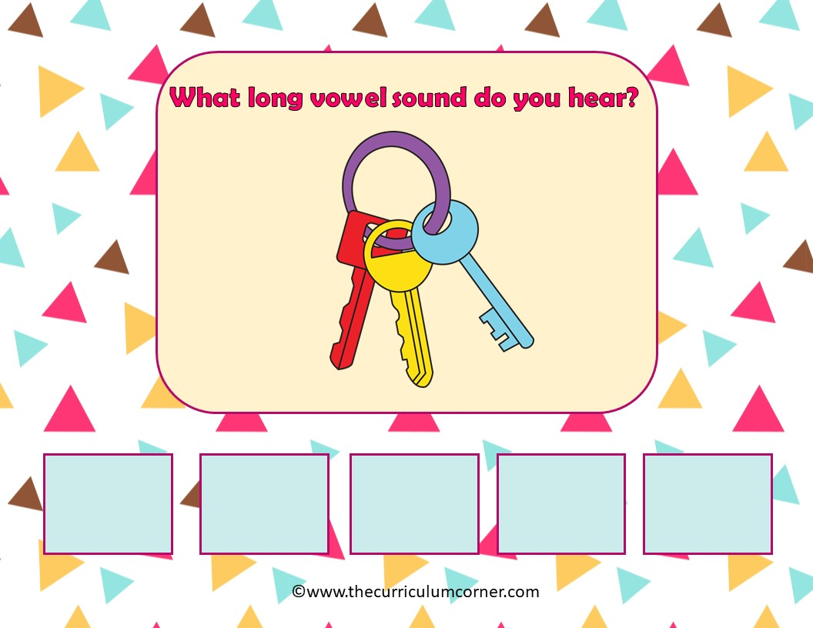
keys
a
e
i
o
u

Slide 9
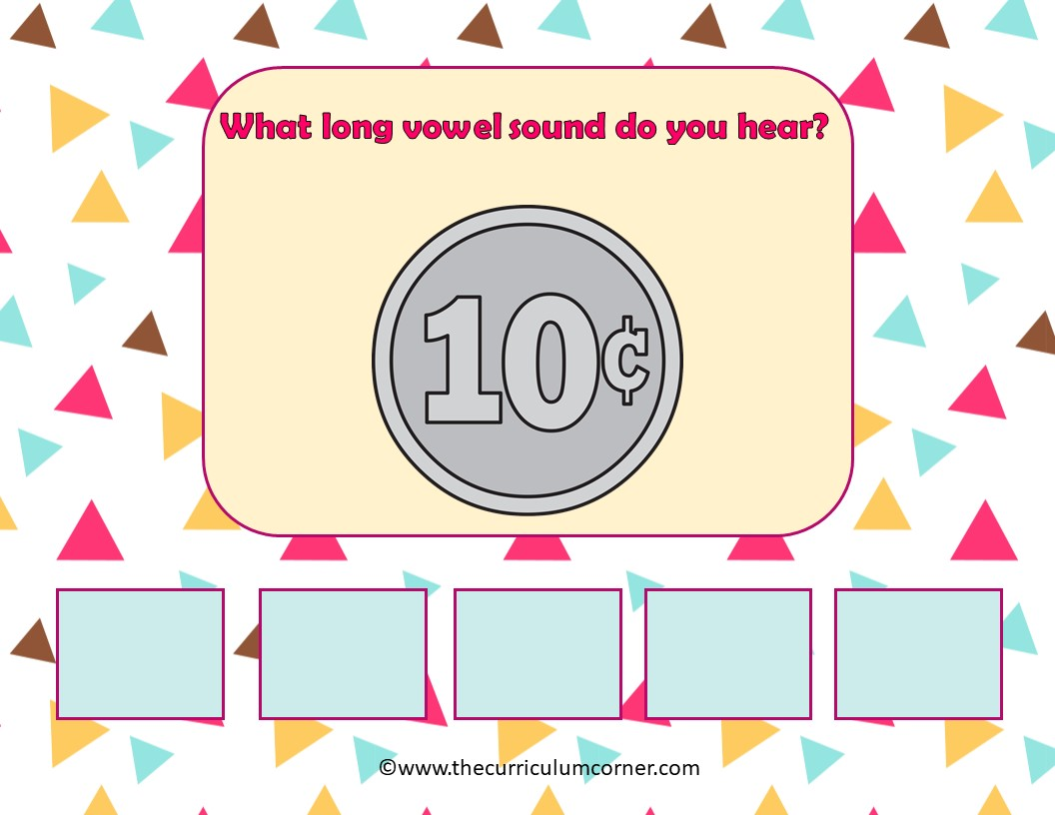
dime
a
e
i
o
u

Slide 10
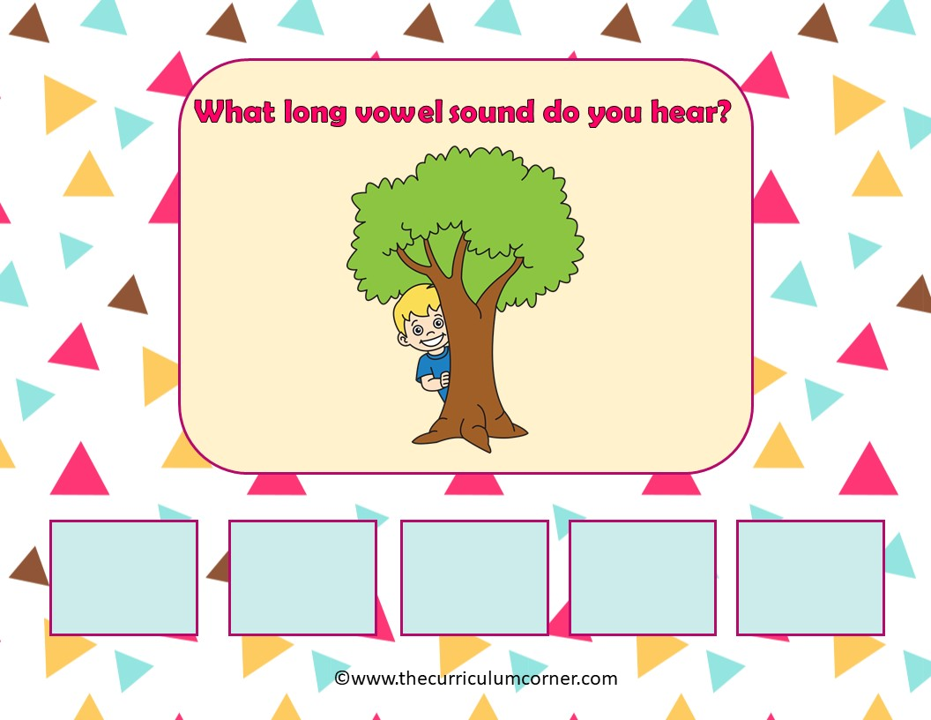
tree
a
e
i
o
u

Slide 11
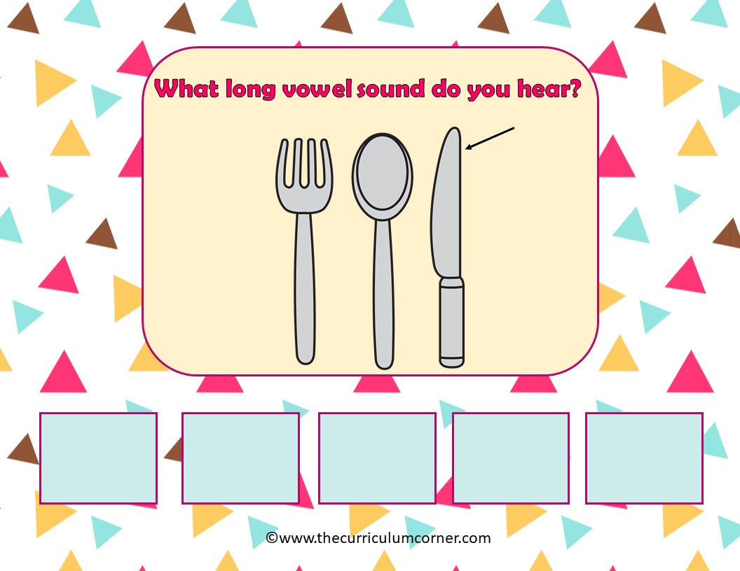
knife
a
e
i
o
u

Slide 12
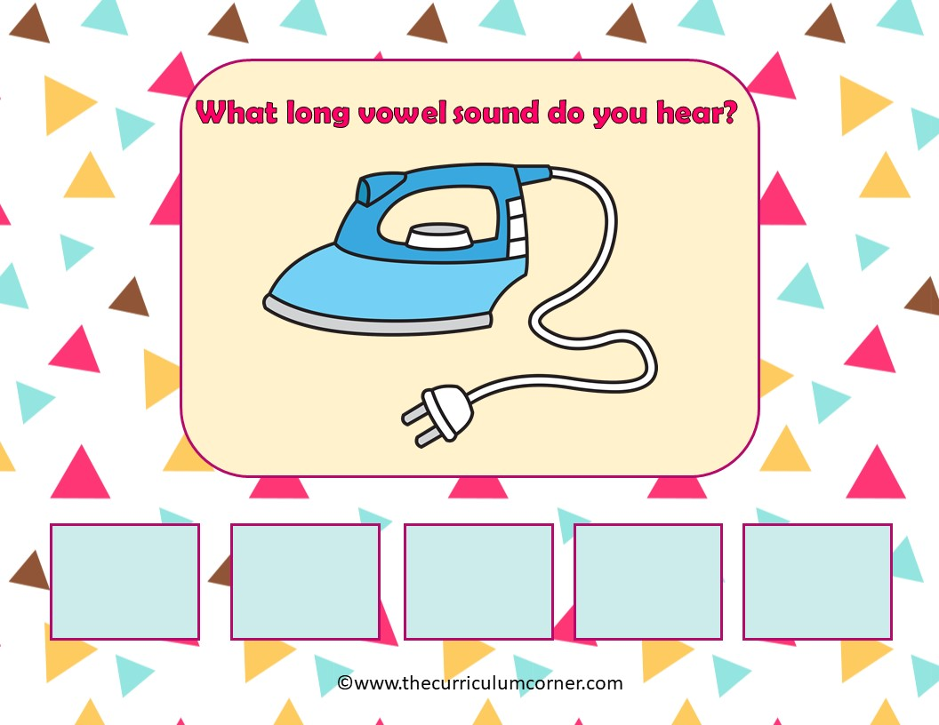
iron
a
e
i
o
u

Slide 13
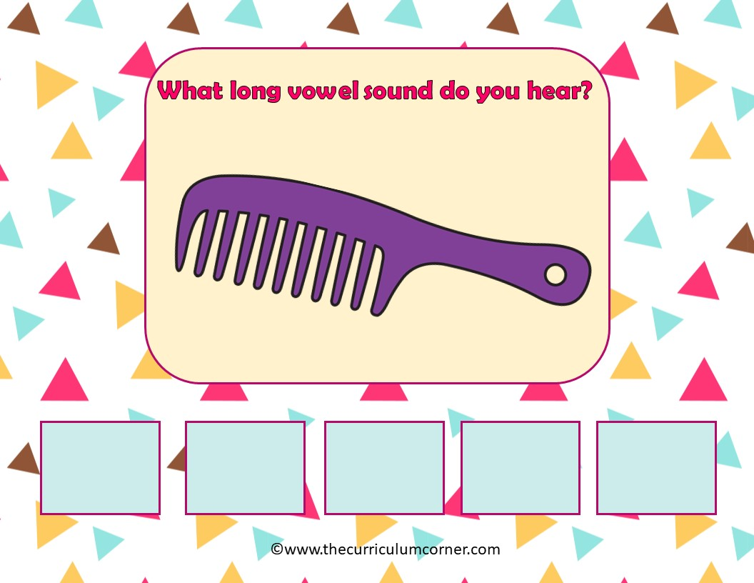
comb
a
e
i
o
u

Slide 14
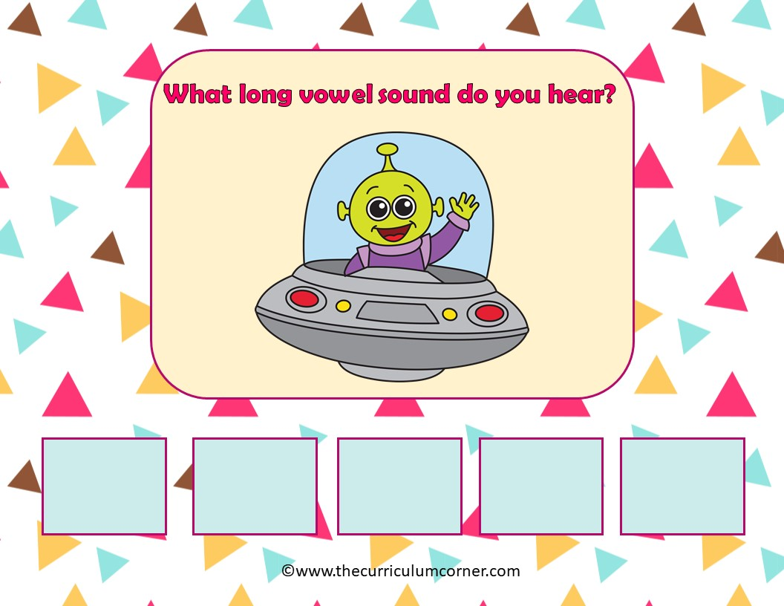
alien
a
e
i
o
u

Slide 15
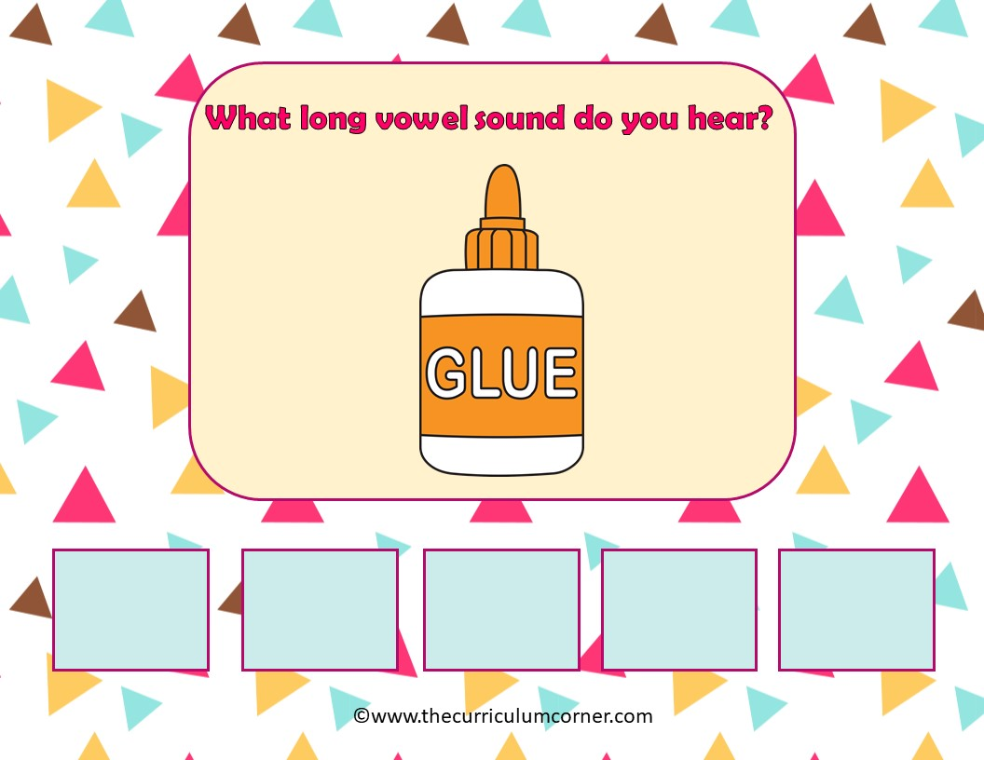
a
e
i
o
u

Slide 16
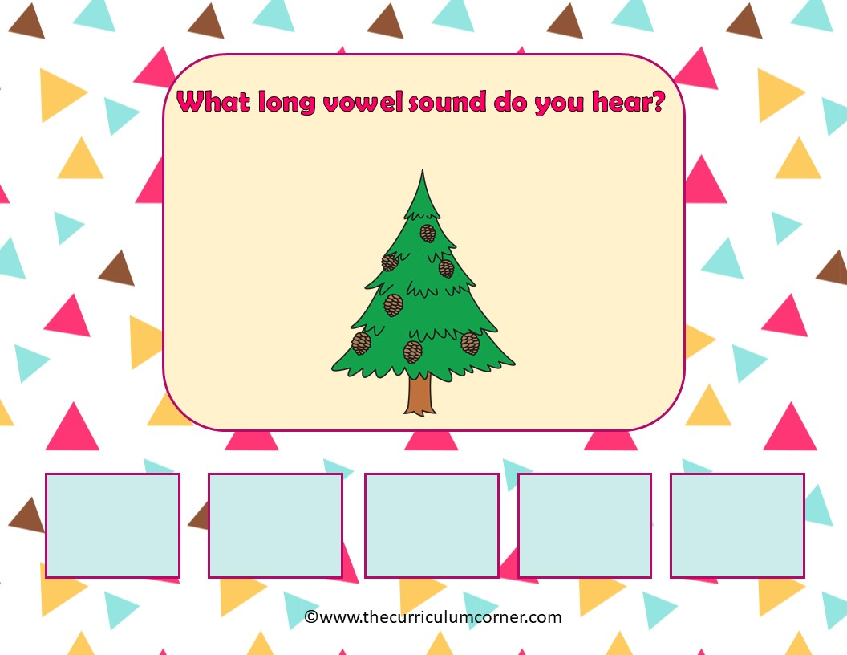
tree
a
e
i
o
u

Slide 17
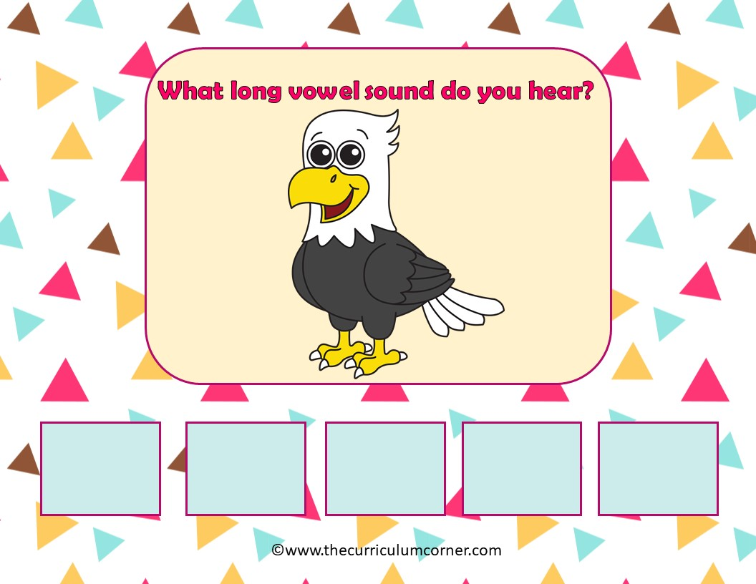
eagle
a
e
i
o
u

Slide 18
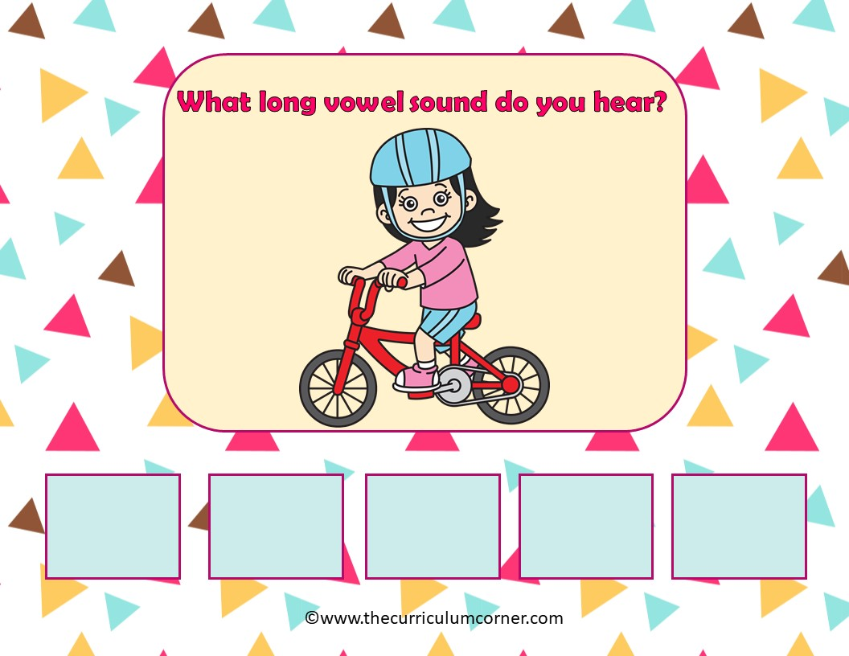
ride
a
e
i
o
u

Slide 19
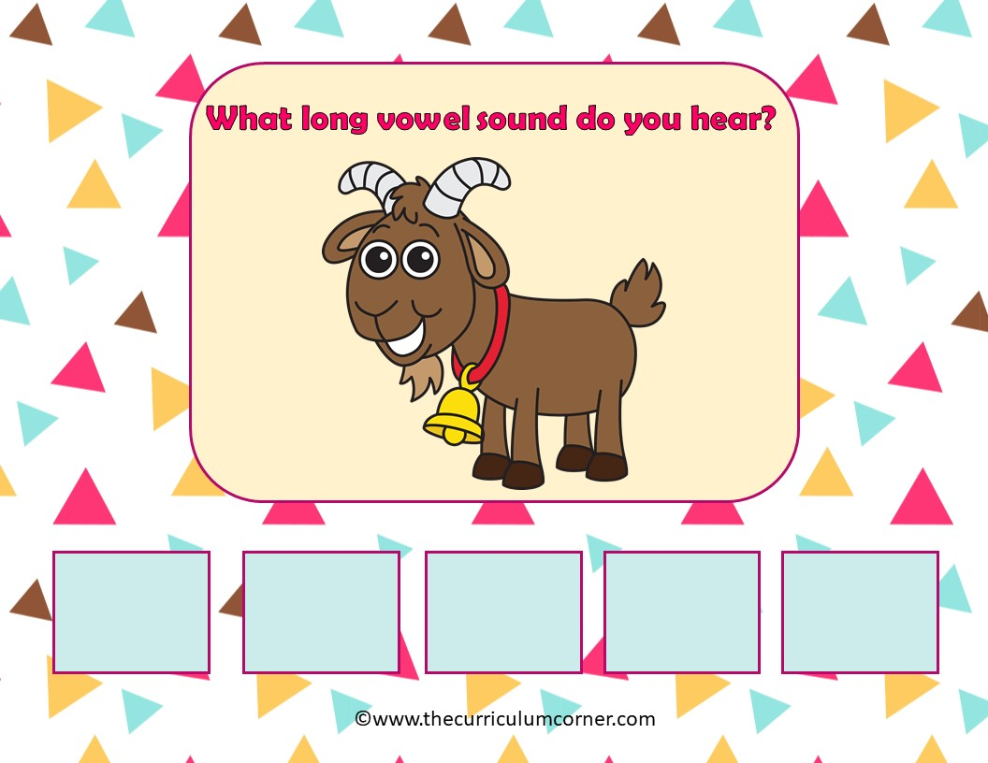
goat
a
e
i
o
u

Slide 20
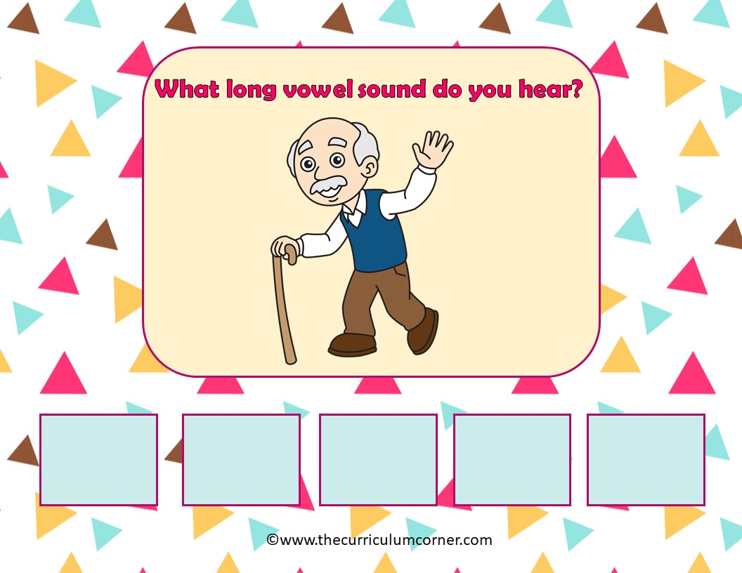
old
a
e
i
o
u

Slide 21
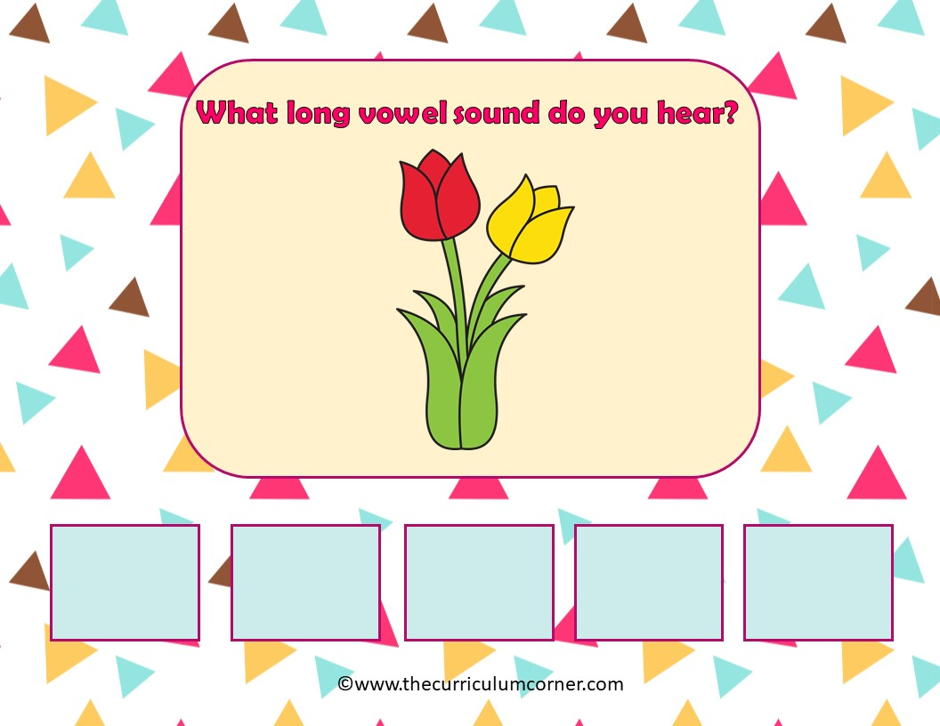
tulip
a
e
i
o
u

Slide 22
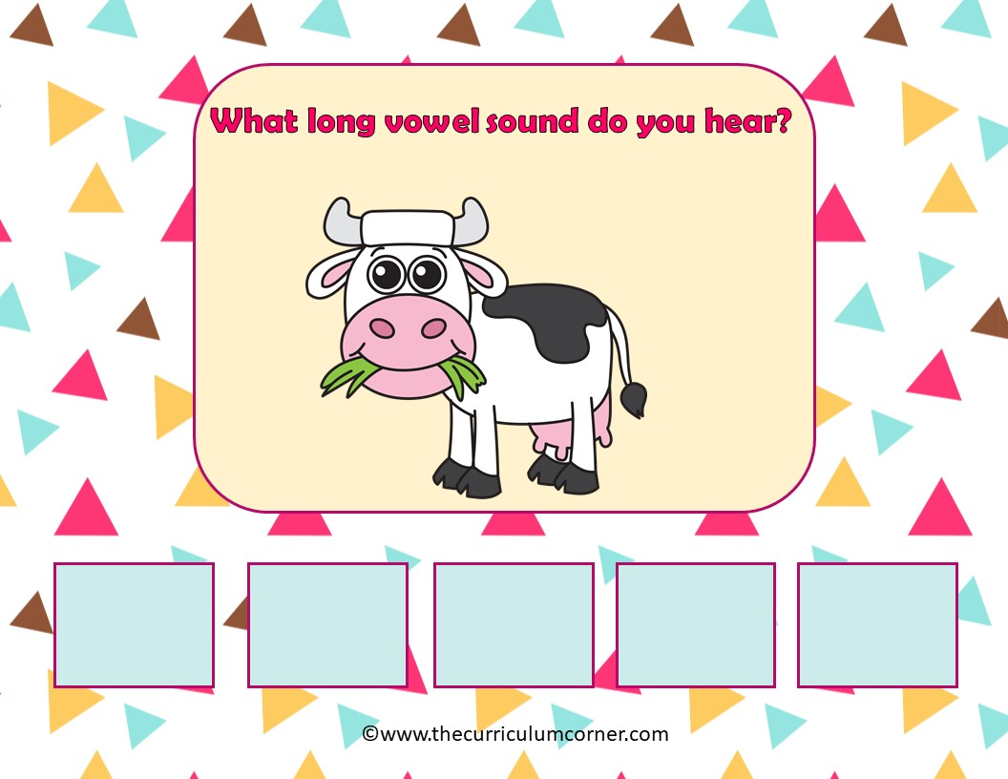
graze
a
e
i
o
u

Slide 23
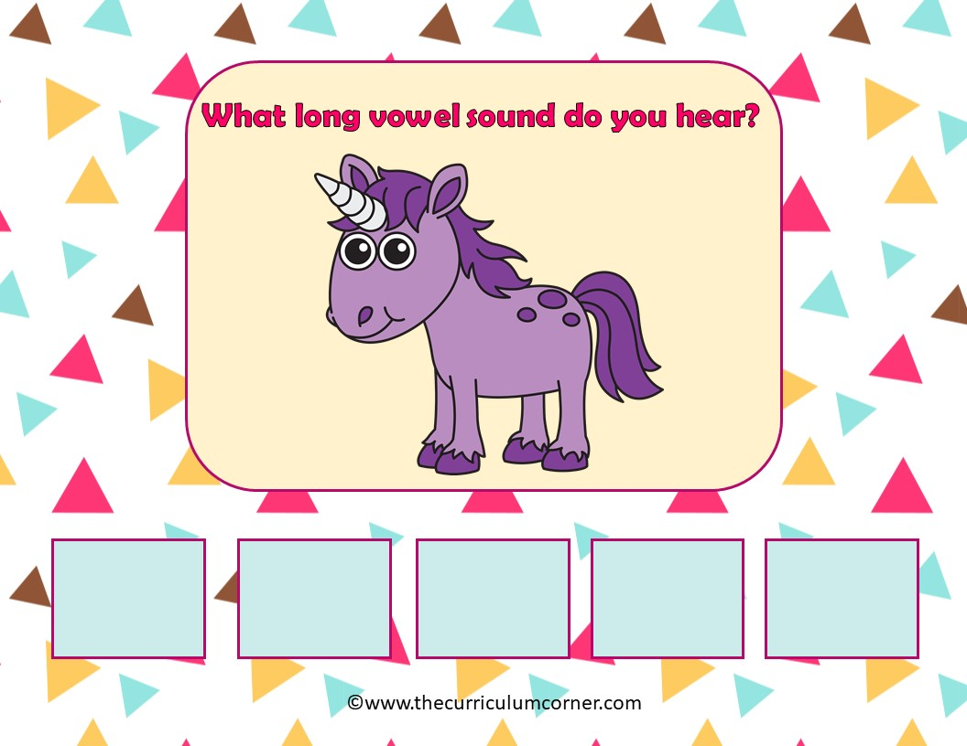
unicorn
a
e
i
o
u

Slide 24
Way to Go!
Click here to go back to the start.
Created by The Curriculum Corner

