Slide 1

Find the Missing Letter
a phonics practice game
long vowel sounds
Click to start.
Created by The Curriculum Corner

Slide 2
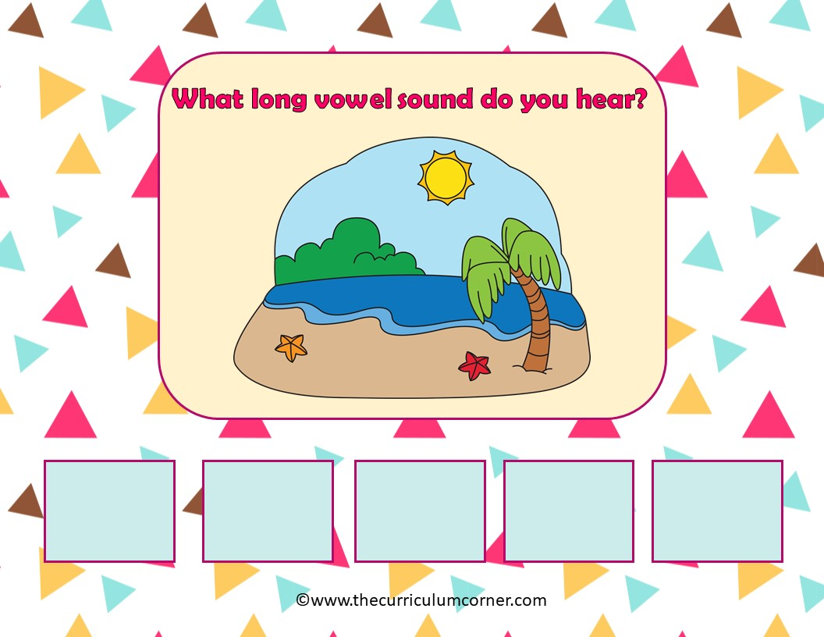
a
e
i
o
u

Slide 3
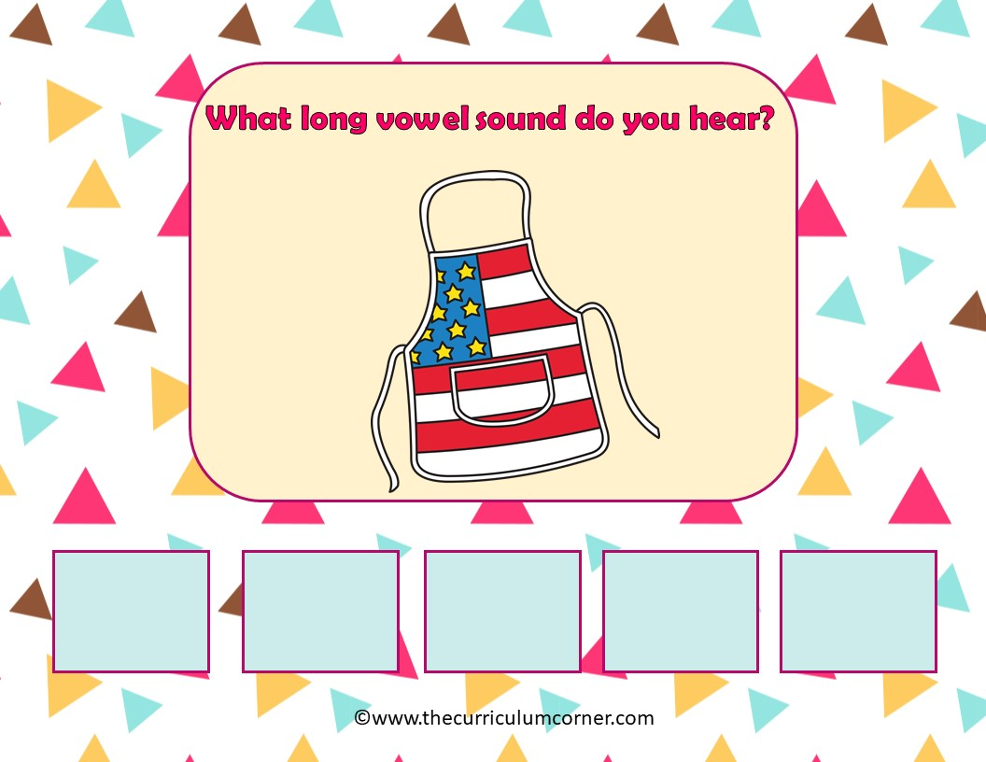
a
e
i
o
u

Slide 4
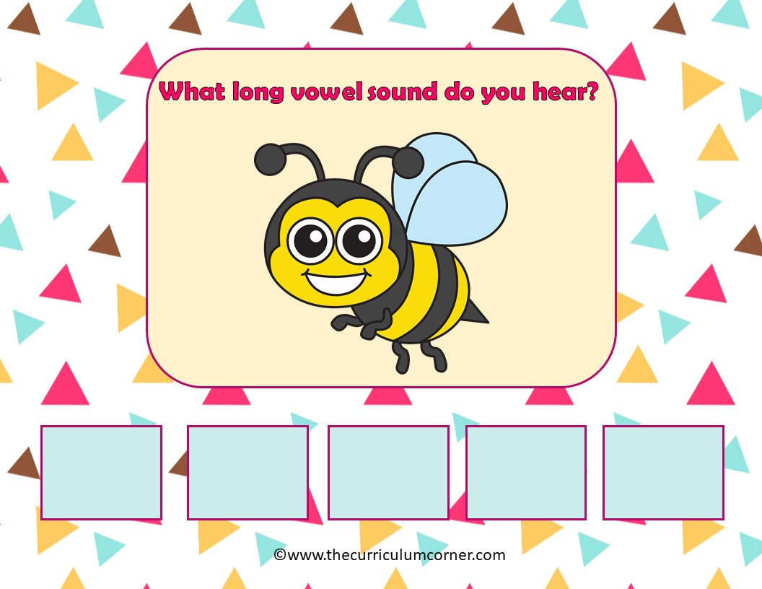
a
e
i
o
u

Slide 5
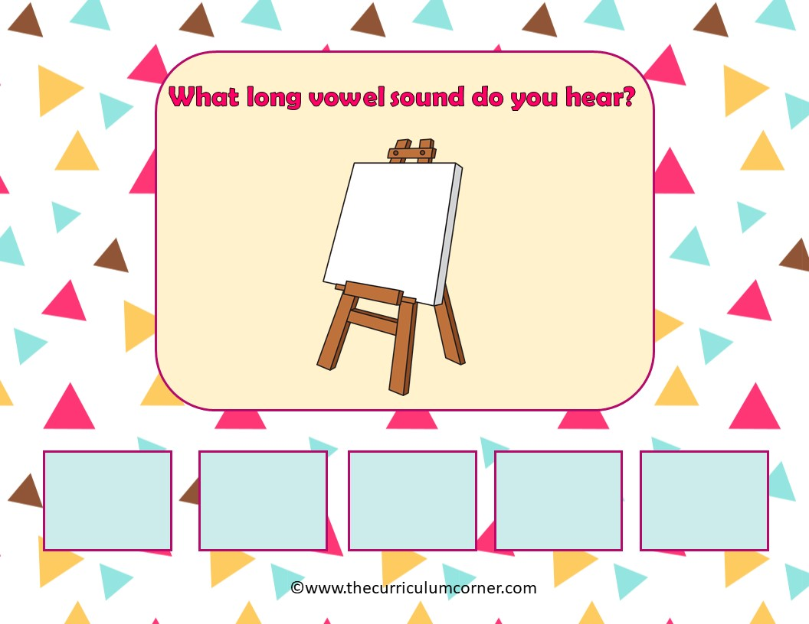
a
e
i
o
u

Slide 6
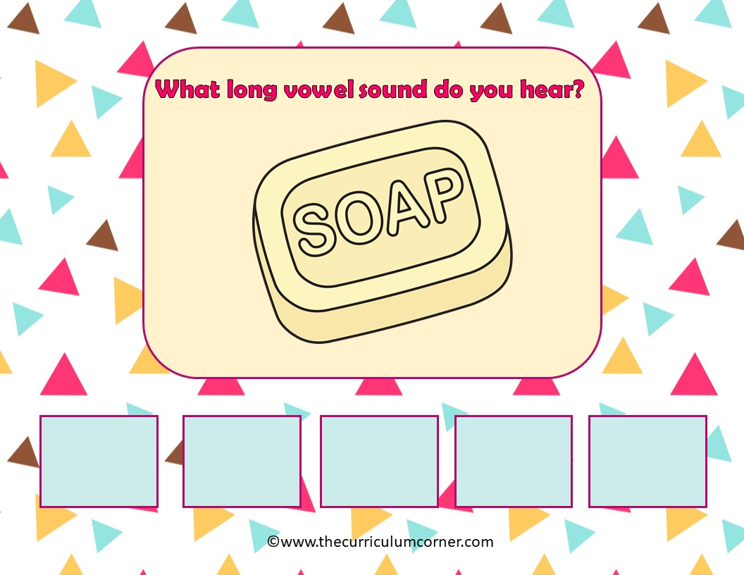
a
e
i
o
u

Slide 7
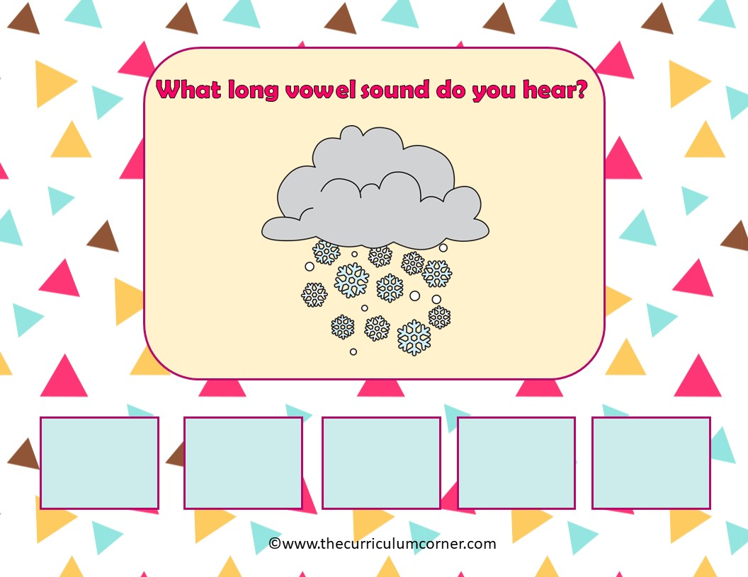
a
e
i
o
u

Slide 8
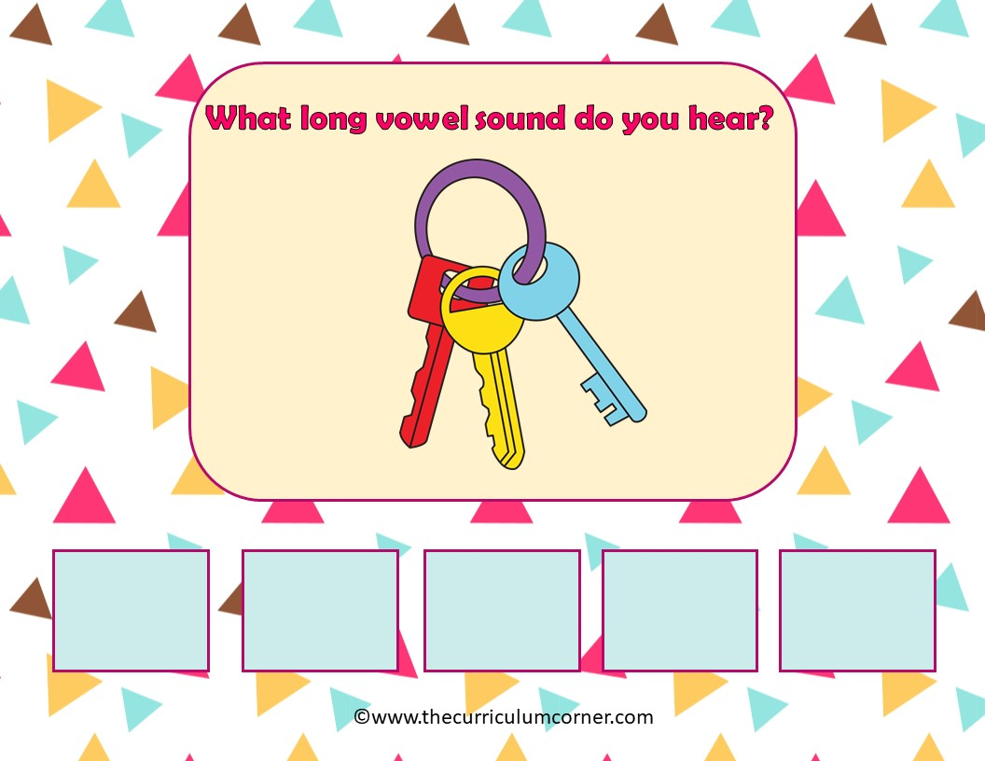
a
e
i
o
u

Slide 9
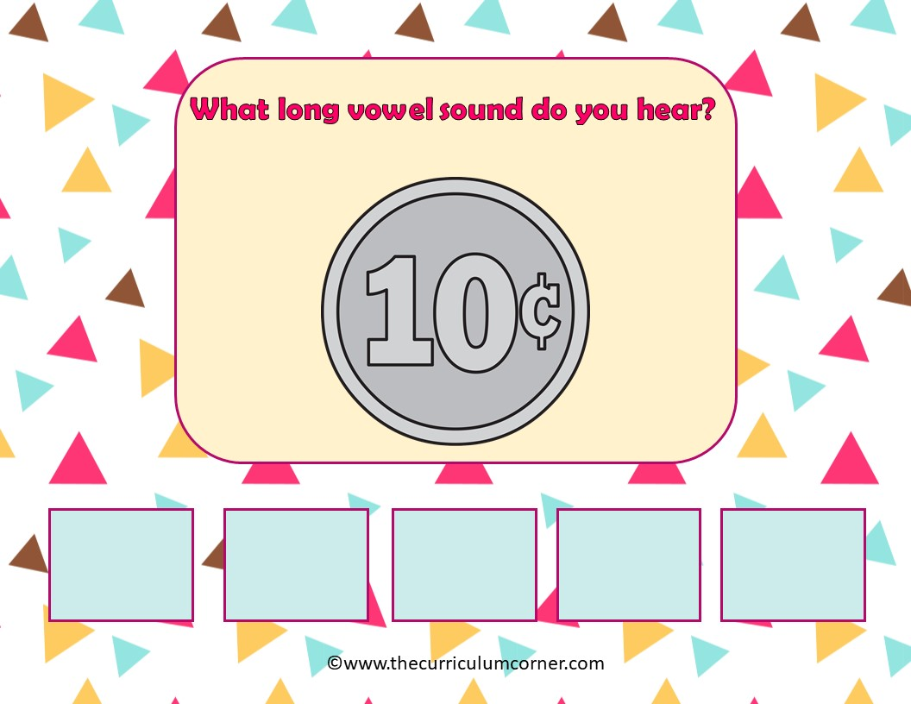
a
e
i
o
u

Slide 10
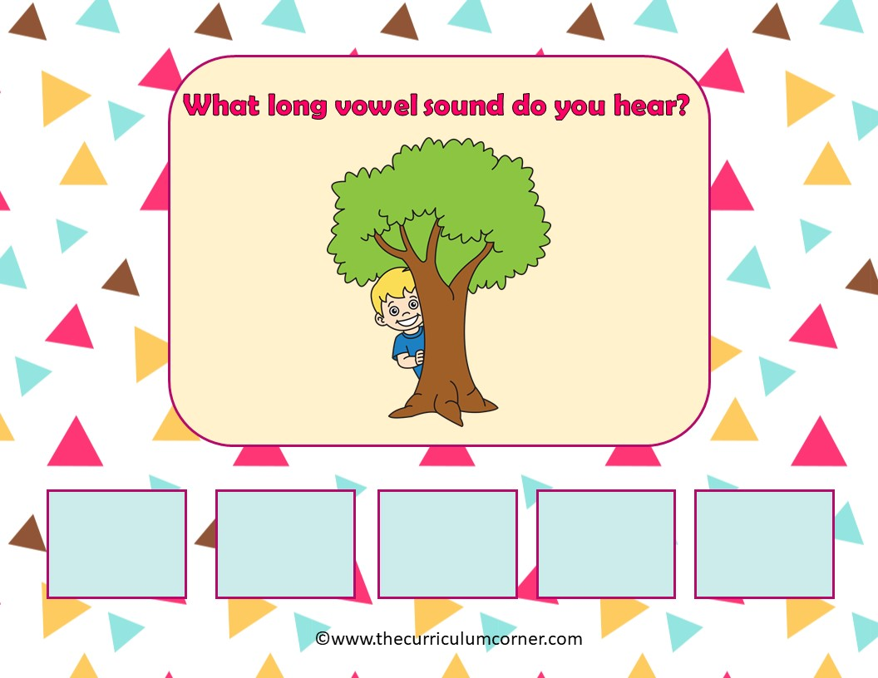
a
e
i
o
u

Slide 11
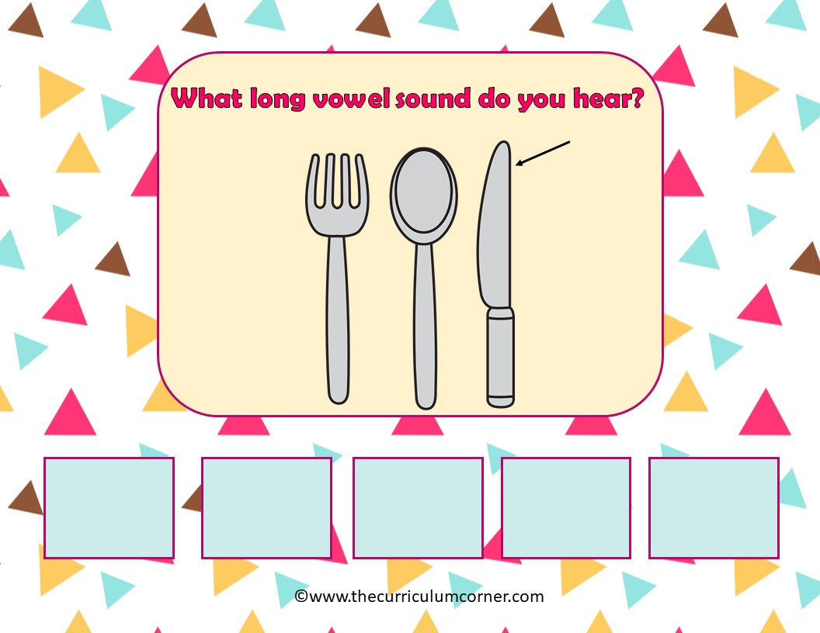
a
e
i
o
u

Slide 12
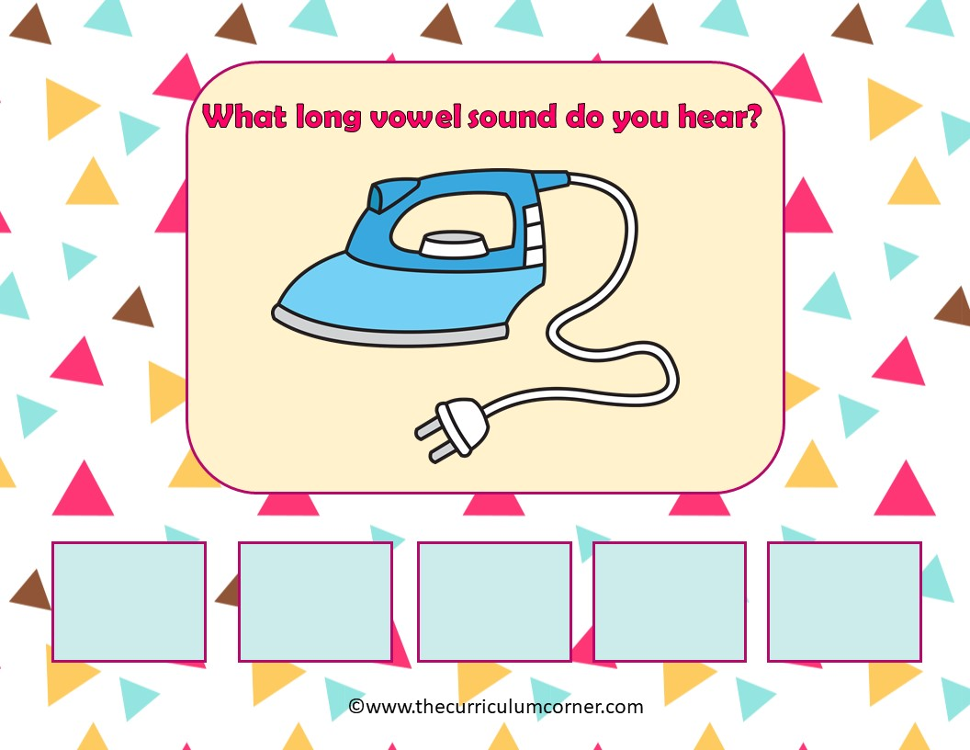
a
e
i
o
u

Slide 13
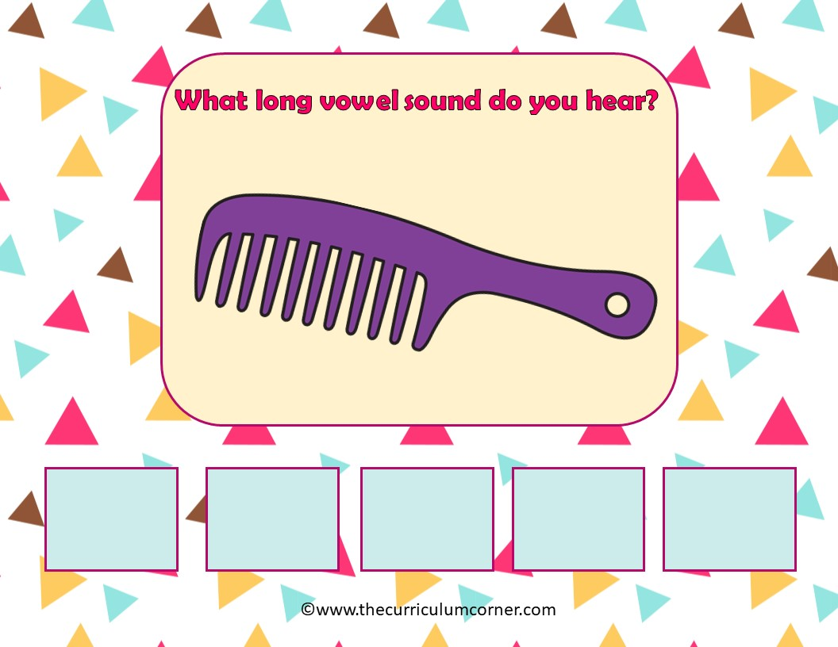
a
e
i
o
u

Slide 14
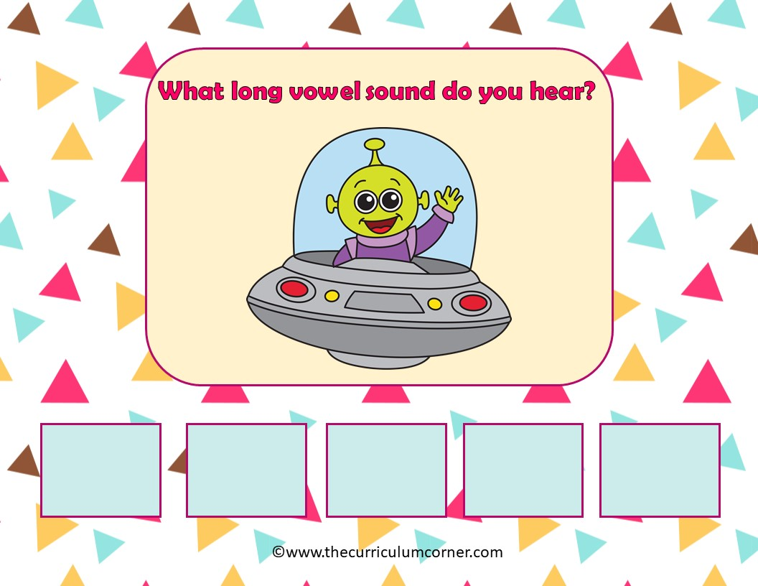
a
e
i
o
u

Slide 15
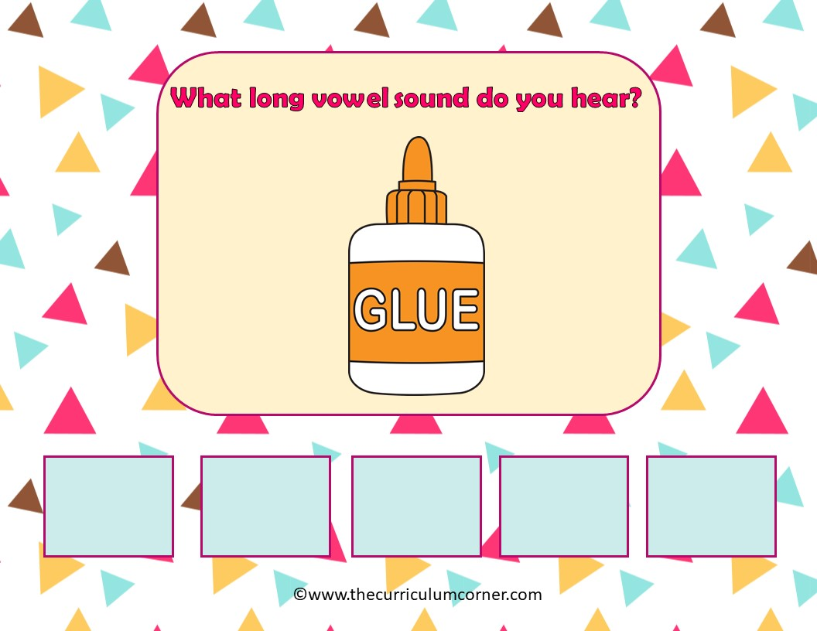
a
e
i
o
u

Slide 16
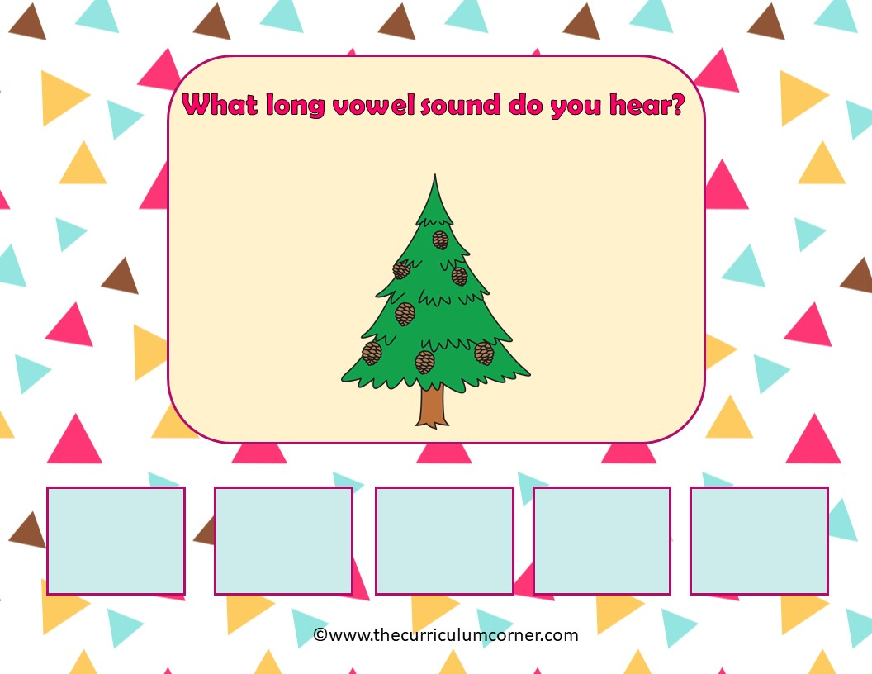
a
e
i
o
u

Slide 17
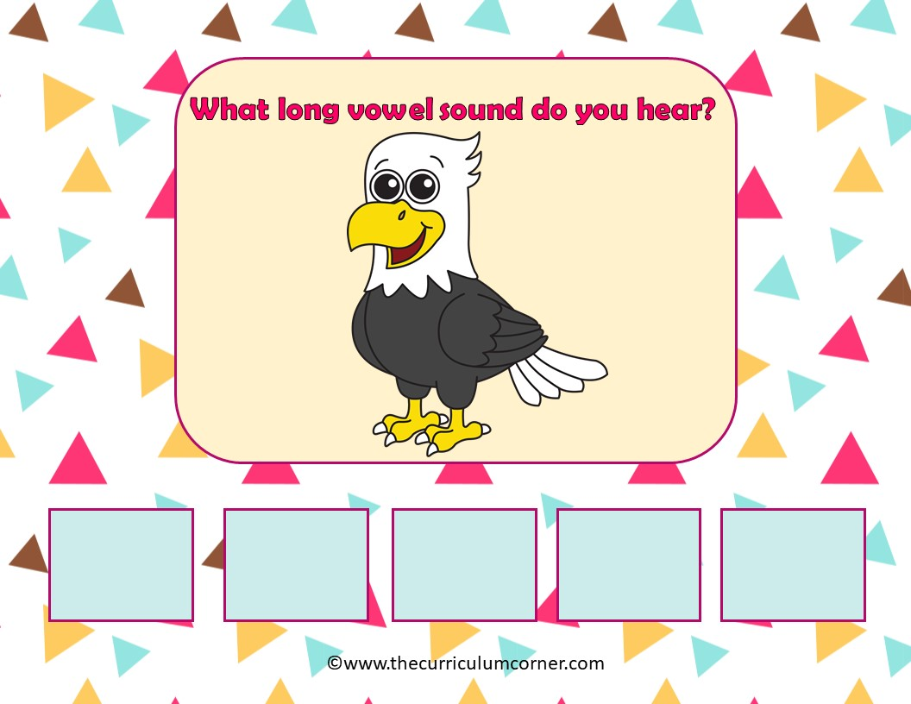
a
e
i
o
u

Slide 18
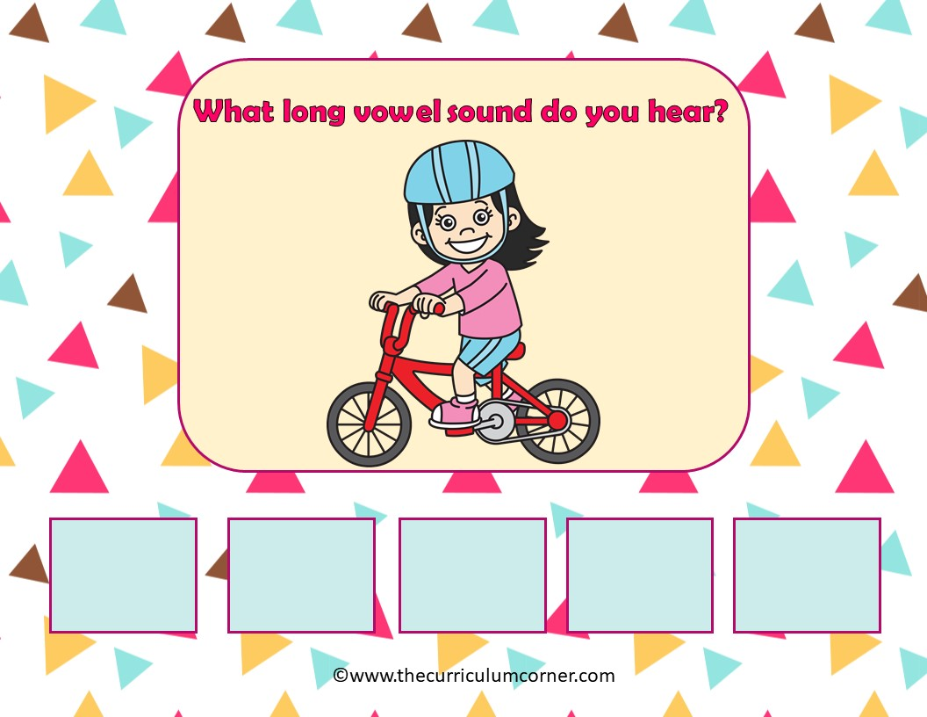
a
e
i
o
u

Slide 19
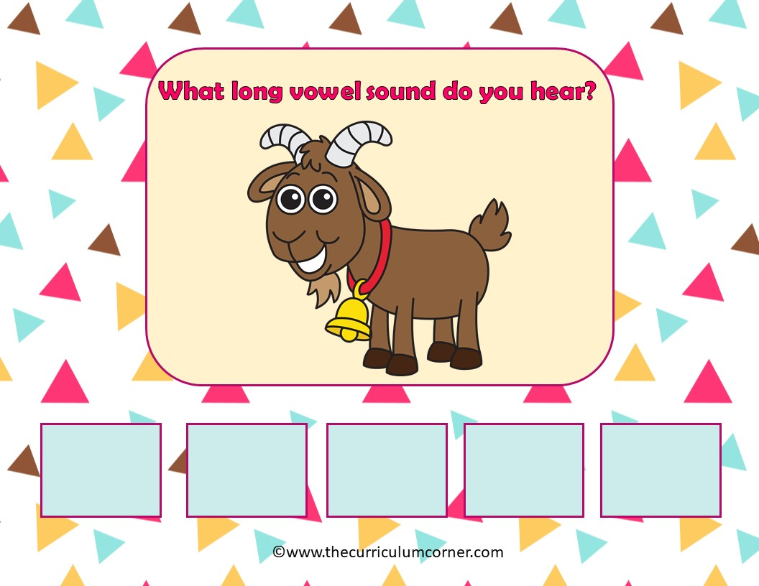
a
e
i
o
u

Slide 20
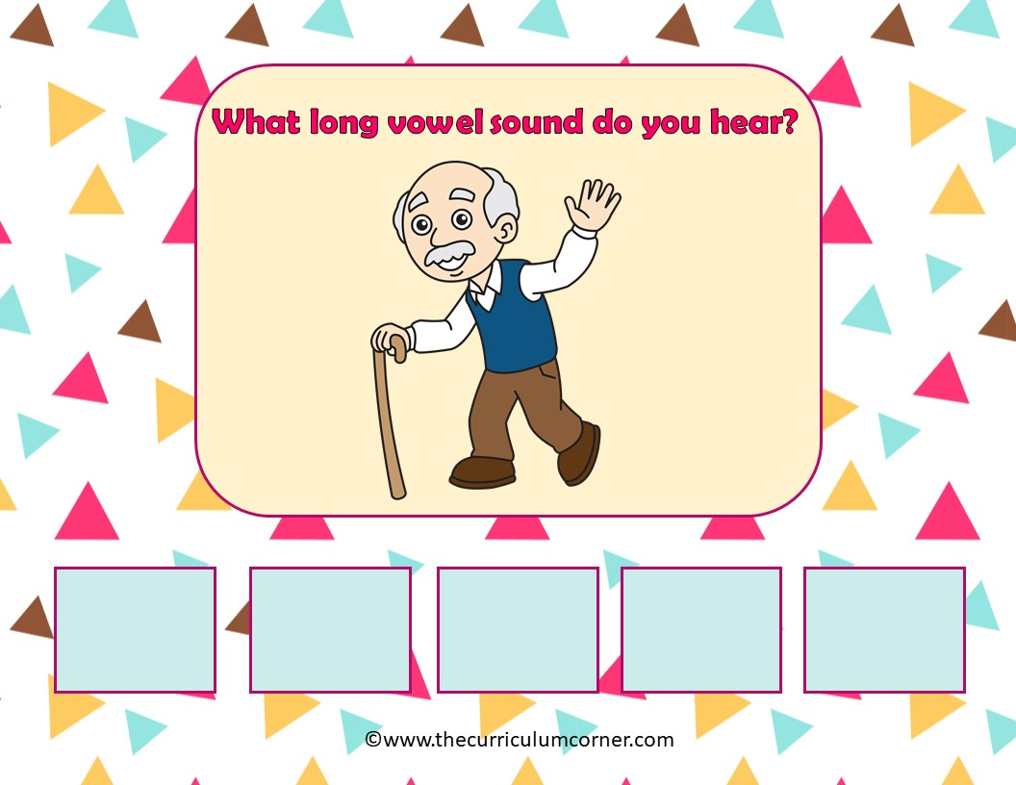
a
e
i
o
u

Slide 21
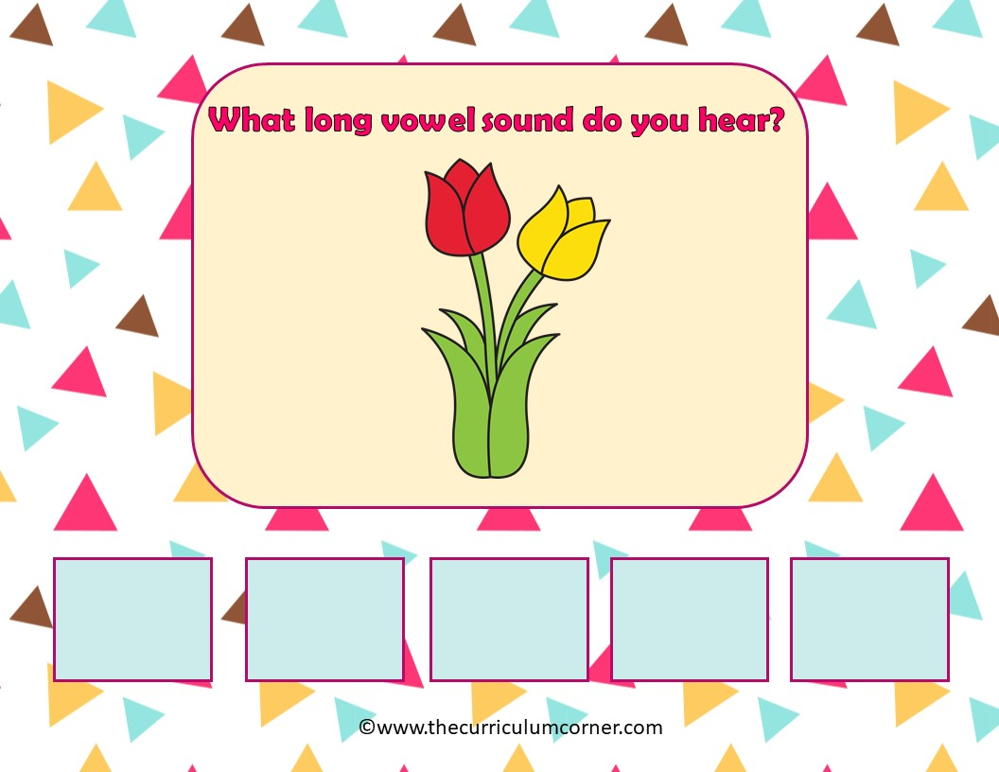
a
e
i
o
u

Slide 22
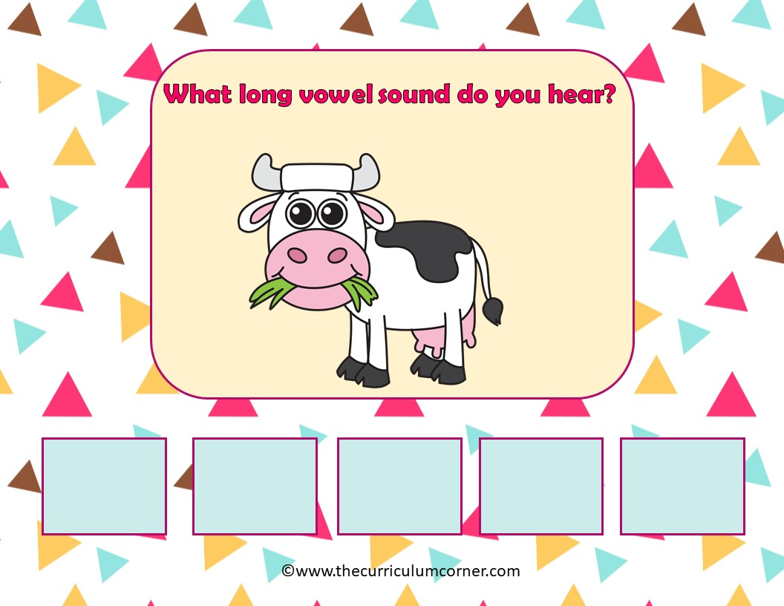
a
e
i
o
u

Slide 23
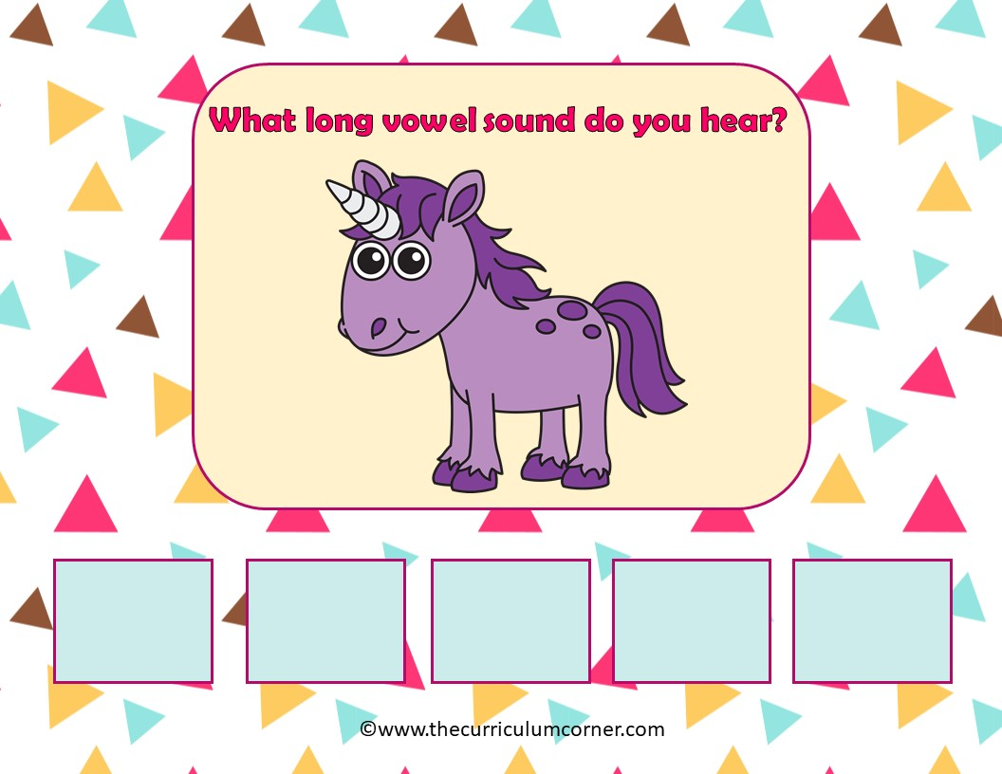
a
e
i
o
u

Slide 24
Way to Go!
Click here to go back to the start.
Created by The Curriculum Corner

