Slide 1

Find the Missing Letter
a phonics practice game
short vowel sounds
Click to start.
Created by The Curriculum Corner

Slide 2
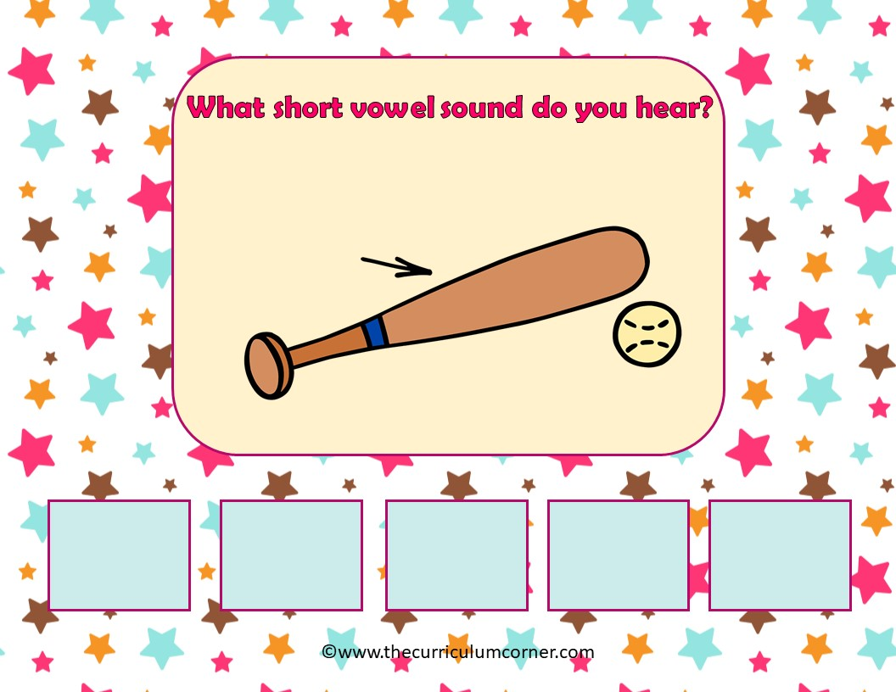
bat
a
e
i
o
u

Slide 3
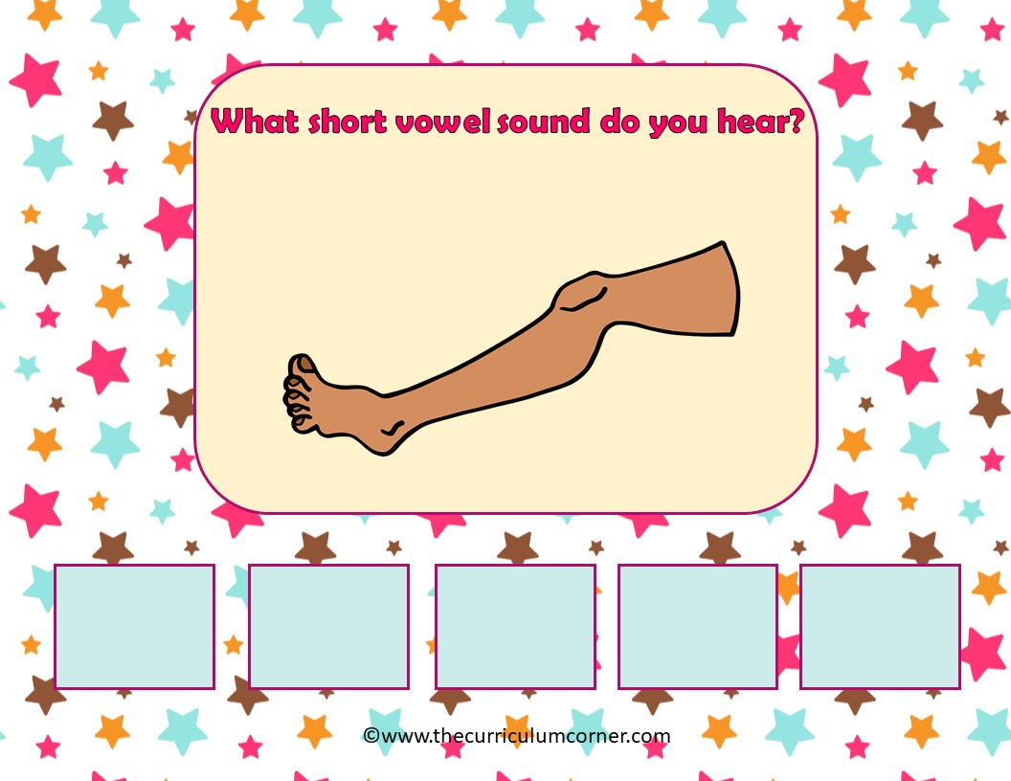
leg
a
e
i
o
u

Slide 4
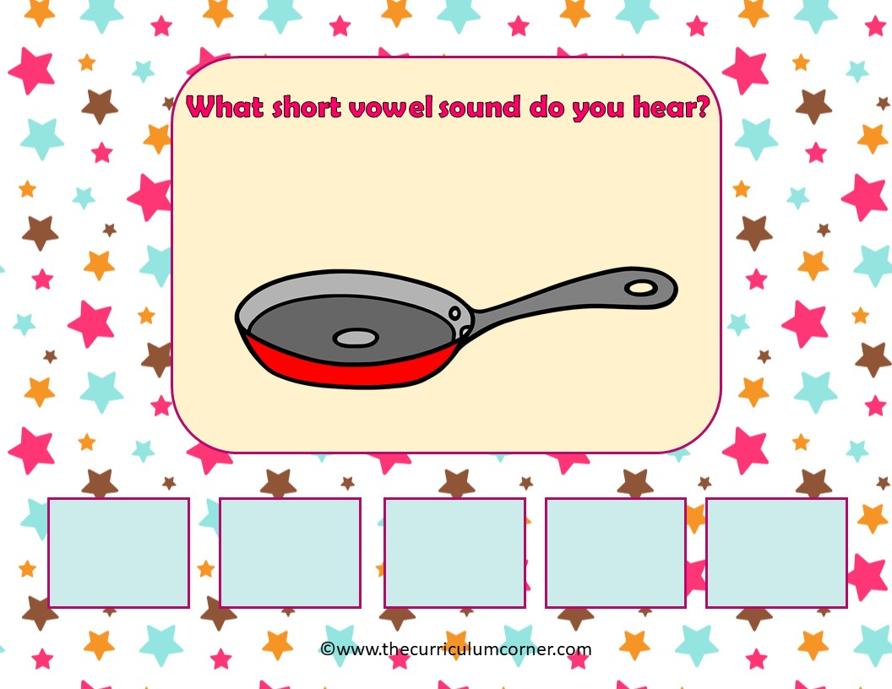
pan
a
e
i
o
u

Slide 5
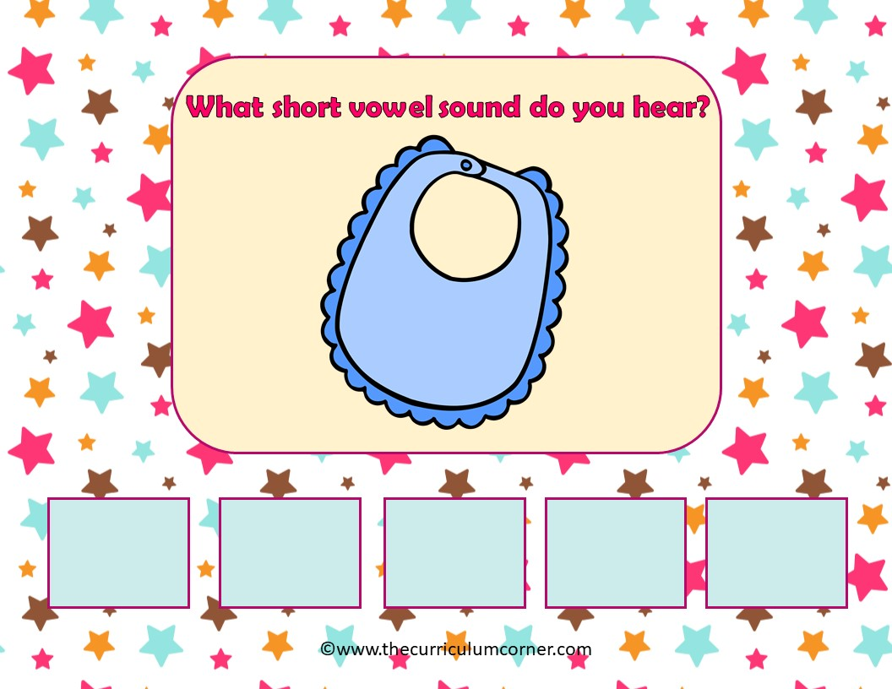
bib
a
e
i
o
u

Slide 6
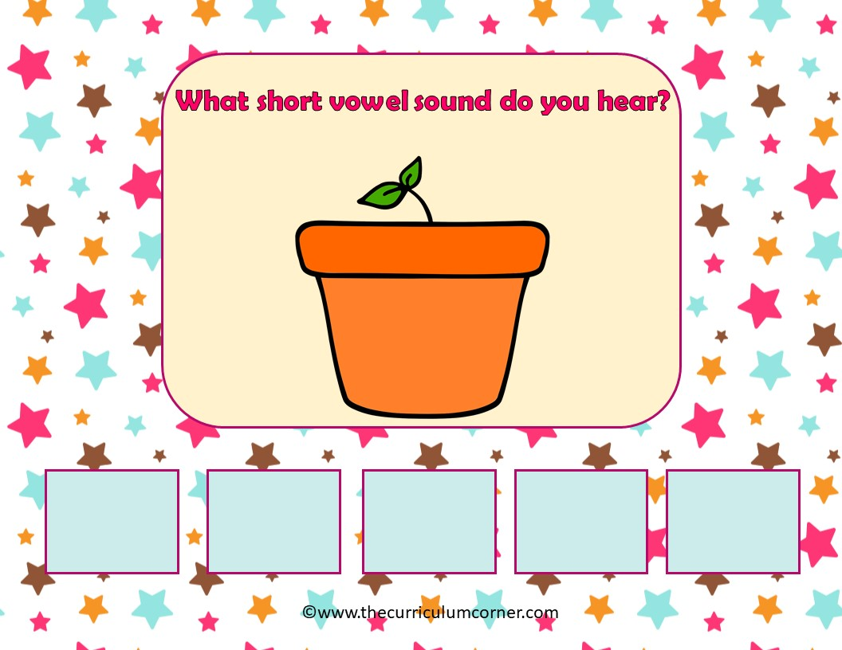
pot
a
e
i
o
u

Slide 7
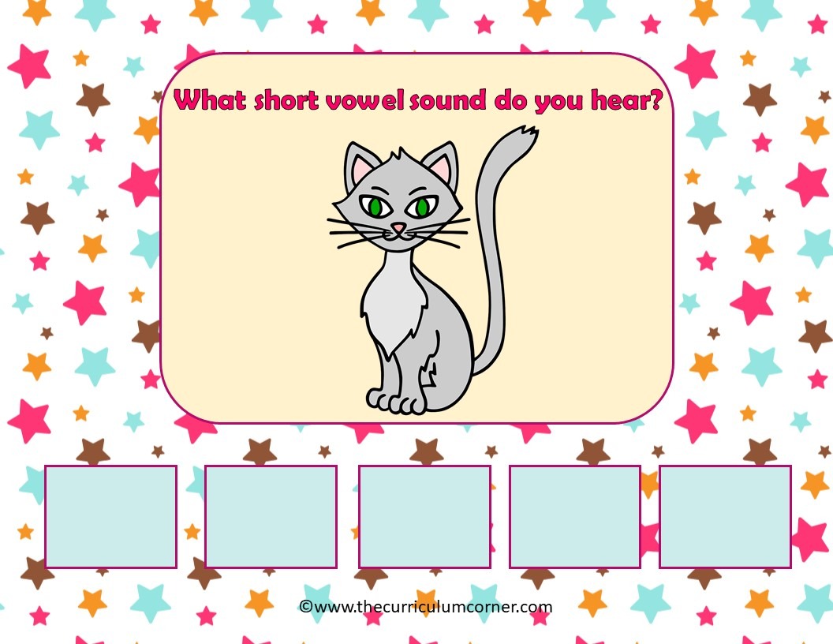
cat
a
e
i
o
u

Slide 8
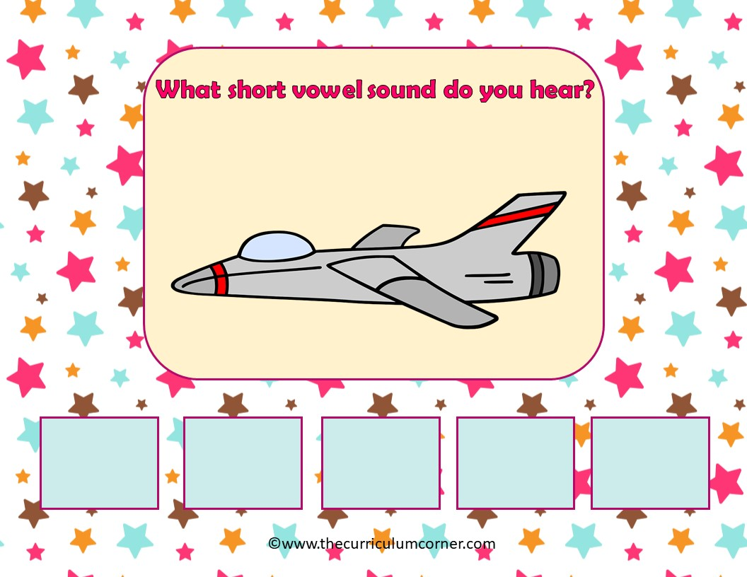
jet
a
e
i
o
u

Slide 9
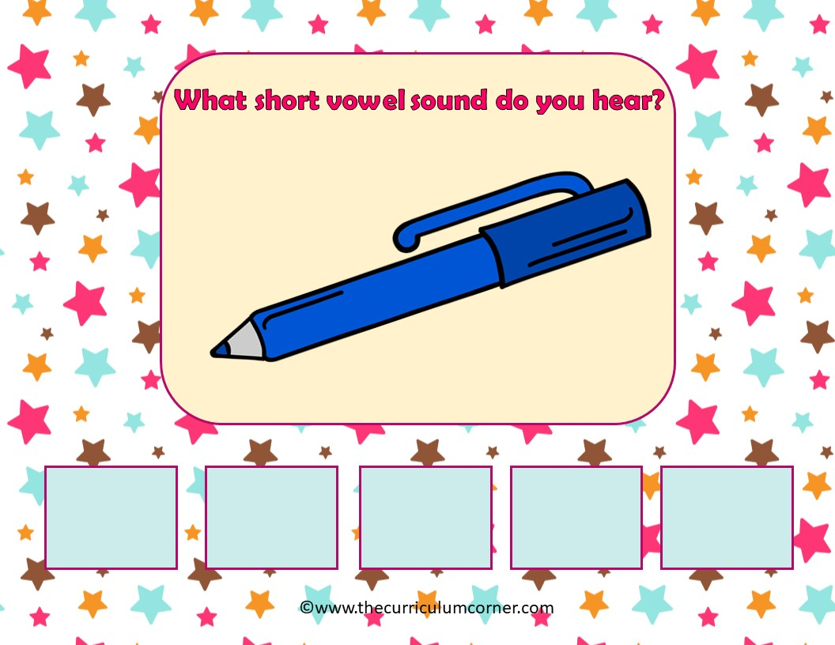
pen
a
e
i
o
u

Slide 10
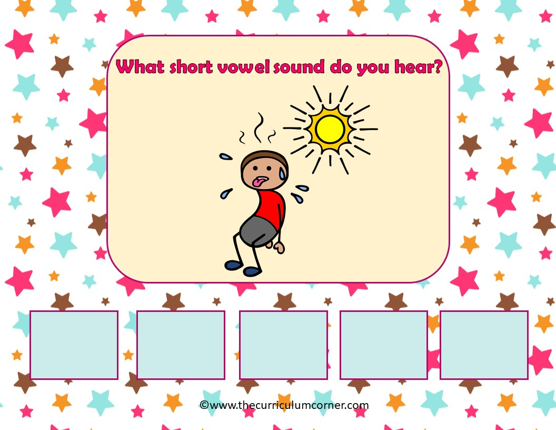
hot
a
e
i
o
u

Slide 11
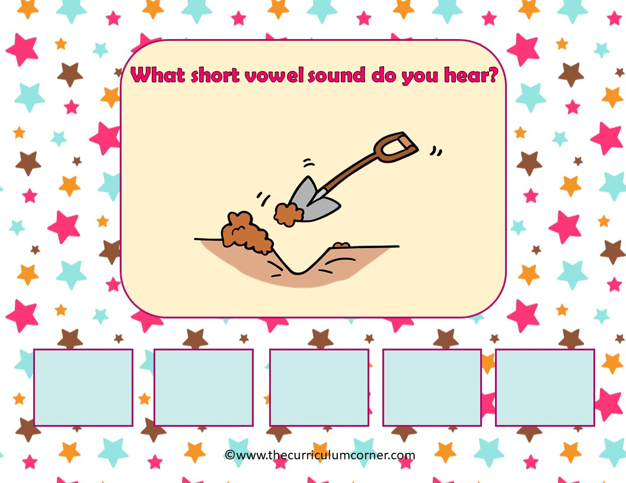
dig
a
e
i
o
u

Slide 12
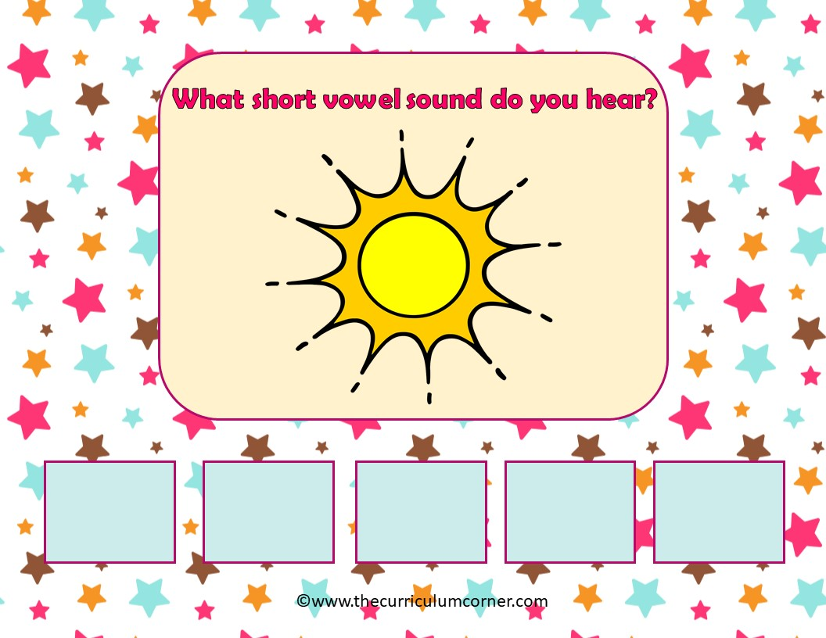
sun
a
e
i
o
u

Slide 13
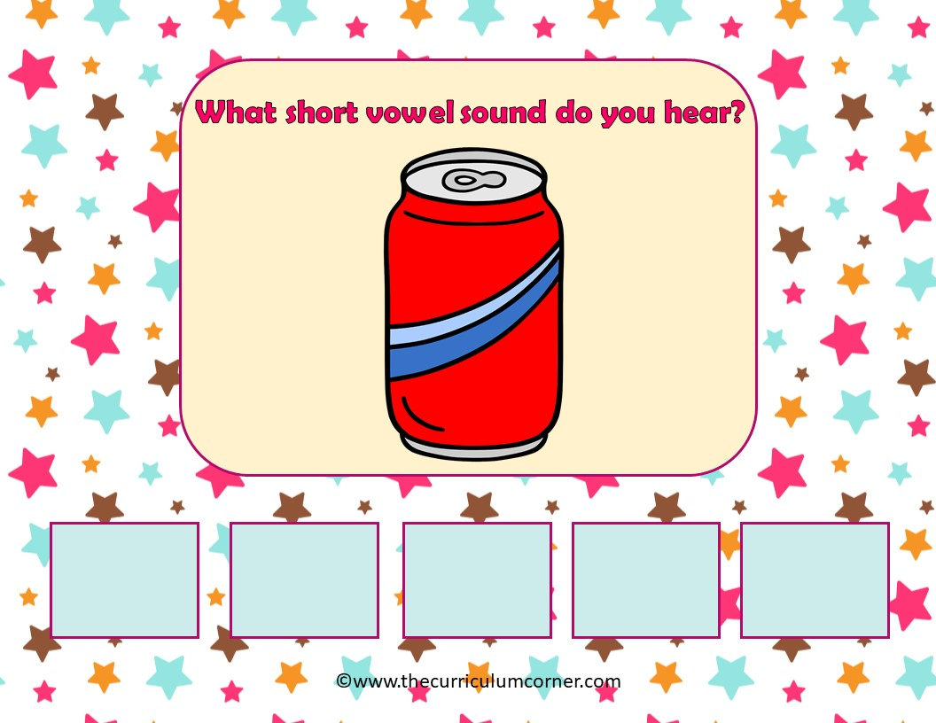
can
a
e
i
o
u

Slide 14
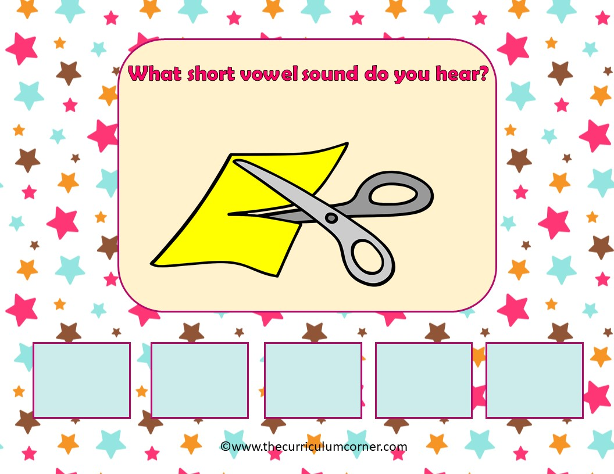
cut
a
e
i
o
u

Slide 15
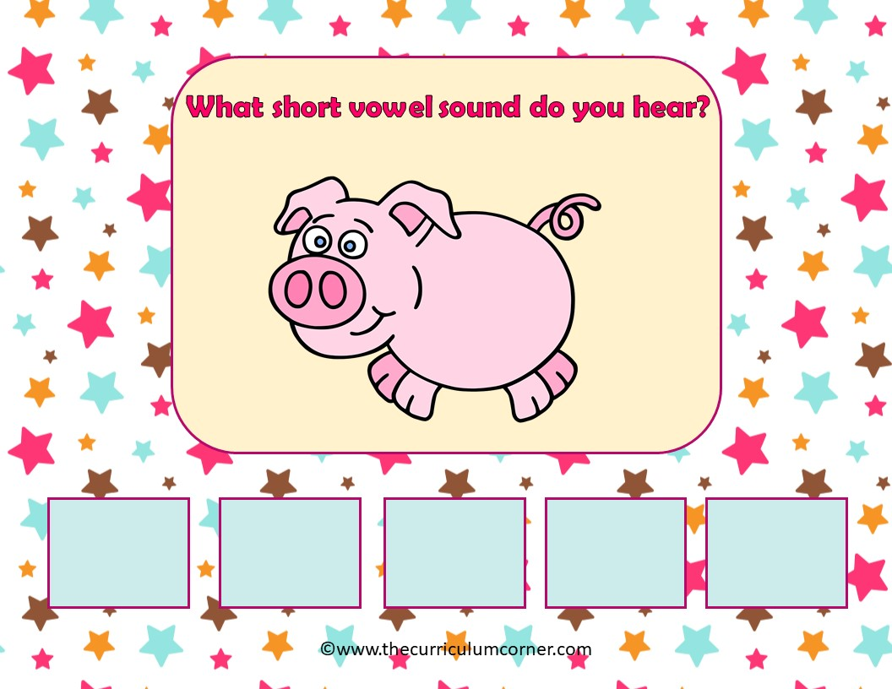
pig
a
e
i
o
u

Slide 16
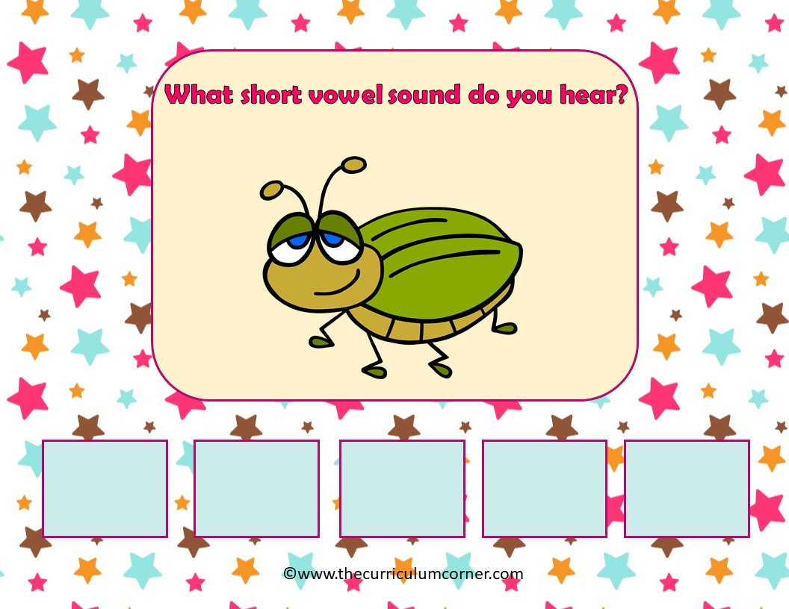
bug
a
e
i
o
u

Slide 17
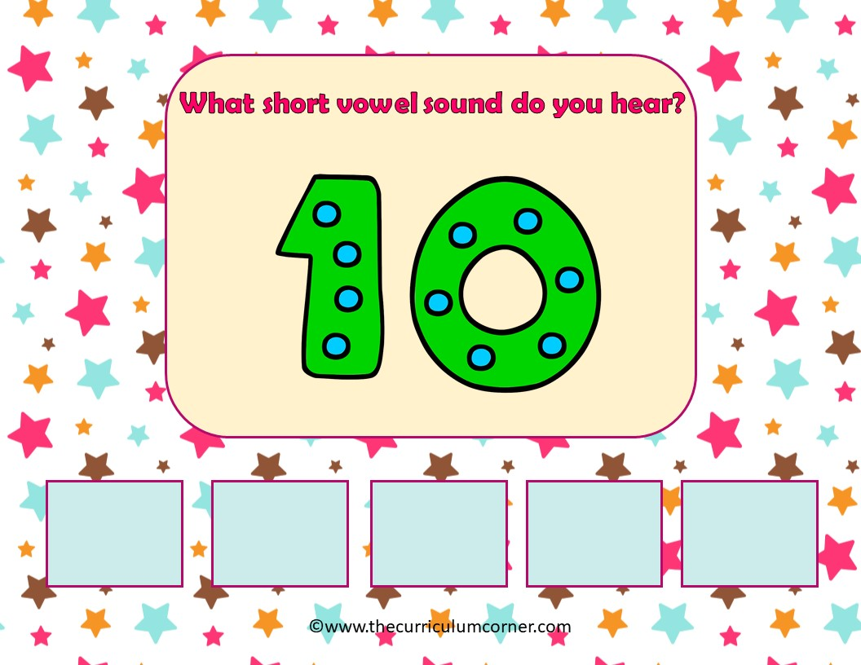
ten
a
e
i
o
u

Slide 18
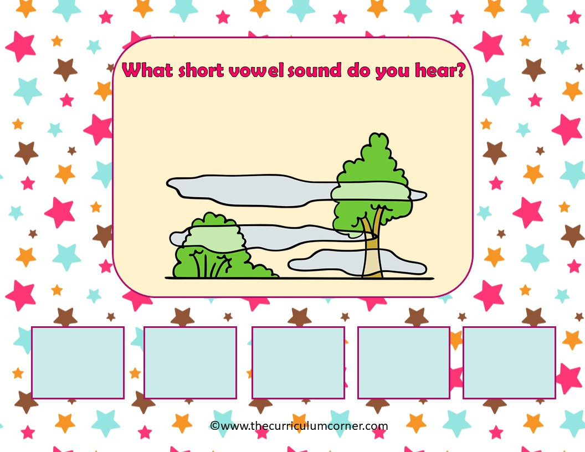
fog
a
e
i
o
u

Slide 19
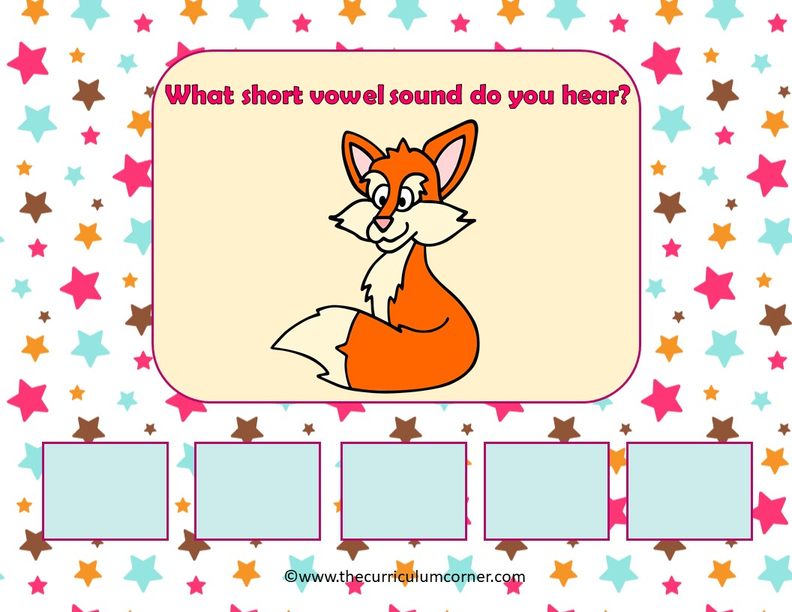
fox
a
e
i
o
u

Slide 20
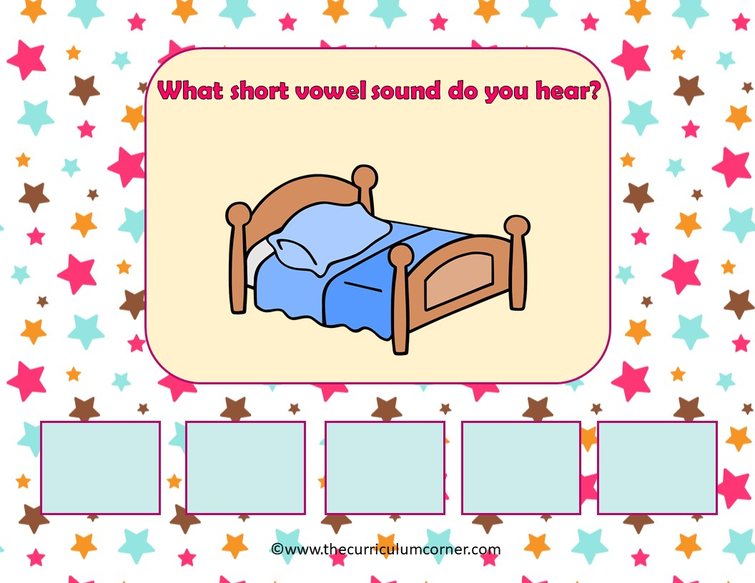
bed
a
e
i
o
u

Slide 21
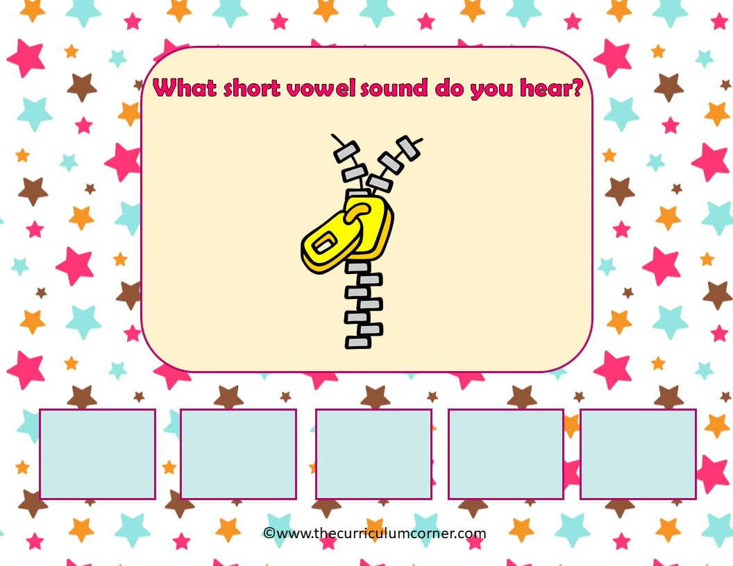
zip
a
e
i
o
u

Slide 22
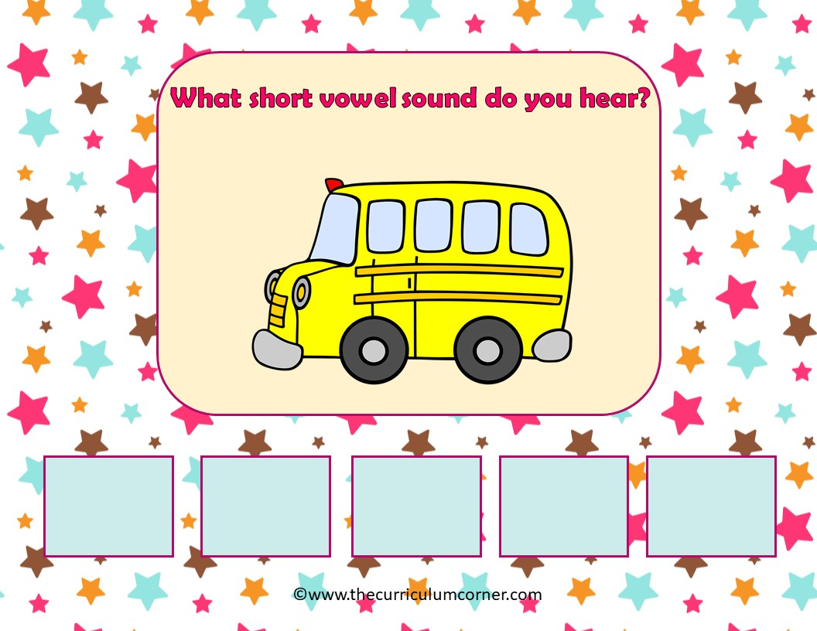
bus
a
e
i
o
u

Slide 23
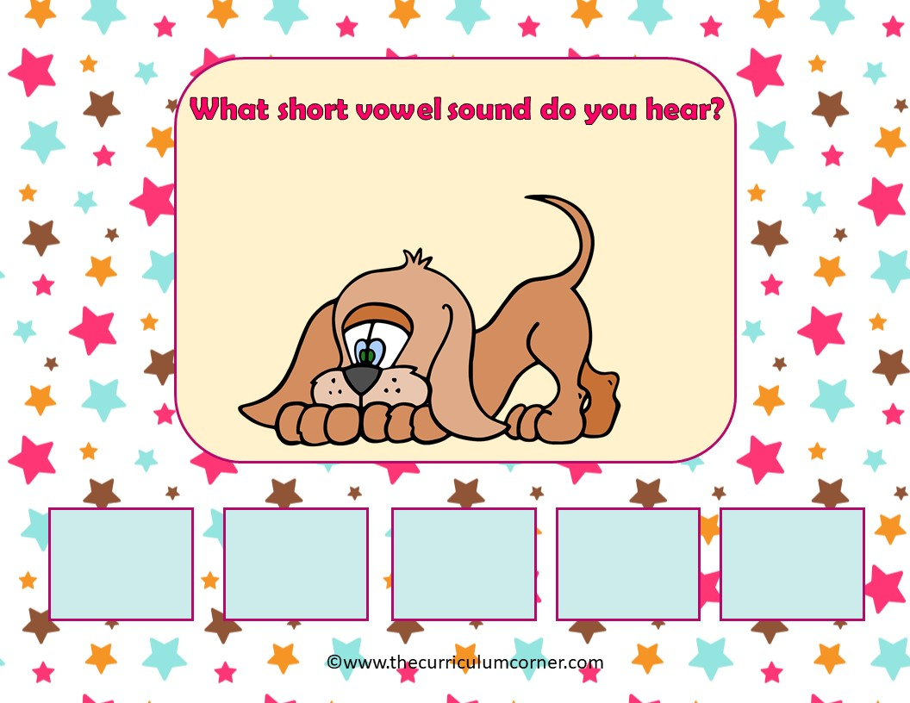
dog
a
e
i
o
u

Slide 24
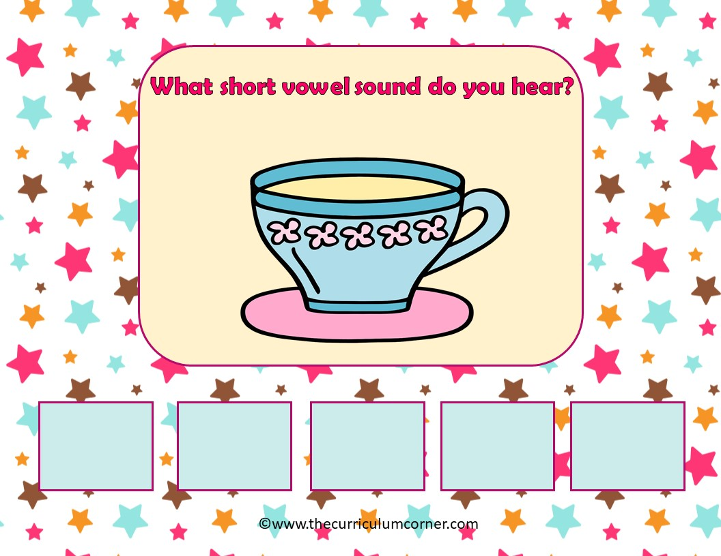
cup
a
e
i
o
u

Slide 25
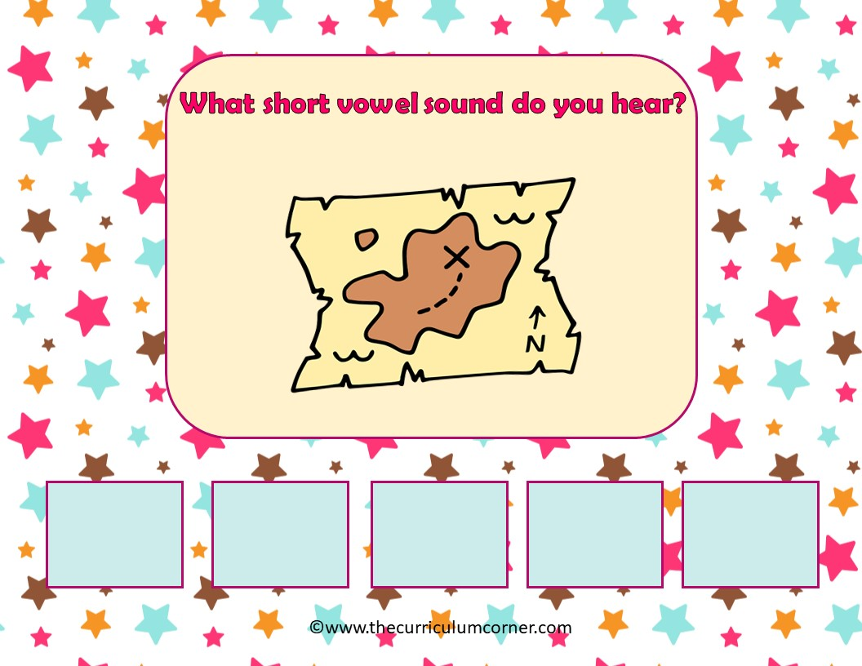
map
a
e
i
o
u

Slide 26
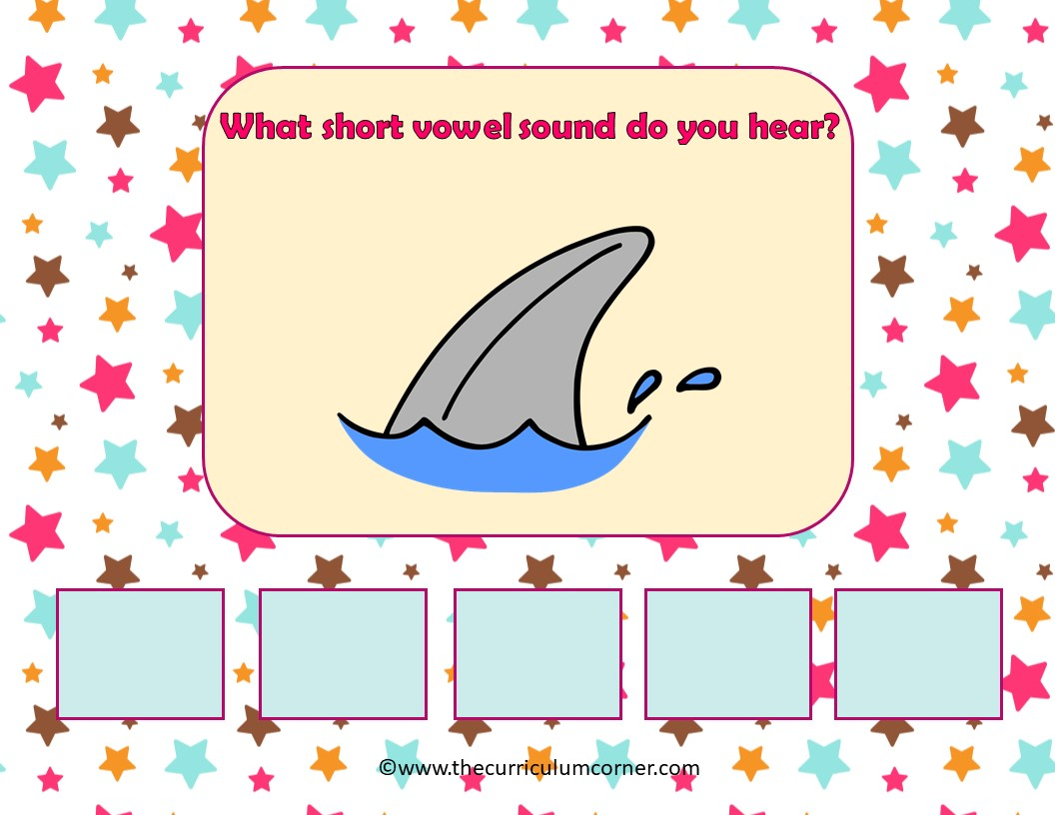
fin
a
e
i
o
u

Slide 27
Way to Go!
Click here to go back to the start.
Created by The Curriculum Corner

