Slide 1

Find the Missing Letter
a phonics practice game
ar, er, ir, or, ur
Click to start.
Created by The Curriculum Corner

Slide 2

b _ r d
a
e
i

Slide 3
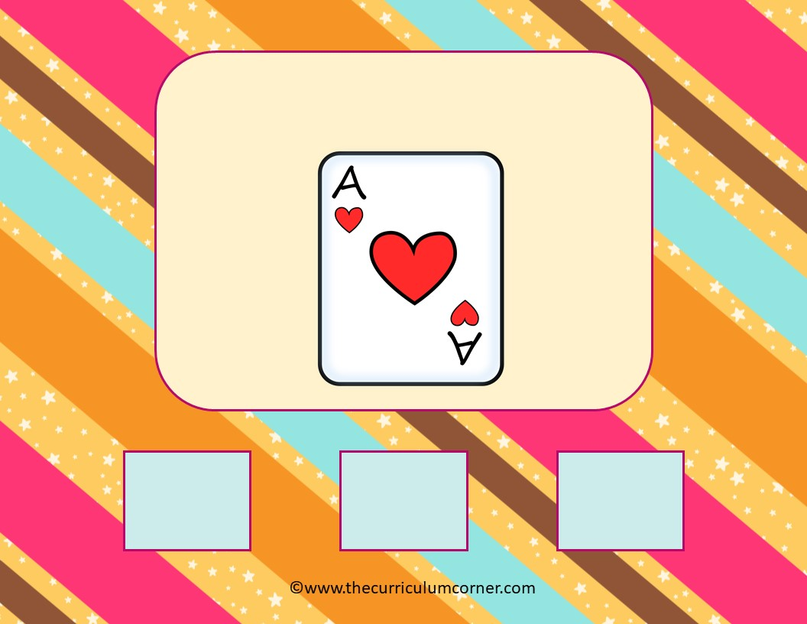
c _ r d
a
e
i

Slide 4
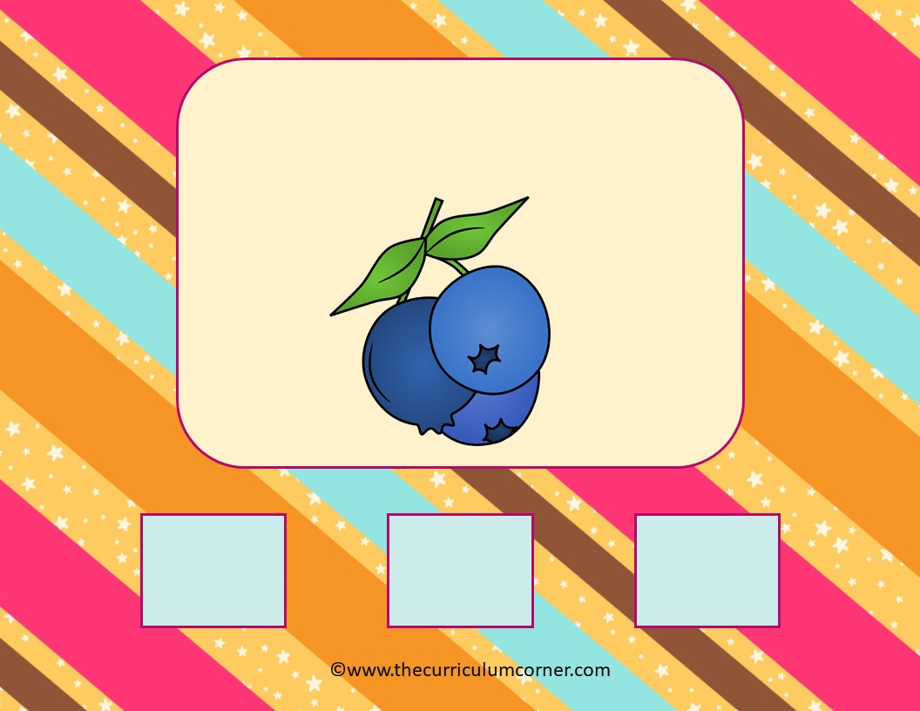
b l u e b_ r r y
a
e
i

Slide 5
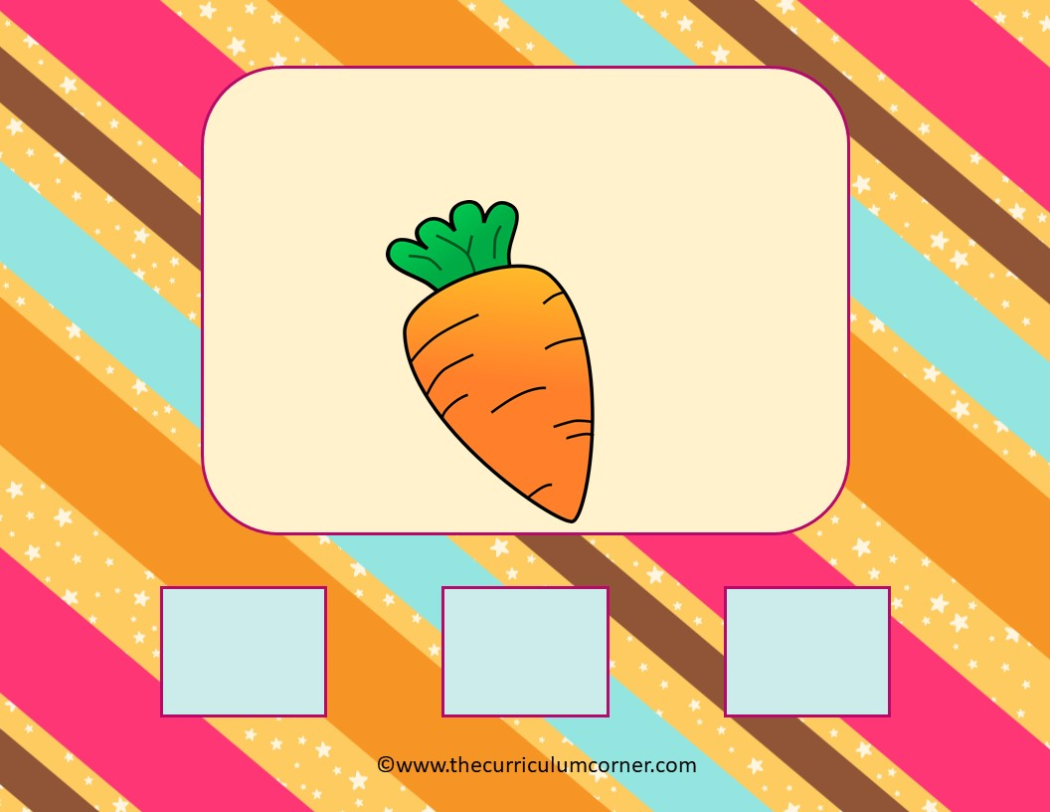
c _ r r o t
a
e
i

Slide 6

b l e n d _ r
a
e
i

Slide 7
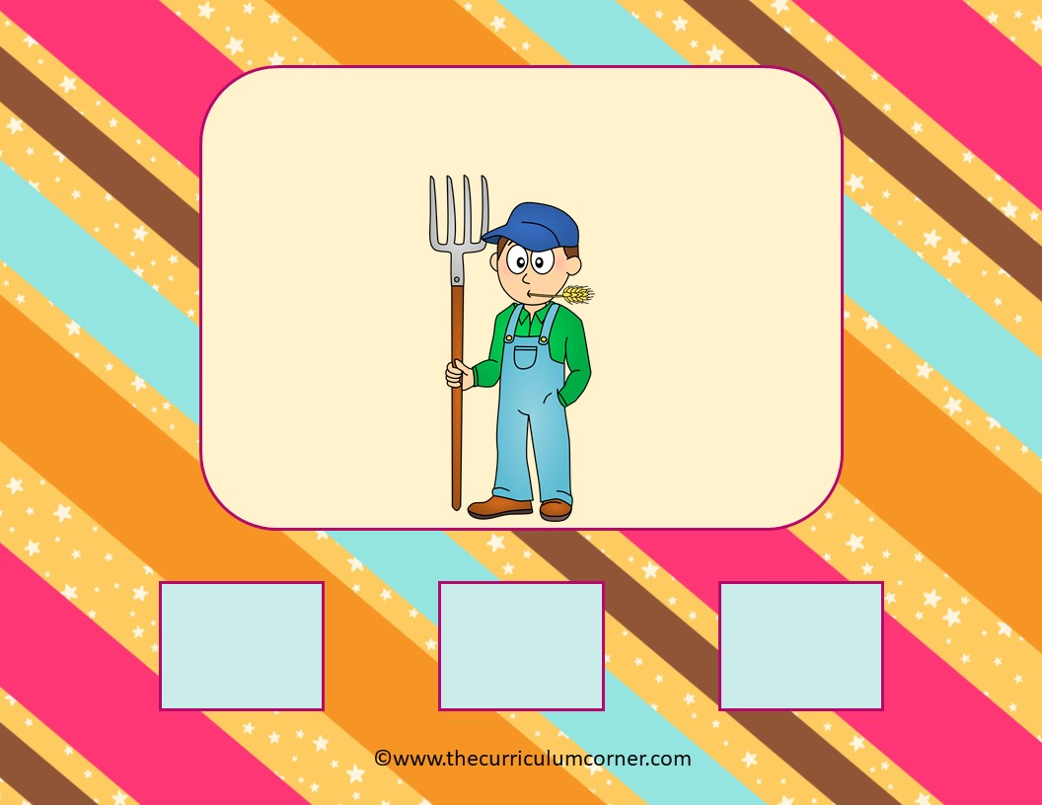
f a r m _ r
a
e
i

Slide 8
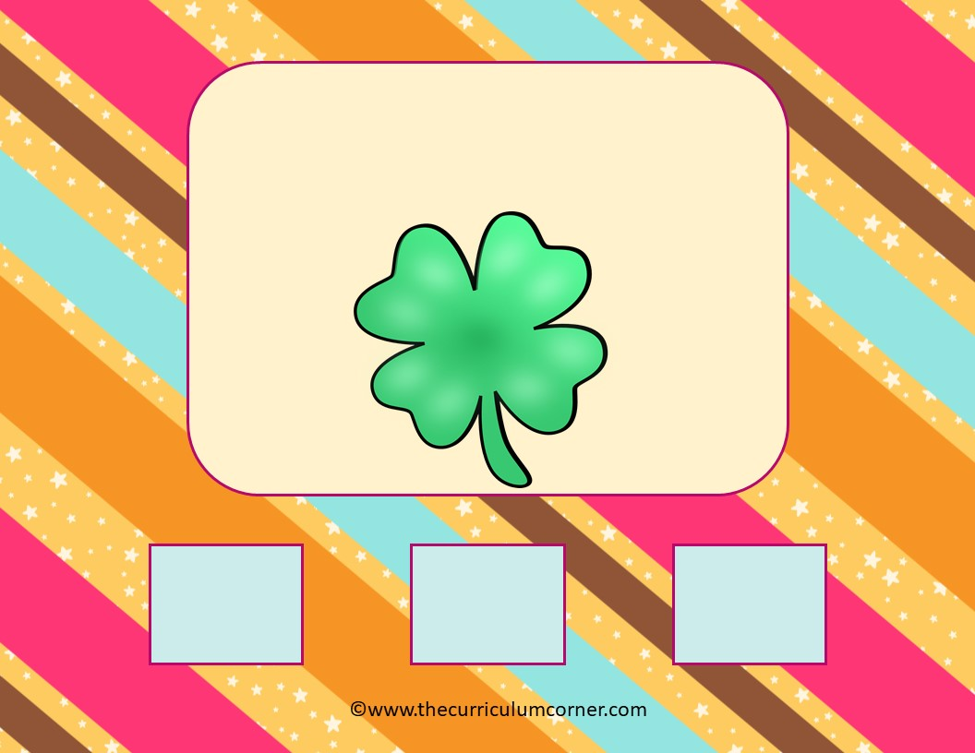
c l o v _ r
a
e
i

Slide 9
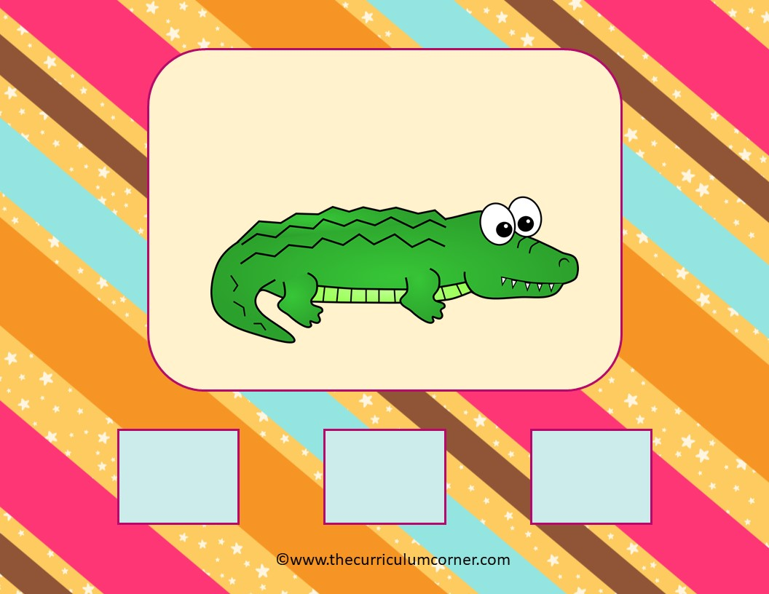
a l l i g a t _ r
a
o
u

Slide 10

f l o w _ r
a
e
i

Slide 11

f _ r k
a
o
u

Slide 12

g _ r b a g e
a
e
i

Slide 13
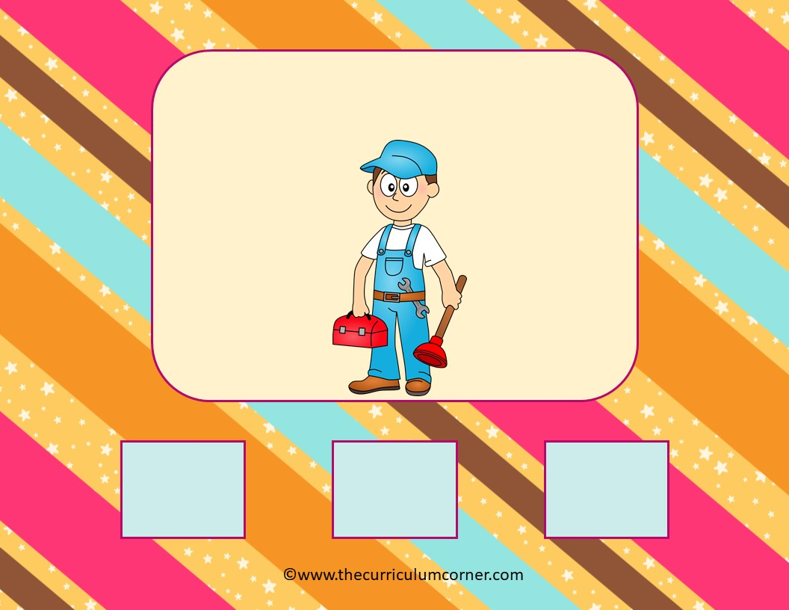
p l u m b _ r
a
e
i

Slide 14
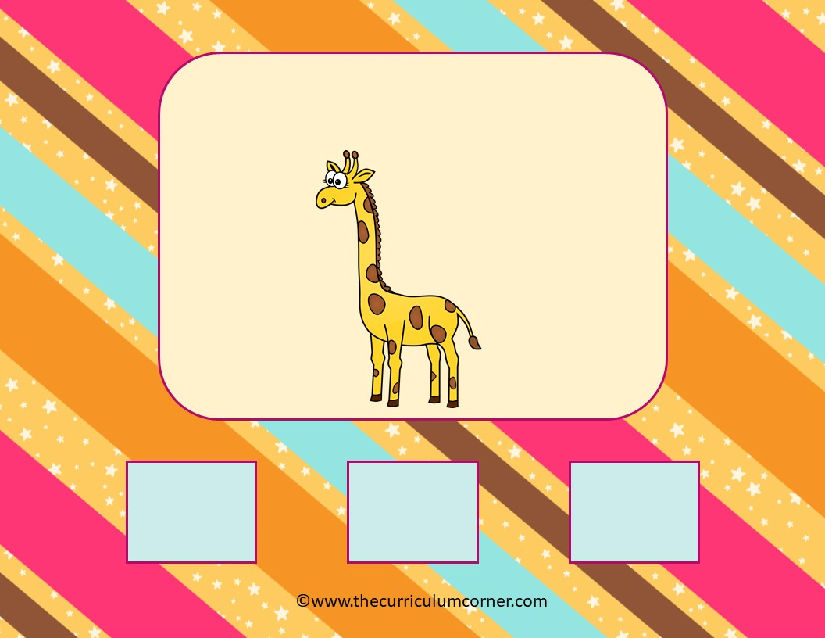
g _ r a f f e
a
e
i

Slide 15

f e a t h _ r
a
e
i

Slide 16

g u i t _ r
a
e
i

Slide 17
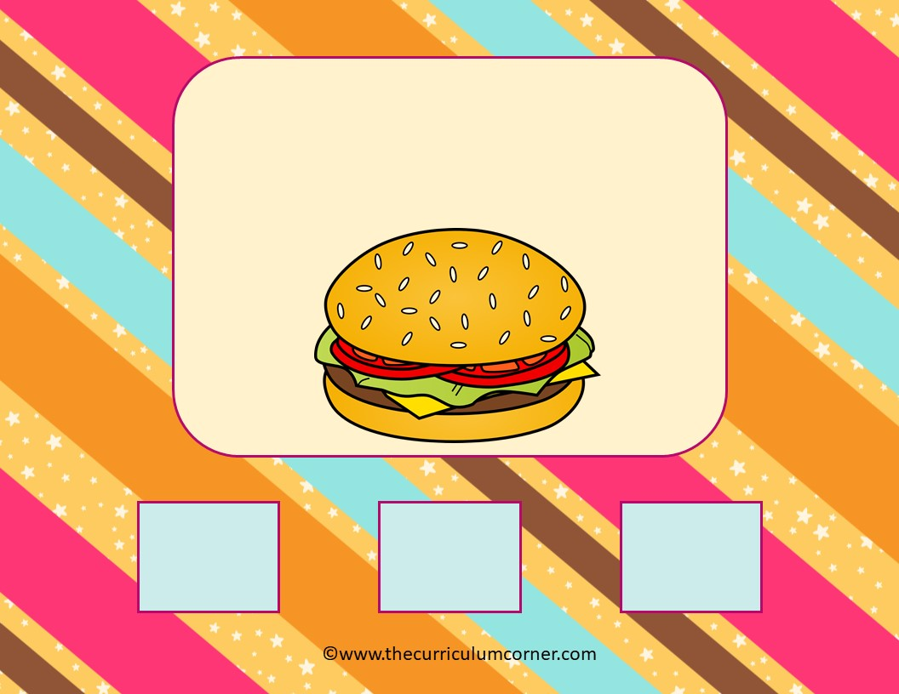
h a m b u r g _ r
a
e
i

Slide 18

h a m m _ r
a
e
i

Slide 19
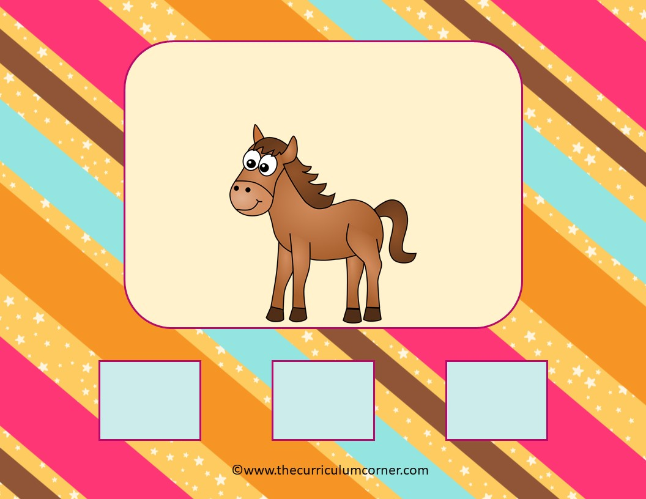
h _ r s e
a
o
u

Slide 20

c _ r
a
e
i

Slide 21
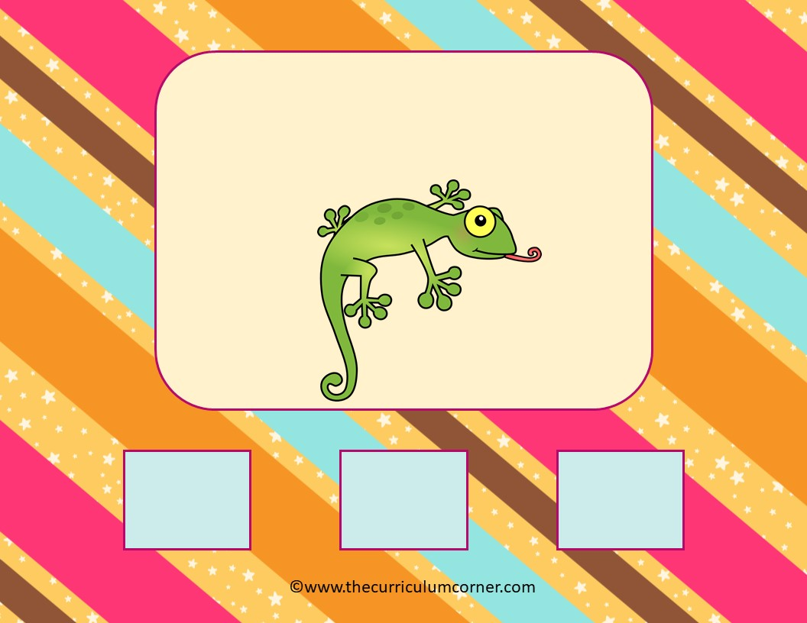
l i z z _ r d
a
e
i

Slide 22

s c o o t _ r
a
e
i

Slide 23

j _ r
a
e
i

Slide 24

s h _ r t
a
e
i

Slide 25

p _ r s e
i
o
u

Slide 26

p l i _ r s
a
e
i

Slide 27

p o p c _ r n
a
o
u

Slide 28
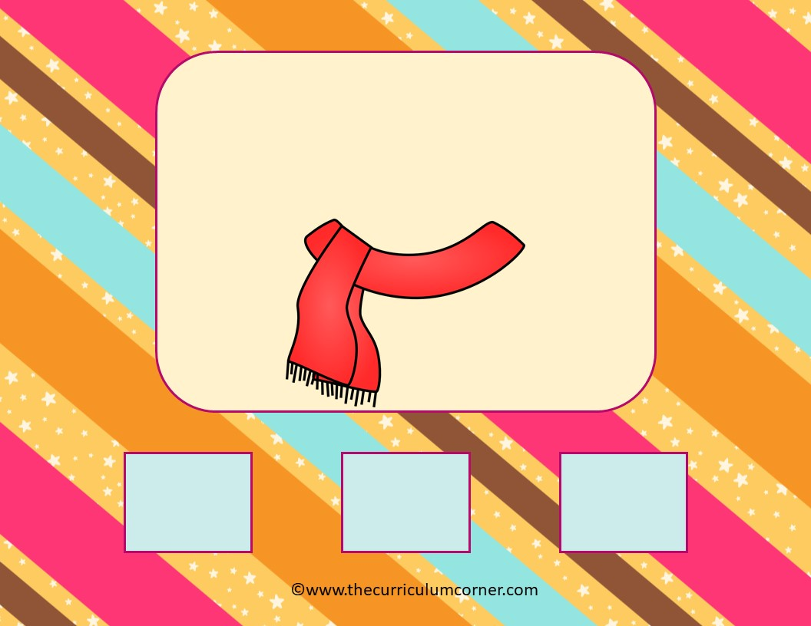
s c _ r f
a
e
i

Slide 29

s k _ r t
a
e
i

Slide 30
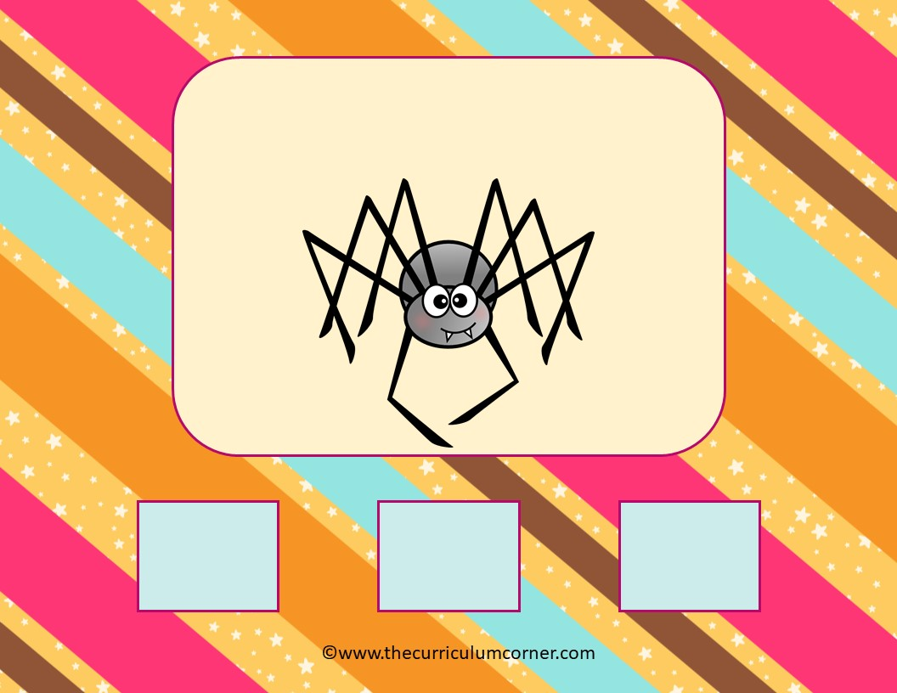
s p i d _ r
e
o
u

Slide 31

s t _ r
a
e
i

Slide 32

t r a c t _ r
a
o
u

Slide 33

t _ r n
i
o
u

Slide 34
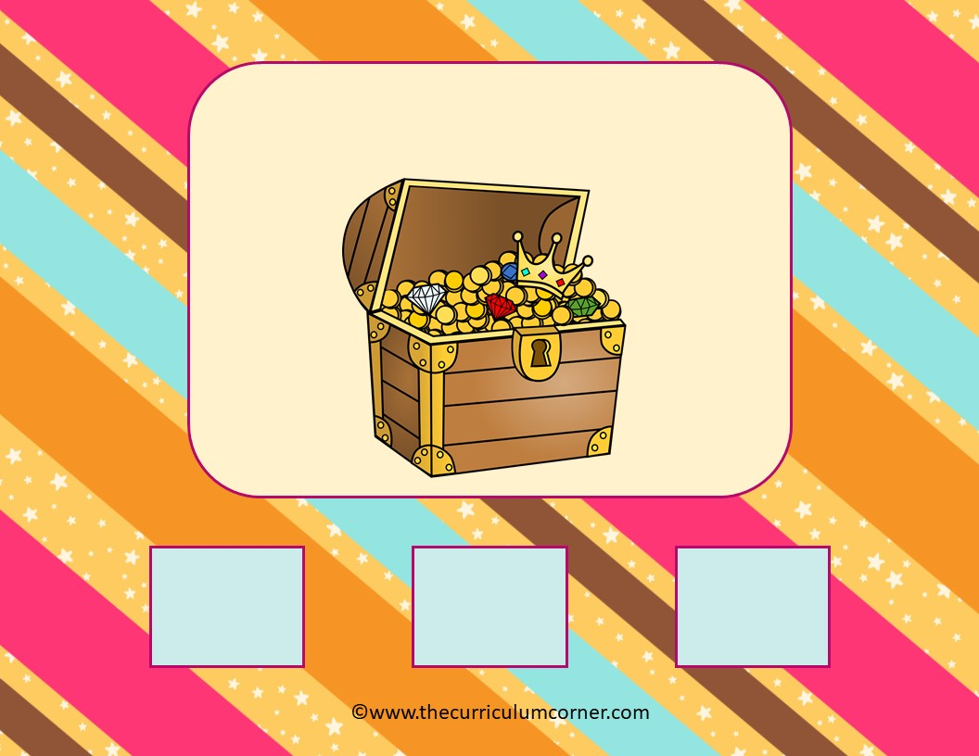
t r e a s _ r e
i
o
u

Slide 35

s t _ r m
a
o
u

Slide 36

Way to Go!
Click here to go to play again.

