Slide 1
Telling Time to
Five Minutes
Click Here to Start.
The Curriculum Corner

Slide 2
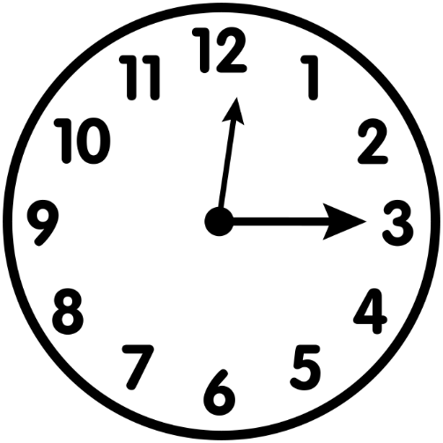
What time is it?
12:15
12:00
3:15

Slide 3
Try again…

Slide 4
Way to Go!!

Slide 5
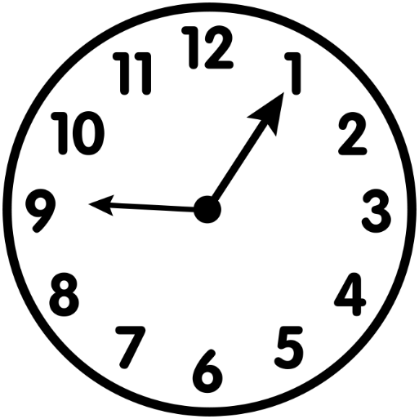
What time is it?
1:45
12:05
9:05

Slide 6
Not Quite…

Slide 7
Summerific!

Slide 8
What time is it?
1:15
2:10
2:15

Slide 9
Sorry…
Try one more time.

Slide 10
You are
amazing!

Slide 11
What time is it?
4:20
3:20
3:30

Slide 12
Think about
that again…

Slide 13
You got it!

Slide 14
What time is it?
7:25
5:40
8:25

Slide 15
Hmmm…
not quite.

Slide 16
Way to
catch a wave!

Slide 17
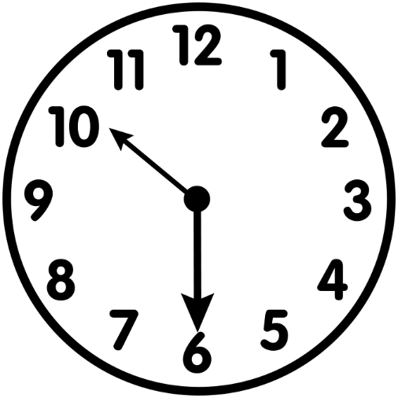
What time is it?
10:20
10:30
6:50

Slide 18
Try Again!

Slide 19
Woo Hoo!

Slide 20
What time is it?
1:35
7:10
2:35

Slide 21
Sorry…
not quite.

Slide 22
Way to go!

Slide 23
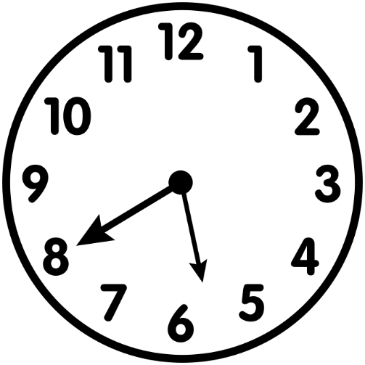
What time is it?
8:30
5:40
5:25

Slide 24
Nope.
Try that one more time.

Slide 25
You are so
BRIGHT!

Slide 26
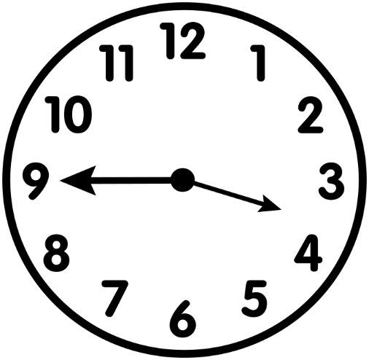
What time is it?
3:40
9:20
3:45

Slide 27
That isn’t
correct.
Try Again!

Slide 28
Wow!
Right On!

Slide 29
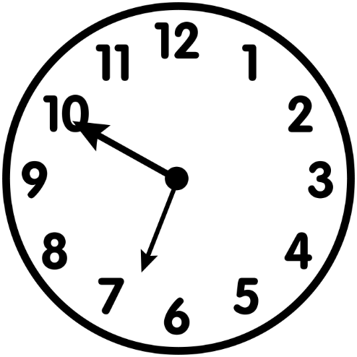
What time is it?
10:35
6:50
7:50

Slide 30
Incorrect.
Look at that
again.

Slide 31
You are
CRAZY good!

Slide 32
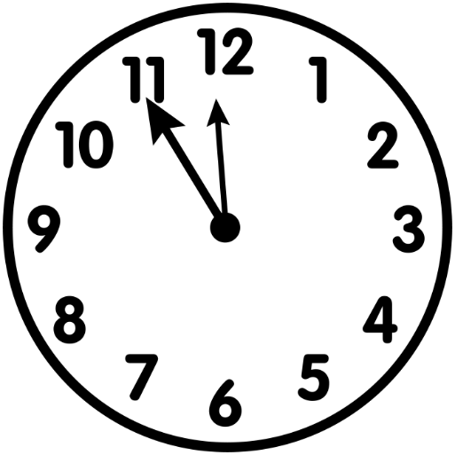
What time is it?
12:00
12:55
11:55

Slide 33
Try Again!

Slide 34
Awesome
Sauce!

Slide 35
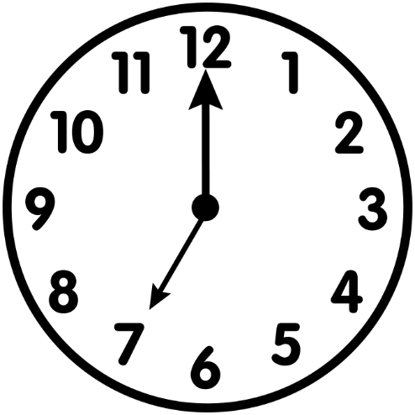
What time is it?
12:35
7:05
7:00

Slide 36
Maybe try
that one again!

Slide 37
You are
FABULOUS!

Slide 38
Great
Practice!!

