Slide 1

I think this cat is going to…

Slide 2
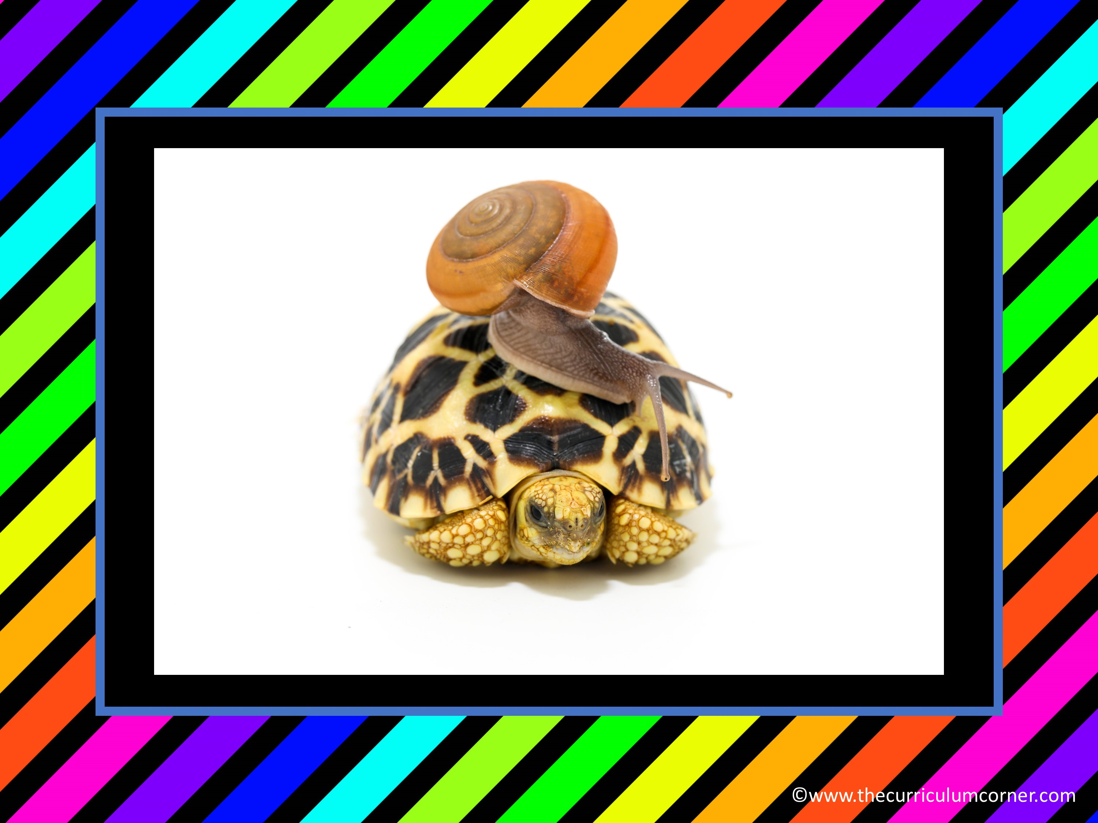
Tell a quick story about the snail and turtle.

Slide 3

What movie is the dog going to see?

Slide 4
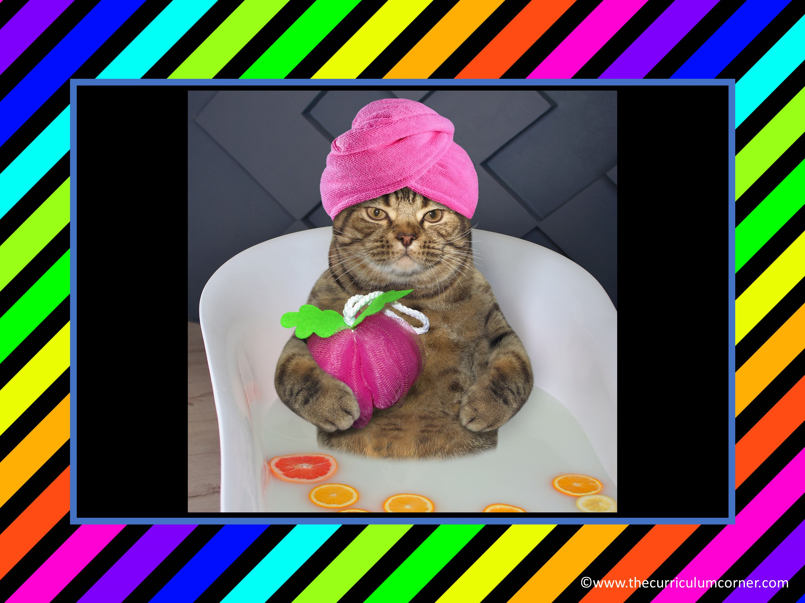
How is the cat feeling?

Slide 5
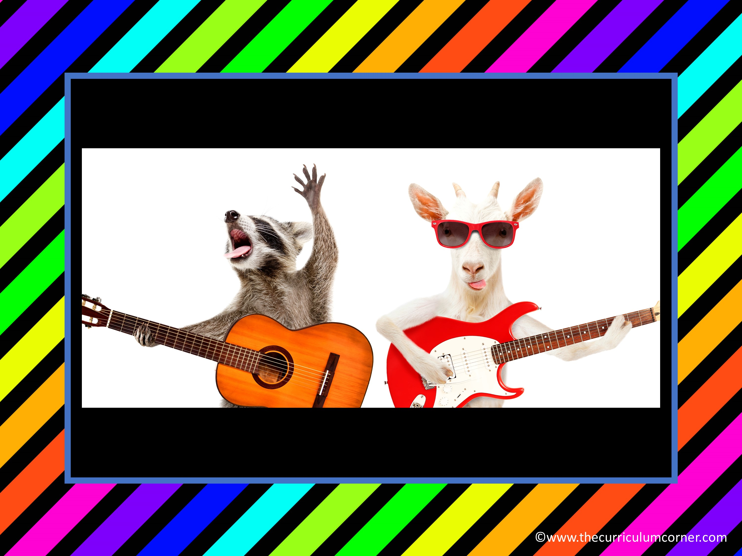
Tell about this musical group.

Slide 6
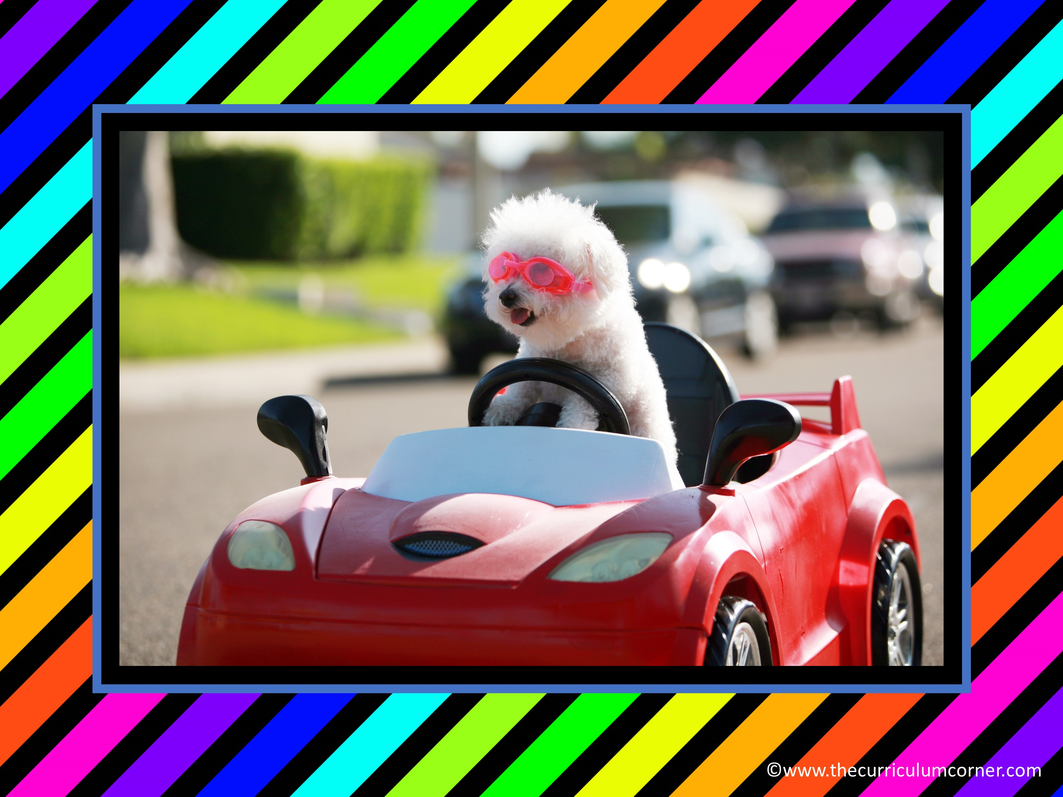
Let’s write a class story about this dog. Add a sentence of your own.

Slide 7
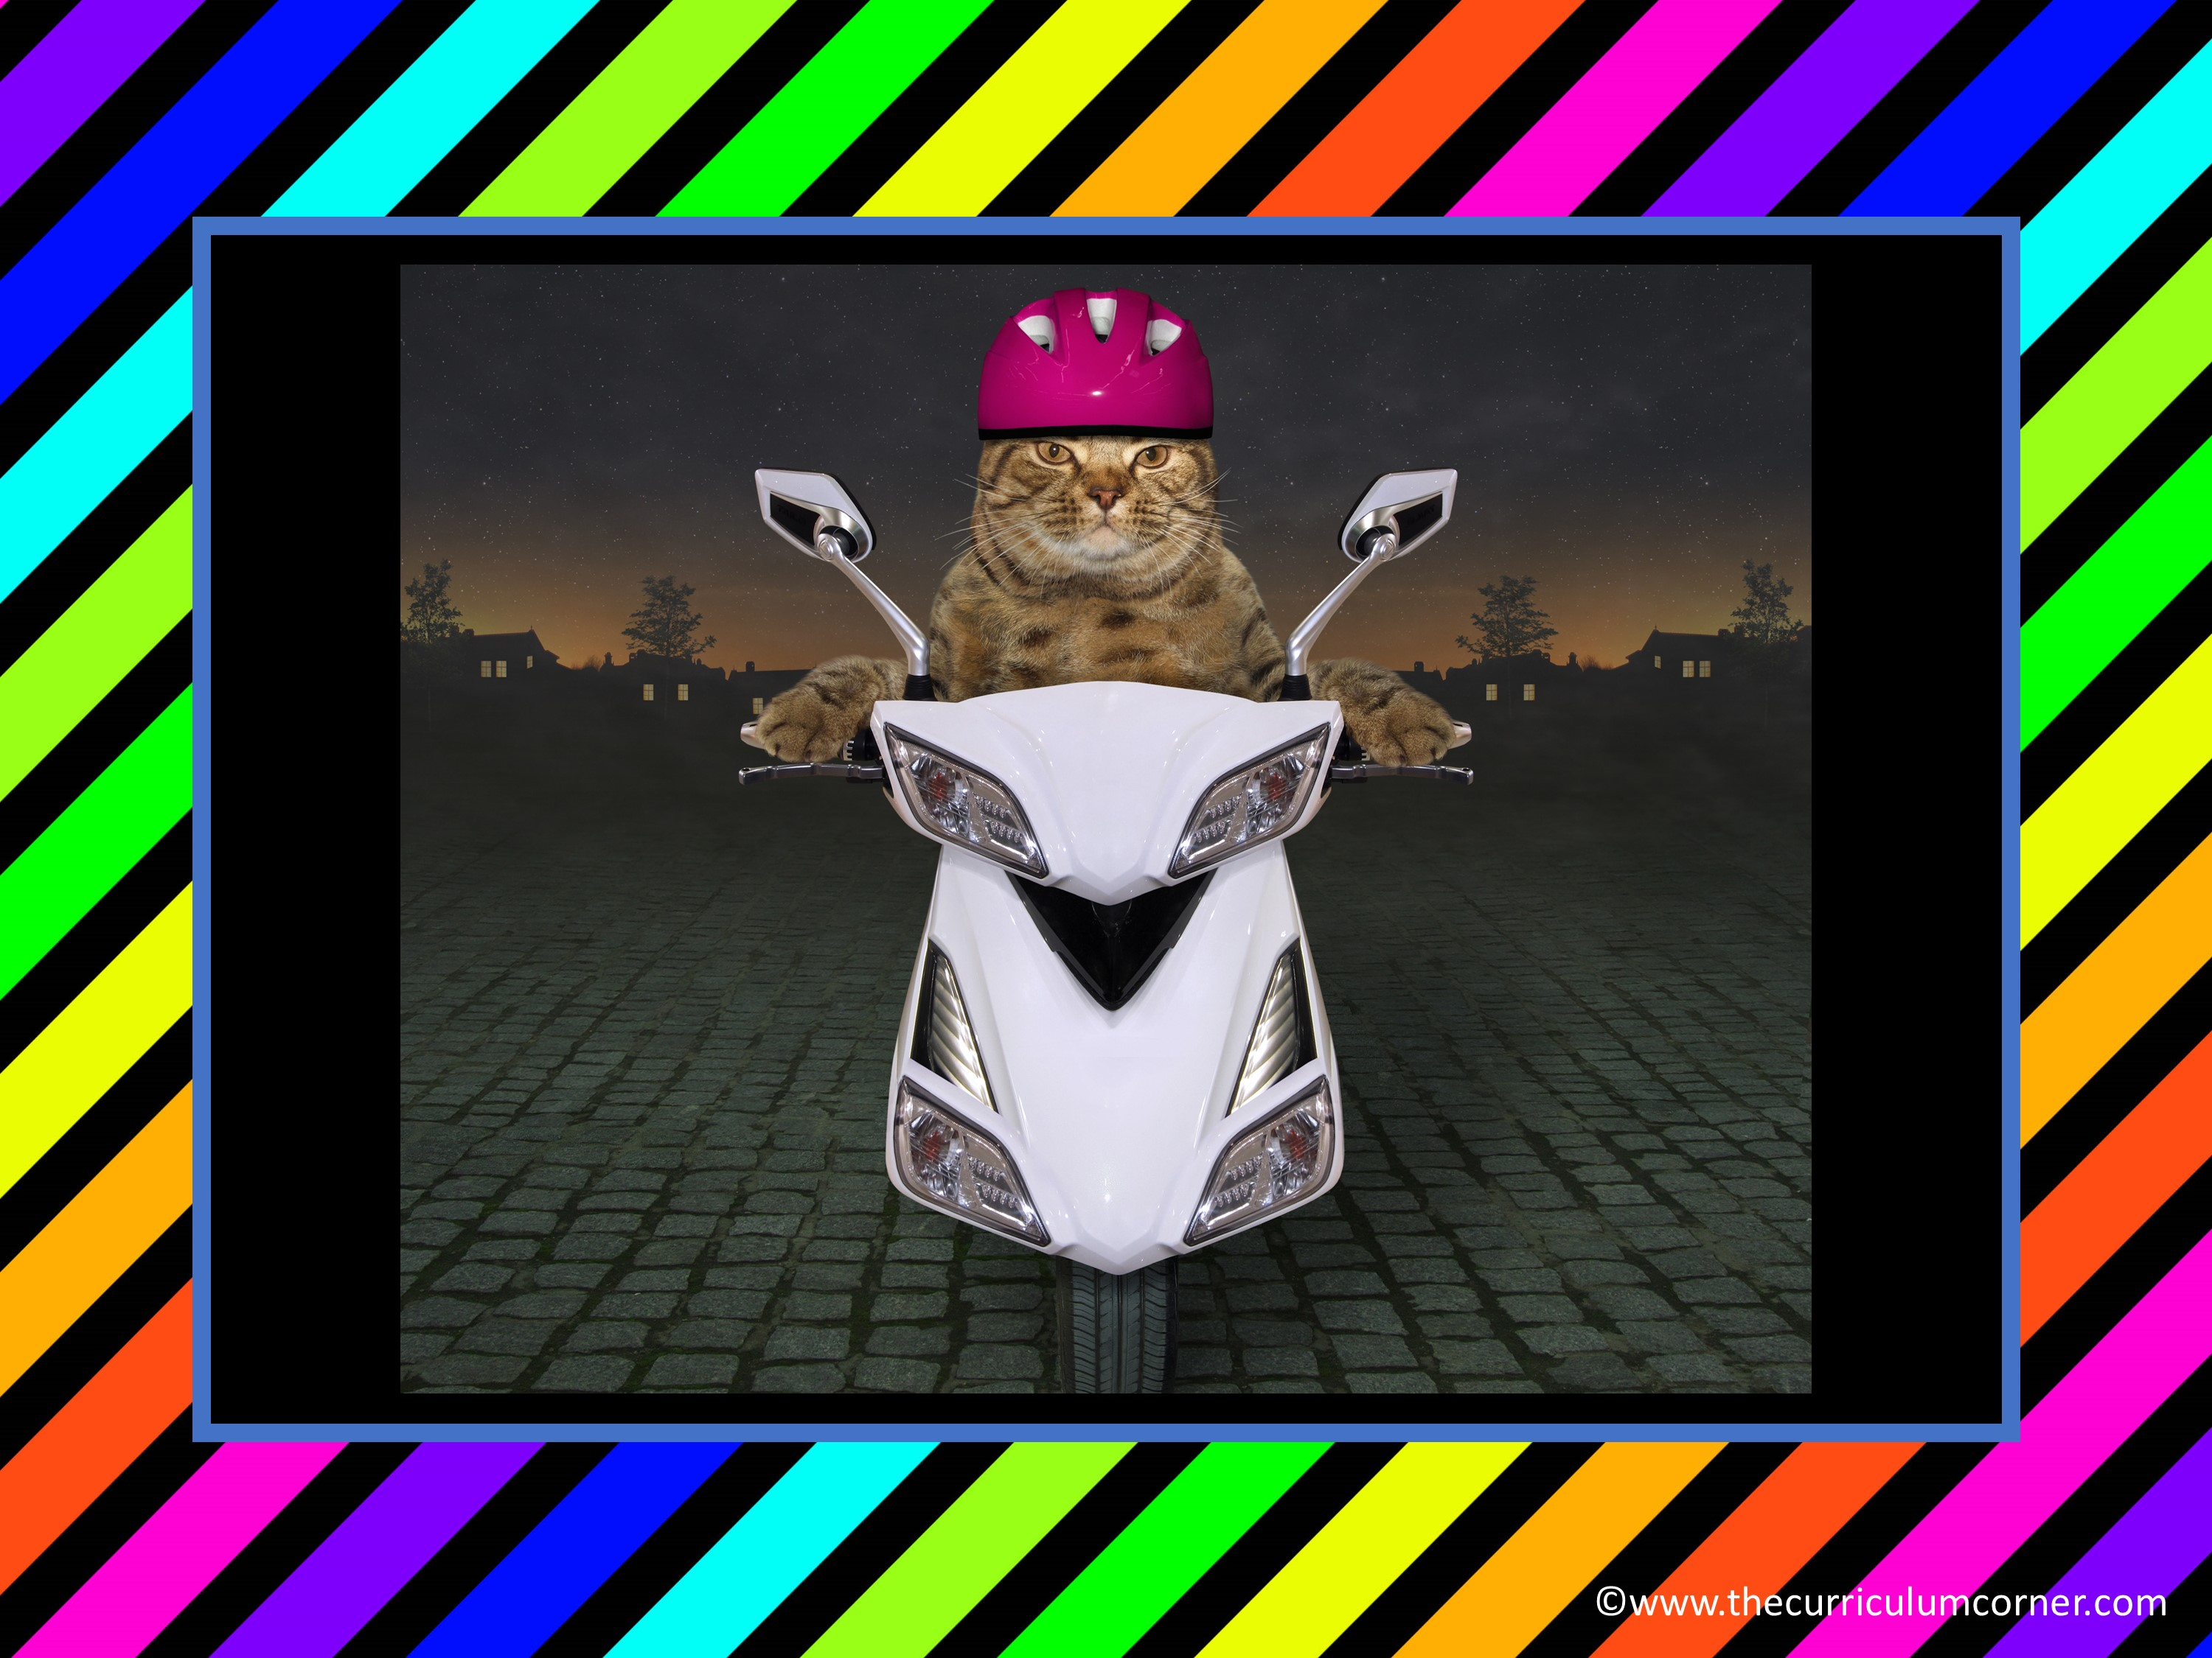
Write a descriptive sentence about the picture.

Slide 8

Tell about the trip this dog took.

Slide 9

How did the turtle get here?

Slide 10

Tell about this cat.

Slide 11

Write a very short story about the fish.

Slide 12
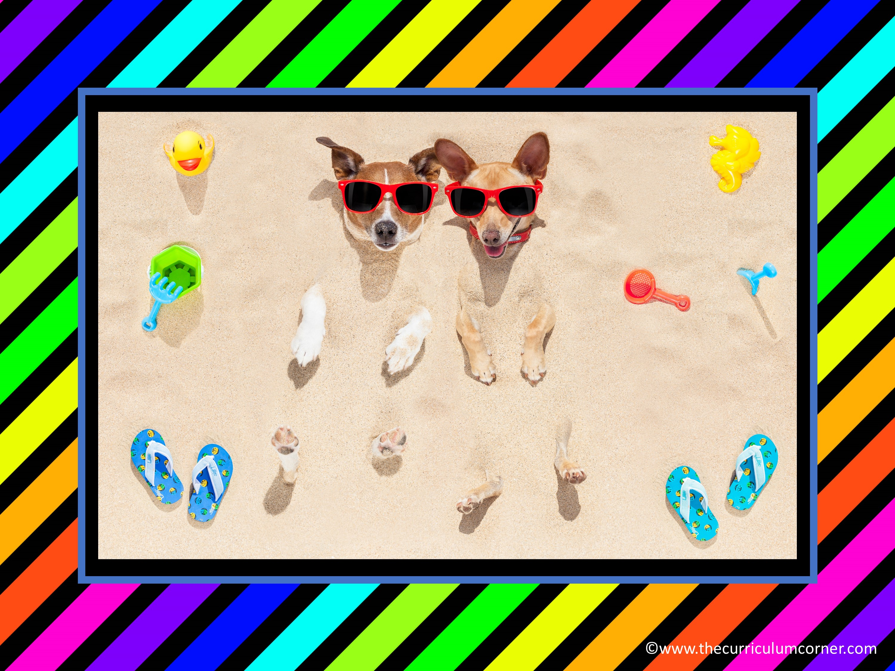
What’s happening here?

Slide 13

Describe the birthday party.

Slide 14
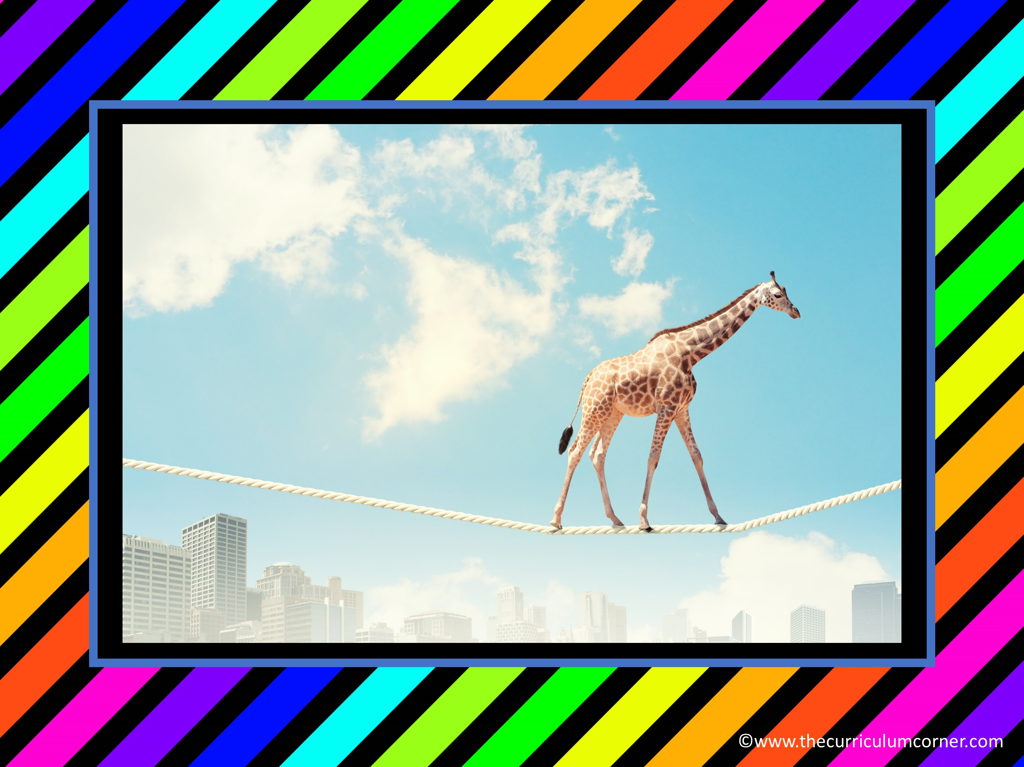
How did the giraffe get here?

Slide 15

What character traits does this cat have?

