Slide 1
Let’s write
about the African Savanna!
©www.thecurriculumcorner.com

Slide 2
Writing Warm-Up
Authors use vivid adjectives to make their writing better.
©www.thecurriculumcorner.com

Slide 3
Look at the pictures from the African Savanna. Make a list of adjectives you could use to describe what you see.
©www.thecurriculumcorner.com

Slide 4
adjectives
©www.thecurriculumcorner.com

Slide 5
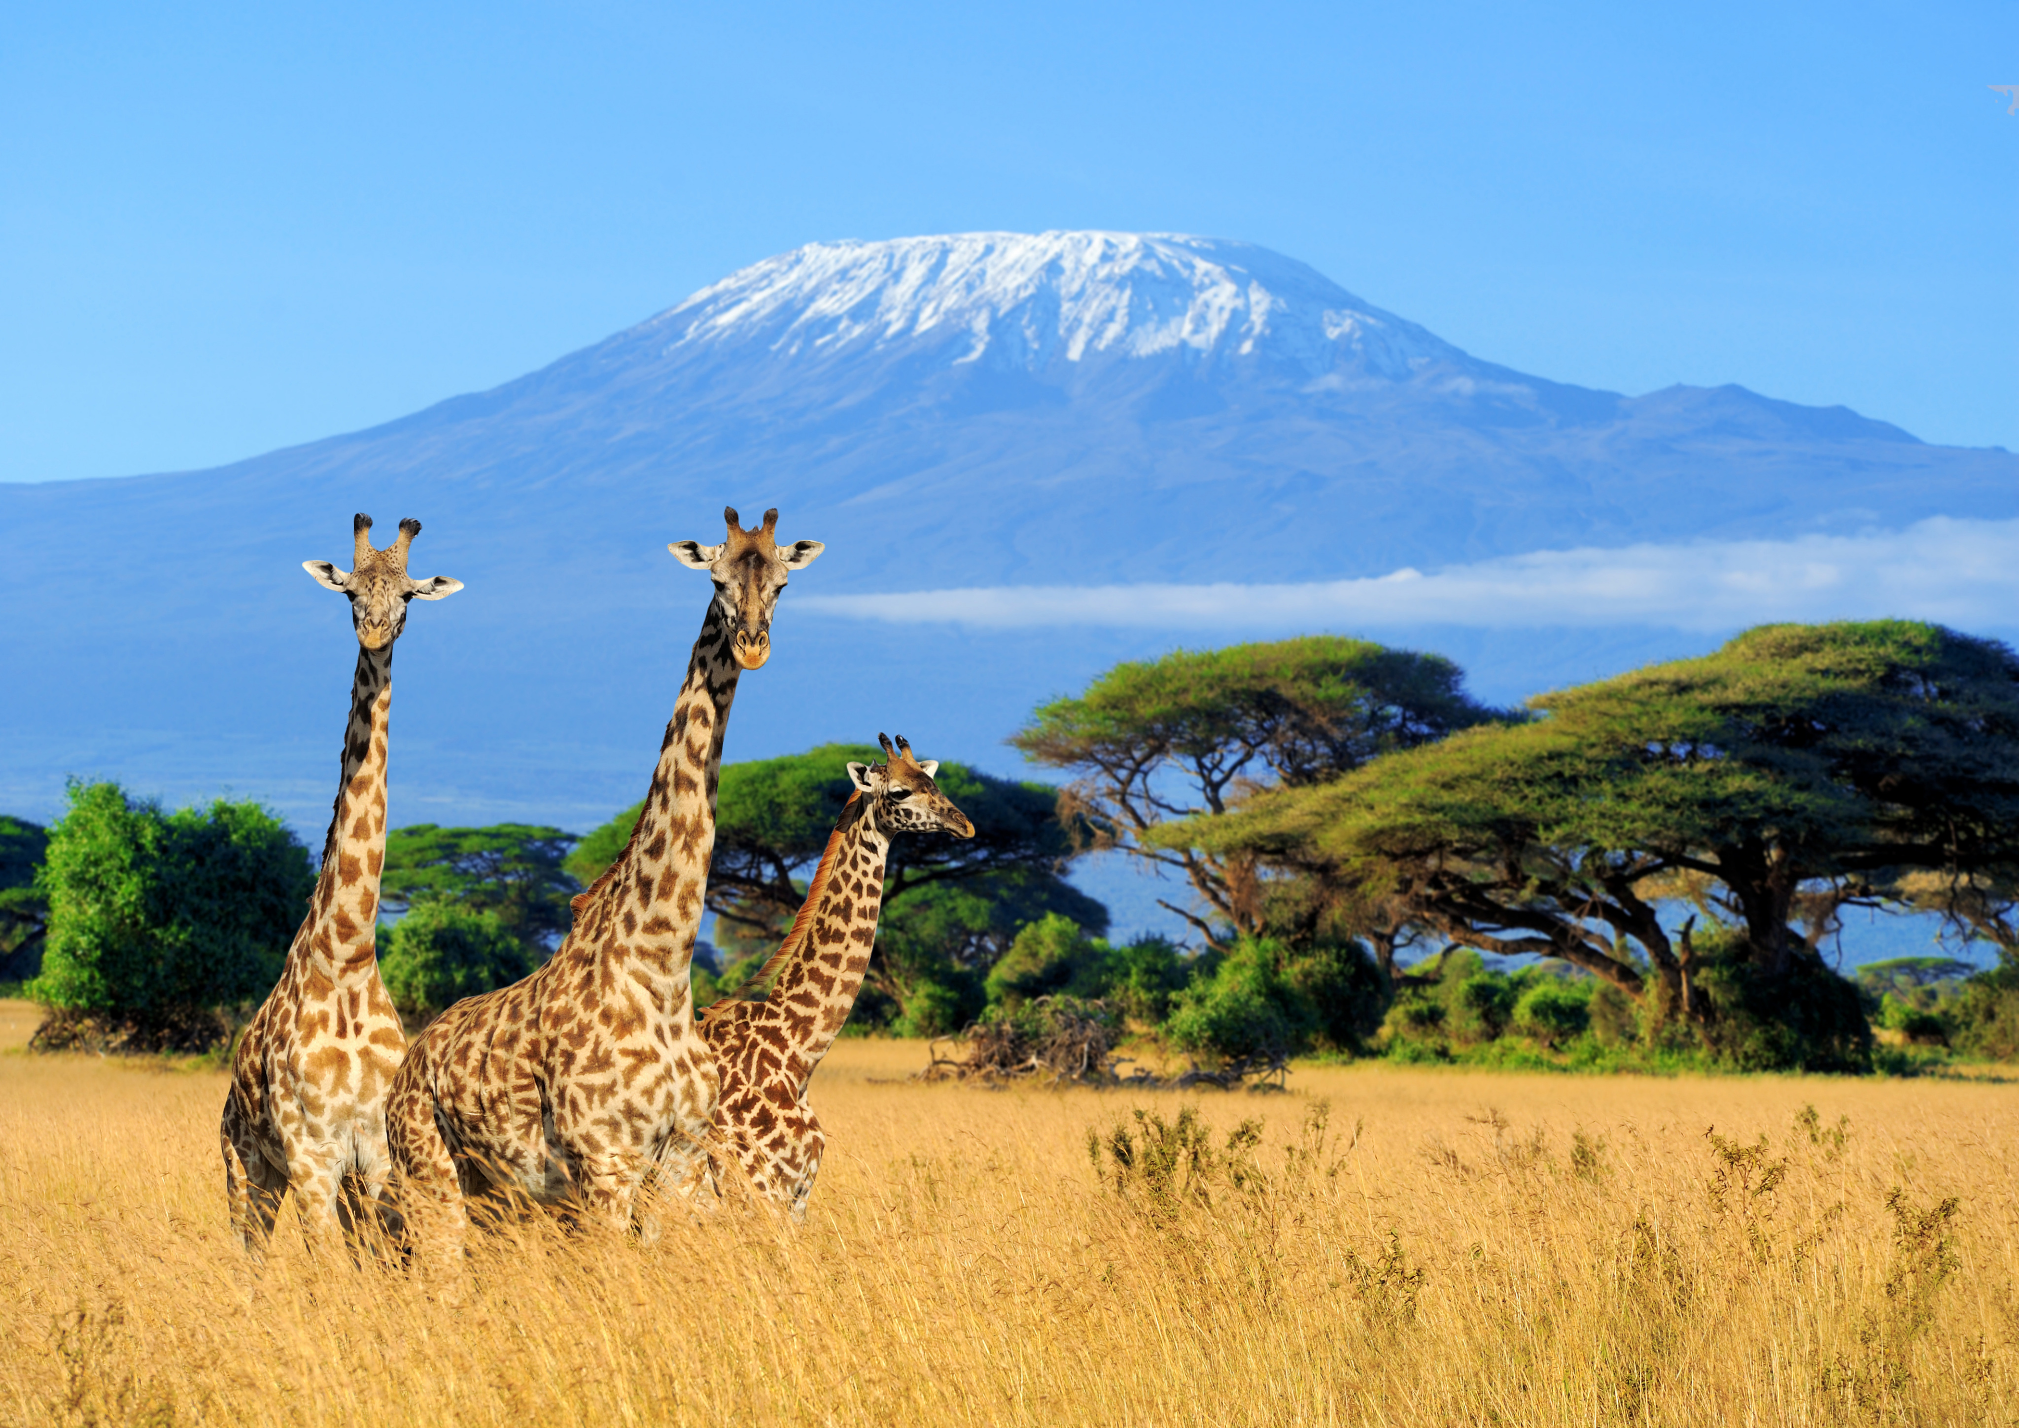
adjectives
©www.thecurriculumcorner.com

Slide 6
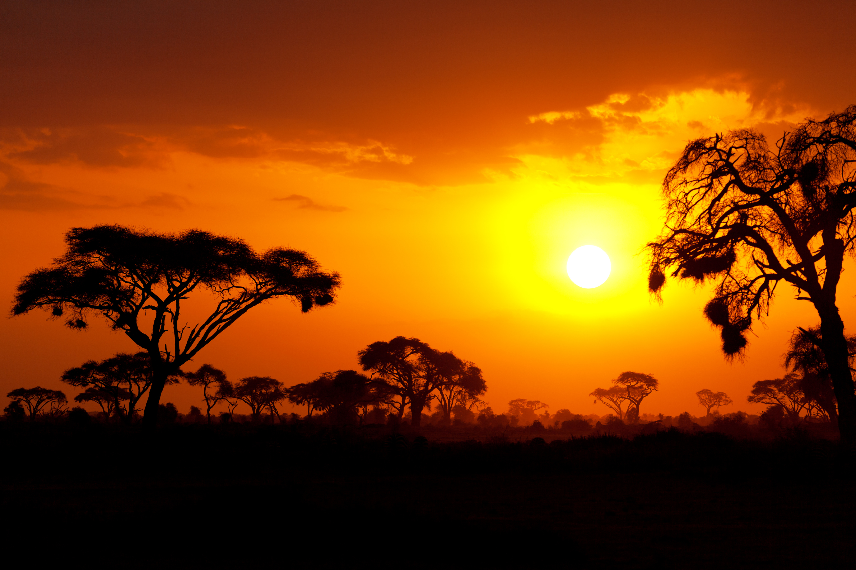
adjectives
©www.thecurriculumcorner.com

Slide 7
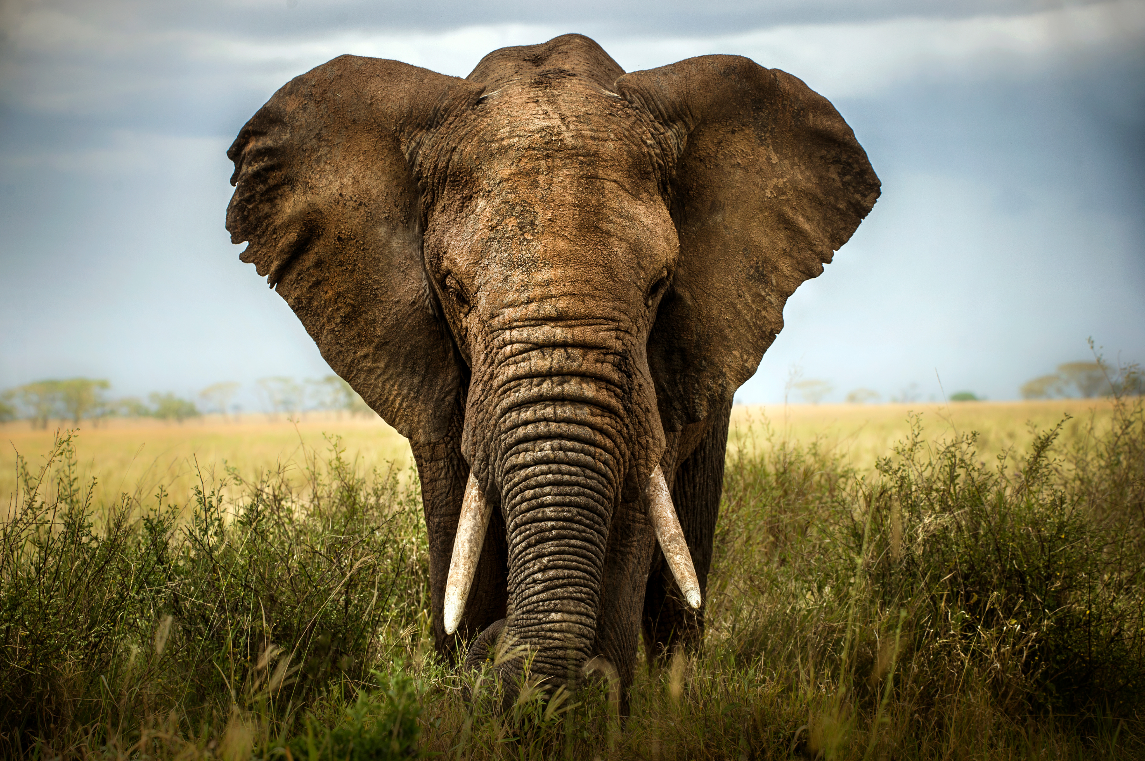
adjectives
©www.thecurriculumcorner.com

Slide 8
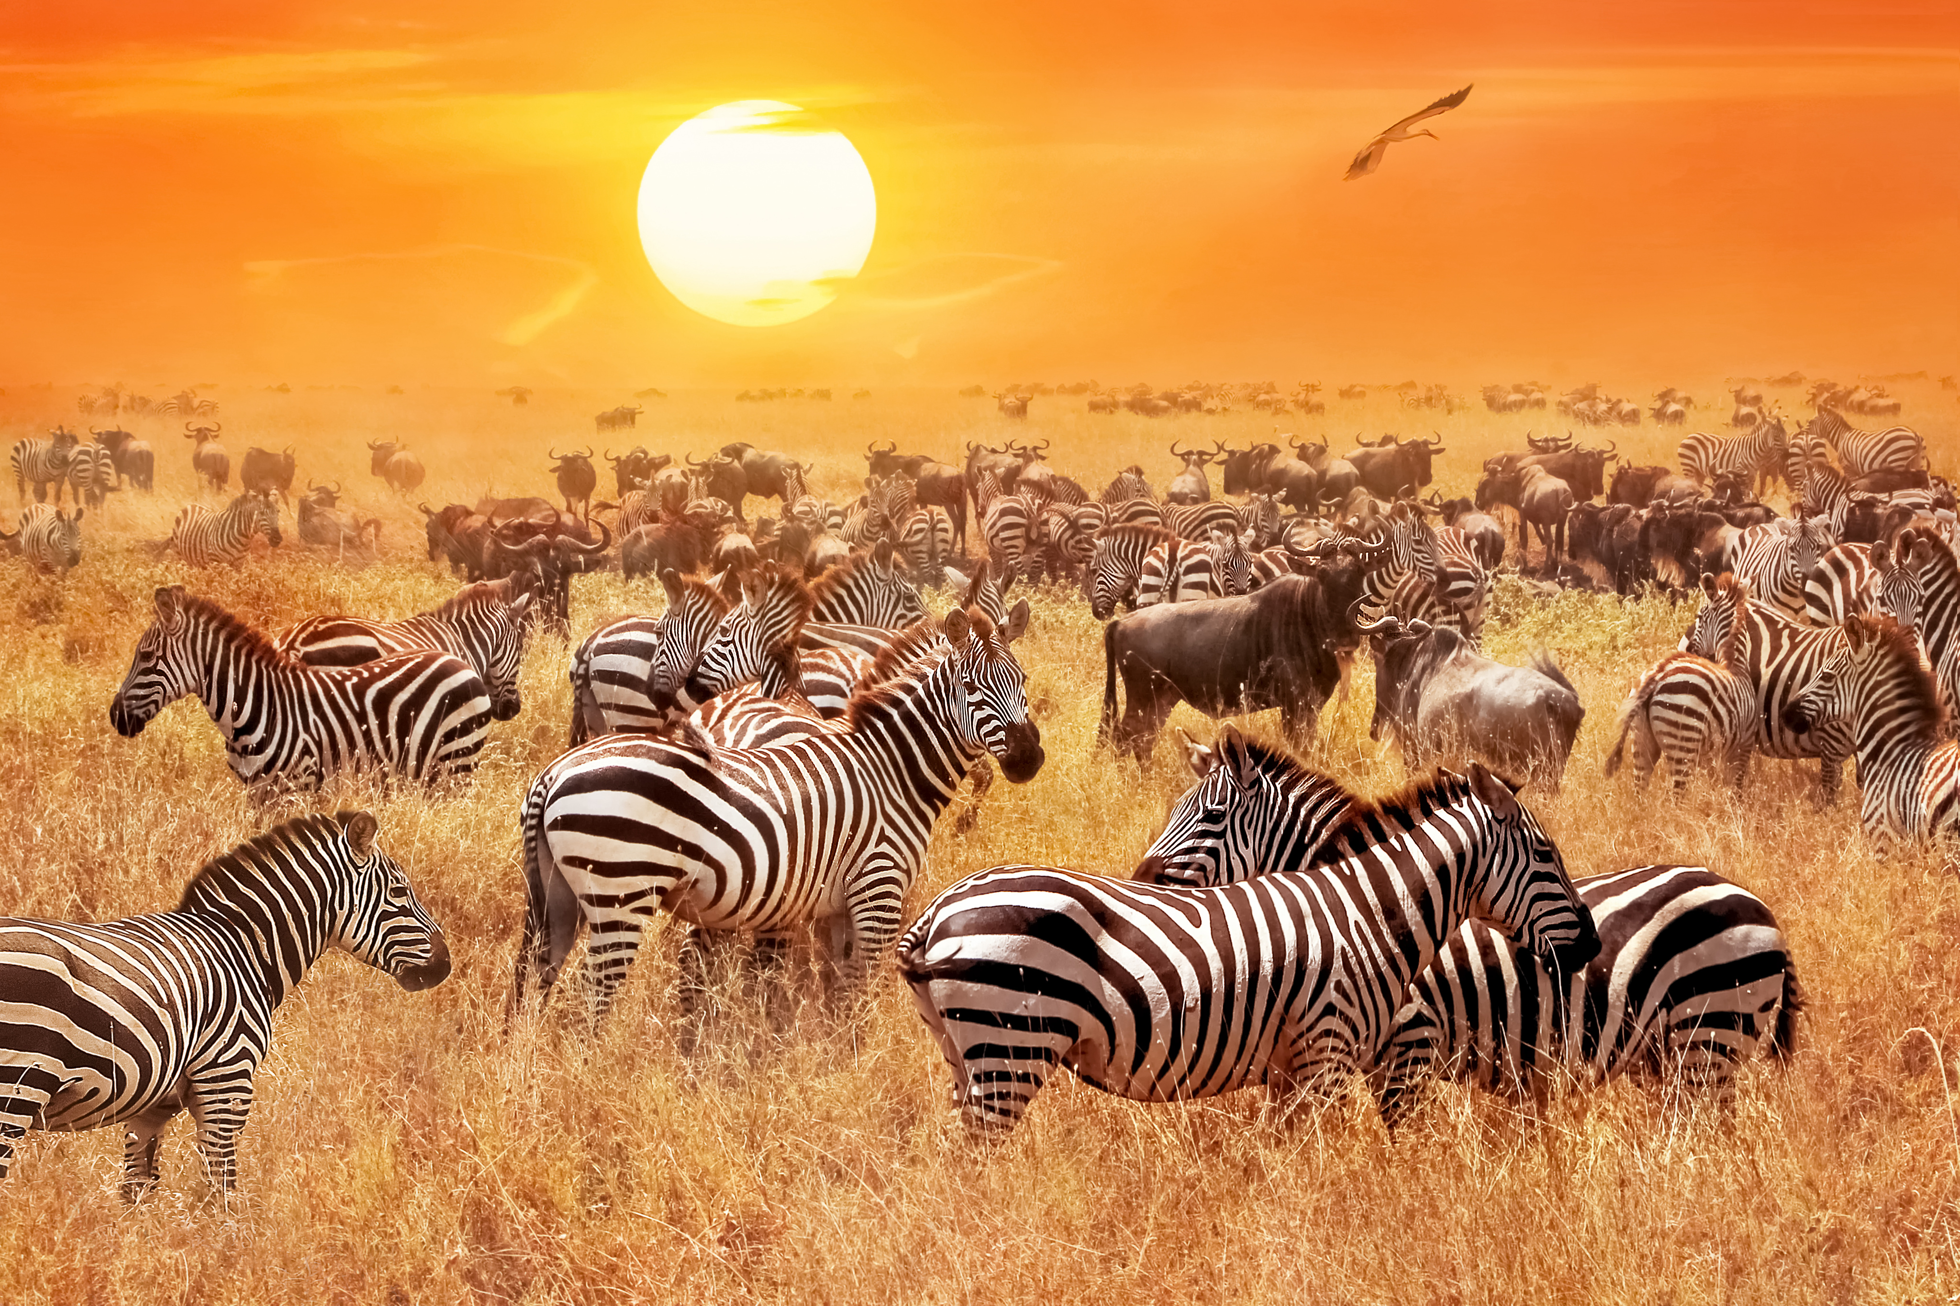
adjectives
©www.thecurriculumcorner.com

Slide 9
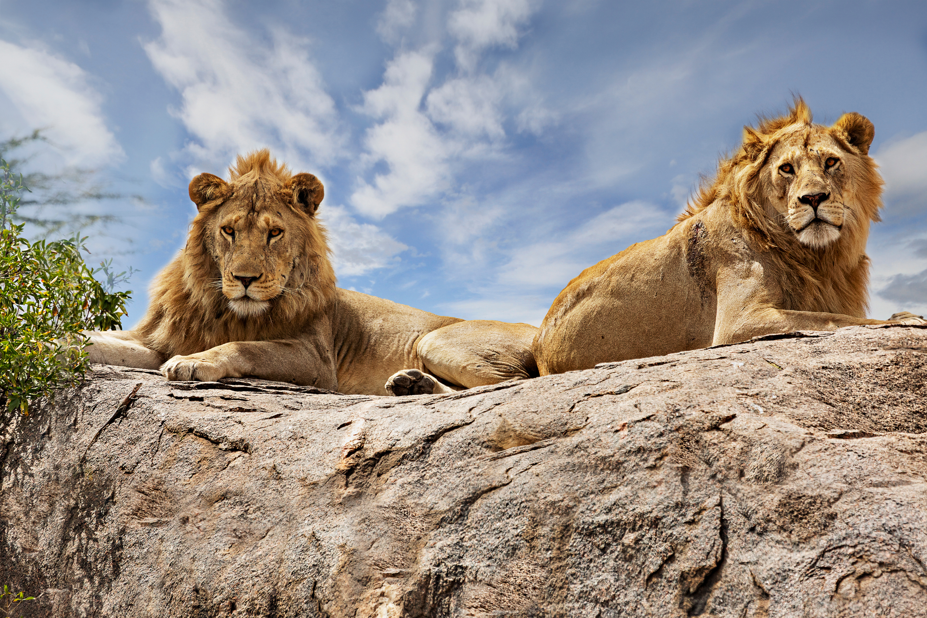
adjectives
©www.thecurriculumcorner.com

Slide 10
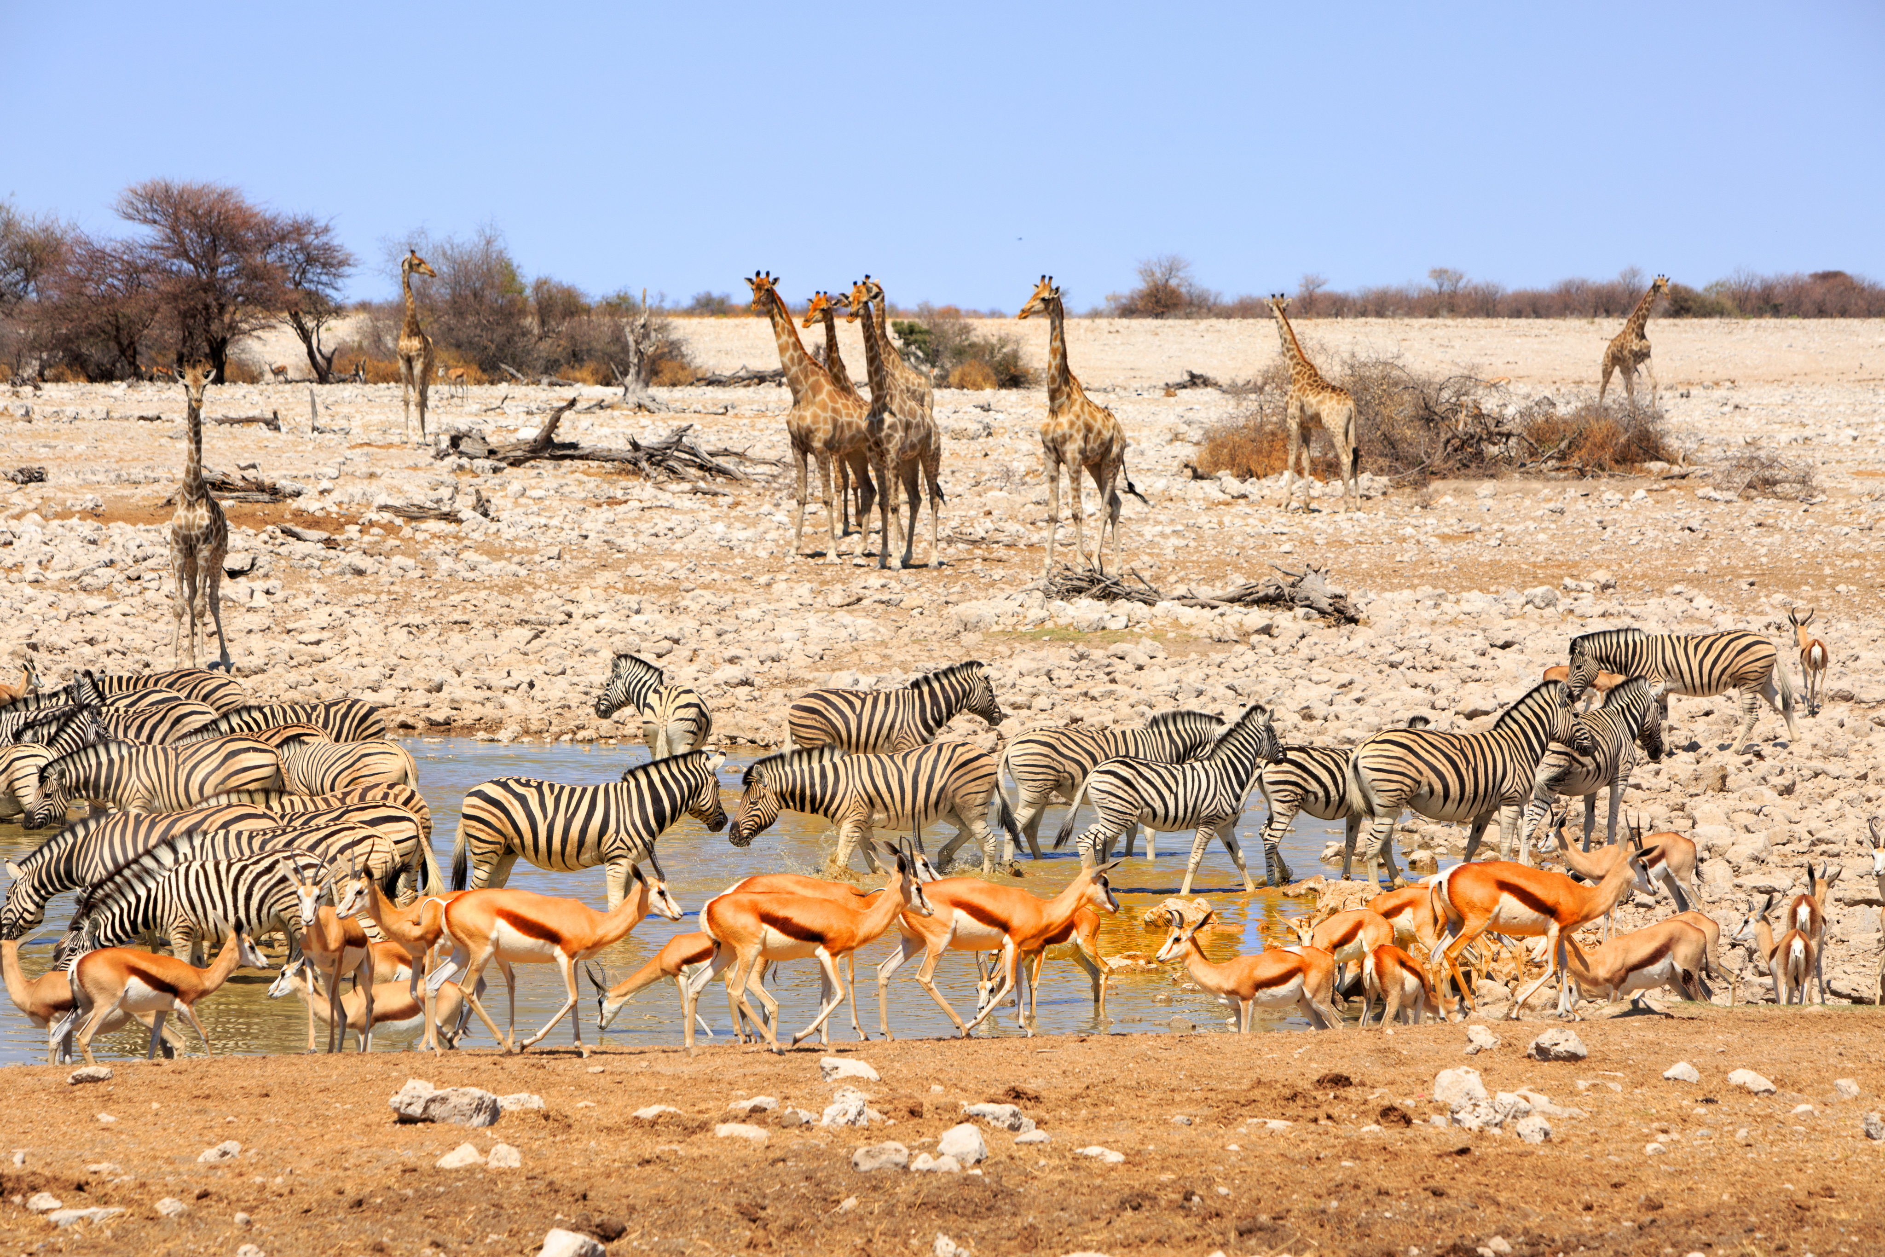
adjectives
©www.thecurriculumcorner.com

Slide 11
Pick a favorite picture we looked at. Write a really great paragraph telling what you see.
Write answer here
©www.thecurriculumcorner.com

Slide 12
Can you edit your paragraph to make it even better? What words could you add to help the reader visualize what you are writing about better?
Write answer here
©www.thecurriculumcorner.com

