Slide 1


Slide 2
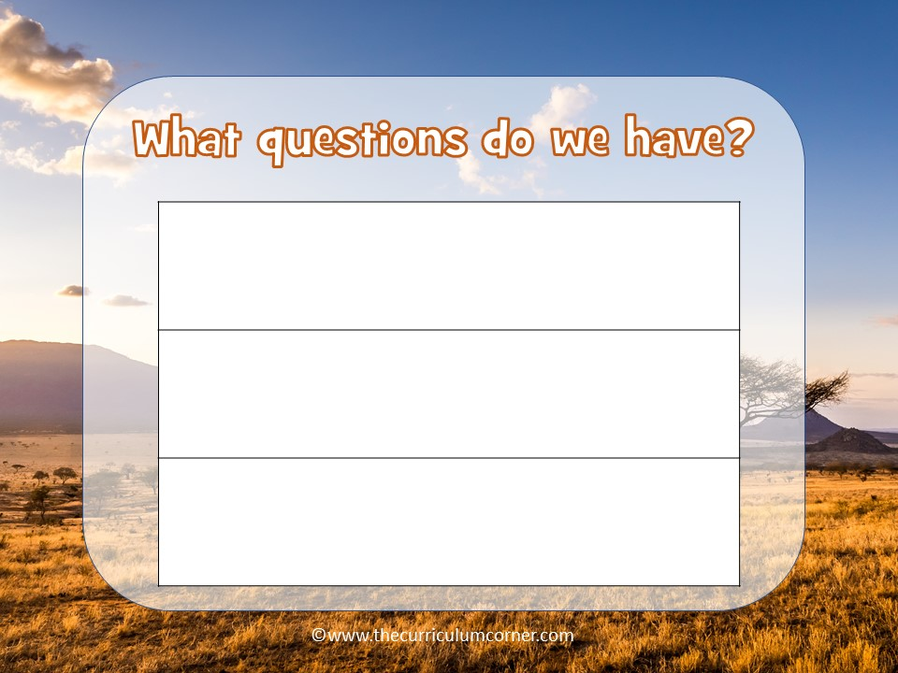
Type here
Type here
Type here

Slide 3
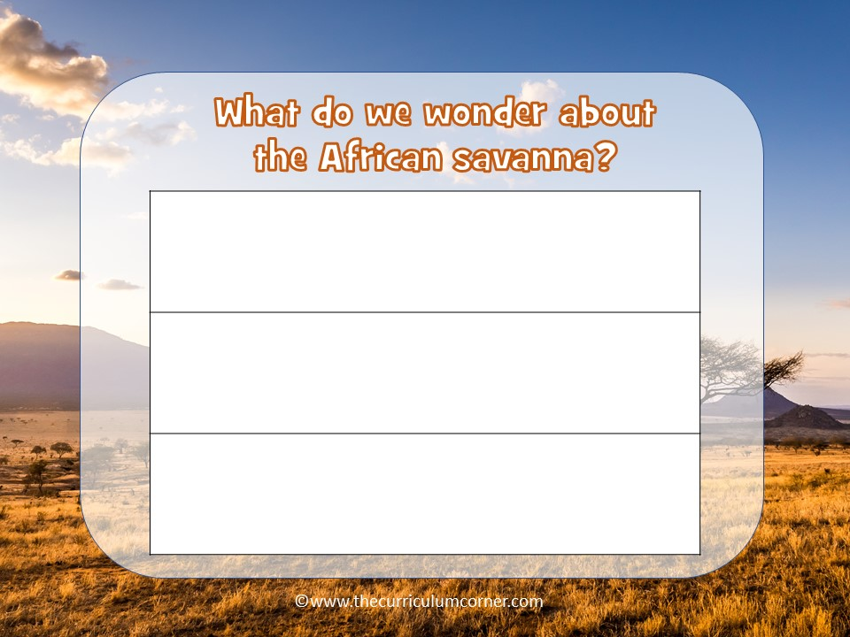
Type here
Type here
Type here

Slide 4
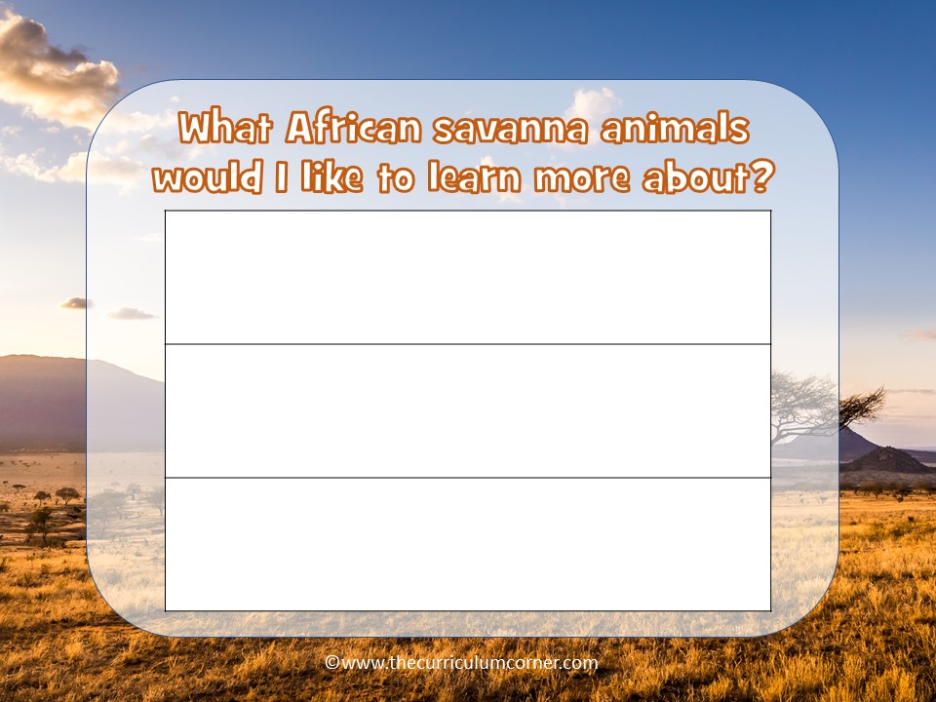
Type here
Type here
Type here

Slide 5

Type here

Slide 6
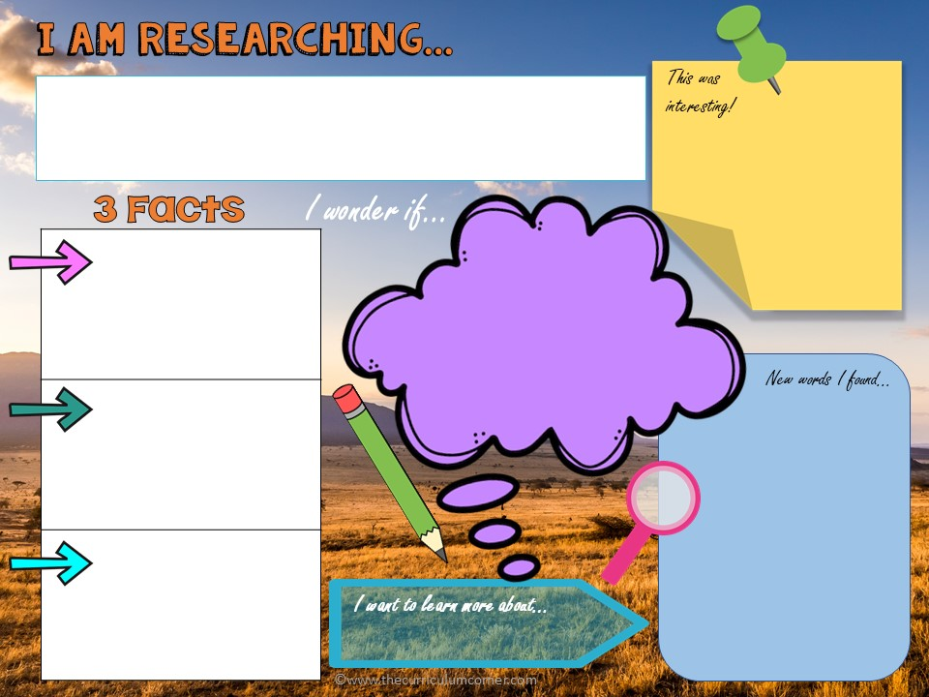
Type here
Type here
Type here
Type here
Type here
Type here
Type here

Slide 7


Slide 8

Use what you learned to write about your topic. You will choose the writing format!
Some ideas:
children’s book
comic book
essay

Slide 9
Type here

