Slide 1
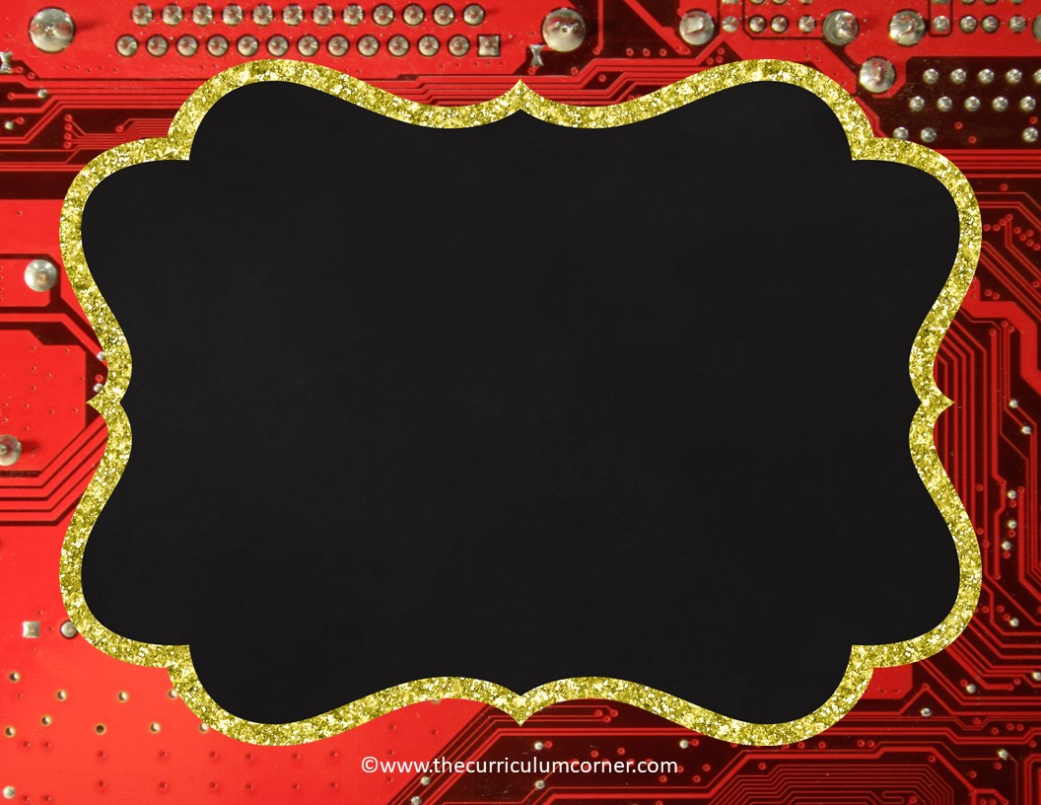
Which Word 2?
PowerPoint Practice Game
Click Here to Start
created by
The Curriculum Corner

Slide 2
The weather might ________ my outdoor plans for tonight.
a . affect
b . effect

Slide 3
Oops!
Click Here
to try again

Slide 4
Way to go!
Click Here
to go to the next question

Slide 5
Do you know what ________ the rain will have on the plants?
a . affect
b . effect

Slide 6
Oops!
Click Here
to try again

Slide 7
Nice thinking!
Click Here
to go to the next question

Slide 8
I need to clean my room right ________.
a . know
b . no
c . now

Slide 9
Oops!
Click Here
to try again

Slide 10
Marvelous!
Click Here
to go to the next question

Slide 11
My mom told me ________ when I asked if I could stay up late.
a . know
b . no
c . now

Slide 12
Oops!
Click Here
to try again

Slide 13
Awesome!
Click Here
to go to the next question

Slide 14
I do not ________ the answer to the question.
a . know
b . no
c . now

Slide 15
Oops!
Click Here
to try again

Slide 16
Terrific!
Click Here
to go to the next question

Slide 17
Did you see how far I ________ the ball?
a . through
b . threw
c . thorough

Slide 18
Oops!
Click Here
to try again

Slide 19
Marvelous!
Click Here
to go to the next question

Slide 20
I needed to have a ________ understanding of the rules to play the game.
a . through
b . threw
c . thorough

Slide 21
Oops!
Click Here
to try again

Slide 22
Very nice!
Click Here
to go to the next question

Slide 23
I looked ________ the window to watch the birds outside.
a . through
b . threw
c . thorough

Slide 24
Oops!
Click Here
to try again

Slide 25
Wonderful!
Click Here
to go to the next question

Slide 26
I am not ________ finished with my homework yet.
a . quit
b . quite
c . quiet

Slide 27
Oops!
Click Here
to try again

Slide 28
Great!
Click Here
to go to the next question

Slide 29
We tried to be ________ while our teacher was working with a student.
a . quit
b . quite
c . quiet

Slide 30
Oops!
Click Here
to try again

Slide 31
Wow!
Click Here
to go to the next question

Slide 32
I will ________ reading when I finish this chapter.
a . quite
b . quit
c . quiet

Slide 33
Oops!
Click Here
to try again

Slide 34
Outstanding!
Click Here
to go to the next question

Slide 35
I bought a shirt that was the wrong size so it was too ________.
a . lose
b . loose
c . loss

Slide 36
Oops!
Click Here
to try again

Slide 37
Outstanding!
Click Here
to go to the next question

Slide 38
We had a bad ________ at the baseball game last night.
a . lose
b . loose
c . loss

Slide 39
Oops!
Click Here
to try again

Slide 40
Great thinking!
Click Here
to go to the next question

Slide 41
I will try not to ________ my new pencil.
a . lose
b . loose
c . loss

Slide 42
Oops!
Click Here
to try again

Slide 43
Sensational!
Click Here
to go to the next question

Slide 44
I will use my colored pencils to _______ a picture of the flowers outside.
a . draw
b . drawer

Slide 45
Oops!
Click Here
to try again

Slide 46
Super!
Click Here
to go to the next question

Slide 47
The supplies we need are in the top ________.
a . drawer
b . draw

Slide 48
Oops!
Click Here
to try again

Slide 49
Fantastic!
Click Here
to go to the next question

Slide 50
The animal was ________ as it hid from the predator.
a . stationary
b . stationery

Slide 51
Oops!
Click Here
to try again

Slide 52
Nice work!
Click Here
to go to the next question

Slide 53
I will get new ________ from the store for my thank you notes.
a . stationary
b . stationery

Slide 54
Oops!
Click Here
to try again

Slide 55
Remarkable!
Click Here
to go to the next question

Slide 56
Do you know ________ or not it will rain today?
a . weather
b . whether

Slide 57
Oops!
Click Here
to try again

Slide 58
Terrific!
Click Here
to go to the next question

Slide 59
What will the ________ be like today?
a . weather
b . whether

Slide 60
Oops!
Click Here
to try again

Slide 61
Well done!
Click Here
to go to the next question

Slide 62
I was ________ while watching the movie my little sister picked.
a . bored
b . board

Slide 63
Oops!
Click Here
to try again

Slide 64
Spectacular!
Click Here
to go to the next question

Slide 65
Can you please write the answer on the ________?
a . bored
b . board

Slide 66
Oops!
Click Here
to try again

Slide 67
Great job practicing!
Click Here
to go back to the beginning!

