Slide 1
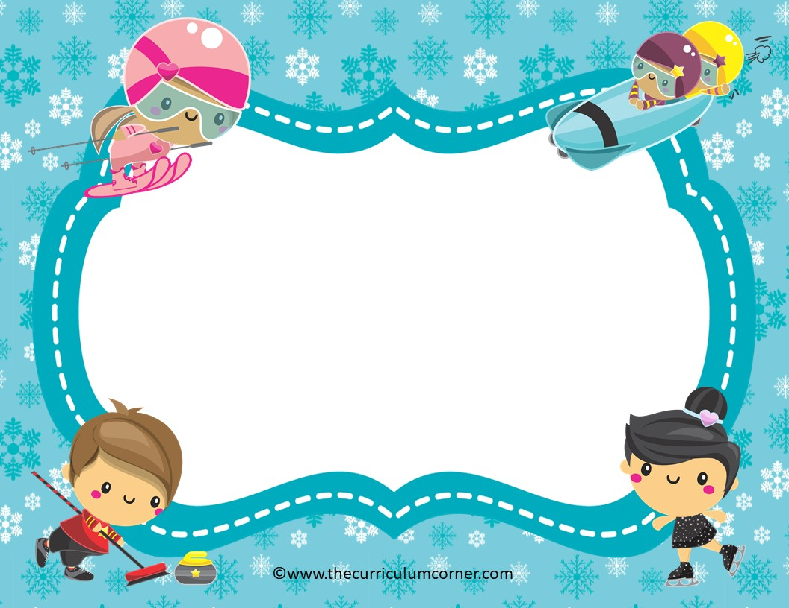
Integers
A PowerPoint Review Game
Click Here to Start
created by
The Curriculum Corner

Slide 2
Add or Subtract
7 - 18
a. 11
b. -11
c. 25

Slide 3
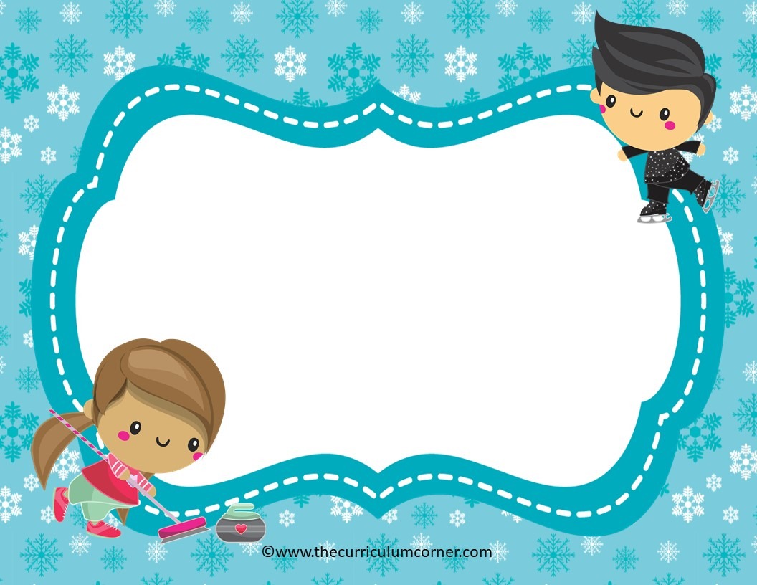
Keep trying!
Click Here to Try Again

Slide 4

Great work!
Click Here to Try the Next Problem

Slide 5
Add or Subtract
- 4 - 6
a. 2
b. 10
c. -10

Slide 6
Keep trying!
Click Here to Try Again

Slide 7
Awesome!
Click Here to Try the Next Problem

Slide 8
Add or Subtract
7 + (-9)
a. -2
b. 2
c. 16

Slide 9
Keep trying!
Click Here to Try Again

Slide 10
You’ve scored!
Click Here to Try the Next Problem

Slide 11
Add or Subtract
-3 + 8
a. 5
b. -5
c. -3

Slide 12
Keep trying!
Click Here to Try Again

Slide 13
You’ve got the gold!
Click Here to Try the Next Problem

Slide 14
Add or Subtract
3 - 11
a. 14
b. 8
c. -8

Slide 15
Keep trying!
Click Here to Try Again

Slide 16
You win!
Click Here to Try the Next Problem

Slide 17
Add or Subtract
-12 - 3
a. -15
b. -9
c. 15

Slide 18
Keep trying!
Click Here to Try Again

Slide 19
Way to go!
Click Here to Try the Next Problem

Slide 20
Add or Subtract
-16 + 0
a. 0
b. -16
c. 16

Slide 21
Keep trying!
Click Here to Try Again

Slide 22
Wow!
Click Here to Try the Next Problem

Slide 23
Add or Subtract
4 - 19
a. 15
b. -15
c. 23

Slide 24
Keep trying!
Click Here to Try Again

Slide 25
Fantastic!
Click Here to Try the Next Problem

Slide 26
Add or Subtract
-6 – (-6)
a. 12
b. -12
c. 0

Slide 27
Keep trying!
Click Here to Try Again

Slide 28
Amazing!
Click Here to Try the Next Problem

Slide 29
Add or Subtract
5 - 2
a. 3
b. -3
c. 7

Slide 30
Keep trying!
Click Here to Try Again

Slide 31
Fabulous work!
Click Here to Try the Next Problem

Slide 32
Add or Subtract
-3 + (-6)
a. 3
b. -3
c. -9

Slide 33
Keep trying!
Click Here to Try Again

Slide 34
Keep up the great work!
Click Here to Try the Next Problem

Slide 35
Add or Subtract
-5 – (-6)
a. -11
b. 1
c. -1

Slide 36
Keep trying!
Click Here to Try Again

Slide 37
You won gold!
Click Here to Try the Next Problem

Slide 38
Add or Subtract
13 + (-24)
a. -11
b. -12
c. -14

Slide 39
Keep trying!
Click Here to Try Again

Slide 40
Keep on going!
Click Here to Try the Next Problem

Slide 41
Add or Subtract
-11 – (-2)
a. -9
b. -7
c. -13

Slide 42
Keep trying!
Click Here to Try Again

Slide 43
You’re a winner!
Click Here to Try the Next Problem

Slide 44
Add or Subtract
-1 + 2
a. 3
b. -2
c. 1

Slide 45
Keep trying!
Click Here to Try Again

Slide 46
Awesome!
Click Here to Try the Next Problem

Slide 47
Add or Subtract
-4 - 8
a. -12
b. 12
c. -4

Slide 48
Keep trying!
Click Here to Try Again

Slide 49
Fantastic!
Click Here to Try the Next Problem

Slide 50
Add or Subtract
-12 + 11
a. 1
b. -1
c. -3

Slide 51
Keep trying!
Click Here to Try Again

Slide 52
Fabulous!
Click Here to Try the Next Problem

Slide 53
Add or Subtract
-6 + 8
a. 2
b. -2
c. -5

Slide 54
Keep trying!
Click Here to Try Again

Slide 55
Way to go!
Click Here to Try the Next Problem

Slide 56
Add or Subtract
8 + (-14)
a. -6
b. -4
c. 6

Slide 57
Keep trying!
Click Here to Try Again

Slide 58
You’ve got it now!
Click Here to Try the Next Problem

Slide 59
Add or Subtract
-9 - 9
a. 0
b. -18
c. 18

Slide 60
Keep trying!
Click Here to Try Again

Slide 61
Amazing!
Click Here to Try the Next Problem

Slide 62
Add or Subtract
-3 + (-9)
a. -12
b. 12
c. -6

Slide 63
Keep trying!
Click Here to Try Again

Slide 64
Brilliant!
Click Here to Try the Next Problem

Slide 65
Add or Subtract
8 - 22
a. -4
b. -14
c. 14

Slide 66
Keep trying!
Click Here to Try Again

Slide 67
Fabulous practicing!
Click Here to
Start Over

