Slide 1
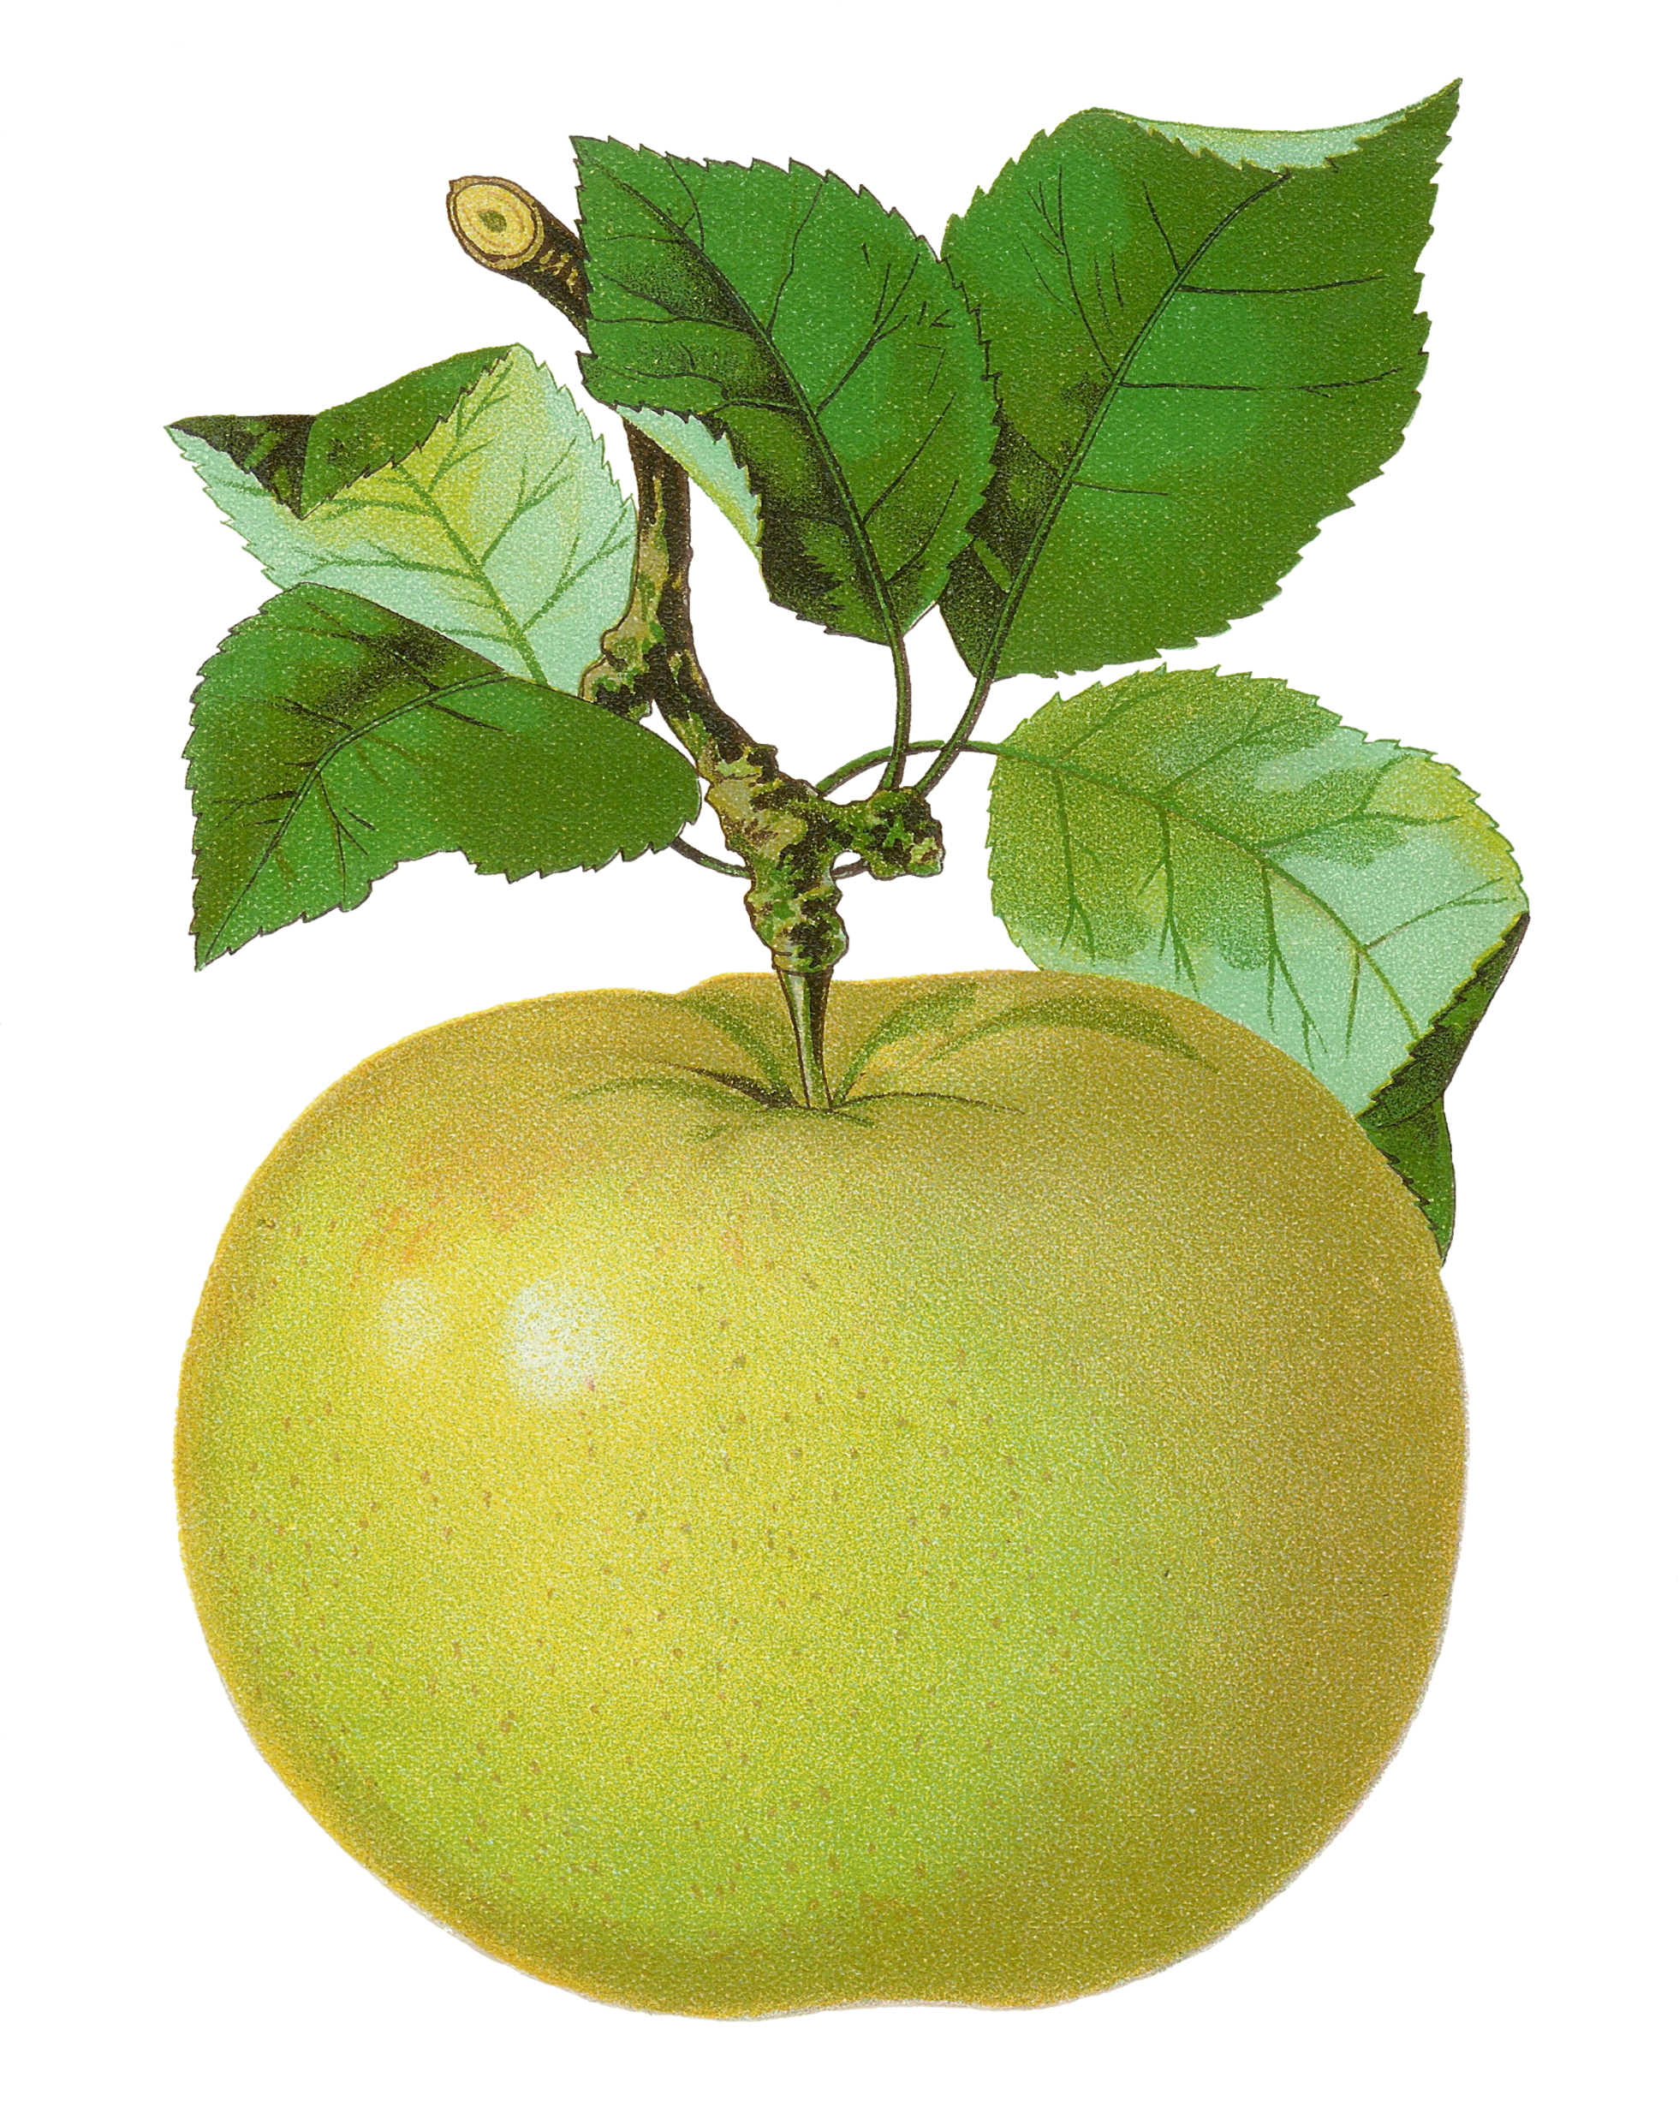
4th Grade
Computation Review
created by
The Curriculum Corner

Slide 2
4,264
+ 2,329
a. 6,543
b. 6,583
c. 6,593

Slide 3
Try again!
Click here to go back to the problem.

Slide 4
Nice work!
Click here to go to the next problem.

Slide 5
7,509
+ 2,146
a. 9,605
b. 9,655
c. 9,615

Slide 6
Try again!
Click here to go back to the problem.

Slide 7
You’re on your way!
Click here to go to the next problem.

Slide 8
34,725
+ 23,619
a. 58,344
b. 57,334
c. 58,314

Slide 9
Try again!
Click here to go back to the problem.

Slide 10
Super star!
Click here to go to the next problem.

Slide 11
7,485
- 3,268
a. 4,252
b. 4,236
c. 4,217

Slide 12
Try again!
Click here to go back to the problem.

Slide 13
Way to go!
Click here to go to the next problem.

Slide 14
18,064
- 14,242
a. 3,822
b. 3,802
c. 3,812

Slide 15
Try again!
Click here to go back to the problem.

Slide 16
Outstanding!
Click here to go to the next problem.

Slide 17
2,268
4,346
+ 2,452
a. 8,066
b. 6,504
c. 9,066

Slide 18
Try again!
Click here to go back to the problem.

Slide 19
Fantastic!
Click here to go to the next problem.

Slide 20
832,487
- 332,295
a. 500,212
b. 500,192
c. 500,232

Slide 21
Try again!
Click here to go back to the problem.

Slide 22
Super work!
Click here to go to the next problem.

Slide 23
4,239
3,247
+ 6,462
a. 13,948
b. 13,853
c. 13,903

Slide 24
Try again!
Click here to go back to the problem.

Slide 25
Exceptional!
Click here to go to the next problem.

Slide 26
98,063
- 34,352
a. 62,711
b. 63,711
c. 64,711

Slide 27
Try again!
Click here to go back to the problem.

Slide 28
You figured it out!
Click here to go to the next problem.

Slide 29
18
x 7
a. 136
b. 116
c. 126

Slide 30
Try again!
Click here to go back to the problem.

Slide 31
Magnificent!
Click here to go to the next problem.

Slide 32
14
x 8
a. 112
b. 122
c. 102

Slide 33
Try again!
Click here to go back to the problem.

Slide 34
Well done!
Click here to go to the next problem.

Slide 35
36
x 3
a. 98
b. 108
c. 118

Slide 36
Try again!
Click here to go back to the problem.

Slide 37
Incredible!
Click here to go to the next problem.

Slide 38
26
x 4
a. 104
b. 114
c. 94

Slide 39
Try again!
Click here to go back to the problem.

Slide 40
Remarkable!
Click here to go to the next problem.

Slide 41
5,264
x 8
a. 42,102
b. 42,011
c. 42,112

Slide 42
Try again!
Click here to go back to the problem.

Slide 43
Way to go!
Click here to go to the next problem.

Slide 44
4,625
x 7
a. 32,375
b. 31,276
c. 30,645

Slide 45
Try again!
Click here to go back to the problem.

Slide 46
Awesome!
Click here to go to the next problem.

Slide 47
53
x 24
a. 1,264
b. 1,353
c. 1,272

Slide 48
Try again!
Click here to go back to the problem.

Slide 49
Perfect!
Click here to go to the next problem.

Slide 50
28
x 49
a. 1,372
b. 1,378
c. 1,382

Slide 51
Try again!
Click here to go back to the problem.

Slide 52
Nice thinking!
Click here to go to the next problem.

Slide 53
57
x 32
a. 1,834
b. 1,824
c. 1,846

Slide 54
Try again!
Click here to go back to the problem.

Slide 55
Tremendous!
Click here to go to the next problem.

Slide 56
602 ÷ 7
a. 86
b. 85
c. 84

Slide 57
Try again!
Click here to go back to the problem.

Slide 58
Wonderful!
Click here to go to the next problem.

Slide 59
2,202 ÷ 6
a. 375
b. 386
c. 367

Slide 60
Try again!
Click here to go back to the problem.

Slide 61
Keep it up!
Click here to go to the next problem.

Slide 62
2,600 ÷ 5
a. 502
b. 362
c. 520

Slide 63
Try again!
Click here to go back to the problem.

Slide 64
Wonderful!
Click here to go to the next problem.

Slide 65
2,616 ÷ 8
a. 348
b. 327
c. 362

Slide 66
Try again!
Click here to go back to the problem.

Slide 67
Terrific!
Click here to go to the next problem.

Slide 68
Find the problem that has the same product as 4 x 2 x 3.
a. 3 x 5 x 2
b. 4 x 2 x 2
c. 2 x 6 x 2

Slide 69
Try again!
Click here to go back to the problem.

Slide 70
Marvelous!
Click here to go to the next problem.

Slide 71
Find the problem that has the same product as 5 x 3 x 4.
a. 5 x 2 x 6
b. 3 x 2 x 6
c. 4 x 3 x 4

Slide 72
Try again!
Click here to go back to the problem.

Slide 73
Wow!
Click here to go to the next problem.

Slide 74
4 ( 10 – 3)
a. 28
b. 37
c. 17

Slide 75
Try again!
Click here to go back to the problem.

Slide 76
You’ve done great!
Click here to go to the next problem.

Slide 77
5 (7 + 6)
a. 70
b. 18
c. 41

Slide 78
Try again!
Click here to go back to the problem.

Slide 79
Great job practicing!
Click here to go back to the beginning.

