Slide 1
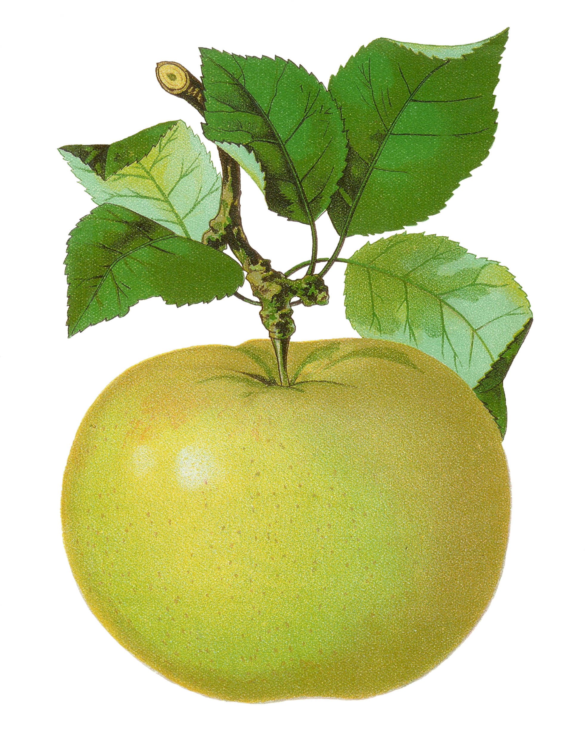
4th Grade
Number Sense Review
created by
The Curriculum Corner

Slide 2
Find the number in word form.
623,194
a. six hundred twenty-three thousand, one hundred ninety-four
b. six hundred twenty-four thousand, one hundred ninety-four
c. six hundred thirty-three thousand, one hundred ninety-four

Slide 3
Try again!
Click here to go back to the problem.

Slide 4
Great thinking!
Click here to go to the next problem.

Slide 5
Find the number in word form.
701,487
a. seven hundred ten thousand, four hundred eighty-seven
b. seven hundred one thousand, four hundred eighty-seven
c. seven hundred one thousand, forty-eight seven

Slide 6
Try again!
Click here to go back to the problem.

Slide 7
Wonderful!
Click here to go to the next problem.

Slide 8
Find the number in word form.
323,763
a. three hundred two three thousand, seven hundred sixty-three
b. three hundred twenty-three thousand, six hundred seventy-three
c. three hundred twenty-three thousand, seven hundred sixty-three

Slide 9
Try again!
Click here to go back to the problem.

Slide 10
Nice work!
Click here to go to the next problem.

Slide 11
Find the number in standard form.
sixty-eight thousand, one hundred twelve
a. 68,102
b. 68,112
c. 68,121

Slide 12
Try again!
Click here to go back to the problem.

Slide 13
Wonderful!
Click here to go to the next problem.

Slide 14
Find the number in standard form.
four hundred fifty-three thousand, nine hundred ninety-one
a. 453,999
b. 453,919
c. 453,991

Slide 15
Try again!
Click here to go back to the problem.

Slide 16
You’ve got it!
Click here to go to the next problem.

Slide 17
Find the number in standard form.
eight thousand fifteen, four hundred seventy-five
a. 815,475
b. 851,475
c. 810,575

Slide 18
Try again!
Click here to go back to the problem.

Slide 19
Great thinking!
Click here to go to the next problem.

Slide 20
Find the value of the underlined number.
641,893
a. 80
b. 800
c. 8,000

Slide 21
Try again!
Click here to go back to the problem.

Slide 22
Marvelous!
Click here to go to the next problem.

Slide 23
Find the value of the underlined number.
721,098
a. 1,000
b. 10,000
c. 100,000

Slide 24
Try again!
Click here to go back to the problem.

Slide 25
Way to go!
Click here to go to the next problem.

Slide 26
Find the value of the underlined number.
908,347
a. 9,000
b. 9,000
c. 900,000

Slide 27
Try again!
Click here to go back to the problem.

Slide 28
Super!
Click here to go to the next problem.

Slide 29
Find the number in expanded form.
72,595
a. 70,000 + 2,000 + 500 + 90 + 5
b. 70,000 + 20,000 + 500 + 90 + 5
c. 70,000 + 2,000 + 50 + 90 + 5

Slide 30
Try again!
Click here to go back to the problem.

Slide 31
You’re a math star!
Click here to go to the next problem.

Slide 32
Find the number in expanded form.
354,247
a. 35,000 + 4,000 + 200 + 40 + 7
b. 30,000 + 50,000 + 4,000 + 200 + 40 + 7
c. 30,000 + 5,000 + 4,000 + 200 + 40 + 7

Slide 33
Try again!
Click here to go back to the problem.

Slide 34
Marvelous!
Click here to go to the next problem.

Slide 35
Find the number in expanded form.
208,850
a. 200,000 + 8,000 + 80 + 50
b. 200,000 + 8,000 + 800 + 50
c. 20,000 + 8,000 + 800 + 50

Slide 36
Try again!
Click here to go back to the problem.

Slide 37
Great thinking!
Click here to go to the next problem.

Slide 38
Compare the numbers.
236,260 ____ 376,206
a. <
b. >
c. =

Slide 39
Try again!
Click here to go back to the problem.

Slide 40
Keep it up!
Click here to go to the next problem.

Slide 41
Compare the numbers.
99,018 ____ 874,213
a. <
b. >
c. =

Slide 42
Try again!
Click here to go back to the problem.

Slide 43
Terrific!
Click here to go to the next problem.

Slide 44
Compare the numbers.
614,284 ____ 614,284
a. <
b. >
c. =

Slide 45
Try again!
Click here to go back to the problem.

Slide 46
Great work!
Click here to go to the next problem.

Slide 47
Find the number in word form.
.7
a. point seven
b. seven tenths
c. seven ones

Slide 48
Try again!
Click here to go back to the problem.

Slide 49
Perfect!
Click here to go to the next problem.

Slide 50
Find the number in word form.
.63
a. sixty-three tenths
b. point sixty-three
c. sixty-three hundredths

Slide 51
Try again!
Click here to go back to the problem.

Slide 52
Fabulous!
Click here to go to the next problem.

Slide 53
Find the number in word form.
.82
a. eighty-two hundredths
b. eight two hundredths
c. eighty-two tenths

Slide 54
Try again!
Click here to go back to the problem.

Slide 55
Great thinking!
Click here to go to the next problem.

Slide 56
Compare the numbers.
.6 ____ .06
a. <
b. >
c. =

Slide 57
Try again!
Click here to go back to the problem.

Slide 58
Fantastic!
Click here to go to the next problem.

Slide 59
Compare the numbers.
2.4 ____ 2.40
a. <
b. >
c. =

Slide 60
Try again!
Click here to go back to the problem.

Slide 61
Great thinking!
Click here to go to the next problem.

Slide 62
Compare the numbers.
.11 ____ .1
a. <
b. >
c. =

Slide 63
Try again!
Click here to go back to the problem.

Slide 64
You’ve got it!
Click here to go to the next problem.

Slide 65
Compare the numbers.
1.5____ 1.05
a. <
b. >
c. =

Slide 66
Try again!
Click here to go back to the problem.

Slide 67
Wow!
Click here to go to the next problem.

Slide 68
Round the number to the neared thousand.
583,194
a. 580,000
b. 583,000
c. 583,200

Slide 69
Try again!
Click here to go back to the problem.

Slide 70
Brilliant!
Click here to go to the next problem.

Slide 71
Round the number to the neared ten-thousand.
927,289
a. 930,000
b. 927,000
c. 927,300

Slide 72
Try again!
Click here to go back to the problem.

Slide 73
Super duper!
Click here to go to the next problem.

Slide 74
Round the number to the neared hundred.
249,481
a. 249,000
b. 249,500
c. 249,400

Slide 75
Try again!
Click here to go back to the problem.

Slide 76
Awesome!
Click here to go to the next problem.

Slide 77
Round the number to the neared hundred-thousand.
914,941
a. 900,000
b. 910,000
c. 915,000

Slide 78
Try again!
Click here to go back to the problem.

Slide 79
You’ve done great!
Click here to go to the beginning.

