Slide 1
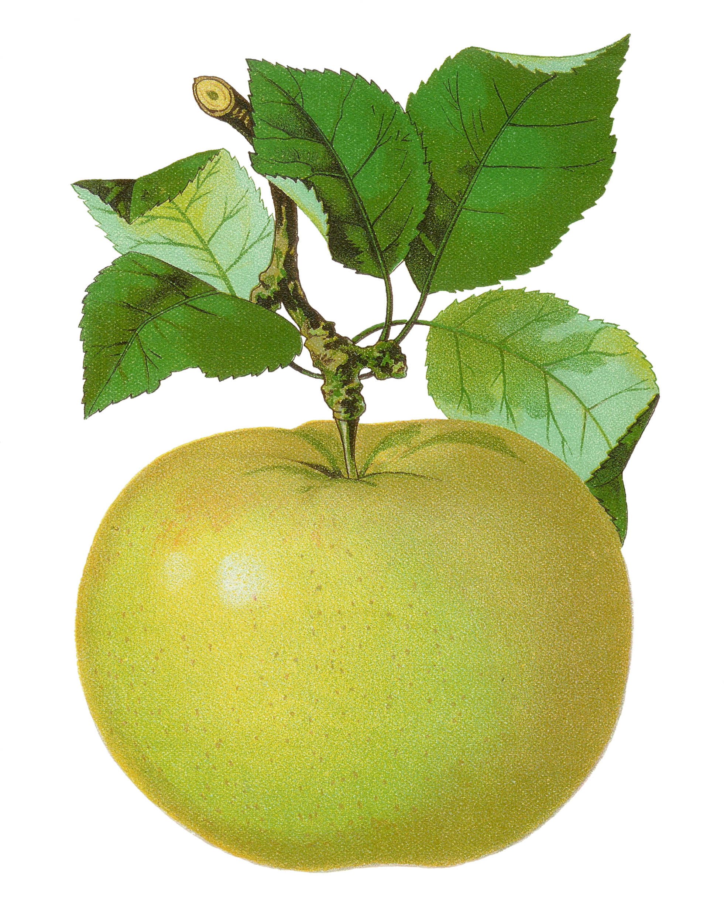
5th Grade
Number Sense Review
created by
The Curriculum Corner

Slide 2
Find the number in word form.
908,417
a. nine hundred eight thousand, four hundred seventy
b. nine hundred eighty thousand, four hundred seventeen
c. nine hundred eight thousand, four hundred seventeen

Slide 3
Try again!
Click here to go back to the problem.

Slide 4
Wonderful!
Click here to go to the next problem.

Slide 5
Find the number in word form.
2,957,481
a. two million, nine hundred fifty-seven, four hundred eighty-one
b. two million, nine hundred five seven, four hundred eighty-one
c. two billion, nine hundred fifty-seven thousand, four hundred eighty-one

Slide 6
Try again!
Click here to go back to the problem.

Slide 7
Great thinking!
Click here to go to the next problem.

Slide 8
Find the number in word form.
823.9
a. eight hundred twenty-three and nine tenths
b. eight hundred two three and nine tenths
c. eight hundred twenty-three and nine

Slide 9
Try again!
Click here to go back to the problem.

Slide 10
Marvelous!
Click here to go to the next problem.

Slide 11
Find the number in word form.
8,491.64
a. eight thousand, four hundred ninety-one and six four
b. eight thousand, four hundred nineteen and sixty-four
c. eight thousand, four hundred ninety-one and sixty-four hundredths

Slide 12
Try again!
Click here to go back to the problem.

Slide 13
Terrific!
Click here to go to the next problem.

Slide 14
Find the number in word form.
30,829.721
a. thirty thousand, eight hundred twenty and seven hundred twenty-one thousandths
b. thirty thousand, eight hundred twenty-nine and seven hundred twenty-one thousandths
c. three thousand, eight hundred twenty-nine and seven hundred twenty-one thousandths

Slide 15
Try again!
Click here to go back to the problem.

Slide 16
Outstanding!
Click here to go to the next problem.

Slide 17
Find the number in standard form.
one million, nine hundred thirteen thousand, two hundred
a. 1,913,002
b. 1,913,020
c. 1,913,200

Slide 18
Try again!
Click here to go back to the problem.

Slide 19
Wow!
Click here to go to the next problem.

Slide 20
Find the number in standard form.
six thousand, eight hundred twenty-two and nine tenths
a. 6,820.9
b. 6,822.0
c. 600,822.9

Slide 21
Try again!
Click here to go back to the problem.

Slide 22
Super!
Click here to go to the next problem.

Slide 23
Find the number in standard form.
fourteen thousand, seven hundred eight and thirty-four hundredths
a. 14,780.34
b. 14,708.34
c. 41,708.34

Slide 24
Try again!
Click here to go back to the problem.

Slide 25
Nice work!
Click here to go to the next problem.

Slide 26
Find the value of the underlined number.
3,819,793
a. 70
b. 700
c. 7,000

Slide 27
Try again!
Click here to go back to the problem.

Slide 28
Magnificent!
Click here to go to the next problem.

Slide 29
Find the value of the underlined number.
7,193,834.27
a. 9
b. 9,000
c. 90,000

Slide 30
Try again!
Click here to go back to the problem.

Slide 31
Tremendous!
Click here to go to the next problem.

Slide 32
Find the value of the underlined number.
91,281,043
a. 200,000
b. 20,000
c. 2,000

Slide 33
Try again!
Click here to go back to the problem.

Slide 34
Very good!
Click here to go to the next problem.

Slide 35
Find the value of the underlined number.
70,284.09
a. .09
b. .9
c. 9

Slide 36
Try again!
Click here to go back to the problem.

Slide 37
Awesome!
Click here to go to the next problem.

Slide 38
Find the number in expanded form.
9,285.74
a. 900 + 200 + 80 + 5 + .7 + 4
b. 9,000 + 20 + 80 + 5 + 7 + .4
c. 9,000 + 200 + 80 + 5 + .7 + .04

Slide 39
Try again!
Click here to go back to the problem.

Slide 40
Looking good!
Click here to go to the next problem.

Slide 41
Find the number in expanded form.
728.307
a. 700 + 20 + 8 + 3 + 7
b. 700 + 20 + 8 + .3 + .07
c. 700 + 20 + 8 + .3 + .007

Slide 42
Try again!
Click here to go back to the problem.

Slide 43
You’ve got it!
Click here to go to the next problem.

Slide 44
Find the number in expanded form.
37,918.62
a. 30,000 + 7,000 + 900 + 10 + 8 + .6 + .02
b. 30,000 + 7,000 + 900 + 18 + .6 + .02
c. 30,000 + 700 + 900 + 10 + 8 + .6 + .02

Slide 45
Try again!
Click here to go back to the problem.

Slide 46
Cool!
Click here to go to the next problem.

Slide 47
Compare the numbers.
8,284,198 ____ 800,284,198
a. <
b. >
c. =

Slide 48
Try again!
Click here to go back to the problem.

Slide 49
Amazing!
Click here to go to the next problem.

Slide 50
Compare the numbers.
467.307 ____ 467.37
a. <
b. >
c. =

Slide 51
Try again!
Click here to go back to the problem.

Slide 52
Wonderful!
Click here to go to the next problem.

Slide 53
Compare the numbers.
9,481.48 ____ 9,481.048
a. <
b. >
c. =

Slide 54
Try again!
Click here to go back to the problem.

Slide 55
Incredible!
Click here to go to the next problem.

Slide 56
Compare the numbers.
8,285.82 ____ 892.82
a. <
b. >
c. =

Slide 57
Try again!
Click here to go back to the problem.

Slide 58
Awesome!
Click here to go to the next problem.

Slide 59
Compare the numbers.
8,285.82 ____ 892.82
a. <
b. >
c. =

Slide 60
Try again!
Click here to go back to the problem.

Slide 61
You’re a math star!
Click here to go to the next problem.

Slide 62
Round the number to the neared hundred.
8,198,382
a. 8,198,300
b. 8,198,400
c. 8,199,000

Slide 63
Try again!
Click here to go back to the problem.

Slide 64
Perfect!
Click here to go to the next problem.

Slide 65
Round the number to the neared tenth.
8,208,489.639
a. 8,208,489.64
b. 8,208,489.6
c. 8,208.489.7

Slide 66
Try again!
Click here to go back to the problem.

Slide 67
Outstanding!
Click here to go to the next problem.

Slide 68
Round the number to the neared hundredth.
7,408.273
a. 7,408
b. 7,408.3
c. 7,408.27

Slide 69
Try again!
Click here to go back to the problem.

Slide 70
Superb!
Click here to go to the next problem.

Slide 71
Round the number to the neared tenth.
7,408.273
a. 7,408
b. 7,408.3
c. 7,408.27

Slide 72
Try again!
Click here to go back to the problem.

Slide 73
Tremendous!
Click here to go to the next problem.

Slide 74
Find the odd number.
a. 6,498.48
b. 2,458.09
c. 5,131.20

Slide 75
Try again!
Click here to go back to the problem.

Slide 76
Great thinking!
Click here to go to the next problem.

Slide 77
Find the even number.
a. 7.280
b. 8.901
c. 6.09

Slide 78
Try again!
Click here to go back to the problem.

Slide 79
Amazing!
Click here to go to the next problem.

Slide 80
Find the next numbers in the pattern.
12, 10, 14, 12, 16, ___, ___
a. 14, 20
b. 14, 16
c. 14, 18

Slide 81
Try again!
Click here to go back to the problem.

Slide 82
Marvelous!
Click here to go to the next problem.

Slide 83
Find the next numbers in the pattern.
30, 27, 32, 29, 34, ___, ___
a. 31, 36
b. 32, 34
c. 30, 35

Slide 84
Try again!
Click here to go back to the problem.

Slide 85
Great practice!
Click here to go back to the beginning.

