Slide 1
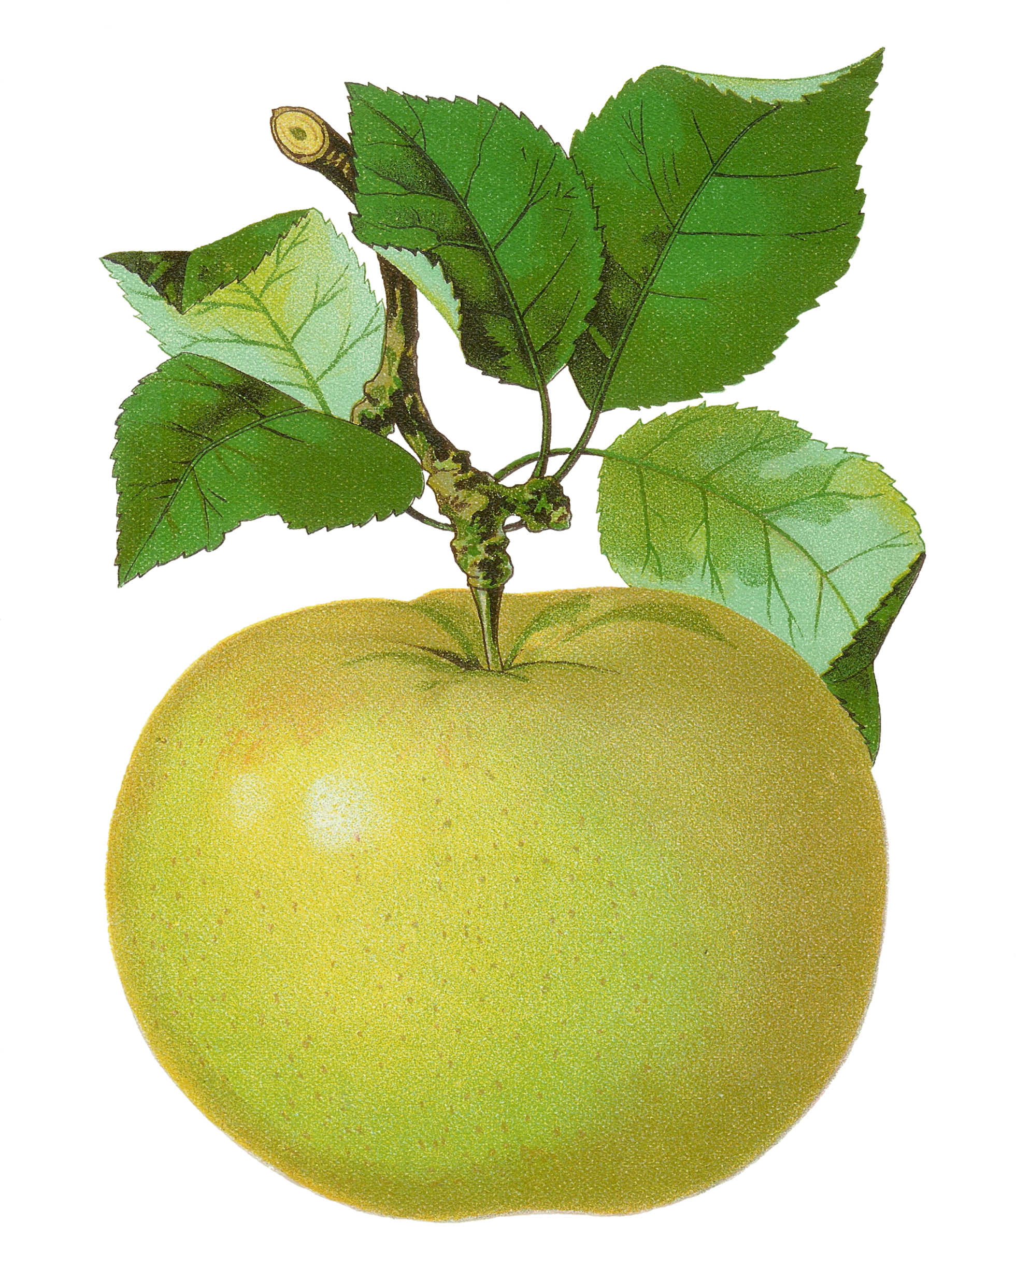
6th Grade
Number Sense Review
created by
The Curriculum Corner

Slide 2
Find the number in word form.
837,104,000,002.48
a. eight hundred thirty-seven billion, one hundred four million, two and forty-eight thousandths
b. eight hundred thirty-seven billion, one hundred four million, two and forty-eight tenths
c. eight hundred thirty-seven billion, one hundred four million, two and forty-eight hundredths

Slide 3
Try again!
Click here to go back to the problem.

Slide 4
Wonderful!
Click here to go to the next problem.

Slide 5
Find the number in word form.
9,829,006.006
a. nine million, eight hundred twenty-nine thousand, six and six thousandths
b. nine billion, eight hundred twenty-nine thousand, six and six thousandths
c. nine million, eight hundred twenty-nine thousand, six and six hundredths

Slide 6
Try again!
Click here to go back to the problem.

Slide 7
Great thinking!
Click here to go to the next problem.

Slide 8
Find the number in word form.
5,030,900,020.034
a. five billion, thirty million, nine hundred thousand, twenty and thirty-four thousandths
b. five billion, thirty million, nine hundred thousand, twenty and thirty-four hundredths
c. five billion, thirty million, nine hundred thousand, twenty and thirty-four tenths

Slide 9
Try again!
Click here to go back to the problem.

Slide 10
Marvelous!
Click here to go to the next problem.

Slide 11
Find the number in word form.
41,982,000,030.163
a. forty-one billion, nine hundred eighty-two million, thirty and one hundred sixty-three tenths
b. forty-one billion, nine hundred eighty-two million, thirty and one hundred sixty-three hundredths
c. forty-one billion, nine hundred eighty-two million, thirty and one hundred sixty-three thousandths

Slide 12
Try again!
Click here to go back to the problem.

Slide 13
Terrific!
Click here to go to the next problem.

Slide 14
Find the number in word form.
200,842,004.0001
a. two hundred billion, eight hundred forty-two thousands, four and one ten-thousandths
b. two hundred million, eight hundred forty-two thousands, four and one ten-thousandths
c. two million, eight hundred forty-two thousands, four and one ten-thousandths

Slide 15
Try again!
Click here to go back to the problem.

Slide 16
Outstanding!
Click here to go to the next problem.

Slide 17
Find the number in standard form.
four billion, two hundred nine million, twenty-three and five hundredths
a. 4,209,023,000.05
b. 4,209,023.05
c. 4,209,000,023.05

Slide 18
Try again!
Click here to go back to the problem.

Slide 19
Wow!
Click here to go to the next problem.

Slide 20
Find the number in standard form.
nineteen billion, seven million, two hundred sixteen thousand, forty-two and one thousandths
a. 19,007,216,042.001
b. 19,700,216,042.001
c. 19,070,216,042.001

Slide 21
Try again!
Click here to go back to the problem.

Slide 22
Super!
Click here to go to the next problem.

Slide 23
Find the number in standard form.
thirty-five million, two hundred eight and twelve thousandths
a. 35,000,208.012
b. 35,000,000,208.012
c. 35,208.012

Slide 24
Try again!
Click here to go back to the problem.

Slide 25
Nice work!
Click here to go to the next problem.

Slide 26
Find the value of the underlined number.
7,236,893.007
a. 80
b. 800
c. 8,000

Slide 27
Try again!
Click here to go back to the problem.

Slide 28
Magnificent!
Click here to go to the next problem.

Slide 29
Find the value of the underlined number.
2,763,000,146.08
a. 600,000
b. 6,000,000
c. 60,000,000

Slide 30
Try again!
Click here to go back to the problem.

Slide 31
Tremendous!
Click here to go to the next problem.

Slide 32
Find the value of the underlined number.
27,361,043,000
a. 300,000,000
b. 30,000,000
c. 3,000,000

Slide 33
Try again!
Click here to go back to the problem.

Slide 34
Very good!
Click here to go to the next problem.

Slide 35
Find the value of the underlined number.
928,162.309
a. .009
b. .09
c. 09

Slide 36
Try again!
Click here to go back to the problem.

Slide 37
Awesome!
Click here to go to the next problem.

Slide 38
Find the number in expanded form.
8,026,040.009
a. 8,000,000 + 20,000 + 6,000 + 40 + .09
b. 8,000,000 + 26,000 + 40 + .009
c. 8,000,000 + 20,000 + 6,000 + 40 + .009

Slide 39
Try again!
Click here to go back to the problem.

Slide 40
Looking good!
Click here to go to the next problem.

Slide 41
Find the number in expanded form.
304,008.004
a. 300,000 + 4,000 + 8 + .04
b. 300,000 + 400 + 8 + .004
c. 300,000 + 4,000 + 8 + .004

Slide 42
Try again!
Click here to go back to the problem.

Slide 43
You’ve got it!
Click here to go to the next problem.

Slide 44
Find the number in expanded form.
204,918.602
a. 200,000 + 4,000 + 900 + 10 + 8 + .6 + .002
b. 200,000 + 4,000 + 900 + 18 + .6 + .002
c. 200,000 + 4,000 + 910 + 8 + .6 + .002

Slide 45
Try again!
Click here to go back to the problem.

Slide 46
Cool!
Click here to go to the next problem.

Slide 47
Compare the numbers.
38,284,198.31 ____ 3,800,284,198
a. <
b. >
c. =

Slide 48
Try again!
Click here to go back to the problem.

Slide 49
Amazing!
Click here to go to the next problem.

Slide 50
Compare the numbers.
241,467.207 ____ 241,467.27
a. <
b. >
c. =

Slide 51
Try again!
Click here to go back to the problem.

Slide 52
Wonderful!
Click here to go to the next problem.

Slide 53
Round the number to the neared thousand.
720,341,999.02
a. 720,341,000
b. 720,342,000
c. 720,341,900

Slide 54
Try again!
Click here to go back to the problem.

Slide 55
Incredible!
Click here to go to the next problem.

Slide 56
Round the number to the neared tenth.
203,482.099
a. 203,480
b. 203,482.1
c. 203,482.01

Slide 57
Try again!
Click here to go back to the problem.

Slide 58
Awesome!
Click here to go to the next problem.

Slide 59
Round the number to the neared ten.
294,024.299
a. 294,024.3
b. 294,020
c. 294,030

Slide 60
Try again!
Click here to go back to the problem.

Slide 61
You’re a math star!
Click here to go to the next problem.

Slide 62
Round the number to the neared hundredth.
289,104.078
a. 289,104.1
b. 289,104.07
c. 289,100

Slide 63
Try again!
Click here to go back to the problem.

Slide 64
Perfect!
Click here to go to the next problem.

Slide 65
Compare the numbers.
24 x 18
___
17 x 25
a. <
b. =
c. >

Slide 66
Try again!
Click here to go back to the problem.

Slide 67
Outstanding!
Click here to go to the next problem.

Slide 68
Compare the values.
427 x 10
___
42.7 x 100
a. <
b. =
c. >

Slide 69
Try again!
Click here to go back to the problem.

Slide 70
Superb!
Click here to go to the next problem.

Slide 71
Compare the numbers.
1
3
___
.33
2
a. <
b. =
c. >

Slide 72
Try again!
Click here to go back to the problem.

Slide 73
Tremendous!
Click here to go to the next problem.

Slide 74
Compare the numbers.
3
6.02
___
6
5
a. <
b. =
c. >

Slide 75
Try again!
Click here to go back to the problem.

Slide 76
Great thinking!
Click here to go to the next problem.

Slide 77
Compare the integers using >, = or <
-15 ___ 4
a. <
b. =
c. >

Slide 78
Try again!
Click here to go back to the problem.

Slide 79
Amazing!
Click here to go to the next problem.

Slide 80
Compare the integers using >, = or <
6 ___ 0
a. <
b. =
c. >

Slide 81
Try again!
Click here to go back to the problem.

Slide 82
Marvelous!
Click here to go to the next problem.

Slide 83
Compare the integers using >, = or <
-3 ___ 3
a. <
b. =
c. >

Slide 84
Try again!
Click here to go back to the problem.

Slide 85
Great practice!
Click here to go back to the beginning.

