Slide 1
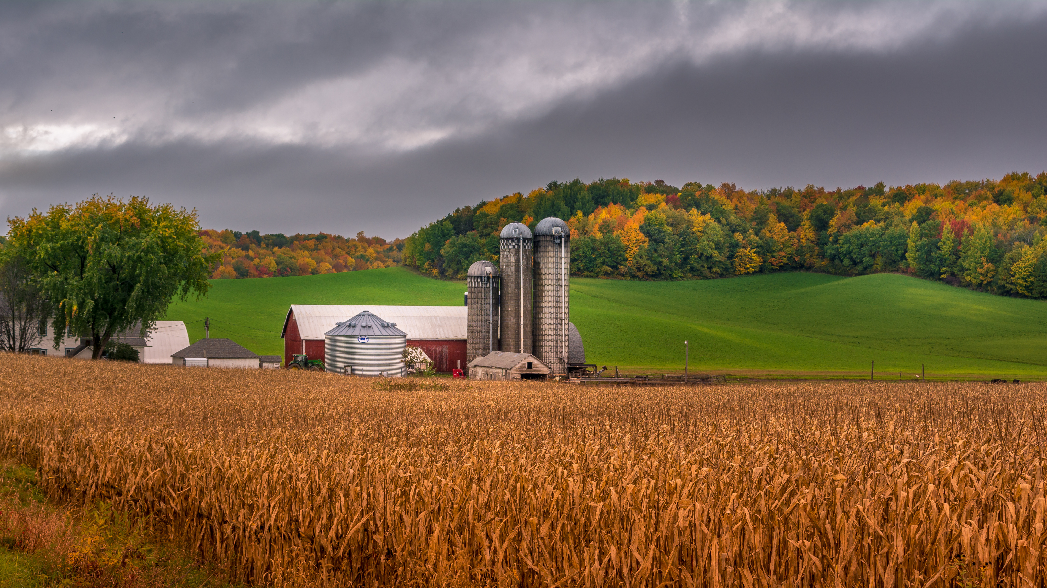
Fun on the
Farm
Virtual sub plans
For kindergarten &
1st grade classrooms
©www.thecurriculumcorner.com

Slide 2
Welcome
to our fun on the farm day!
©www.thecurriculumcorner.com

Slide 3
Think about it!
What do you know about farms?
©www.thecurriculumcorner.com

Slide 4
Think about it!
Have you been to a farm?
©www.thecurriculumcorner.com

Slide 5
Think about it!
Have you read about a farm?
©www.thecurriculumcorner.com

Slide 6
Think about it!
Have you watched a movie that takes place on a farm?
©www.thecurriculumcorner.com

Slide 7
Think about it!
What kind of tools could you find on a farm?
©www.thecurriculumcorner.com

Slide 8
Think about it!
What kind of animals could you find on a farm?
©www.thecurriculumcorner.com

Slide 9
Visualize
Close your eyes. What do you see when you think of a farm?
©www.thecurriculumcorner.com

Slide 10
Visualize
Draw a picture to show a farm scene.
©www.thecurriculumcorner.com

