Slide 1
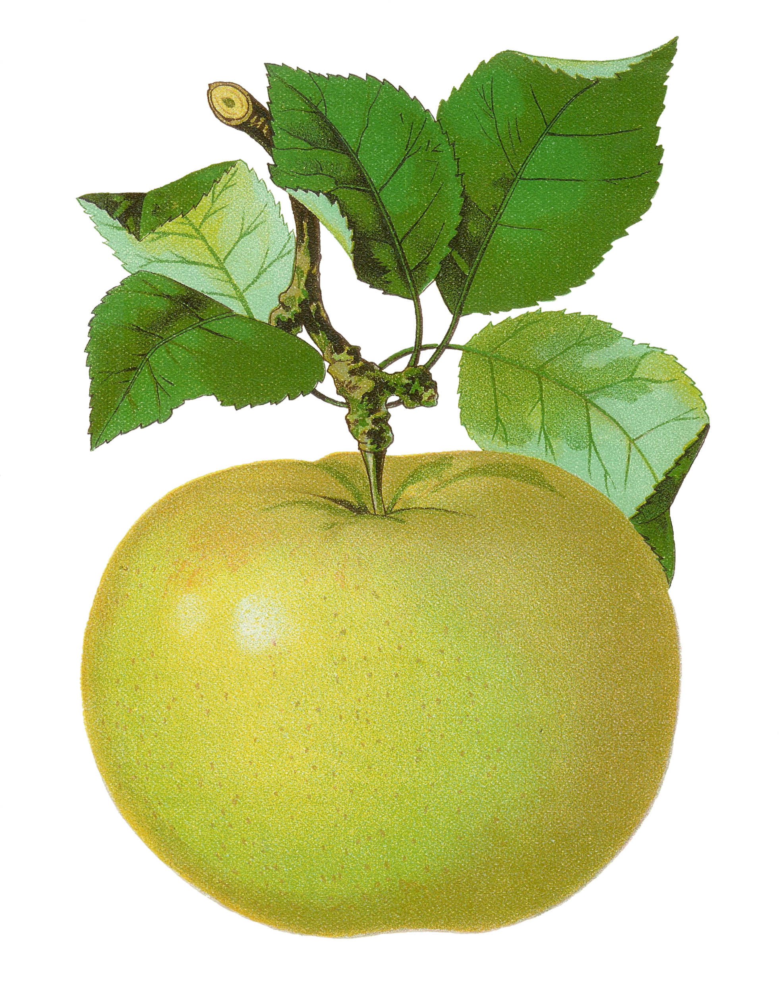
Kindergarten
Number Sense Review
created by
The Curriculum Corner

Slide 2
How many apples?
a. 5
b. 4
c. 3

Slide 3
Try again!
Click here to go back to the problem.

Slide 4
Nice!
Click here to go to the next problem.

Slide 5
How many apples?
a. 2
b. 1
c. 3

Slide 6
Try again!
Click here to go back to the problem.

Slide 7
Wonderful!
Click here to go to the next problem.

Slide 8
How many apples?
a. 5
b. 4
c. 9

Slide 9
Try again!
Click here to go back to the problem.

Slide 10
Great work!
Click here to go to the next problem.

Slide 11
How many apples?
a. 1
b. 3
c. 2

Slide 12
Try again!
Click here to go back to the problem.

Slide 13
Keep it up!
Click here to go to the next problem.

Slide 14
How many apples?
a. 8
b. 6
c. 7

Slide 15
Try again!
Click here to go back to the problem.

Slide 16
Wow!
Click here to go to the next problem.

Slide 17
How many apples?
a. 9
b. 8
c. 10

Slide 18
Try again!
Click here to go back to the problem.

Slide 19
Really good!
Click here to go to the next problem.

Slide 20
How many apples?
a. 3
b. 5
c. 4

Slide 21
Try again!
Click here to go back to the problem.

Slide 22
Yes!
Click here to go to the next problem.

Slide 23
How many apples?
a. 7
b. 5
c. 6

Slide 24
Try again!
Click here to go back to the problem.

Slide 25
Very nice!
Click here to go to the next problem.

Slide 26
How many apples?
a. 4
b. 3
c. 5

Slide 27
Try again!
Click here to go back to the problem.

Slide 28
Terrific!
Click here to go to the next problem.

Slide 29
How many apples?
a. 7
b. 8
c. 9

Slide 30
Try again!
Click here to go back to the problem.

Slide 31
Good thinking!
Click here to go to the next problem.

Slide 32
How many apples?
a. 9
b. 6
c. 8

Slide 33
Try again!
Click here to go back to the problem.

Slide 34
Super duper!
Click here to go to the next problem.

Slide 35
What number is next?
1, 2, ___
a. 3
b. 4
c. 5

Slide 36
Try again!
Click here to go back to the problem.

Slide 37
Good!
Click here to go to the next problem.

Slide 38
What number is next?
3, 4, ___
a. 6
b. 5
c. 7

Slide 39
Try again!
Click here to go back to the problem.

Slide 40
Wonderful!
Click here to go to the next problem.

Slide 41
What number is next?
5, 6, ___
a. 5
b. 6
c. 7

Slide 42
Try again!
Click here to go back to the problem.

Slide 43
Super!
Click here to go to the next problem.

Slide 44
What number is next?
7, 8, ___
a. 9
b. 8
c. 7

Slide 45
Try again!
Click here to go back to the problem.

Slide 46
So good!
Click here to go to the next problem.

Slide 47
What number comes before?
___, 4, 5
a. 2
b. 3
c. 4

Slide 48
Try again!
Click here to go back to the problem.

Slide 49
Wow!
Click here to go to the next problem.

Slide 50
What number comes before?
___, 6, 7
a. 6
b. 4
c. 5

Slide 51
Try again!
Click here to go back to the problem.

Slide 52
Super!
Click here to go to the next problem.

Slide 53
What number comes before?
___, 8, 9
a. 7
b. 8
c. 9

Slide 54
Try again!
Click here to go back to the problem.

Slide 55
Great work!
Click here to go to the next problem.

Slide 56
Find the box with more apples
a.
b.

Slide 57
Try again!
Click here to go back to the problem.

Slide 58
Cool!
Click here to go to the next problem.

Slide 59
Find the box with more apples
a.
b.

Slide 60
Try again!
Click here to go back to the problem.

Slide 61
Keep it up!
Click here to go to the next problem.

Slide 62
Find the box with more apples
a.
b.

Slide 63
Try again!
Click here to go back to the problem.

Slide 64
Super!
Click here to go to the next problem.

Slide 65
How many?
a. 2
b. 1
c. 3

Slide 66
Try again!
Click here to go back to the problem.

Slide 67
Way to go!
Click here to go to the next problem.

Slide 68
How many?
a. 3
b. 4
c. 5

Slide 69
Try again!
Click here to go back to the problem.

Slide 70
Good work!
Click here to go to the next problem.

Slide 71
How many?
a. 5
b. 4
c. 3

Slide 72
Try again!
Click here to go back to the problem.

Slide 73
Nice!
Click here to go to the next problem.

Slide 74
How many?
a. 8
b. 7
c. 9

Slide 75
Try again!
Click here to go back to the problem.

Slide 76
Good job!
Click here to go to the next problem.

Slide 77
How many?
a. 6
b. 5
c. 7

Slide 78
Try again!
Click here to go back to the problem.

Slide 79
Wow!
Click here to go to the next problem.

Slide 80
How many?
a. 4
b. 6
c. 5

Slide 81
Try again!
Click here to go back to the problem.

Slide 82
You’re a star!
Click here to go back to the start.

