Slide 1
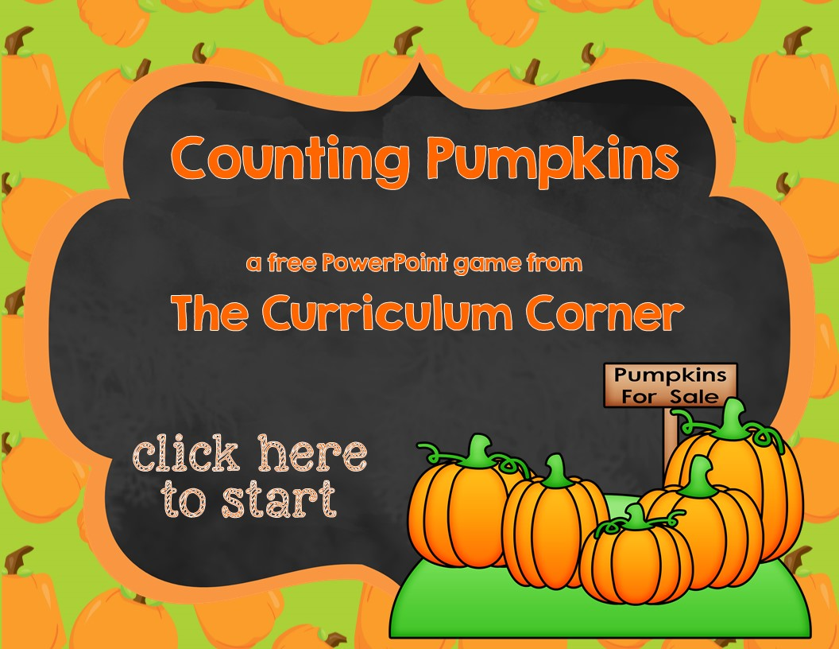

Slide 2
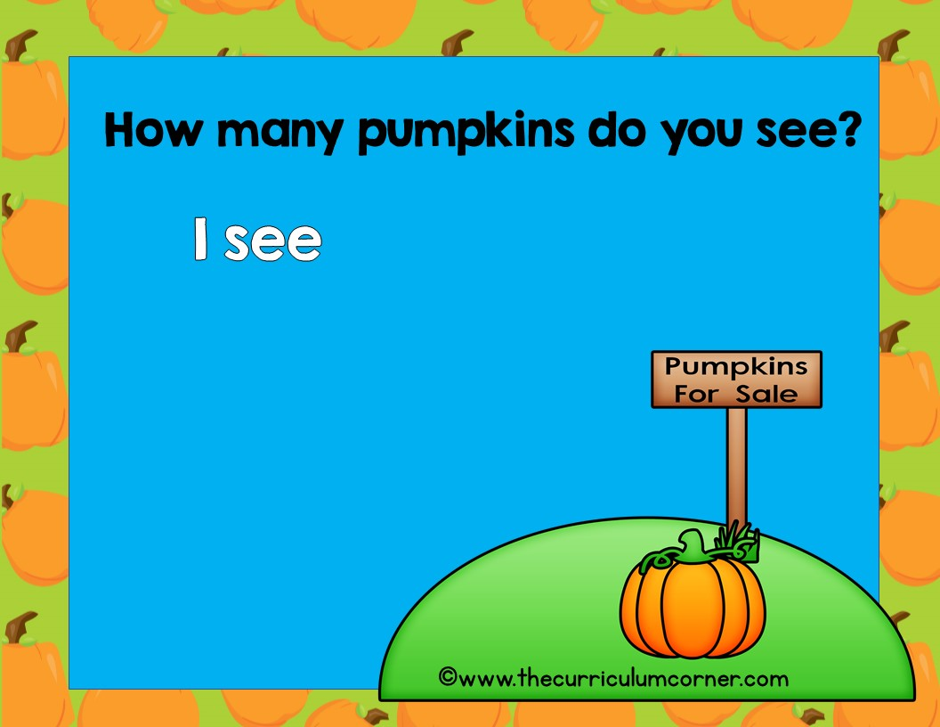
How many pumpkins do you see?
I see
0 pumpkin
1 pumpkins
2 pumpkins
©www.thecurriculumcorner.com

Slide 3

Oops!
click here to try again

Slide 4
Wow!
click here to go to the next question

Slide 5
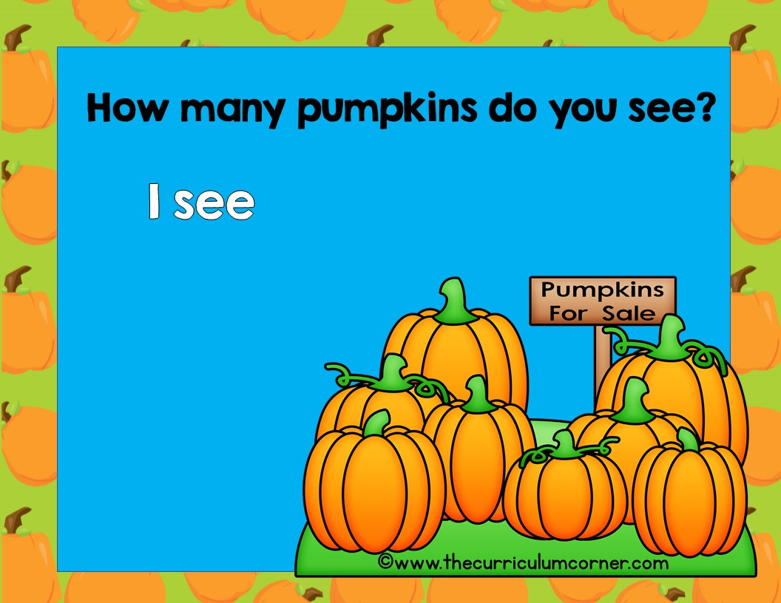
8 pumpkins
9 pumpkins
10 pumpkins

Slide 6
Oops!
click here to try again

Slide 7
Good!
click here to go to the next question

Slide 8
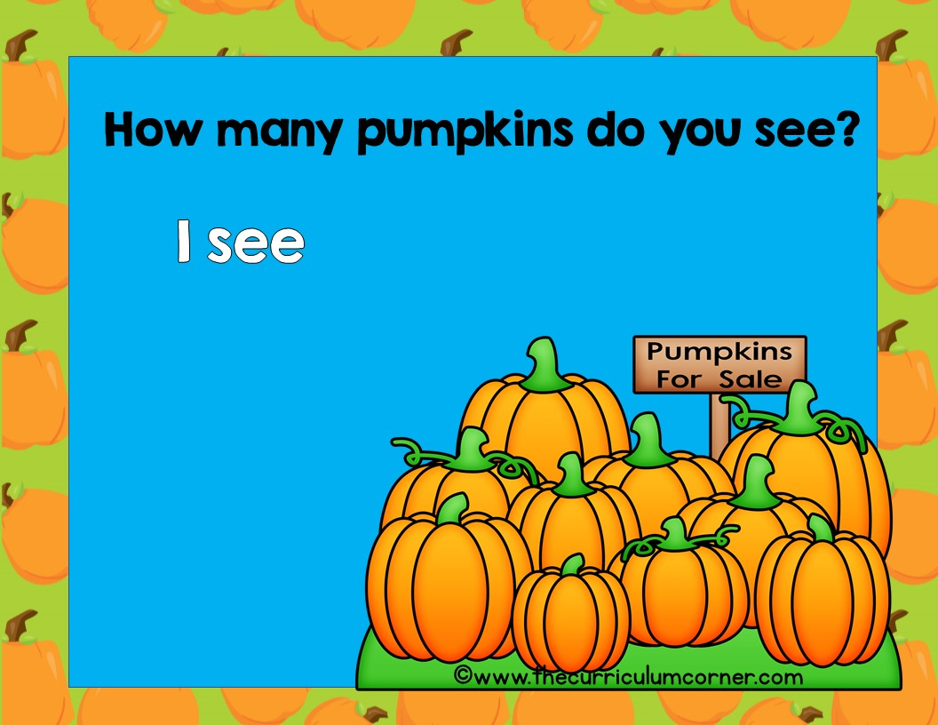
8 pumpkins
9 pumpkins
10 pumpkins

Slide 9
Oops!
click here to try again

Slide 10
Great!
click here to go to the next question

Slide 11
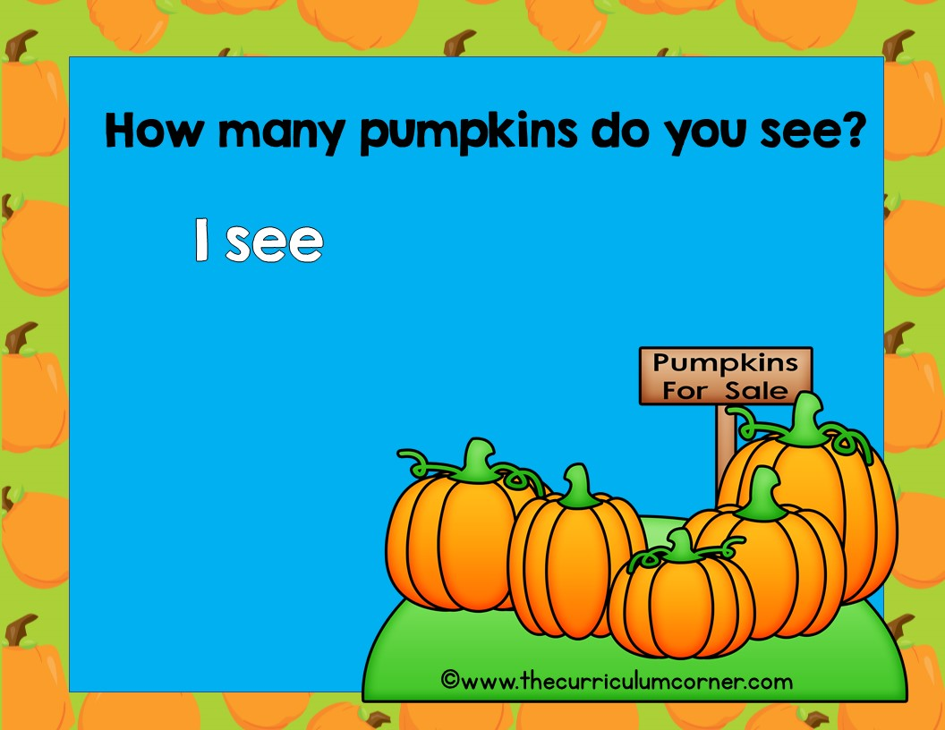
5 pumpkins
6 pumpkins
7 pumpkins

Slide 12
Oops!
click here to try again

Slide 13
Hurray!
click here to go to the next question

Slide 14
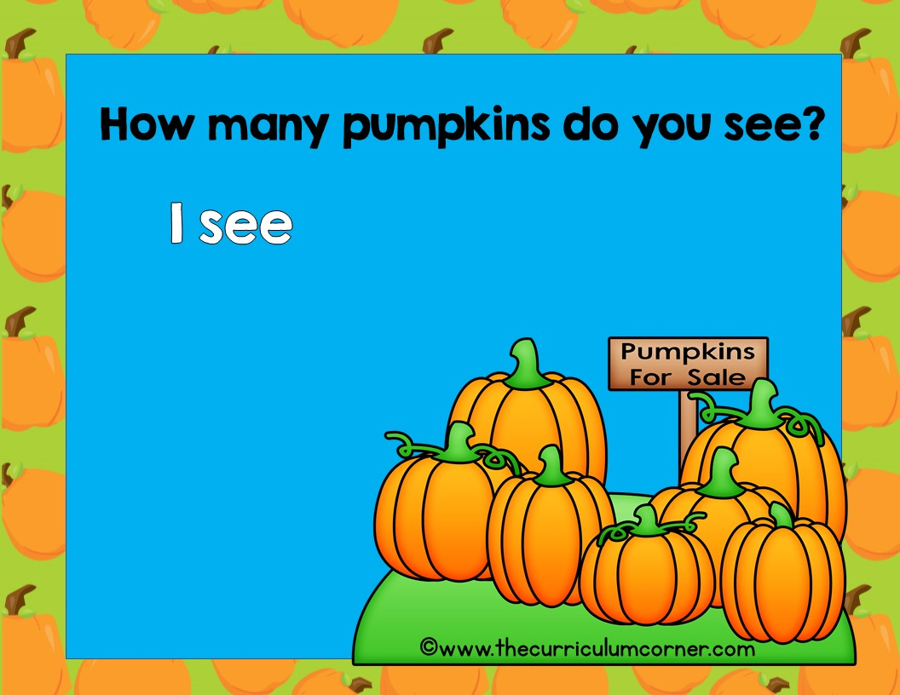
5 pumpkins
6 pumpkins
7 pumpkins

Slide 15
Oops!
click here to try again

Slide 16
Wow!
click here to go to the next question

Slide 17
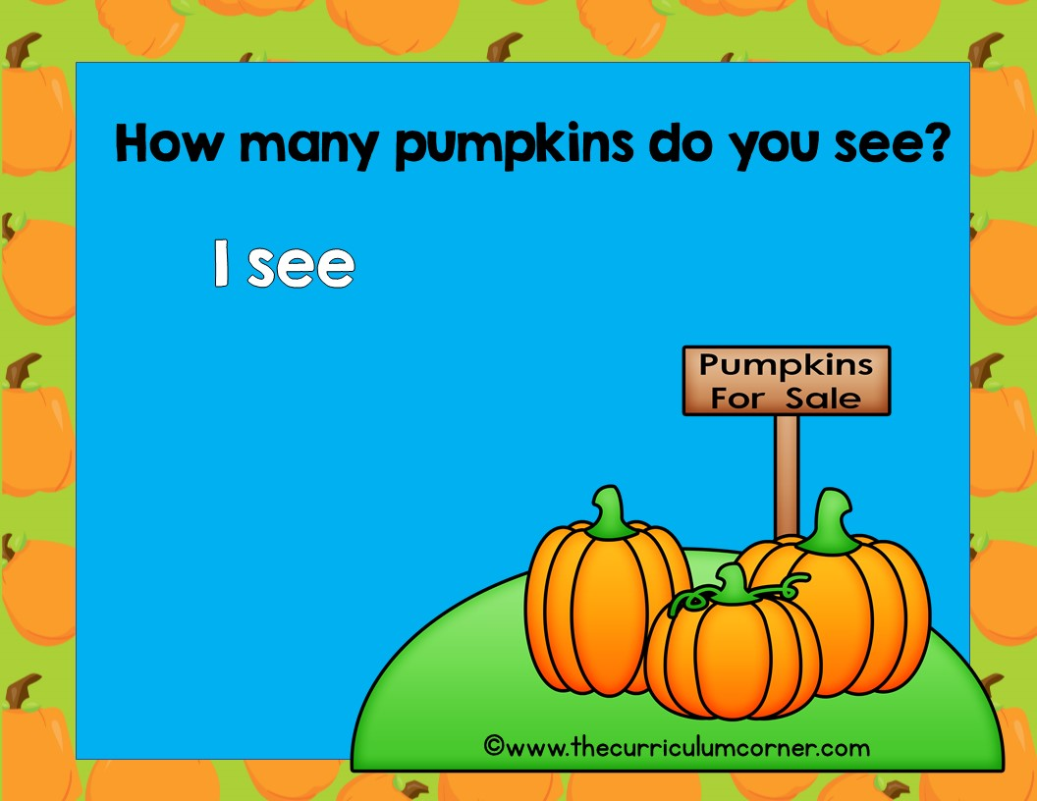
1 pumpkin
2 pumpkins
3 pumpkins

Slide 18
Oops!
click here to try again

Slide 19
Good!
click here to go to the next question

Slide 20
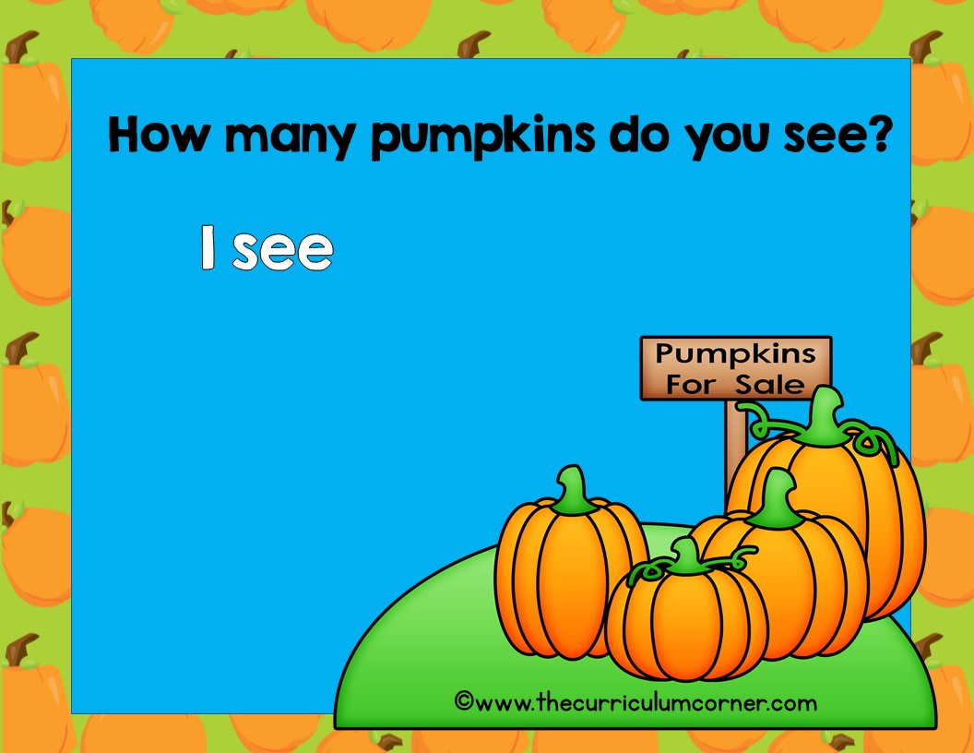
2 pumpkins
3 pumpkins
4 pumpkins

Slide 21
Oops!
click here to try again

Slide 22
Great!
click here to go to the next question

Slide 23
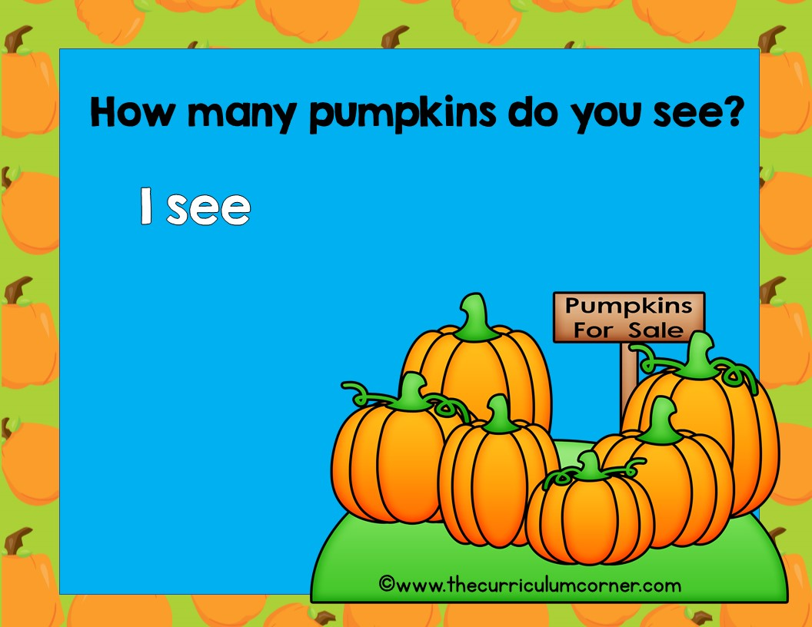
5 pumpkin
6 pumpkins
7 pumpkins

Slide 24
Oops!
click here to try again

Slide 25
Hurray!
click here to go to the next question

Slide 26
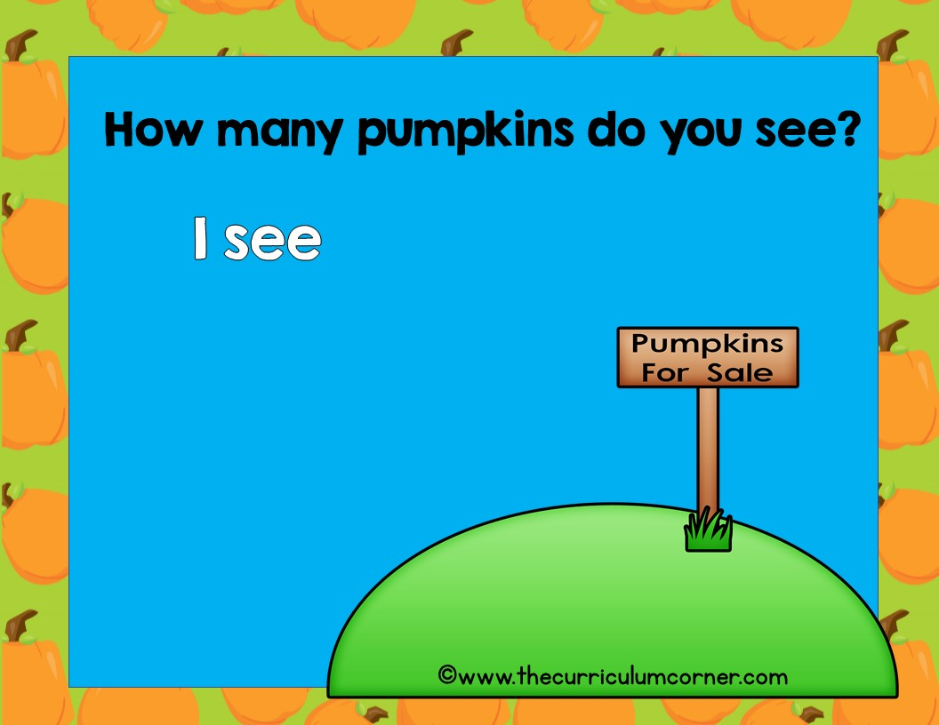
0 pumpkins
1 pumpkins
2 pumpkins

Slide 27
Oops!
click here to try again

Slide 28
Wow!
click here to go to the next question

Slide 29
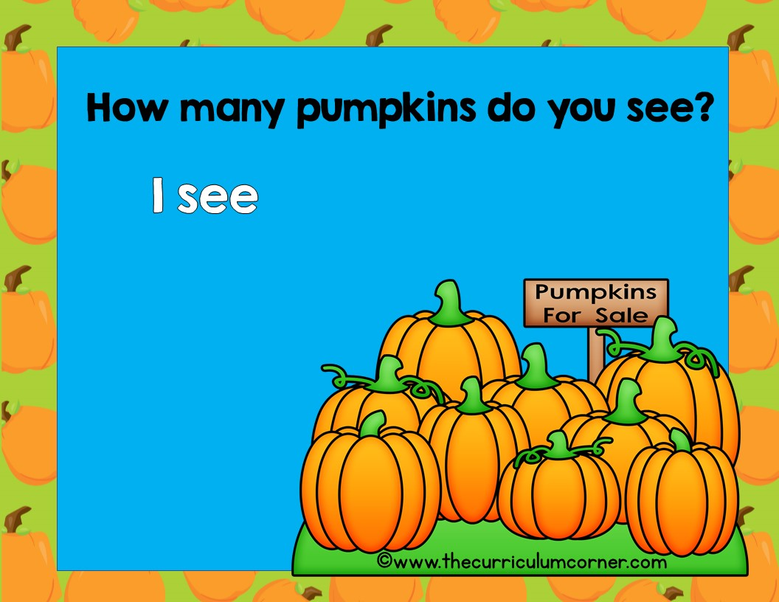
8 pumpkins
9 pumpkins
10 pumpkins

Slide 30
Oops!
click here to try again

Slide 31
Good!
click here to go to the next question

Slide 32
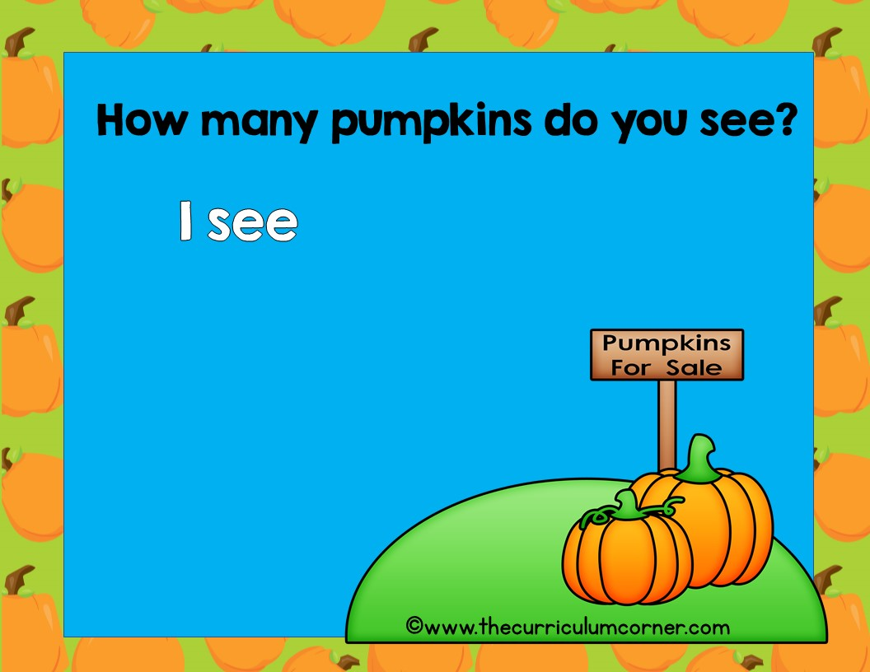
How many pumpkins do you see?
I see
1 pumpkin
2 pumpkins
3 pumpkins
©www.thecurriculumcorner.com

Slide 33
Oops!
click here to try again

Slide 34
Super!
click here to go to the beginning

