Slide 1
Counting to 5
The Curriculum Corner

Slide 2
How many?
1
2
3

Slide 3
Try Again!

Slide 4
Yes!

Slide 5
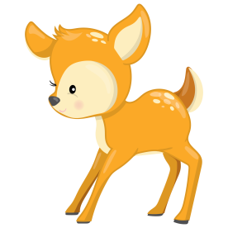
How many?
1
2
3

Slide 6
Try Again!

Slide 7
Yes!

Slide 8
How many?
1
2
3

Slide 9
Try Again!

Slide 10
Yes!

Slide 11
How many?
1
2
3

Slide 12
Try Again!

Slide 13
Yes!

Slide 14
How many?
3
4
5

Slide 15
Try Again!

Slide 16
Yes!

Slide 17
How many?
1
2
3

Slide 18
Try Again!

Slide 19
Yes!

Slide 20
How many?
1
2
3

Slide 21
Try Again!

Slide 22
Yes!

Slide 23
How many?
3
4
5

Slide 24
Try Again!

Slide 25
Yes!

Slide 26
How many?
3
4
5

Slide 27
Try Again!

Slide 28
Yes!

Slide 29
How many?
1
2
3

Slide 30
Try Again!

Slide 31
Yes!

Slide 32
How many?
2
3
4

Slide 33
Try Again!

Slide 34
Yes!

Slide 35
How many?
3
4
5

Slide 36
Try Again!

Slide 37
Yes!

Slide 38
Good job
Practicing!

