Slide 1
Can You Find the Ending Sounds?
The Curriculum Corner
Click Here to Start

Slide 2
Directions:
1. Look at the picture.
2. Say the word to yourself.
3. Pick the ending sound.

Slide 3
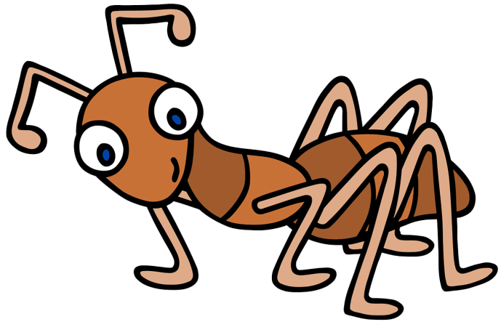
The sounds I hear are…
st
nt
ct

Slide 4
Good job!

Slide 5
Try again.

Slide 6
The sounds I hear are…
nd
pt
sh

Slide 7
Good job!

Slide 8
Try again.

Slide 9
The sound I hear is…
rn
sp
lt

Slide 10
Good job!

Slide 11
Try again.

Slide 12
The sound I hear is…
st
ft
rk

Slide 13
Good job!

Slide 14
Try again.

Slide 15
The sound I hear is…
s
m
t

Slide 16
Good job!

Slide 17
Try again.

Slide 18
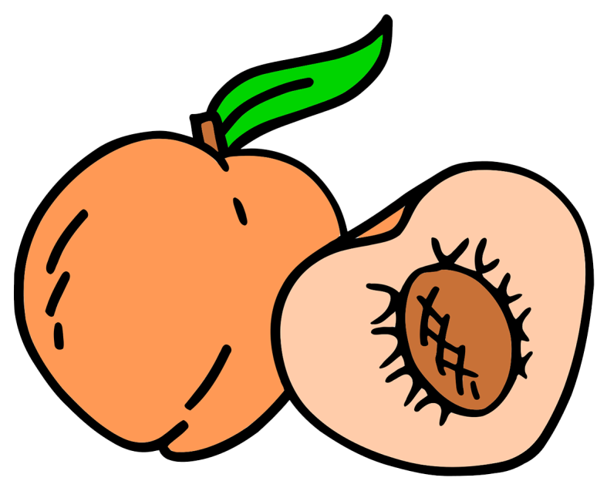
The sound I hear is…
ch
sp
sh

Slide 19
Good job!

Slide 20
Try again.

Slide 21
The sound I hear is…
m
k
l

Slide 22
Good job!

Slide 23
Try again.

Slide 24
The sound I hear is…
b
n
z

Slide 25
Good job!

Slide 26
Try again.

Slide 27
The sound I hear is…
ng
nk
ct

Slide 28
Good job!

Slide 29
Try again.

Slide 30
The sound I hear is…
sk
st
sh

Slide 31
Good job!

Slide 32
Try again.

Slide 33
The sound I hear is…
sk
ch
ft

Slide 34
Good job!

Slide 35
Try again.

Slide 36
The sound I hear is…
r
k
t

Slide 37
Good job!

Slide 38
Try again.

Slide 39
The sound I hear is…
ct
st
rt

Slide 40
Good job!

Slide 41
Try again.

Slide 42
The sound I hear is…
th
st
sm

Slide 43
Good job!

Slide 44
Try again.

Slide 45
The sound I hear is…
f
t
d

Slide 46
Good job!

Slide 47
Try again.

Slide 48
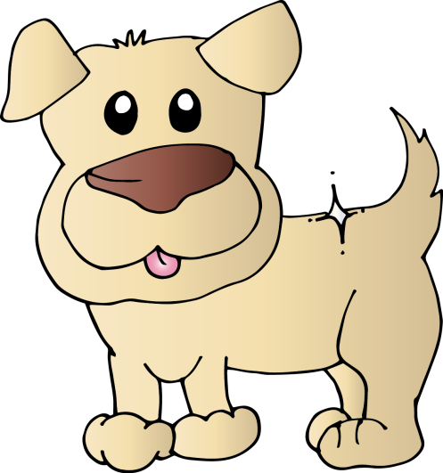
The sound I hear is…
z
g
c

Slide 49
Good job!

Slide 50
Try again.

Slide 51
The sound I hear is…
t
s
p

Slide 52
Good job!

Slide 53
Try again.

Slide 54
Great
practice
today!

