Slide 1
Can You Find the Beginning Sound?
The Curriculum Corner
Click Here to Start

Slide 2
Directions:
1. Look at the picture.
2. Say the word to yourself.
3. Pick the beginning sound.

Slide 3
The sound I hear is…
z
u
c

Slide 4
Good job!

Slide 5
Try again.

Slide 6
The sound I hear is…
b
a
f

Slide 7
Good job!

Slide 8
Try again.

Slide 9
The sound I hear is…
t
b
w

Slide 10
Good job!

Slide 11
Try again.

Slide 12
The sound I hear is…
o
r
k

Slide 13
Good job!

Slide 14
Try again.

Slide 15
The sound I hear is…
h
m
d

Slide 16
Good job!

Slide 17
Try again.

Slide 18
The sound I hear is…
s
p
g

Slide 19
Good job!

Slide 20
Try again.

Slide 21
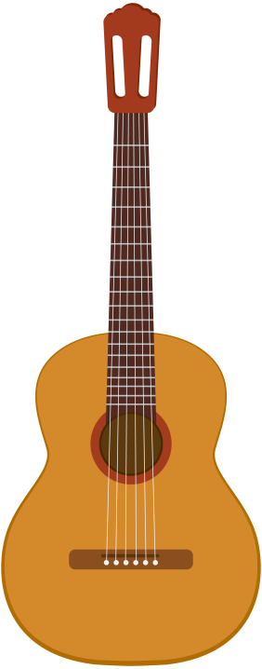
The sound I hear is…
l
g
e

Slide 22
Good job!

Slide 23
Try again.

Slide 24
The sound I hear is…
j
y
i

Slide 25
Good job!

Slide 26
Try again.

Slide 27
The sound I hear is…
n
v
o

Slide 28
Good job!

Slide 29
Try again.

Slide 30
The sound I hear is…
n
x
m

Slide 31
Good job!

Slide 32
Try again.

Slide 33
The sound I hear is…
d
b
y

Slide 34
Good job!

Slide 35
Try again.

Slide 36
The sound I hear is…
u
n
t

Slide 37
Good job!

Slide 38
Try again.

Slide 39
The sound I hear is…
e
w
v

Slide 40
Good job!

Slide 41
Try again.

Slide 42
The sound I hear is…
k
l
c

Slide 43
Good job!

Slide 44
Try again.

Slide 45
The sound I hear is…
q
x
p

Slide 46
Good job!

Slide 47
Try again.

Slide 48
The sound I hear is…
y
h
u

Slide 49
Good job!

Slide 50
Try again.

Slide 51
The sound I hear is…
a
f
j

Slide 52
Good job!

Slide 53
Try again.

Slide 54
The sound I hear is…
z
l
i

Slide 55
Good job!

Slide 56
Try again.

Slide 57
The sound I hear is…
e
q
m

Slide 58
Good job!

Slide 59
Try again.

Slide 60
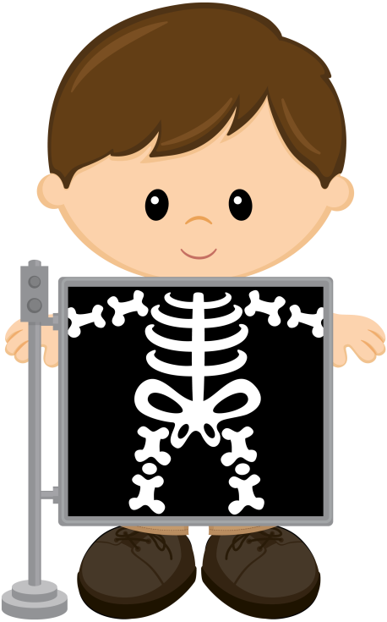
The sound I hear is…
j
f
x

Slide 61
Good job!

Slide 62
Try again.

Slide 63
The sound I hear is…
c
b
h

Slide 64
Good job!

Slide 65
Try again.

Slide 66
The sound I hear is…
g
t
n

Slide 67
Good job!

Slide 68
Try again.

Slide 69
The sound I hear is…
h
s
r

Slide 70
Good job!

Slide 71
Try again.

Slide 72
The sound I hear is…
l
p
k

Slide 73
Good job!

Slide 74
Try again.

Slide 75
The sound I hear is…
i
q
d

Slide 76
Good job!

Slide 77
Try again.

Slide 78
The sound I hear is…
a
s
m

Slide 79
Good job!

Slide 80
Try again.

Slide 81
Great
practice
today!

