Slide 1
Can You Find the Vowel Sounds?
Click Here to Start

Slide 2
Directions:
1. Look at the picture.
2. Say the word to yourself.
3. Pick the ending sound.

Slide 3
The vowel sound
I hear is…
o
a
e

Slide 4
Good job!

Slide 5
Try again.

Slide 6
The vowel sound
I hear is…
e
a
o

Slide 7
Good job!

Slide 8
Try again.

Slide 9
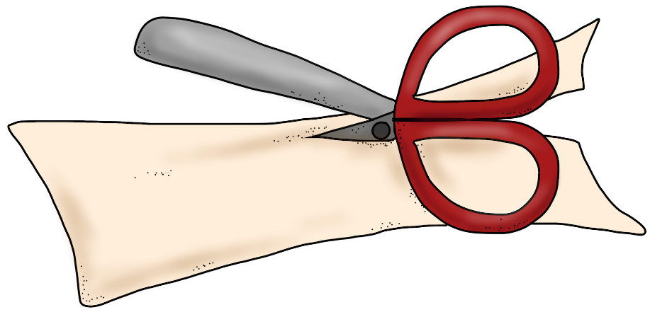
The vowel sound I hear is…
e
a
u

Slide 10
Good job!

Slide 11
Try again.

Slide 12
The vowel sound I hear is…
u
a
e

Slide 13
Good job!

Slide 14
Try again.

Slide 15
The vowel sound I hear is…
o
u
i

Slide 16
Good job!

Slide 17
Try again.

Slide 18
The vowel sound I hear is…
e
u
i

Slide 19
Good job!

Slide 20
Try again.

Slide 21
The vowel sound I hear is…
a
o
e

Slide 22
Good job!

Slide 23
Try again.

Slide 24
The vowel sound I hear is…
i
e
a

Slide 25
Good job!

Slide 26
Try again.

Slide 27
The vowel sound I hear is…
o
e
u

Slide 28
Good job!

Slide 29
Try again.

Slide 30
The vowel sound I hear is…
e
u
i

Slide 31
Good job!

Slide 32
Try again.

Slide 33
The vowel sound I hear is…
e
o
i

Slide 34
Good job!

Slide 35
Try again.

Slide 36
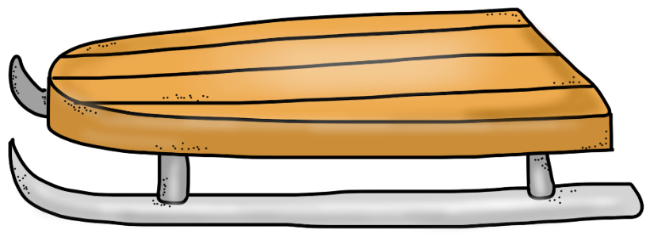
The vowel sound I hear is…
e
u
o

Slide 37
Good job!

Slide 38
Try again.

Slide 39
The vowel sound I hear is…
e
a
i

Slide 40
Good job!

Slide 41
Try again.

Slide 42
The vowel sound I hear is…
i
a
o

Slide 43
Good job!

Slide 44
Try again.

Slide 45
The vowel sound I hear is…
i
e
o

Slide 46
Good job!

Slide 47
Try again.

Slide 48
The vowel sound I hear is…
e
u
i

Slide 49
Good job!

Slide 50
Try again.

Slide 51
The vowel sound I hear is…
o
i
u

Slide 52
Good job!

Slide 53
Try again.

Slide 54
Great
Practice today!

